Slide 1
Electrical Measuring Instruments
Topic 2, Unit 8.1
All copyright and intellectual property rights in respect of materials developed by the service provider during this project will vest in the Department of Higher Education and Training, which will have the right to allow any individual, company, agency or organisation to use or modify the materials for any purpose approved by this Department, including selling the materials or releasing them as Open Educational Resources (OER) under an appropriate copyright license.
Notes:
https://www.youtube.com/watch?v=vXbllFrpL7Q
https://www.youtube.com/watch?v=NfcgA1axPLo
https://www.youtube.com/watch?v=bF3OyQ3HwfU

Slide 2
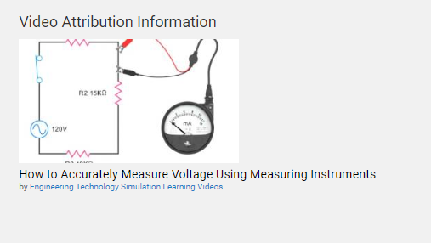
CC Attributions
Notes:
Attribution to materials:
https://courses.lumenlearning.com/boundless-physics/chapter/voltmeters-and-ammeters/

Slide 4
Outcomes
By the end of this unit you will be able to:
Describe how to measure voltage, resistance and current.
Draw a circuit diagram to describe how to correctly connect a voltmeter
Draw a circuit diagram to describe how to correctly connect a ammeter
Draw a circuit diagram to describe how to correctly connect a wattmeter
Explain how to use a multimeter
Notes:
Notes:
To explain how each meter is connected in a circuit for example a voltmeter is connected in parallel because of the internal resistance of the meter. If you connect it in series it will create an open circuit.
Ammeter is connected in series because an ammeter has very little resistance if you connect it across a resistance (ie live or neutral on a stove) you will have a short circuit and a big explosion.
Ohmeter can only be connected across a resistance once the power has been switched off.

Slide 5
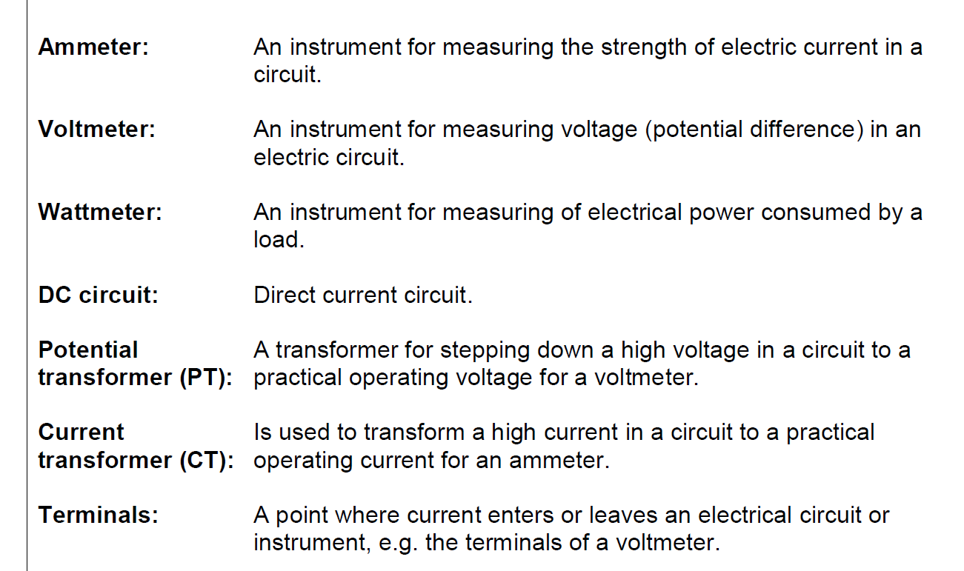
Glossy of words

Slide 6
What will I be learning?
In this unit you will learn about the different types of electrical measuring instruments that electricians use to test voltage, resistance and current. To get the most out of this unit there are some concepts that you should already understand.
Click on the links below to revise these topics.
What is Ohm’s Law?
What is voltage?
What is resistance?
What is current?
Notes:
Note for interactivity:
Blocks should be hyperlinked the relevant sections/topics on the NOLS

Slide 7
Why do electricians do testing?
So, why do electricians even need electrical measuring instruments? Watch the video below to find out why these instruments play such an important role in the work that an electrician does.
Placeholder Video 01: Paul
Click on the videos for more information.
Notes:
Notes for interactivity:
When learner clicks on video it should play fullscreen.

Slide 8
Test yourself
Why do electricians use electrical measuring instruments?
To make sure that power source will last longer.
To make sure there’s no current flowing before trying to fix something.
To find out why there is not enough power flowing to something.
To find how much power a machine is using.
To be able to draw a circuit diagram
Choose the correct answer(s) below and click ‘Submit’.
Notes:
Notes for interactivity:
Multiple Choice
Three correct answer indicated in italics.
Feedback if correct; Well done you are correct!
Feedback if incorrect: Not quite, Electricians use electrical measuring instruments for the following reasons:
To make sure there’s no current flowing before trying to fix something.
To find out why there is not enough power flowing to something.
To find how much power a machine is using.

Slide 9
Electrical measuring instruments
As you saw in the video, electricians measure three main things: resistance, voltage and current. The instruments that they use to test each of these things are:
Voltmeter
Ammeter
Wattmeter
Image of voltmeter
Image of ammeter
Image of wattmeter
Measures voltage.
Measures current in a circuit.
Measures power consumed in a load.

Slide 10
Electrical measuring instruments
Click on the videos below to see how to use each of these instruments.
Voltmeter
Ammeter
Wattmeter
Placeholder Video 04
How to use a voltmeter
Placeholder Video 05
How to use an ammeter
Placeholder Video 06
How to use a wattmeter

Slide 11
Tips about voltmeters
Here are some things you need to remember about voltmeters:
A voltmeter measures electrical potential difference between two points in a circuit.
It is connected in parallel with a device to measure the voltage of the device.
A voltmeter is an analogue meter which means it has a galvanometer which measures the current flow using the movement or deflection of a needle. The needle deflection is produced by a magnetic force acting on current carrying wire.
Placeholder image of voltmeter
Placeholder image of inside of voltmeter showing galvameter

Slide 12
Diagram voltmeter connection
Ask SME for a suitable scenario and diagram
You should be able to explain by use of a diagram how a voltmeter is connected to a device. Here is an example:

Slide 13
Draw a diagram voltmeter connection
Ask SME for a suitable scenario and diagram
Now it’s your turn to see if you can draw a diagram of a voltmeter connection. You will upload your diagram as part of your ePortfolio.
Insert scenario
Click on the button below to upload your completed diagram.
Upload my diagram

Slide 14
Compare diagrams
Exemplar diagram based on previous scenario
Scenario info from previous slide
Did your diagram look like this?
Exemplar diagram based on previous scenario

Slide 15
Tips about ammeters
Add more tips for ammeters
Here are some things you need to remember about ammeters:
A ammeter measures the electric current in a circuit.
Ammeters have very low resistance and are always connected in series in any circuit.
Placeholder image of ammeter
Placeholder image of inside of ammeter

Slide 16
Diagram ammeter connection
Ask SME for a suitable scenario and diagram
You should be able to explain by use of a diagram how a ammeter is connected to a device. Here is an example:
Scenario information

Slide 17
Draw a diagram ammeter connection
Ask SME for a suitable scenario and diagram
Now it’s your turn to see if you can draw a diagram of an ammeter connection. You will upload your diagram as part of your ePortfolio.
Insert scenario
Click on the button below to upload your completed diagram.
Upload my diagram

Slide 18
Compare diagrams
Exemplar diagram based on previous scenario
Scenario info from previous slide
Did your diagram look like this?
Exemplar diagram based on previous scenario

Slide 19
Tips about wattmeters
Add more tips for wattmeters
Here are some things you need to remember about wattmeters:
Wattmeter measures the electric power (or the supply rate of electrical energy) in watts of any given circuit.
Placeholder image of wattmeter
Placeholder image of inside of wattmeter

Slide 20
Diagram wattmeter connection
Ask SME for a suitable scenario and diagram
You should be able to explain by use of a diagram how a wattmeter is connected to a device. You should be able to show the current coil and voltage coil Here is an example:
Scenario information

Slide 21
Draw a diagram wattmeter connection
Ask SME for a suitable scenario and diagram
Now it’s your turn to see if you can draw a diagram of an wattmeter connection. You will upload your diagram as part of your ePortfolio.
Insert scenario
Click on the button below to upload your completed diagram.
Upload my diagram

Slide 22
Compare diagrams
Exemplar diagram based on previous scenario
Scenario info from previous slide
Did your diagram look like this?
Exemplar diagram based on previous scenario

Slide 23
Multimeter
In this unit you have learned about three different measuring devices. The good news is that these days electricians use one device that can measure all three things: resistance, voltage and current. Take a look at how it works.
Placeholder Video 06:How to use a multimeter
Click on the videos for more information.
Notes:
Notes for interactivity:
When learner clicks on video it should play fullscreen.

Slide 24
Multimeter
Take a look of this multimeter to see the different settings available.
Placeholder image: Detailed image of the multimeter showing the various parts and settings.
Click on the videos for more information.
Notes:
Notes for interactivity:
When learner clicks on video it should play fullscreen.

Slide 25
Quiz
This quiz is out of 15 marks.
You need to get at least 13/15
If you get less, we suggest that you work through the materials again before moving onto the next topic.

Slide 26
Question 1
Why do electricians use electrical measuring instruments?
To make sure that power source will last longer.
To make sure there’s no current flowing before trying to fix something.
To find out why there is not enough power flowing to something.
To find how much power a machine is using.
To be able to draw a circuit diagram
Choose the correct answer(s) below and click ‘Submit’.
Notes:
Notes for interactivity:
Multiple Choice
Three correct answer indicated in italics.
Feedback if correct; Well done you are correct!
Feedback if incorrect: Not quite, Electricians use electrical measuring instruments for the following reasons:
To make sure there’s no current flowing before trying to fix something.
To find out why there is not enough power flowing to something.
To find how much power a machine is using.

Slide 27
Question2
How should a voltmeter be connected to a device?
In series
In parallel
You don’t connect voltmeters to devices
Choose the correct answer below and click ‘Submit’.
Notes:
Notes for interactivity:
Multiple Choice
Three correct answer indicated in italics.
Feedback if correct; Well done you are correct!
Feedback if incorrect: Not quite, Electricians use electrical measuring instruments for the following reasons:
To make sure there’s no current flowing before trying to fix something.
To find out why there is not enough power flowing to something.
To find how much power a machine is using.

Slide 28
Question 3
Ask SME what is the correct answer and why
Is a voltmeter’s internal resistance high or low?
High
Low
Choose the correct answer below and click ‘Submit’.
Notes:
Notes for interactivity:
Multiple Choice
Three correct answer indicated in italics.
Feedback if correct; Well done you are correct!
Feedback if incorrect: Not quite, Electricians use electrical measuring instruments for the following reasons:
To make sure there’s no current flowing before trying to fix something.
To find out why there is not enough power flowing to something.
To find how much power a machine is using.

Slide 29
Question 4
Ask SME what is the correct answer and why
Is a voltmeter’s internal resistance needs to be (high or low?) because:
Insert reason
Insert reason
Insert reason
Choose the correct answer below and click ‘Submit’.
Notes:
Notes for interactivity:
Multiple Choice
Three correct answer indicated in italics.
Feedback if correct; Well done you are correct!
Feedback if incorrect: Not quite, Electricians use electrical measuring instruments for the following reasons:
To make sure there’s no current flowing before trying to fix something.
To find out why there is not enough power flowing to something.
To find how much power a machine is using.

Slide 30
Question 5
Ask SME what is the correct answer and why
What is important to remember when connecting a voltmeter in a DC circuit?
Insert reason
Insert reason
Insert reason
Choose the correct answer below and click ‘Submit’.
Notes:
Notes for interactivity:
Multiple Choice
Three correct answer indicated in italics.
Feedback if correct; Well done you are correct!
Feedback if incorrect: Not quite, Electricians use electrical measuring instruments for the following reasons:
To make sure there’s no current flowing before trying to fix something.
To find out why there is not enough power flowing to something.
To find how much power a machine is using.

Slide 31
Question 6
Take a look at this diagram, is this the correct way to connect a voltmeter in a circuit?
Yes this is correct
No this is not correct
Placeholder image: Circuit diagram of voltmeter incorrectly connected
Choose the correct answer below and click ‘Submit’.
Notes:
Notes for interactivity:
Multiple Choice
Three correct answer indicated in italics.
Feedback if correct; Well done you are correct!
Feedback if incorrect: Not quite, Electricians use electrical measuring instruments for the following reasons:
To make sure there’s no current flowing before trying to fix something.
To find out why there is not enough power flowing to something.
To find how much power a machine is using.

Slide 32
Question 7
How should a ammeter be connected to a device?
In series
In parallel
You don’t connect voltmeters to devices
Choose the correct answer below and click ‘Submit’.
Notes:
Notes for interactivity:
Multiple Choice
Three correct answer indicated in italics.
Feedback if correct; Well done you are correct!
Feedback if incorrect: Not quite, Electricians use electrical measuring instruments for the following reasons:
To make sure there’s no current flowing before trying to fix something.
To find out why there is not enough power flowing to something.
To find how much power a machine is using.

Slide 33
Question 8
Ask SME what is the correct answer and why
Is a ammeter’s internal resistance high or low?
High
Low
Choose the correct answer below and click ‘Submit’.
Notes:
Notes for interactivity:
Multiple Choice
Three correct answer indicated in italics.
Feedback if correct; Well done you are correct!
Feedback if incorrect: Not quite, Electricians use electrical measuring instruments for the following reasons:
To make sure there’s no current flowing before trying to fix something.
To find out why there is not enough power flowing to something.
To find how much power a machine is using.

Slide 34
Question 9
Ask SME what is the correct answer and why
Is a ammeter’s internal resistance needs to be (high or low?) because:
Insert reason
Insert reason
Insert reason
Choose the correct answer below and click ‘Submit’.
Notes:
Notes for interactivity:
Multiple Choice
Three correct answer indicated in italics.
Feedback if correct; Well done you are correct!
Feedback if incorrect: Not quite, Electricians use electrical measuring instruments for the following reasons:
To make sure there’s no current flowing before trying to fix something.
To find out why there is not enough power flowing to something.
To find how much power a machine is using.

Slide 35
Question 10
Take a look at this diagram, is this the correct way to connect a ammeter in a circuit?
Yes this is correct
No this is not correct
Placeholder image: Circuit diagram of ammeter correctly connected
Choose the correct answer below and click ‘Submit’.
Notes:
Notes for interactivity:
Multiple Choice
Three correct answer indicated in italics.
Feedback if correct; Well done you are correct!
Feedback if incorrect: Not quite, Electricians use electrical measuring instruments for the following reasons:
To make sure there’s no current flowing before trying to fix something.
To find out why there is not enough power flowing to something.
To find how much power a machine is using.

Slide 36
Question 11
Ask SME what is the correct answer and why
What is important to remember when connecting an ammeter in a DC circuit?
Insert reason
Insert reason
Insert reason
Choose the correct answer below and click ‘Submit’.
Notes:
Notes for interactivity:
Multiple Choice
Three correct answer indicated in italics.
Feedback if correct; Well done you are correct!
Feedback if incorrect: Not quite, Electricians use electrical measuring instruments for the following reasons:
To make sure there’s no current flowing before trying to fix something.
To find out why there is not enough power flowing to something.
To find how much power a machine is using.

Slide 37
Question 12
What does a wattmeter measure?
Voltage
Resistance
Current
Choose the correct answer(s) below and click ‘Submit’.
Notes:
Notes for interactivity:
Multiple Choice
Three correct answer indicated in italics.
Feedback if correct; Well done you are correct!
Feedback if incorrect: Not quite, Electricians use electrical measuring instruments for the following reasons:
To make sure there’s no current flowing before trying to fix something.
To find out why there is not enough power flowing to something.
To find how much power a machine is using.

Slide 38
Question 13
Take a look at this diagram, is this the correct way to connect a wattmeter in a circuit?
Yes this is correct
No this is not correct
Placeholder image: Circuit diagram of ammeter incorrectly connected
Choose the correct answer below and click ‘Submit’.
Notes:
Notes for interactivity:
Multiple Choice
Three correct answer indicated in italics.
Feedback if correct; Well done you are correct!
Feedback if incorrect: Not quite, Electricians use electrical measuring instruments for the following reasons:
To make sure there’s no current flowing before trying to fix something.
To find out why there is not enough power flowing to something.
To find how much power a machine is using.

Slide 39
Question 14
What two things can you use to extend the range of a wattmeter?
Add a current coil and voltage coil
Add insert possible answer
Add insert possible answer
Choose the correct answer(s) below and click ‘Submit’.
Notes:
Notes for interactivity:
Multiple Choice
Three correct answer indicated in italics.
Feedback if correct; Well done you are correct!
Feedback if incorrect: Not quite, Electricians use electrical measuring instruments for the following reasons:
To make sure there’s no current flowing before trying to fix something.
To find out why there is not enough power flowing to something.
To find how much power a machine is using.

Slide 40
Question 15
There is a special instrument that can measure voltage, resistance and current. What is it called?
Multimeter
Ampmeter
Analogue meter
Galvameter
Choose the correct answer(s) below and click ‘Submit’.
Notes:
Notes for interactivity:
Multiple Choice
Three correct answer indicated in italics.
Feedback if correct; Well done you are correct!
Feedback if incorrect: Not quite, Electricians use electrical measuring instruments for the following reasons:
To make sure there’s no current flowing before trying to fix something.
To find out why there is not enough power flowing to something.
To find how much power a machine is using.

Slide 41
Video 01: Paul- Ammeter
Check script with SME
Animated video black white hand drawn images (this should include cut-away screens to circuit diagrams of voltmeter and ammeter connected to connection box in front of geyser)
Mrs Brown’s geyser is not working. Paul is the electrician that goes to see what is wrong with Mrs Brown’s geyser. Paul know that in order for something to work there always needs to be three things: resistance, voltage and current flow (Ohm’s law). In front the geyser is a small connection box. This is where he will do all of his testing. The first thing Paul is going to check is if there is voltage. He will connect the voltmeter across the Live and the Neutral connections. The voltmeter will then register if there is voltage. If there is voltage he will check to see if there is resistance over the element by connecting the ohmmeter across the elements. If there is no resistance it means the element is faulty. If there is resistance and voltage, there should be current flow that he can measure with an ammeter. If there is no current flow it means there is a connection missing. Ie wire broken or burnt off.
While he was at her house Mrs Brown also mentioned to Paul that she feels her electricity bill is very high. Mrs Brown has a tenant that lives on the property and she wants to know how much power the tenant is using each month. To be able to measure how much power is being used by a household, Paul is going to go to the electricity meter located on the property and he is going use a wattmeter to determine how much power the household has used.
Notes:
Resitance, the voltage and the current flow

Slide 42
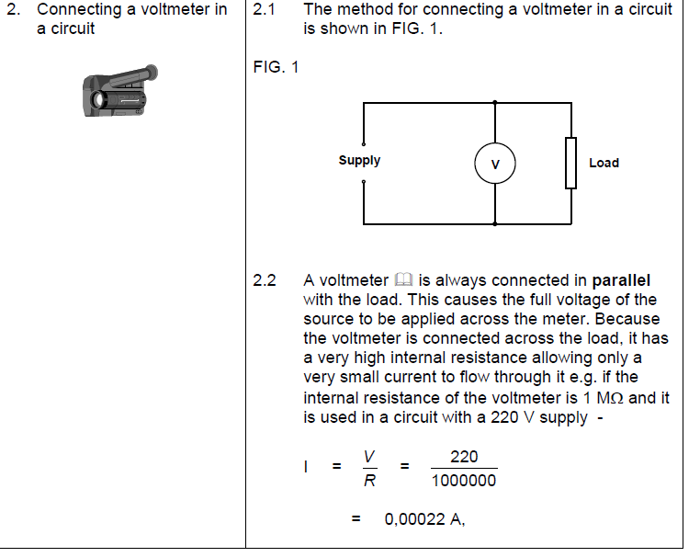
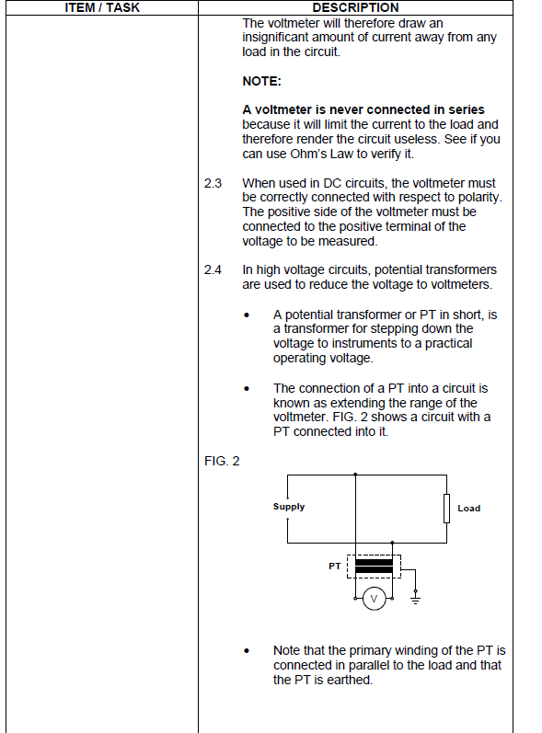
Video 02: Voltmeter
Demonstration video with experienced facilitator taking the learner through how to use a voltmeter. Must show closeups of the voltmeter, how it’s connected, the readings and what they mean. Use the following references for style and content:
https://www.youtube.com/watch?v=vXbllFrpL7Q
https://www.youtube.com/watch?v=TBt-kxYfync

Slide 43
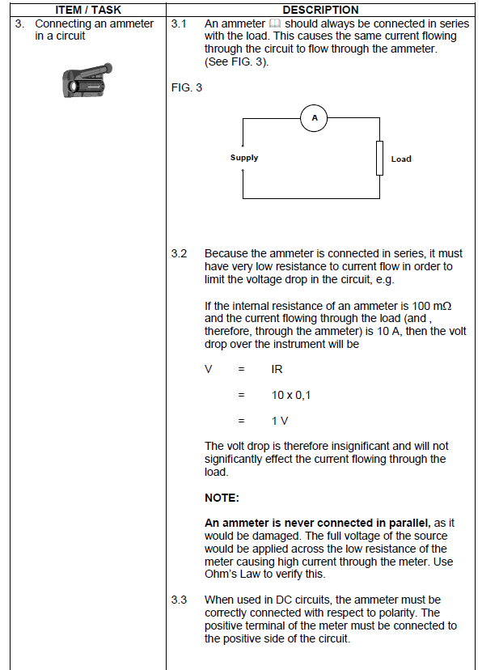
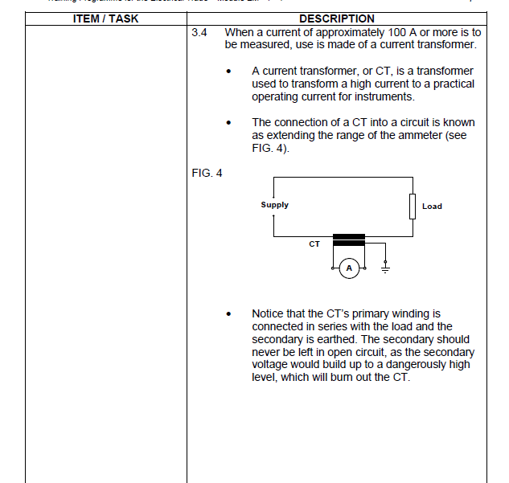
Video 03: Ammeter
Demonstration video with experienced facilitator taking the learner through how to use a ammeter. Must show closeups of the ammeter, how it’s connected, the readings and what they mean. Use the following references for style and content:
https://www.youtube.com/watch?v=vXbllFrpL7Q
https://www.youtube.com/watch?v=TBt-kxYfync

Slide 44
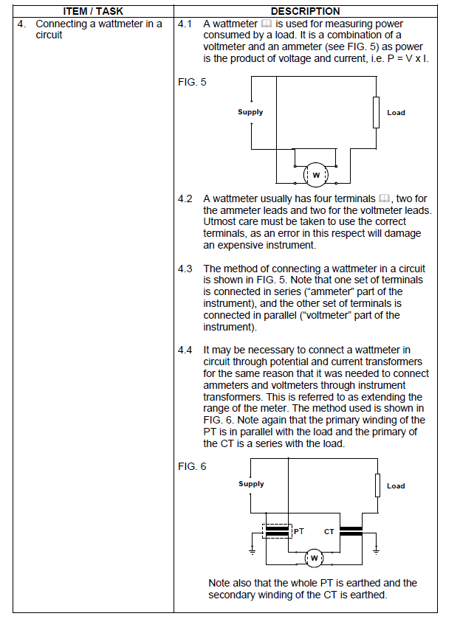
Video 04: Wattmeter
Demonstration video with experienced facilitator taking the learner through how to use a wattmeter. Must show closeups of the wattmeter, how it’s connected, the readings and what they mean. Use the following references for style and content:
https://www.youtube.com/watch?v=vXbllFrpL7Q
https://www.youtube.com/watch?v=TBt-kxYfync
Notes:
A whattmeter is a voltage and ammeter in one device and it measure the wattage used per installation ie a house. For example if you have a granny flat that you rent out you can supply the house with electricity and the wattmeter will measure how much electricity that flat has consumed so that you can charge them.

Slide 45
Video 05: Multimeter
Demonstration video with experienced facilitator taking the learner through how to use a multimeter. Must show closeups of the multimeter, how it’s connected, the readings and what they mean. Use the following references for style and content:
https://www.youtube.com/watch?v=vXbllFrpL7Q
https://www.youtube.com/watch?v=TBt-kxYfync

Slide 46
Video 06: Multimeter
Demonstration video with experienced facilitator taking the learner through how to use a multimeter. Must show closeups of the multimeter, how it’s connected, the readings and what they mean. Use the following references for style and content:
https://www.youtube.com/watch?v=vXbllFrpL7Q
https://www.youtube.com/watch?v=TBt-kxYfync

