Slide 1
Gas Cutting
Need SME in put especially for the video scripts
Topic 2, Unit 7.2
All copyright and intellectual property rights in respect of materials developed by the service provider during this project will vest in the Department of Higher Education and Training, which will have the right to allow any individual, company, agency or organisation to use or modify the materials for any purpose approved by this Department, including selling the materials or releasing them as Open Educational Resources (OER) under an appropriate copyright license.

Slide 2
Outcomes
By the end of this unit you will be able to:
Define gas cutting
Understand why electricians need to cut metal
Describe how to use a oxy-acetylene machine
Describe which safety precautions should be taken when using a welding machine.
Notes:
Note for interactivity:
When learner clicks on video it should appear as a full screen.

Slide 3
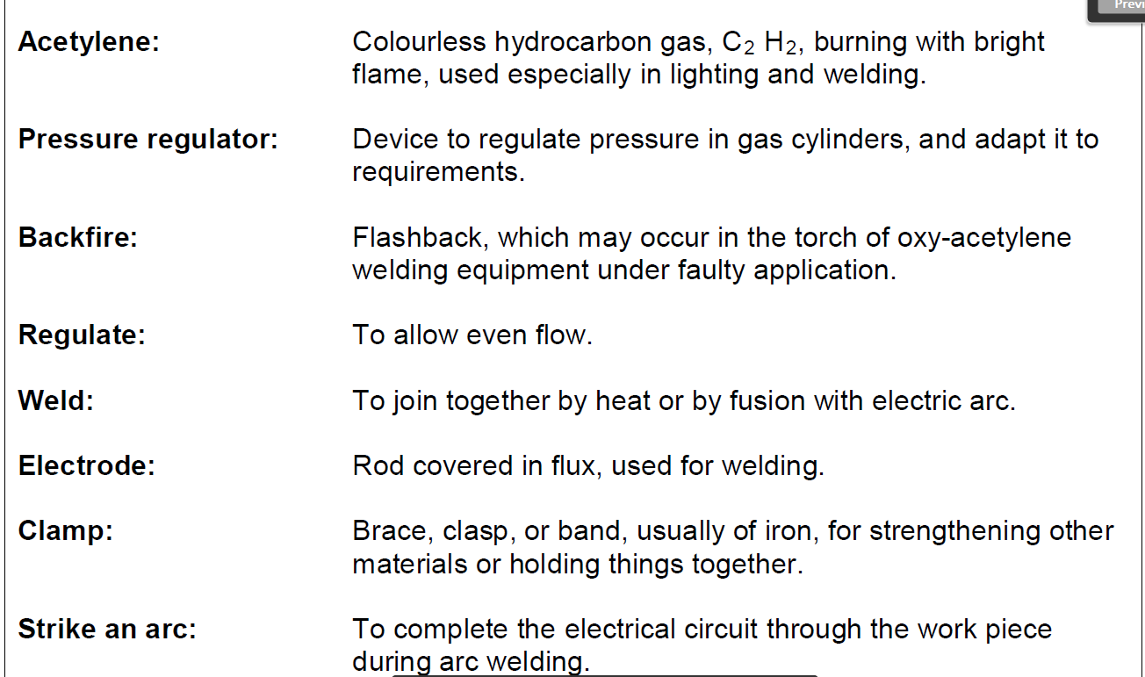
Glossy of words

Slide 4
What will I be learning?
In this unit you will learn about why electricians need to cut metal and the process that they use to cut metal which is called Gas Cutting. You will also learn about the very important safety precautions you must take when gas cutting.
Gas cutting is a very practical skill. While this unit will give you some information about welding you will need to go to a training centre to practice your gas cutting skills.
Notes:
Note for interactivity:
Underlined section should be hyperlinked to Topic 2: Unit 1 Hand tools

Slide 5
Introduction
In the unit on welding you learned metal brackets used to create wire ways come in standards sizes. Electricians sometimes need melt or fuse two metal brackets together to make a longer bracket especially in a large environment such as a factory.
Image of someone welding two metal brackets together.

Slide 6
Introduction
What do you think an electrician could do if the metal bracket is too long and they needed to make it smaller?
The electrician could use a hacksaw to make it smaller
Nothing, the electrician would need to use a plastic bracket instead
The electrician could use a device that uses gas to ignite a flame that is hot enough to cut through metal.
Choose the correct answer and click ‘Submit’.
Notes:
Notes for interactivity:
Multiple Choice
One correct answer indicated in italics.
Feedback if correct; Well done you are correct!
Feedback if incorrect: Not quite, The correct answer is that the electrician could use a device that uses gas to ignite a flame that is hot enough to cut through metal.

Slide 7
What is gas cutting?
To be able to cut a metal bracket into smaller pieces an electrician would need to make use of a gas cutting machine, also called an Oxy-acetylene cutting torch. This type of machine uses a combination of gases such as oxygen and acetylene to create a flame hot enough to cut through metal.
Watch the video for more information on the process of cutting metal using an Oxy-acetylene cutting torch.
Placeholder Video 01: How an Oxy-acetylene cutting torch works
Notes:
Note for interactivity:
When learner clicks on video it should play full screen.

Slide 8
Test yourself
Which two gasses combine to create a flame hot enough to cut through metal?
Choose the correct answer and click ‘Submit’.
Oxygen and carbon dioxide
Acetylene and nitrogen
Oxygen and acetylene
Notes:
Note for interactivity:
Multiple Choice Activity
1 correct answer
Correct answer shown in italics
Feedback if correct- Well done you are correct.
Feedback if incorrect- Not quite. Oxygen and acetylene are the two gasses used to create a flame hot enough to cut through metal.

Slide 9
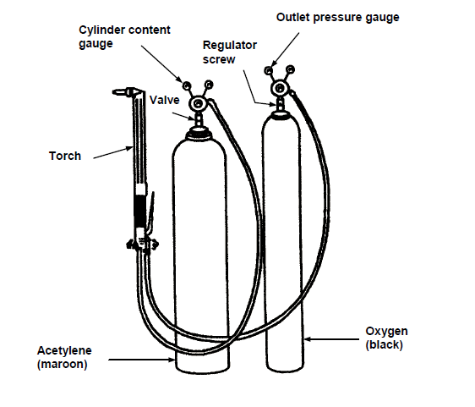
Parts of Oxy-acetylene cutting torch
Image placeholder: This should be an image of a real torch with corresponding labels
This is what an arc welding machine looks like.
Move over each part of the image to see the different parts
Notes:
Note for interactivity:
When learner moves mouse over the hotspots the corresponding labels should appear.

Slide 10
Test yourself
What colour is the tank containing the oxygen?
Choose the correct answer and click ‘Submit’.
Black
Maroon
Orange
Notes:
Note for interactivity:
Multiple Choice Activity
1 correct answer
Correct answer shown in italics
Feedback if correct- Well done you are correct.
Feedback if incorrect- Not quite. Oxygen and acetylene are the two gasses used to create a flame hot enough to cut through metal.

Slide 11
Test yourself
What colour is the tank containing the acetylene?
Choose the correct answer and click ‘Submit’.
Black
Maroon
Orange
Notes:
Note for interactivity:
Multiple Choice Activity
1 correct answer
Correct answer shown in italics
Feedback if correct- Well done you are correct.
Feedback if incorrect- Not quite. Oxygen and acetylene are the two gasses used to create a flame hot enough to cut through metal.

Slide 12
Parts of an Oxy-acetylene cutting torch
Now that you know what the torch looks like on an image, let’s take a look at this tool in more detail
Click on the video for more information.
Placeholder Video 02: Parts of a torch
Notes:
Note for interactivity:
When learner moves mouse over the hotspots the corresponding labels should appear.

Slide 13
Test yourself
Can you label this diagram?
Drag and drop the label to the correct part of the machine and click ‘Submit’.
Image placeholder: This should be an image of a real torch with corresponding labels
Notes:
Note for interactivity:
Drag and drop activity.
Learner must drag and drop the correct label to the correct hotspot on the diagram.

Slide 14
How to use an Oxy-acetylene cutting torch
Now that you know what the torch looks like, let’s take a look at how to use this tool to cut a metal bracket into smaller pieces.
Click on the video for more information.
Placeholder Video 03: How to cut a metal bracket
Notes:
Note for interactivity:
When learner moves mouse over the hotspots the corresponding labels should appear.

Slide 15
Test yourself
Here are the steps for cutting a metal bracket into two pieces. Can you put them in the correct order?
Move the steps into the correct order and click ‘Submit’.
Step 1
Steps need to be added once Video 02 has been created
Step 2
Step 3
Step 4
Step 5
Notes:
Note for interactivity:
Drag and drop activity.
Learner must drag and drop the correct label to the correct hotspot on the diagram.

Slide 16
Safety precautions
When using any kind of machinery you must make sure that you take the correct safety precautions to keep yourself and those around you safe.
Watch the video below for more information.
Placeholder Video 04: Safety precautions
Notes:
Note for interactivity:
When learner moves mouse over each block they should see the following:
PPE Block: Slide 14
Precautions Block: Slide 15

Slide 17
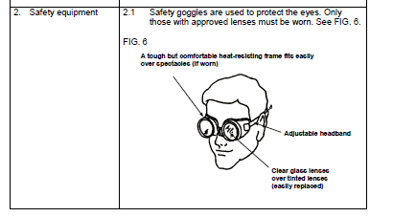
Personal Protective Equipment
Here is the PPE you would need when gas cutting.
Click on the blocks below for more information.
Image of a person wearing the following PPE:
Safety overalls non flammable
Safety shoes
Safety glasses
Notes:
Note for interactivity:

Slide 18
Safety precautions
Making sure you the people around you are safe is very important. Here are some things you should keep in mind when gas cutting.
Click on the video for more information.
Placeholder Video 04 Safety Precautions
Notes:
Note for interactivity:
When learner moves mouse over the hotspots the corresponding labels should appear.

Slide 19
Test yourself
Say whether the following statement is true or false.
The gasses used for gas cutting are not flammable so it’s ok to smoke near them.
Choose the correct answer and click ‘Submit’.
True
False
Notes:
Note for interactivity:
Multiple Choice Activity
1 correct answer
Correct answer shown in italics
Feedback if correct- Well done you are correct.
Feedback if incorrect-Incorrect. Oxygen and acetylene are highly flammable which means you should never smoke near them.

Slide 20
Test yourself
Say whether the following statement is true or false.
You should always wear fire resistant overalls when using an oxy-acetylene torch.
Choose the correct answer and click ‘Submit’.
True
False
Notes:
Note for interactivity:
Multiple Choice Activity
1 correct answer
Correct answer shown in italics
Feedback if correct- Well done you are correct.
Feedback if incorrect-Incorrect. Because oxygen and acetylene gasses are flammable (able to catch on fire) You should always wear fire resistant overalls when using an oxy-acetylene torch.

Slide 21
Test yourself
Why are backfires a problem?
Choose the correct answers and click ‘Submit’.
Backfires can cause injuries to people
Backfires mean you have to start all over again
Backfires can damage the equipment
Backfires can damage the metal you are cutting
Notes:
Note for interactivity:
Multiple Choice Activity
1 correct answer
Correct answer shown in italics
Feedback if correct- Well done you are correct.
Feedback if incorrect-Incorrect. Because oxygen and acetylene gasses are flammable (able to catch on fire) You should always wear fire resistant overalls when using an oxy-acetylene torch.

Slide 22
Test yourself
How will you know if a backfire has occurred?
Choose the correct answers and click ‘Submit’.
There is a sound like a gunshot
The flame gets bigger
The flame is extinguished (goes out)
The body of the torch feels cold to the touch
The body of the torch heats up.
Notes:
Note for interactivity:
Multiple Choice Activity
1 correct answer
Correct answer shown in italics
Feedback if correct- Well done you are correct.
Feedback if incorrect-Incorrect. Because oxygen and acetylene gasses are flammable (able to catch on fire) You should always wear fire resistant overalls when using an oxy-acetylene torch.

Slide 23
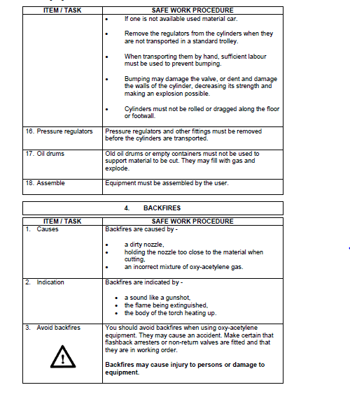
Test yourself
What are some of things that could cause a backfire?
Choose the correct answers and click ‘Submit’.
A dirty nozzle
A faulty connector
Holding the nozzle too close to the material when cutting
A broken valve
An incorrect mixture of oxy-acetylene gas.
Notes:
Note for interactivity:
Multiple Choice Activity
1 correct answer
Correct answer shown in italics
Feedback if correct- Well done you are correct.
Feedback if incorrect-Incorrect. Because oxygen and acetylene gasses are flammable (able to catch on fire) You should always wear fire resistant overalls when using an oxy-acetylene torch.

Slide 24
Video 01 How an oxy-acetylene torch works
Check this explanation with an SME
Demonstration video interspersed with animated explanations. Use the following video as reference:
Reference video: https://www.youtube.com/watch?v=Yjg3ZxMDv_4 (from 4 min into the video)
An oxy-acetylene torch uses a combination of two gasses, oxygen and acetylene to create a flame hot enough to cut through metal. Each of the gasses are stored in a separate tank. A black tank for the oxygen and a maroon tank for the acetylene. Both of these tanks are connected to the torch which is the part used for creating the flame. You would first open up the oxygen valve a little bit to allow oxygen to flow through the top of the torch. Then you turn on the acetylene valve (just a little bit) and light the torch using a lighter. Once the flame is burning you then regulate your oxygen flow using the second valve at the top of the torch. You do this until you have a bright white light flowing from the top of the torch. You are now ready to use the torch to cut through a piece of metal.

Slide 25
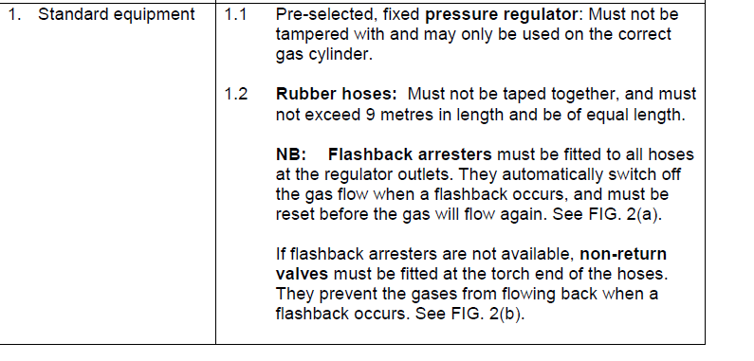
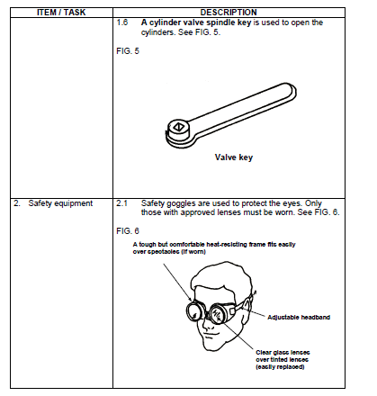
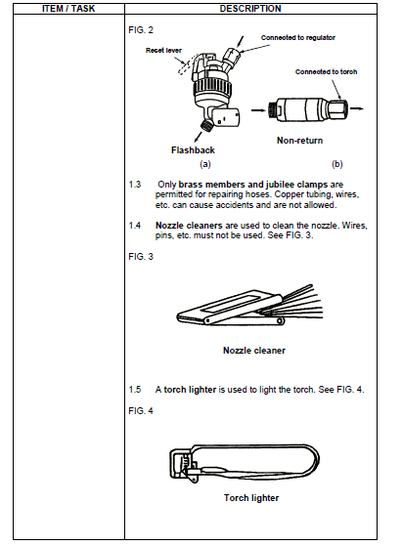
Video 02 Parts of a Oxy-acetylene cutting torch.
Demonstration video with a facilitator talking the learner through the different parts of an Oxy-acetylene cutting torch.
Notes:
Notes continue on next slide.

Slide 26
Video 03 How to use an Oxy-acetylene cutting torch.
Demonstration video demonstrating how to cut a metal bracket into smaller pieces They should mention the safe ways to use this machine. Must also include how to calculate the amount of gas to be used.

Slide 27
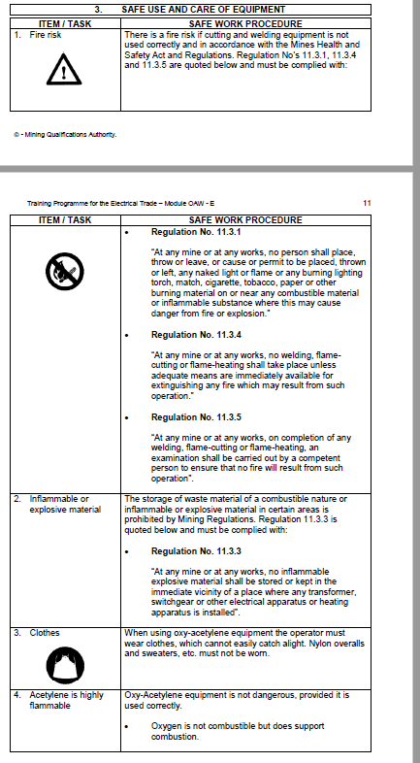
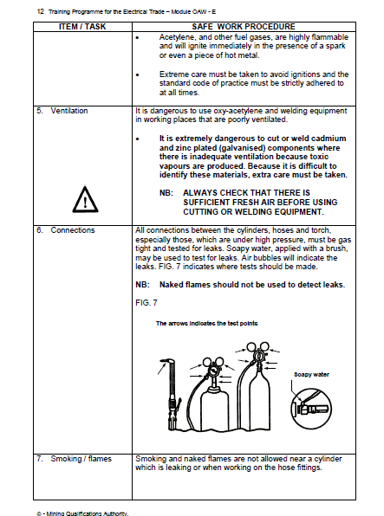
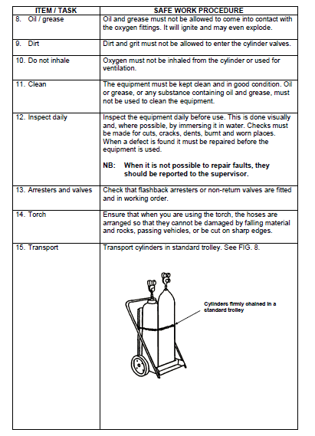
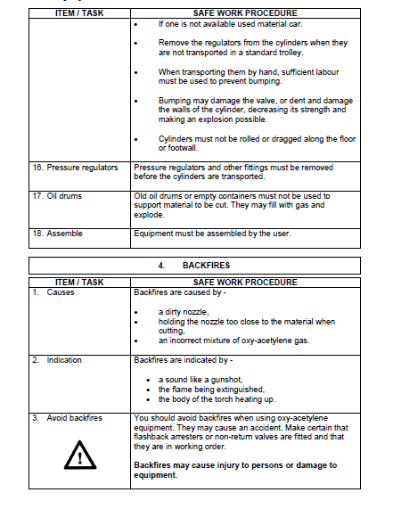
Video 04 Safety Precautions
Animated black and white video with voice over, real images of the torch can be added to the video as well. Must contain the following information:

