Slide 1
Welding
Need SME in put especially for the video scripts
Topic 2, Unit 7
All copyright and intellectual property rights in respect of materials developed by the service provider during this project will vest in the Department of Higher Education and Training, which will have the right to allow any individual, company, agency or organisation to use or modify the materials for any purpose approved by this Department, including selling the materials or releasing them as Open Educational Resources (OER) under an appropriate copyright license.

Slide 2
Outcomes
By the end of this unit you will be able to:
Define welding
Understand why electricians weld
Describe how to use a welding machine
Describe which safety precautions should be taken when using a welding machine.
Notes:
Note for interactivity:
When learner clicks on video it should appear as a full screen.

Slide 3
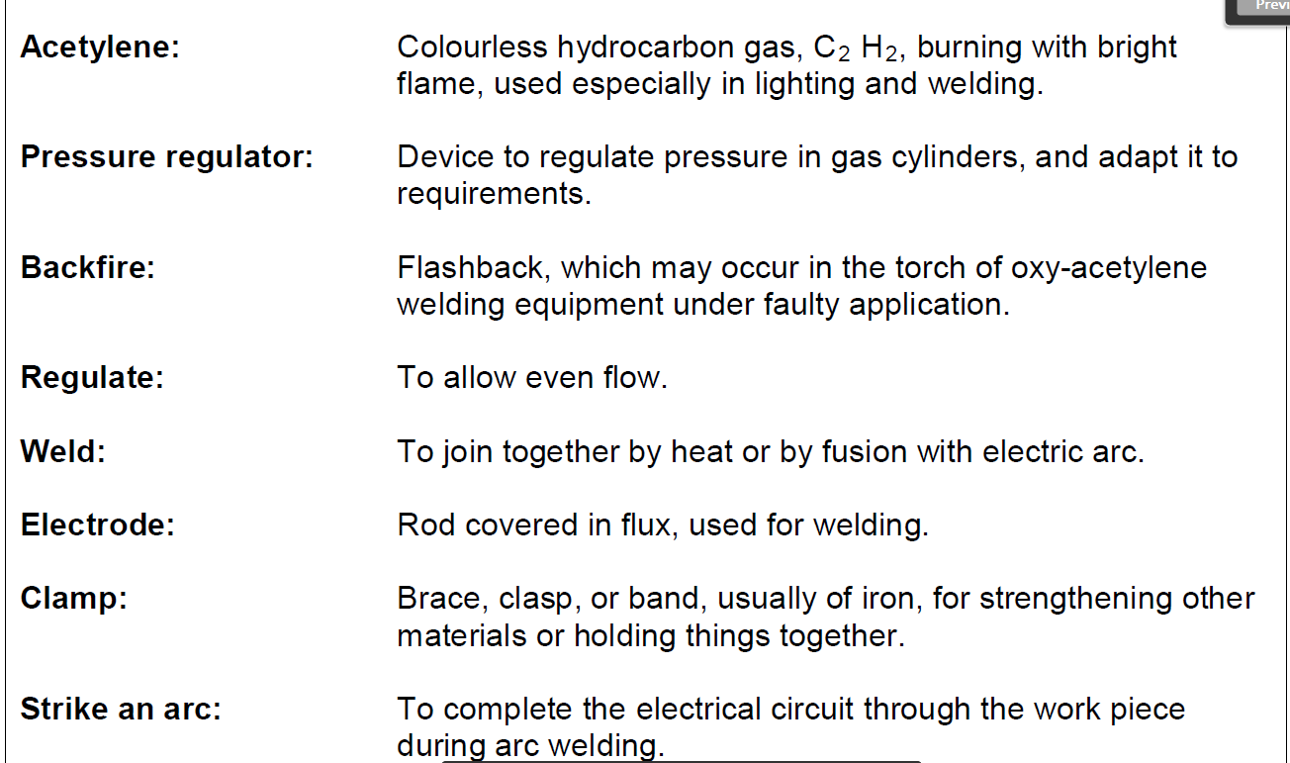
Glossy of words

Slide 4
What will I be learning?
In this unit you will learn about what welding is and why electricians need to weld on the job. You will be introduced to the welding machine most commonly used by electricians and finally, you will also learn about the very important safety precautions you must take when welding.
Welding is a very practical skill. While this unit will give you some information about welding you will need to go to a training centre to practice your welding skills
Notes:
Note for interactivity:
Underlined section should be hyperlinked to Topic 2: Unit 1 Hand tools

Slide 5
What is welding?
Take a look at the first image. There are two pieces of metal. Now take a look at the second image, the two pieces of metal have now been joined to make one piece. How did this happen?
Image of two separate pieces of metal
Image of two pieces of metal now welded together

Slide 6
What is welding?
The two pieces of metal became one piece by welding them together. Welding is the process of making two pieces of metal into one piece by using a tool that creates a heat source hot enough to melt metal.
Watch the video below for more information on welding.
Placeholder Video 01: What is welding
Notes:
Note for interactivity:
When learner clicks on video it should play full screen.

Slide 7
Test yourself
What is welding?
Choose the correct answer and click ‘Submit’.
Welding is the process of making two pieces of metal into one piece by using a tool that creates a heat source hot enough to melt metal.
Welding is the process of melting a filler metal in order to join two pieces of metal together.
Welding the process of using gas to cut a piece of metal into two pieces.
Notes:
Note for interactivity:
Multiple Choice Activity
1 correct answer
Correct answer shown in italics
Feedback if correct- Well done you are correct.
Feedback if incorrect- Not quite. Welding is the process of making two pieces of metal into one piece by using a tool that creates a heat source hot enough to melt metal.

Slide 8
Test yourself
What is the difference between welding and soldering?
Choose the correct answer and click ‘Submit’.
There is no difference they are the same process
Welding melts the two base metals together while soldering melts a filler metal to join pieces of metal together.
Welding melts a filler metal to join two pieces together while soldering melts the two base metals together.
Notes:
Note for interactivity:
Multiple Choice Activity
1 correct answer
Correct answer shown in italics
Feedback if correct- Well done you are correct.
Feedback if incorrect- Not quite. Welding melts the two base metals together while soldering melts a filler metal to join pieces of metal together.

Slide 9
Why do electricians need to weld?
Image of electrician using a bracket to put cables into it
The blocks below explain why an electrician needs to weld. Click on each box to see an image.
Electricians use metal brackets to make sure cables are neatly placed.
These metal brackets usually come in a standard size.
Factories are often big spaces which means that the standard sized brackets won’t work.
To solve this problem the electrician can weld brackets together to make the correct size.
Image of metal bracket standard size
Image of a interior space of a factory showing a metal bracket
Image of someone welding two pieces of metal together.
Notes:
Note for interactivity:
When learner clicks on each block a corresponding image should appear:
Block 1- Image of electrician using a bracket to put cables into it
Block 2- Image of metal bracket standard size
Block 3- Image of a interior space of a factory showing a metal bracket
Block 4- Image of someone welding two pieces of metal together.

Slide 10
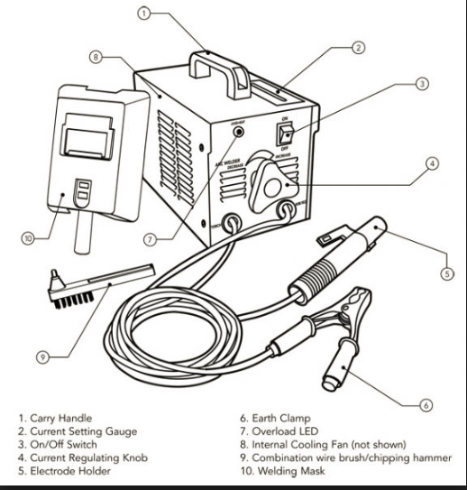
Parts of a welding machine
Image placeholder: This should be an image of a real welding machine with corresponding labels
This is what an arc welding machine looks like.
Move over each part of the machine to see the different parts.
Notes:
Note for interactivity:
When learner moves mouse over the hotspots the corresponding labels should appear.

Slide 11
Parts of a welding machine
Now that you have a general idea of what a welding machine looks like, let’s take a detailed look at how this kind of machine works.
Click on the video for more information.
Placeholder Video 02: Parts of a welding machine
Notes:
Note for interactivity:
When learner moves mouse over the hotspots the corresponding labels should appear.

Slide 12
Test yourself
Can you label this diagram?
Drag and drop the label to the correct part of the machine and click ‘Submit’.
Image placeholder: This should be an image of a real welding machine with corresponding labels
Notes:
Note for interactivity:
Drag and drop activity.
Learner must drag and drop the correct label to the correct hotspot on the diagram.

Slide 13
How to use a welding machine
Now that you know what a welding machine looks like, let’s take a look at how to use this machine to weld two metal brackets together.
Click on the video for more information.
Placeholder Video 02: How to weld
Notes:
Note for interactivity:
When learner moves mouse over the hotspots the corresponding labels should appear.

Slide 14
Test yourself
Here are the steps for welding two metal brackets together. Can you put them in the correct order?
Move the steps into the correct order and click ‘Submit’.
Step 1
Steps need to be added once Video 02 has been created
Step 2
Step 3
Step 4
Step 5
Notes:
Note for interactivity:
Drag and drop activity.
Learner must drag and drop the correct label to the correct hotspot on the diagram.

Slide 15
Safety precautions
When using any kind of machinery you must make sure that you take the correct safety precautions to keep yourself and those around you safe.
Touch the blocks below for more information.
What PPE do I need when I am welding?
What precautions should I take?
Notes:
Note for interactivity:
When learner moves mouse over each block they should see the following:
PPE Block: Slide 14
Precautions Block: Slide 15

Slide 16
Personal Protective Equipment
Here is the PPE you would need when welding.
Click on the blocks below for more information.
Image of a person wearing the following PPE:
Safety overalls
Safety shoes
Headscreen, each item should be labelled on the diagram
Notes:
Note for interactivity:

Slide 17
Precautions
Here are the precautions you should take when welding:
All electrical connections must be sound otherwise they will overheat and the arc will fluctuate.
Image of electrical connections on a welding machine
All insulated components must be in good condition and a proper earth must be used.
Image of insulated component in good condition and proper earth
Notes:
Note for interactivity:

Slide 18
Precautions
An electrode holder of adequate amperage rating must always used for the work to be done
Image of electrical connections on a welding machine
Protect your eyes from intense visible light and ultra-violet and infrared emissions of the arc by using a handshield or headmask
Image of person welding using a handshield or headmask
Notes:
Note for interactivity:
When learner moves mouse over the blocks the following information should appear:
Precaution 1: All electrical connections must be sound otherwise they will overheat and the arc will fluctuate
Precaution 2: All insulated components must be in good condition and a proper
Precaution 3:
Precaution 4:

Slide 19
Safety thoughts
Here are some final things you need to be aware of when welding:
Click on the video for more information.
Placeholder Video 04 Safety Thoughts
Notes:
Note for interactivity:
When learner moves mouse over the hotspots the corresponding labels should appear.

Slide 21
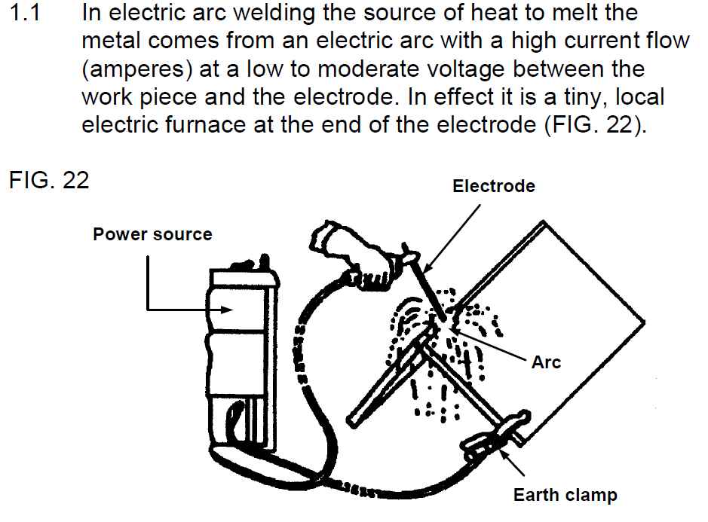
Video 01 What is welding
Demonstration video interspersed with animated explanations. Use the following video as reference: https://www.youtube.com/watch?v=ZZvMsnSUDqo
Welding is the process of making two pieces of metal into one piece by using a tool that creates a heat source hot enough to melt metal. This is different from the technique of soldering or brazing where a filler metal is melted in order to join two pieces of metal (the metal equivalent of using glue). With welding the edges of the two base metals are melted so that they become one piece. This is called fusion. The part where the two metals have melted together, called the join will be much stronger than if a filler metal was used.

Slide 22
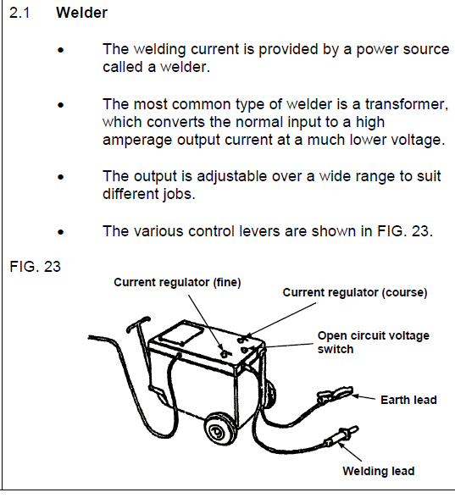
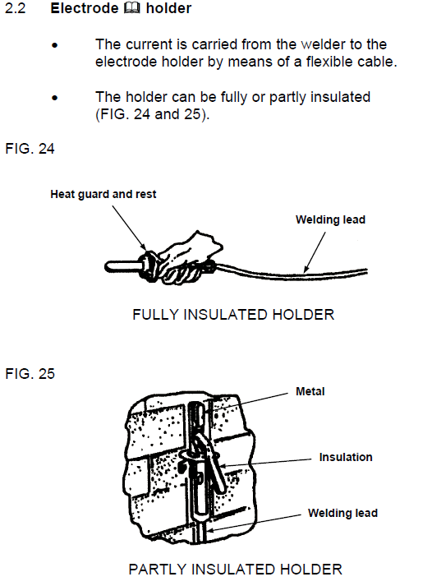
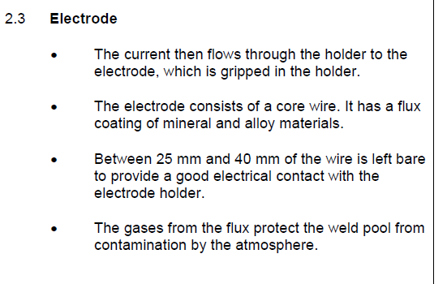
Video 02 Parts of a welding machine
Demonstration video with a facilitator talking the learner through the different parts of an actual welding machine. Information provided is what facilitator should cover in this video.
Notes:
Notes continue on next slide.

Slide 23
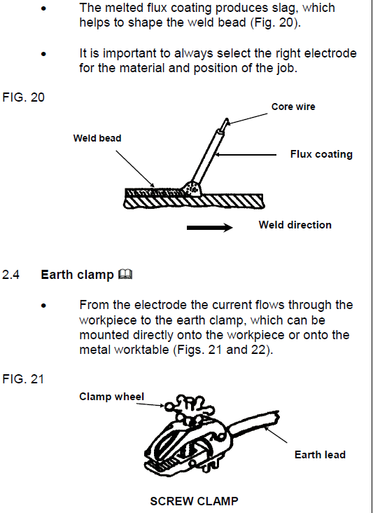
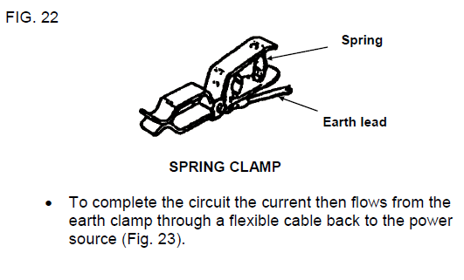
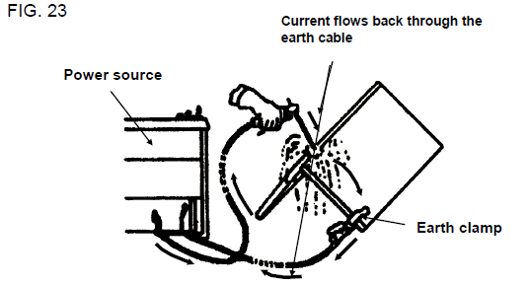

Slide 24
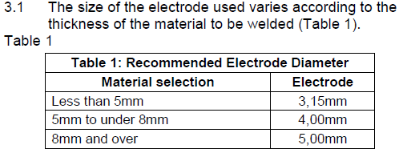
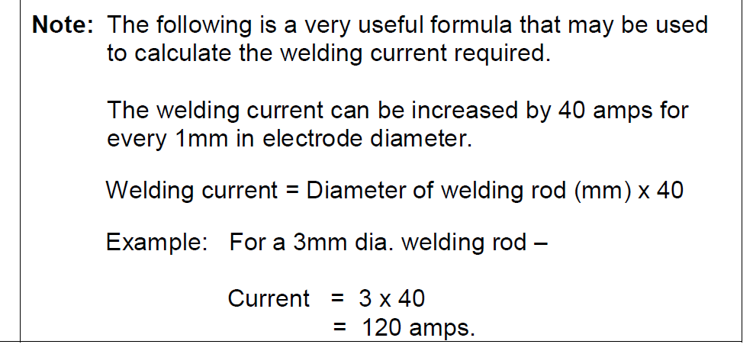
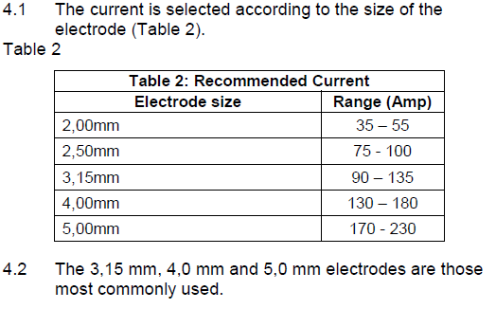
Video 03 How to weld
Demonstration video demonstrating how to weld two pieces of metal brackets (used for wireways) together. They should mention the safe ways to use this machine. Must also include how to calculate the correct current.

Slide 25
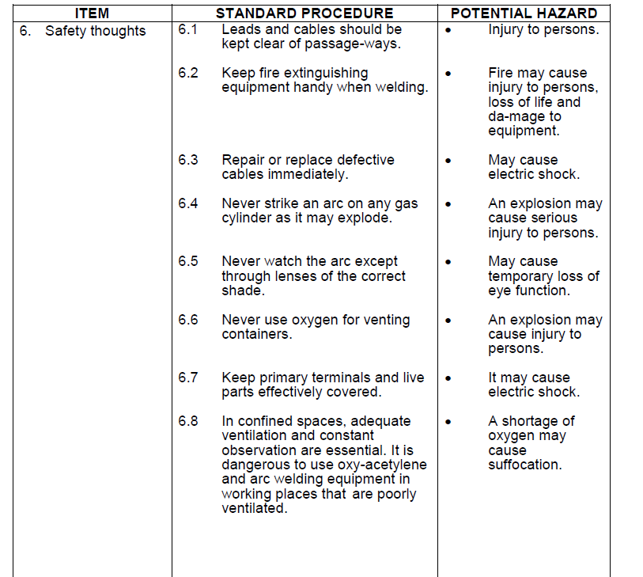
Video 04 Safety Thoughts
Video combination of images and voice over. An image for each point should appear and as it appears there should be a voice over reading out the point and it’s associated hazard.

