Slide 1
Tools and Electrical Measuring Instruments
Topic: Reading engineering drawings
Incomplete – add 5 questions. Add video and image briefs

Slide 2
Assumed prior learning
Notes:
Note for navigation on site:
This information needs to be taken into account and needs to stated on the LMS, perhaps as part of the introduction?

Slide 3
Outcomes
On completion of this unit, you will be able to state the meaning of all abbreviations used on a technical drawing.
Notes:
Note for design:
This list of text should be broken up to make it more interesting. Text should be presented in a menu type of format.
Note for interactivity:
Information should be presented in a clickable menu so that learner can click on each outcome instead of it being one long list.

Slide 4
Unit 2: Symbols and abbreviations
Notes:
Note for development:
There are 8 steps for each of the 6 scenarios in Course 4. The scenario will be built out as once piece. This storyboard covers:
Step 1- Client Brief

Slide 5
Introduction
Have you figured out how to help Katlego yet? Do you know what the piece of equipment is called?
You now understand what the lines on engineering drawings represent, but there are still symbols and abbreviations that you may not be familiar with. These are used to save space on drawings. This unit will list and describe all of these.
Repeat intro image from Unit 1
Click here to enlarge the image and look at the information in the bottom right-hand corner.
Notes:
Note for interactivity:
Image showing electrician from unit 1 looking at plans (if there is space) and also image must be able to be enlarged

Slide 6
Click here to go to symbols. This will show you examples of the equipment and how it is drawn in a technical drawing.
Click here to go to abbreviations used in technical drawings.
Notes:
Note for interactivity:
Click here to go to symbols: Click through to next slide for symbols
Click here to go to abbreviations: Go to abbreviations (slide 20)

Slide 7
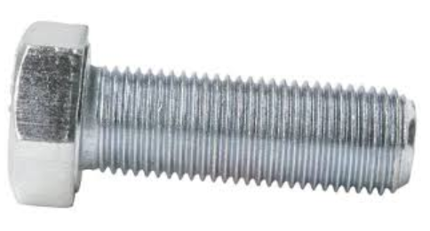
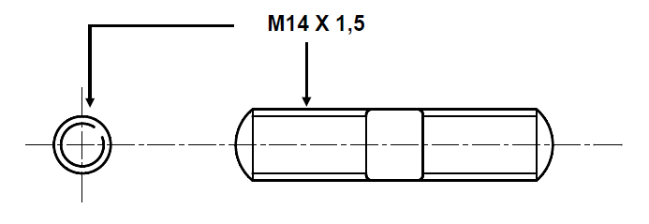
External screw threads
M = Metric
14 = 14 mm outside diameter
1,5 = 1,5 mm pitch of the thread (a thread pitch of 1.5 means that the distance between one thread and the next is 1.5mm)
Notes:
Note for interactivity:

Slide 8
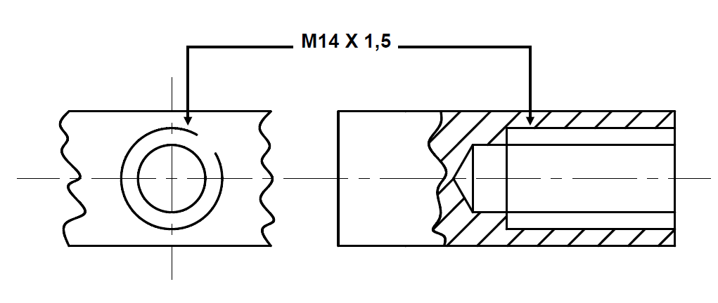
Internal screw threads
This diagram shows the inside where the screw from the previous image will fit.
As before:
M = Metric
14 = 14 mm outside diameter
1,5 = 1,5 mm pitch of the thread (a thread pitch of 1.5 means that the distance between one thread and the next is 1.5mm)
Notes:
Note for interactivity:

Slide 9
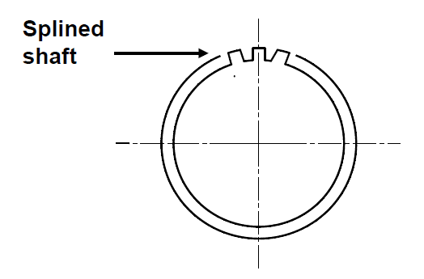
Splined shaft
Splines are ridges or teeth on a drive shaft that match with grooves in a matching piece and transfer torque to it.
Notes:
Note for interactivity:

Slide 10
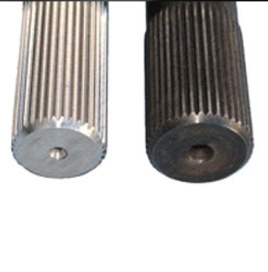
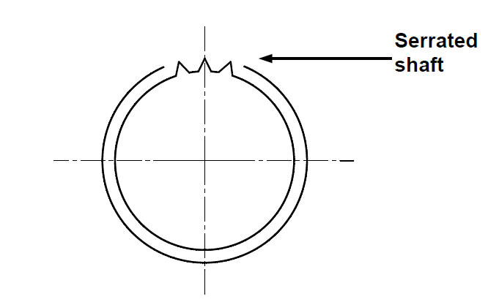
Serrated shaft
Can you tell the difference between a serrated shaft and a splined shaft?
Notes:
Note for interactivity:

Slide 11
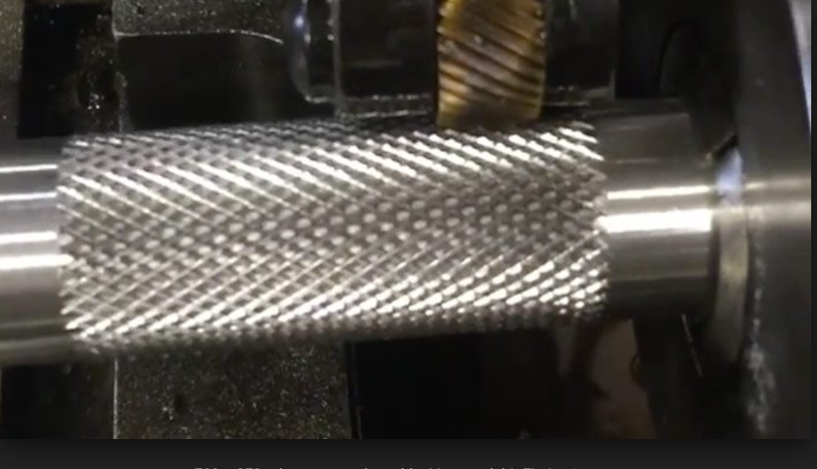
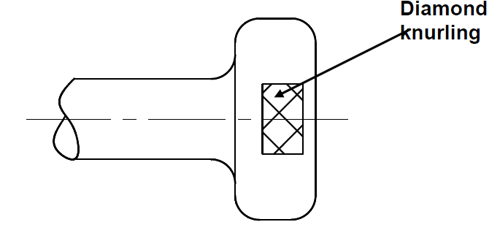
Knurling
Knurling when a pattern is pressed onto the round section of equipment.
Notes:
Note for interactivity:

Slide 12
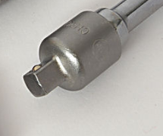
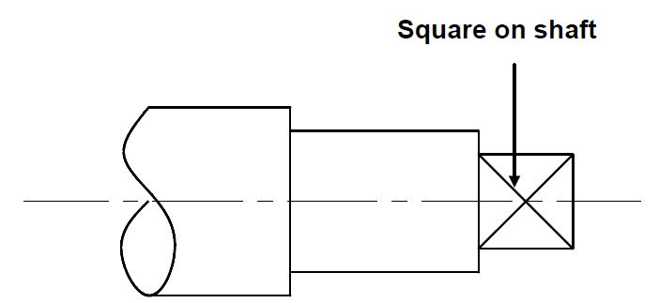
Square on a shaft
Need better image

Slide 13
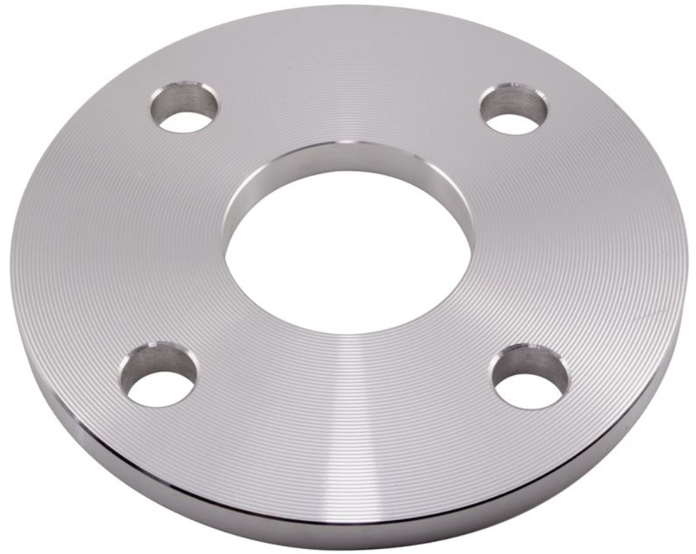
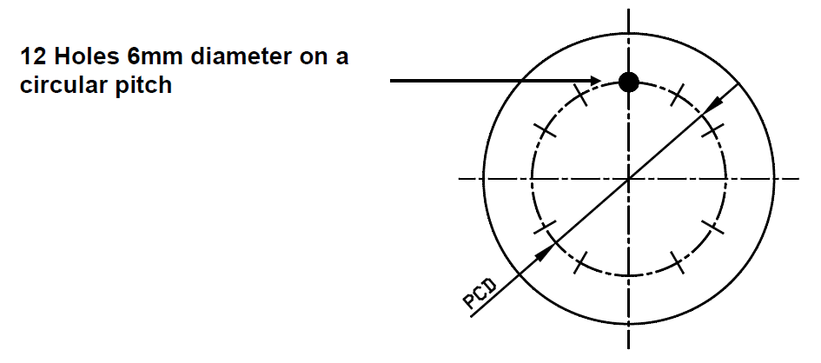
Holes in a PCD
PCD stands for pitch circle diameter.
12 Holes 6 mm means that 12 holes with a diameter of 6 mm must be drilled in the flange, at a given PCD.
Need better image – must match drawing: 12 holes
Notes:
Note for interactivity:

Slide 14
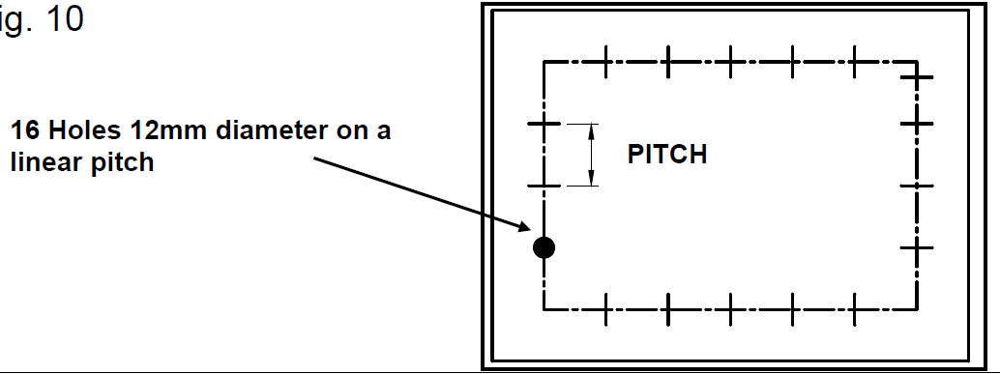
Hole pitches on a linear plane
P = Pitch, which is the distance from the centre of the one hole to the centre of the next hole.
16 holes 12 mm means that 16 holes with a diameter of 12 mm must be drilled in the flange at a given distance (P) apart.
Need better image – must match drawing: 12 holes
Notes:
Note for interactivity:

Slide 15
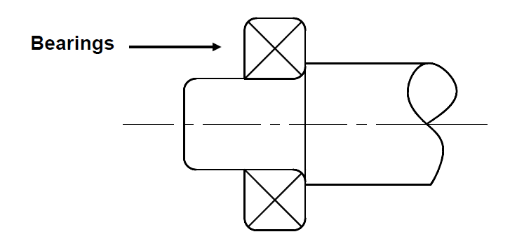
Bearing
A bearing is the part of a machine that bears the friction, especially between a rotating shaft and its housing. Can you see the bearings in the photo?
Need better image – must match drawing and show a shaft
Notes:
Note for interactivity:

Slide 16
Radius
SME: Please assist with this slide
A radius is a radial line from the focus to any point on a curve.
Notes:
Note for interactivity:

Slide 17
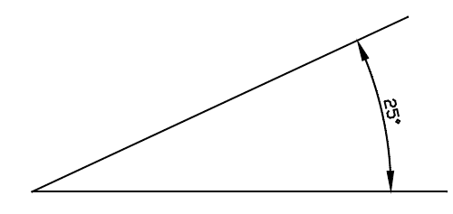
Angle
This shows that the angle is 25°.

Slide 18
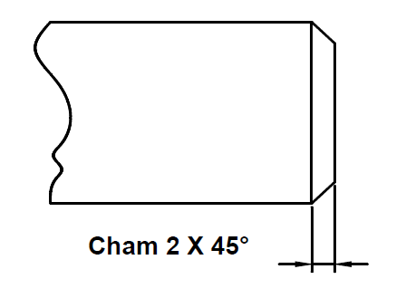
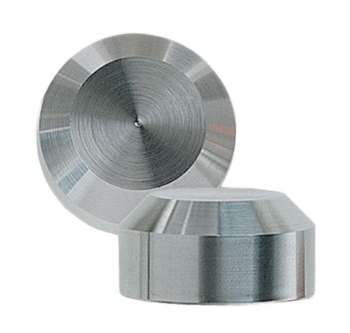
Chamfer
A chamfer is a bevelled surface at an edge or a corner or a workpiece.
The diagram shows the chamfer is 2 mm wide by 45° angle.
Notes:
Note for interactivity:

Slide 19
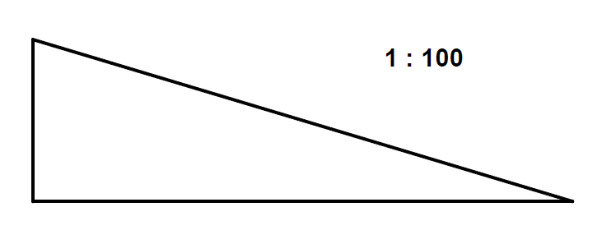
Taper
SME: Please assist with this slide. Practical example?
A taper shows a gradual narrowing at one end.
This image shows:
1:100 = 1 millimetre taper for every 100 millimetres
Notes:
Note for interactivity:

Slide 20
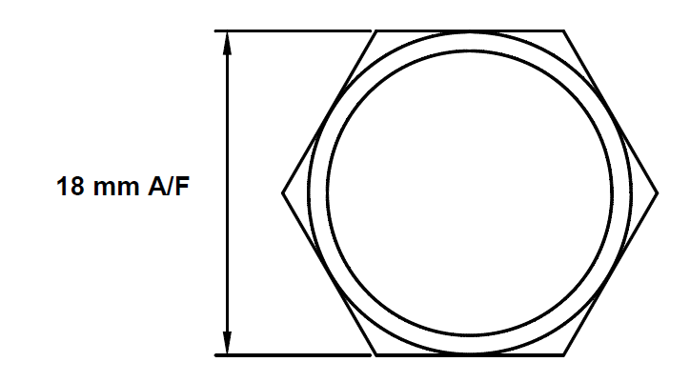
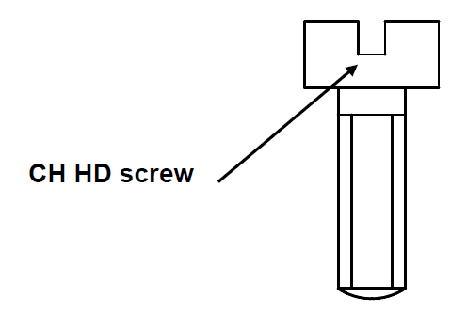
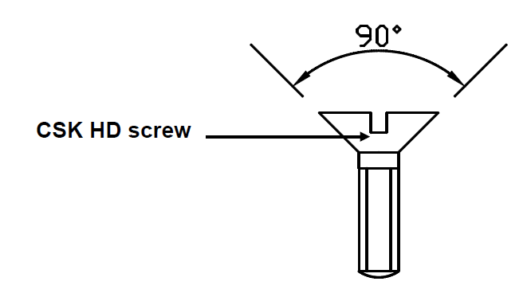
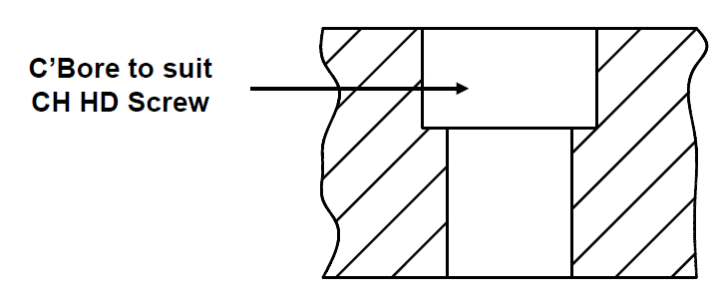
Abbreviations
Here is a list of abbreviations you might come across:
A/F = across flats
CRS = centres
CH HD = cheese head
CL or C = centre line
CHAM = chamfered
C’Bore = counterbore
CSK = countersunk
CSK HD = countersunk head
HEX = hexagon
Notes:
Note for interactivity:

Slide 21
Abbreviations
Here are more abbreviations you need to know:
DIA = Diameter (in a note)
⌀ = Diameter (preceding a dimension)
DRG = Drawing
FIG = Figure
HEX HD = Hexagon Head
MAT = Material
NO = Number
PCD = Pitch circle diameter
RAD = Radius (in a note)
R = Radius (preceding a dimension)
SCR = Screwed
Notes:
Note for interactivity:
The text “Click on the phone to hear Mr Mabuzo’s brief to you” should fade in once learner clicks on this slide.
When learner clicks on the image of the cell phone Voice Rec 01: Client brief should play.
Hint box should fade in/float in approx. 7 seconds into the slide
Note for design:
Need an image of Mr Mabuzo (black male, middle age, professional, the same person should be used throughout this entire scenario as Mr Mabuzo.

Slide 22
Check what you remember
SME: Please assist with this slide. Practical example?
State what the following symbol and abbreviations mean in the context of these drawings. Remember you can go back and check what these mean.
[This is followed by a quiz. No need to draw anything. Just ensure they understand the abbreviations in the context of the drawing from unit 1.]
Video of somebody showing all of these concepts in context on a drawing. Suggest SME for this.
Notes:
Note for interactivity:

Slide 23
A Quick Quiz
Before we end off, take some time to check your understanding of what we have covered in this unit by answering the following questions.
Incomplete – add 5 questions

Slide 24
Video Briefing-
What videos can assist with this? Do we need somebody to teach these on a drawing to tie this up?
Notes:
Video script for placeholder on Slide 3.

Slide 25
Resource 01:

