Slide 1
Tools and Electrical Measuring Instruments
Topic: Reading engineering drawings
Incomplete unit

Slide 2
Assumed prior learning
Notes:
Note for navigation on site:
This information needs to be taken into account and needs to stated on the LMS, perhaps as part of the introduction?

Slide 3
Outcomes
Identify the different types of lines on an engineering drawing and state their meaning.
State the meaning of all the abbreviations used on a technical drawing.
Read and interpret a given engineering drawing.
A theory test will be set at the end of the module and must be completed without using references.
3.2 The learner will be given an engineering drawing of a work piece and must correctly
(a) name the work piece and state the material that must be used to manufacture it,
(b) identify and state the meaning of all the different lines and abbreviations used in the drawing,
(c) state the dimensions of the work piece, and the tolerances allowed during manufacture.
Notes:
Note for design:
This list of text should be broken up to make it more interesting. Text should be presented in a menu type of format.
Note for interactivity:
Information should be presented in a clickable menu so that learner can click on each outcome instead of it being one long list.

Slide 4
Unit 1: Lines
Notes:
Note for development:

Slide 5
Introduction
SME: For what machine part/piece of equipment would they need a drawing?
Complicated drawing here. Resource 1
Have you ever seen engineering drawings like this one?
If you don’t know how to read this, it may seem complicated. This unit will guide you through understanding engineering drawings. But why do you need to understand this?
Click here to find out why Katlego needs your help. [link to video]
Notes:
Note for interactivity:
Video of Katlego holding a machine part (to be specified by SME): Katlego has the plans but the machine part is in pieces. He needs to screw it together but how does he know which screws he will need to buy to put it together?
SME: What would they need to fix/do? What kind of thing do they use this for?
You will be able to interpret engineering drawings.

Slide 6
Some general information on drawings
We can see all the construction details of a piece of equipment in an engineering drawing.
Symbols, lines and figures give drawings meaning. These have been standardised so they mean the same thing wherever the drawings are made and used.
Resource 1 repeated but clickable.
Click on the numbers on this drawing to find out more.
Notes:
Note for interactivity:
Click on different parts of drawing for different information. Pop out with info
Lines – Highlight lines
Symbols – Highlight
Variances
Measurements

Slide 7
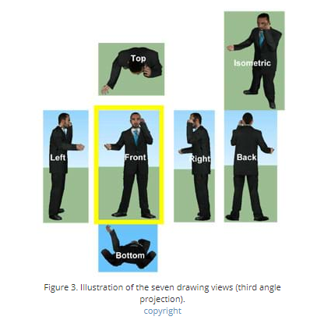
Understanding different views
This image shows different views of one man. Each view can be represented in a drawing.
Image
Click on this image to enlarge it.
Notes:
Video brief: Imagine that you have an object suspended by transparent threads inside a glass box. Then draw the object on each of three faces as seen from that direction. Unfold the box and you have the three views. We call this an "orthographic" or "multiview" drawing. This is how the three views appear on a piece of paper after unfolding the box. Now use a piece of paper in place of the glass box and create your own Multiview drawing of any simple object.

Slide 8
Understanding perspectives
SME: For what machine part/piece of equipment would they need a drawing? Same thing used throughout lesson.
Any engineering drawing should show everything so you have a complete understanding of the object from the drawing.
Image showing a machine part and as it is moved, you can see the drawing that is associated with the part.
Move this machine part around to be able to show the different perspectives and how each is represented in a drawing.
Notes:
Describe what is needed here?
Isometric view
Multiview – top view, left view, right view,
Show interactive machine part (SME Q – what machine part shows this?)
Look at how much detail we can include?

Slide 9
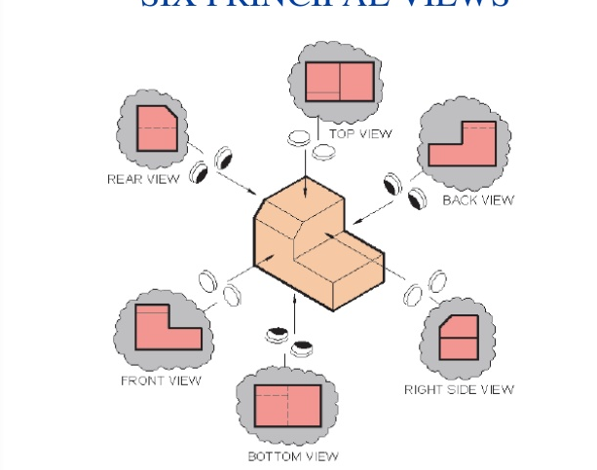
What are multiview drawings?
Incomplete
These drawings are used to represent a 2D view of a 3D object.
You don’t need to be able to draw these but you must be able to interpret them.
Watch this video and create your own multiview drawing of any simple object. Upload to your ePortfolio.
Notes:
Video brief: Imagine that you have an object suspended by transparent threads inside a glass box. Then draw the object on each of three faces as seen from that direction. Unfold the box and you have the three views. We call this an "orthographic" or "multiview" drawing. This is how the three views appear on a piece of paper after unfolding the box. Now use a piece of paper in place of the glass box and create your own Multiview drawing of any simple object.

Slide 10
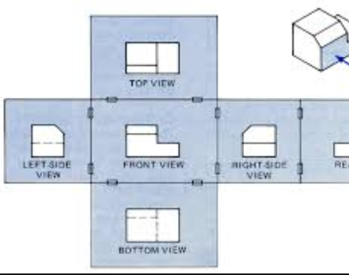
What do multiview drawings show?
We have seen that these drawings show a representation of 3D objects from different angles.
Do you think this is enough detail? What else might we need to see?
Incomplete
Notes:
Find better image. Interactivity here?

Slide 11
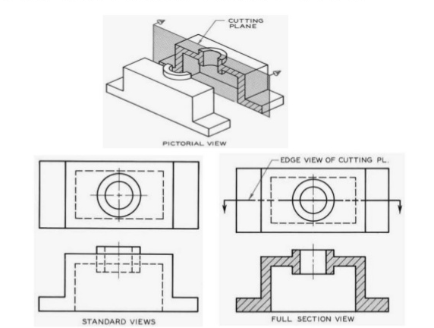
How do we show more views?
Sometimes we need to see what the inside of a piece of equipment looks like. To show this, we can use a sectional view.
This shows what the object looks like if we cut it open along a line. What do you notice about the sectional view?
Click the image to see how this works.
Notes:
Note for interactivity:
Click object to show the drawing with the cutting plane. Click to explode drawing in 3D. Turn and show front view of section. Overlay drawing.
Did you notice these lines? Get more thinking.

Slide 12
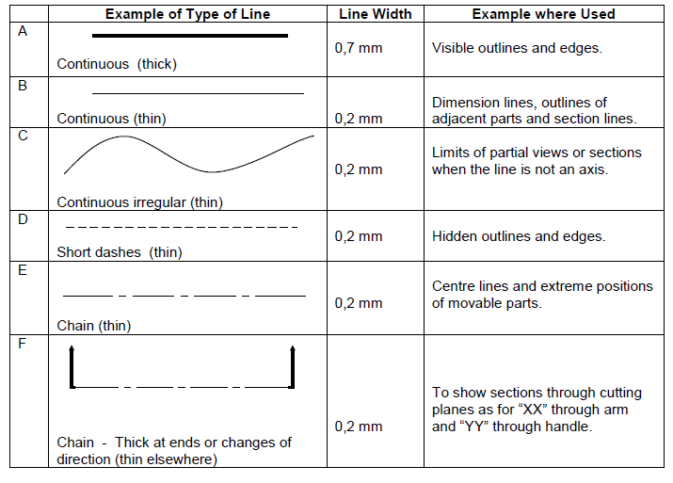
Types of lines
Did you notice that different lines and symbols can show different details?
Can you tell what each line shows?
Click the image to find out more about the detail.
Incomplete
Notes:
Note for interactivity:
Questions:
Select the lines that show hidden outlines and edges. [all are highlighted when selected correctly]
Select the lines that show visible outlines and edges. [all are highlighted when selected correctly]
Select the lines that show limits of partial views. [all are highlighted when selected correctly]
Select the lines that show centre lines. [all are highlighted when selected correctly]
Select the lines that show a section through a cutting plane. [all are highlighted when selected correctly]

Slide 13
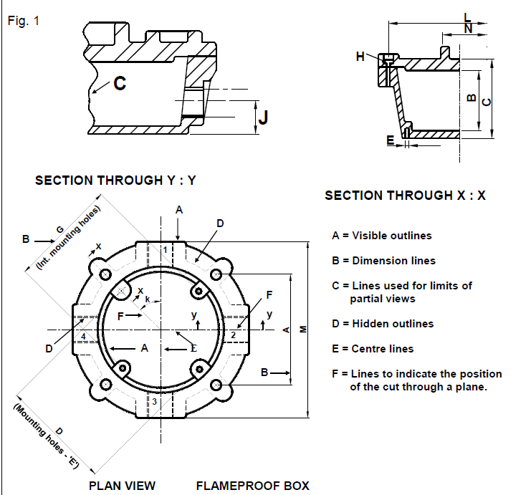
Identify different lines
This drawing shows the use of lines and symbols.
It contains a lot of detail, and shows two sections.
Click the image to find out more about the detail.
Notes:
Note for interactivity:
A-F: Must be clickable and explode out.

Slide 14
A Quick Quiz
Before we end off, take some time to check your understanding of what we have covered in this unit by answering the following questions.
Incomplete – add 5 questions

Slide 15
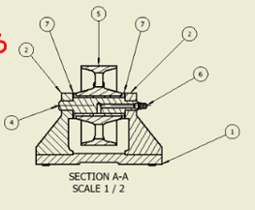
Types of lines
You have seen that different lines and symbols can show different details.
Can you tell what each line shows in this diagram?
Notes:
Note for interactivity:
Match image to description
Note line thickness – all 2mm except outline: 7mm

Slide 16
Video Briefing-
Types of lines overview: https://www.youtube.com/watch?v=_t2NjPpsegE
Types of lines details: https://www.youtube.com/watch?v=jj4mUHzTSYc
Notes:
Video script for placeholder on Slide 3.

Slide 17
Resource 01: Intro
Notes:
Different ways of looking at an image
Look at object. Choose perspectives.
Lines help you tell you what view you are looking at.
where things are/what

Slide 18
Resource 01:
Notes:
Different ways of looking at an image
Look at object. Choose perspectives.
Lines help you tell you what view you are looking at.
where things are/what

Slide 19
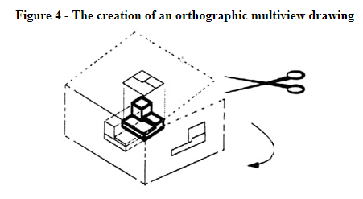
Video Briefing-
Notes:
Use at end of unit.

Slide 20
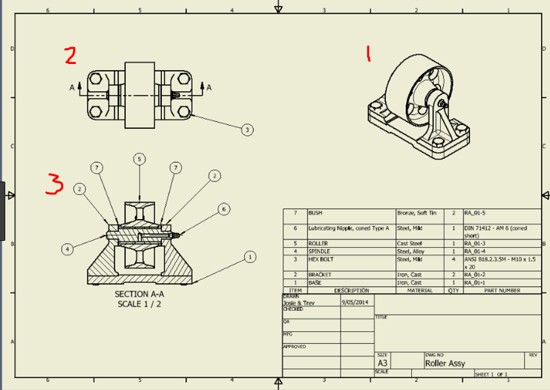
Resource 01:
Redraw
Notes:
Click on each to show text:
This is an isometric drawing.
This is an orthographic representation of the view of the top of this machine part.
This is a sectional view. If we cut the machine part open along the line A-A showing in 2, this is how we represent what we see.

Slide 21
Resource 01:

Slide 22
Video Briefing-
Types of lines overview: https://www.youtube.com/watch?v=_t2NjPpsegE
Types of lines details: https://www.youtube.com/watch?v=jj4mUHzTSYc
Notes:
Use at end of unit.

Slide 23
Resource 01:

Slide 24
Resource 01:
Redraw
Notes:
Click on each to show text:
This is an isometric drawing.
This is an orthographic representation of the view of the top of this machine part.
This is a sectional view. If we cut the machine part open along the line A-A showing in 2, this is how we represent what we see.

Slide 25
Resource 01:

