Slide 1
Tools and Electrical Measuring Instruments
Topic 1: Hand tools
Unit 1: Types and uses of basic hand tools

Slide 2

Assumed Prior Learning
X
Y
Z
Don’t feel confident yet about these topics? Click on each to review the content. Feeling confident? Click next to proceed with this unit.
Notes:
Note for navigation on site:
This information needs to be taken into account and needs to stated on the LMS, perhaps as part of the introduction?

Slide 3

Outcomes
By the of this topic, you will be able to:
1. Identify basic hand tools and describe their purpose.
2. Know how to basic hand tools safely.
Notes:
Present boxes with just the number. On click/touch, reveal the full statement as a slide right animation
Display small animations to indicate that boxes can be clicked/touched

Slide 4
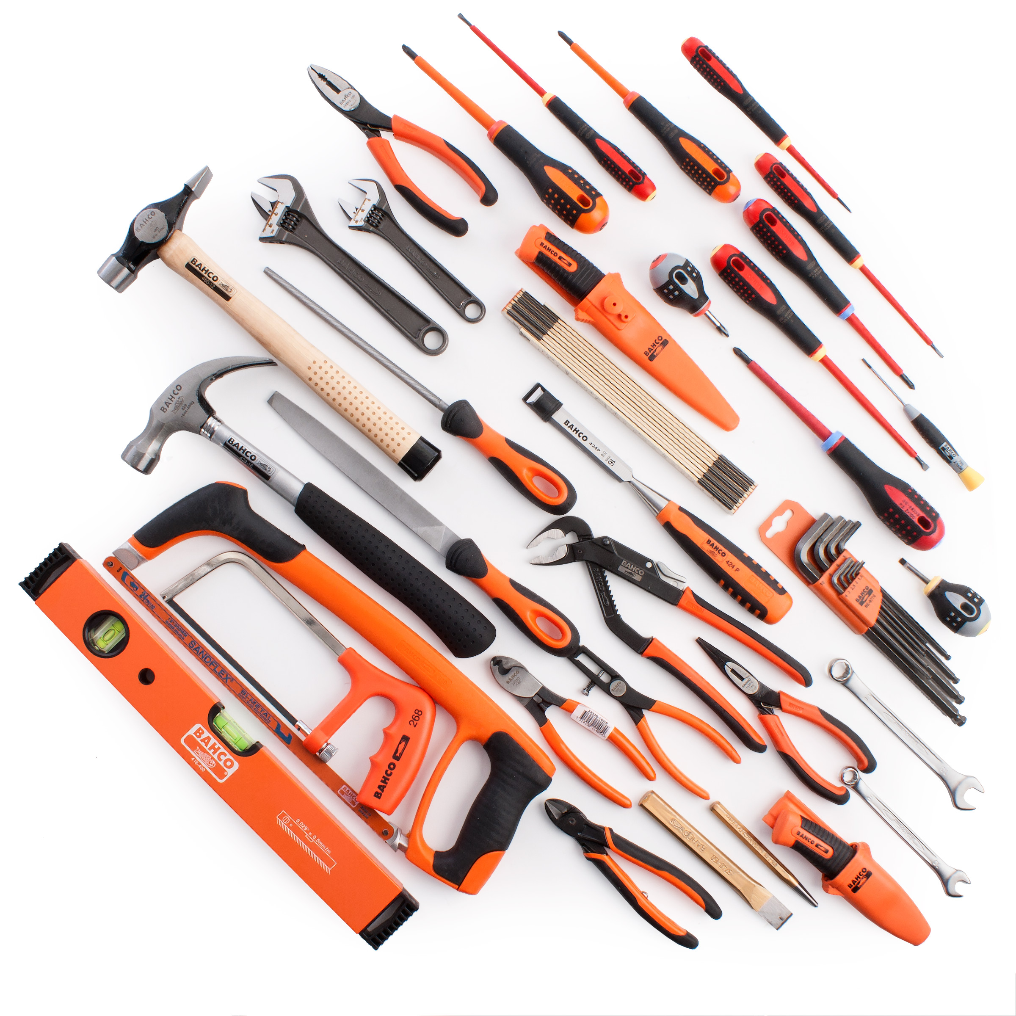
Introduction
Whether you are an apprentice or an experienced electrician, you need access to basic hand tools to help perform tasks in your everyday working environment.
In this unit you will identify some common hand tools and understand their purpose so you can select the right tool for the job.
Notes:
1. IMG01 - Please recreate image or source new one
2. Image reference: https://www.toolstop.co.uk/bahco-4750fb3-12ts2-electricians-tool-kit-35-piece-p79678

Slide 5
Staying safe
Hand tools are non-powered. That means they do not need electricity to work.
Hand tools include anything from axes to wrenches. The greatest risks posed by hand tools are from improper use and maintenance.
So, how can you stay safe when working with hand tools?
Video placeholder- See appendix
Watch the video for some great tips on staying safe when working with hand tools.
Notes:
1. Notes for development- SEE VID01 script in Appendix

Slide 6


Can you spot the hazards?
Can you identify the hazards in each of the scenes below? Click on each to view.
SCENE 1
SCENE 2
NEXT
Notes:
Notes: Next button only appears when all three scenarios have been viewed
IMG02- IMG02- Create (cartoon style)image of electrician working at ceiling light fitting. He is standing on small ladder, with tools and equipment sprawled all over floor. His pants are long and baggy and go way over his shoes.
IMG03 -IMG03- Create (cartoon style)image of electrician standing at DB board. He is using a tool that is not insulated and has a utility knife sticking out his pocket.

Slide 7
Scene 1
What is wrong with this picture? Can you identify the possible risks? Select your answer/s from the options below.
He is using the incorrect tool for the job.
The electrician is not correctly dressed for the job.
He is not wearing the correct personal protective equipment
The electrician has a very messy work space.
Submit
Go Back to Scenes
Notes:
Notes for interactivity:
Button to allow student to return to slide and view remaining scenes
IMG02- Create (cartoon style)image of electrician working at ceiling light fitting replacing a light fitting. He is wearing all correct PPE.
He is standing on small ladder, with tools and equipment sprawled all over floor as well as draped over the ladder. His pants are long and baggy and go way over his shoes.
Multiple choice
Correct answers: b; d
Feedback for multiple choice (once submit button clicked)
If correct:
Yes, great work that is correct.
If incorrect: No, that is incorrect. Take a look at the electricians workspace. His tools are all over the place putting himself at risk of injury. Also long baggy clothing is very hazardous when using tools. Make sure you are dressed correctly to complete the job without injury.

Slide 8
Scene 2
What is wrong with this picture? Can you identify the possible risks? Select your answer/s from the options below.
The electrician is not using the correct tool for the job.
The electrician is not correctly dressed for the job.
He is not wearing the correct personal protective equipment
The electrician is dressed incorrectly.
Submit
Go Back to Scenes
Notes:
Notes for interactivity:
Button to allow student to return to slide and view remaining scenes
IMG03- Create (cartoon style)image of electrician standing at DB board. He is using a tool that is not insulated and has a utility knife sticking out his pocket.
Multiple choice
Correct answers: a
Feedback for multiple choice (once submit button clicked)
If correct:
Yes, great work that is correct.
If incorrect: No, that is incorrect.
This electrician has not used the correct tool for the job. Tools are designed to perform a specific task in a specific manner. When you use a tool improperly, you risk not only damaging the tool, but also place your safety at risk. His tool is not insulated. Working with electricity includes the threat of electrical shock. That is why there are tools specially designed for electricians. These are insulated to reduce the impact electricity may have on ones body and health when accidentally hit a live circuit.

Slide 9

Know your job
The best tool for the job is one that….
We know it is extremely important to stay safe when using tool. But before you can select a tool, you need to think about the job you will be doing.
Tools are designed for a specific purpose. Using a tool for something other than its intended purpose can damage the tool or cause you pain or even injury.
Reduces the force you need to apply
Fits the job you are doing
Fits the work space available
Can be used in a comfortable work position
Click here for a very handy guide to help you select the best tool for the job.
Notes:
Add link to resource: https://www.dir.ca.gov/dosh/dosh_publications/HandTools.pdf
Recreate IMG02 to be more visually appealing. Include icons and graphics.

Slide 10
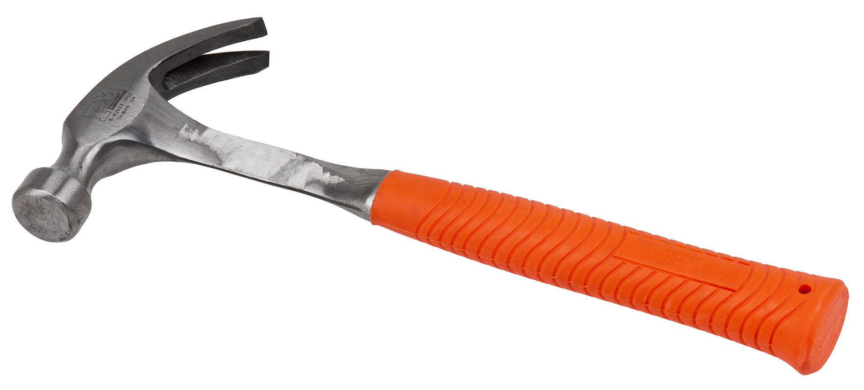
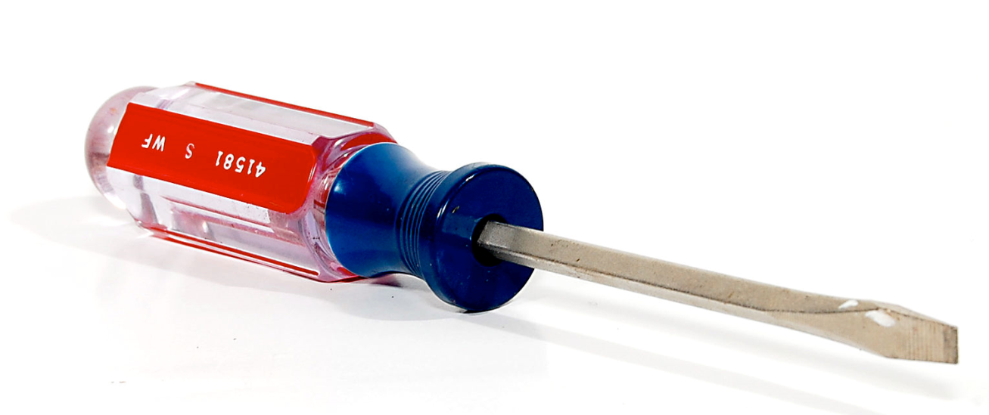
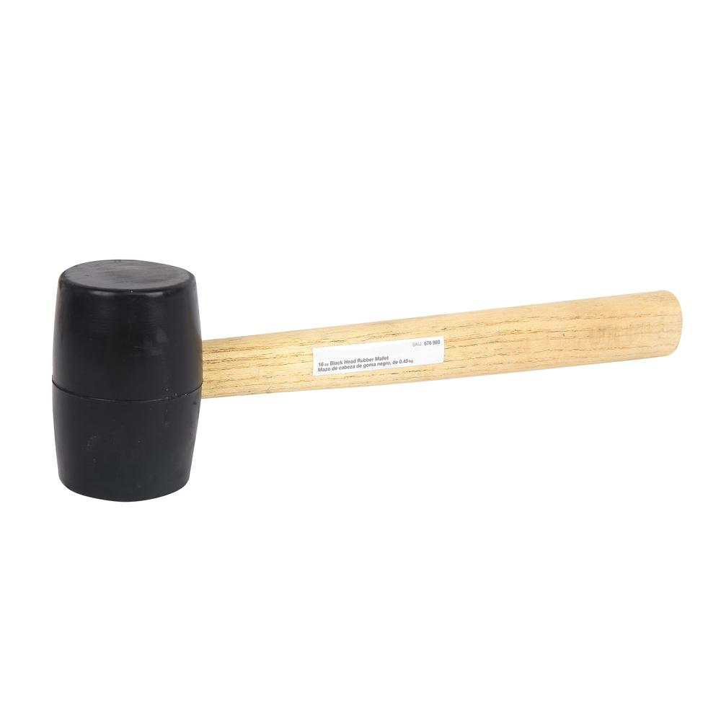
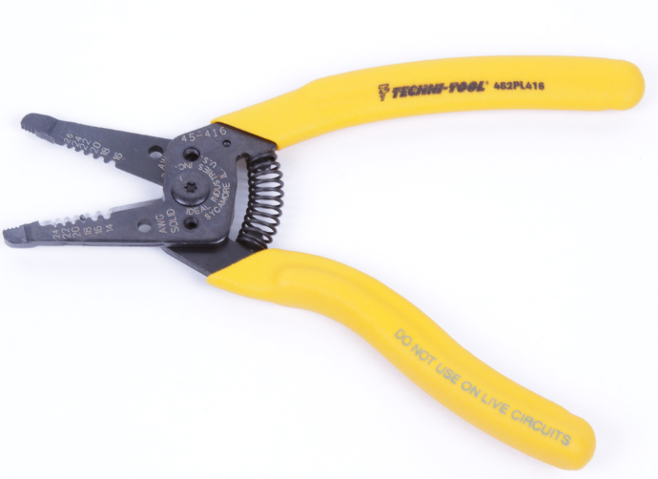
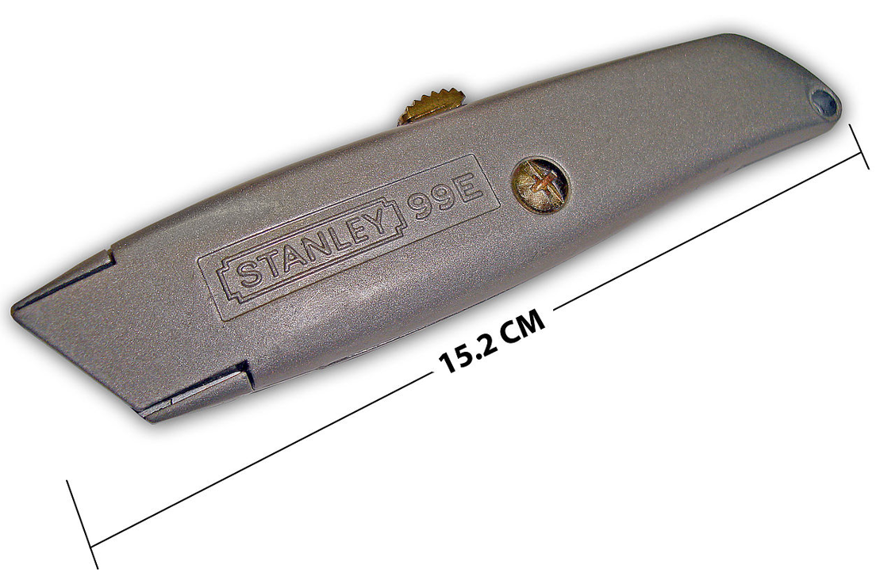
What tools are available?
SME to confirm if these are sufficient in terms of basic hand tools? See list in Notes section
There are so many hand tools available to electricians. Let’s take a look at some of the most common. Click on each tool to find out more…
Go and look at CTC Common handtools module (CHT)
Pliers (normal, long nose)
Screwdriver
Knife
Hacksaw
Spanners
Side cutter/diagonal cutter
Notes:
Notes for interactivity:
Include image for each tool. Only a few have been added as example. When student clicks on tool; it takes them to additional info slide. Each slide to contain image of tool, short description and video of an expert showing how to use tool. See example on next slide for layout.
Tools to be included:
Spanners
Sliding “T” bar
Power bar
Ratchet
Screwdrivers
Hammers
Chisels
Punches
Pliers
Side cutters
Wrenches
Tin snips
Utility knife
Pop riveter
Wire stripper
Fish tape

Slide 11
Basic Hand Tools
Wire Strippers
Example Tool Layout
Description:
A wire stripper is a small, hand-held device used to strip the electrical insulation from electric wires. (Wikipedia)
Video demonstration:
Notes:
Example layout – This is required for each tool. Will require an image, description and short video of an electrician showing how to use the tool.

Slide 12
What tools are needed?
Thabo, Mike and Johan are in a predicament! They all have a job to do and are not sure what tools are needed. Can you help them? Click on a scenario to see if you know what is needed.
Thabo’s situation
Mike’s situation
Johan’s situation
NEXT
Notes:
Notes:
Create images representing Thabo, Mike and Johan to place in 3 blocks
Next only appears when all three have been viewed

Slide 13
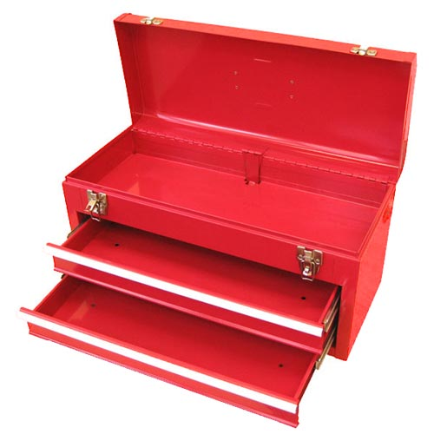
Help Thabo!
SME to confirm scenario and correct tools needed.
Thabo is an apprentice electrician. He needs to install a socket outlet in a garage. Which hand tools does he need to complete this job? Drag and drop your chosen tools into the tool box.
Spanner
Sliding “T” bar
Ratchet
Screwdriver
Chisel
Punch
Pliers
Mallet
Placeholder for another tool
Hammer
Side cutter
Wrench
Placeholder for another tool
Tin snips
Hacksaw
Placeholder for another tool
Pop riveter
Placeholder for another tool
Fish tape
Wire stripper
Submit
Notes:
Note for interactivity:
This is a drag and drop activity. Learner should be able to drag and drop correct tool to the image of the toolbox.
When they click on the submit button they should be taken to feedback page. – see below
Please replace labels with actual images of each tool.
List of tools to be shown:
Spanners
Sliding “T” bar
Power bar
Ratchet
Screwdrivers
Hammers
Chisels
Punches
Pliers
Side cutters
Wrenches
Tin snips
Utility knife
Pop riveter
Wire stripper
Fish tape
Correct tools:
Feedback for correct answer:
Well done! You have chosen the correct tools for this job.
Feedback for incorrect answer:
Oops not quite. You are missing some essential tools for this job.

Slide 14
Help Mike!
Need scenario using hand tools only.
Mike has to check the connections on a motor by opening it up.
Which tools do you think Mike needs to complete this job? Drag and drop your chosen tools into the tool box.
Spanner
Sliding “T” bar
Ratchet
Screwdriver
Chisel
Punch
Pliers
Mallet
Placeholder for another tool
Hammer
Side cutter
Wrench
Placeholder for another tool
Tin snips
Hacksaw
Sockets
Pop riveter
Placeholder for another tool
Fish tape
Wire stripper
Submit
Notes:
Note for interactivity:
This is a drag and drop activity. Learner should be able to drag and drop correct tool to the image of the toolbox.
When they click on the submit button they should be taken to feedback page. – see below
Please replace labels with actual images of each tool.
List of tools to be shown:
Spanners
Sliding “T” bar
Power bar
Ratchet
Screwdrivers
Hammers
Chisels
Punches
Pliers
Side cutters
Wrenches
Tin snips
Utility knife
Pop riveter
Wire stripper
Fish tape
Correct tools:
Feedback for correct answer:
Well done! You have chosen the correct tools for this job.
Feedback for incorrect answer:
Oops not quite. You are missing some essential tools for this job.

Slide 15
Complete a project
SME to provide additional project ideas using hand tools only.
Ideally buy yourself a cheap toolbox and practice doing these projects or if you don’t have the money you can watch these videos of projects being done.
There are so many tools available! To really become fully familiar with them, its important that you actually use them. We encourage you to complete Project 1 and at least two other projects listed below.
Choose a project and get busy using your tools. When you are done, return here and choose another project.
DO THIS
ANY TWO OF THESE
Project 1
Build a lockout device
Project 2
Strip Plastic-Sheathed Cable
Project 3
Fit a new plug to an appliance
Project 4
Replace a wall socket
Project 5
PLUS
+
Start Project
Start Project
Start Project
Start Project
Start Project
Notes:
Notes:
Project page outlined on next slide. Details and videos to be created for each project.

Slide 16
Project 1: Build a lockout device
SME to provide content for this slide
Tools
Steps:
X Y Z
Materials
See CTC module HM1
Video tutorial
Return to Projects
NEXT
Notes:
Notes for design and interactivity:
Each project page to contain:
Steps
Tools needed
Materials needed
Video demonstration of electrician showing how job is done. This will also require description/explanation of what a lockout device is and how it is used.
Return – takes them back to Project listing page
Next – takes then to quiz

Slide 17
Project 2: Strip Plastic-Sheathed Cable
SME to provide content for this slide
Tools
Steps:
X Y Z
Materials
See CTC module CA 3 and 4 putting on a gland or connecting a cable
Video tutorial
Return to Projects
NEXT
Notes:
Notes for design and interactivity:
Create video showing how to do this project.

Slide 18
Project 3: Fit a new plug to an appliance
Tools
Insulated screwdriver Retractable knife Side cutters Wire strippers
Steps:
Using the correct screwdriver for the screw type used on the plug unscrew the cover and remove. Use the screw driver to loosen terminal screws (L) and (N) to provide sufficient space to receive the wires. Inspect the wires on the appliance’s power cable and strip back the cable sheath using the retractable knife, or the wire strippers, to expose the three wires (Blue – Neutral, Brown – Live and Green/yellow – Earth) Use the wire strippers to strip off a small section of the plastic insulation to expose the copper wire on each wire. Insert the correct colour wire to the correct terminal in the plug. (look for the letters ‘N’, [bottom left ] and ‘L’ [bottom right] on the terminals. While Earth is the top terminal.) and using the screw driver tighten the terminal clamp to hold the wire firmly in place. Push the core cable firmly into the core bracket Once all three wires and the cable is secure screw the plastic cover back onto the plug.
Materials
Plug An appliance (e.g. toaster, washing machine.)
Video tutorial
https://youtu.be/zgLo9WsDR4I
Return to Projects
NEXT
Notes:
Video tutorial - https://youtu.be/zgLo9WsDR4I

Slide 19

Project 4: Replace a wall socket
Steps:
Before you start ensure the power has been turned off at the distribution board (DB)! (Plug in a lamp to test if there is still power being distributed to the socket.) Use the correct screw driver and remove any screws that hold the face plate and the receptacle/bracket to the wall socket box. When loose pull the receptacle/bracket forward to expose the wires and note how it is wired. The new socket will need to be wired in exactly the same way. Use the correct screwdriver to loosen the wires connected to the receptacle. If you cannot release the wires use the side cutters and cut it free. Then use the wire strippers to expose some of the copper wires, ready for connection to the new receptacle . Insert the wires into the correct terminals on the new socket. Blue (N - bottom left terminal) and Brown (B - bottom right terminal ). Earth is often demarcated as Fold the wires so that you can insert the receptacle back into the wall and then screw the face plate back on. Turn on the power at the DB box.
Tools
Insulated screwdriver Retractable knife Side cutters Wire strippers Pliers
Materials
Replacement Socket Outlet
Video tutorial
https://youtu.be/tWb-NP44gvo
Return to Projects
NEXT
Notes:
Video tutorial https://youtu.be/tWb-NP44gvo Need a SA version of exactly the same content.

Slide 20
Project 5:
SME to provide content for this slide
Tools
Steps:
X Y Z
Materials
Video tutorial
Return to Projects
NEXT
Notes:
Notes for design and interactivity:
Each project page to contain:
Steps
Tools needed
Materials needed
Video demonstration of electrician showing how job is done.

Slide 21
Vid01 – Working safely with hand tools
Short video where electrician ( could be animated white board style) talks about how to work safely with hand tools:
MUST COVER THE FOLLOWING CONCEPTS:
Proper hand tool safety is vital for anyone that works with them. There are a lot of things that could go wrong when working with hand tools. So, how can you stay safe when working with tools? Follow these guidelines…
1. READ SAFETY GUIDELINES
Tools come not only with manuals, but also safety guidelines to teach you how to use them properly and safely. Ignoring these precautions can lead to serious accidents.
2. Use the RIGHT TOOL FOR THE JOB
Using the right tool for the job is the first step in hand tool safety. Tools are designed to perform a specific task in a specific manner. When you use a tool improperly, you risk not only damaging the tool, but also place your safety at risk.
3. Check tools regularly for wear and damage
Look at handles, tool edges, hoses and connections, switches, triggers, casings and attachments. Check hand tools for cracks dings and chips. Keep tools clean and in good condition. Don’t use damaged tools.
4. Keep it Sharp
If a tool is designed to cut, keeping the cutting edge sharp is a safety priority. Sharp tools work better and require less force.
5. Check adjustments
If there are any adjustable parts of a tool, they can move when being transported, so always check before using.
6. Personal Protective Equipment
Almost all tool use requires protection of some kind. Refer to Course 0| Unit 2 to refresh your knowledge on protective equipment.
7. Clothing Hazards
Long draping sleeves, baggy shirts, and floppy pants are hazardous when using tools. Make sure you are dressed correctly to complete the job without injury.
8. USE INSULATED TOOLS
Working with electricity includes the threat of electrical shock. That is why there are tools specially designed for electricians. These are insulated to reduce the impact electricity may have on ones body and health when accidentally hit a live circuit.

Slide 22
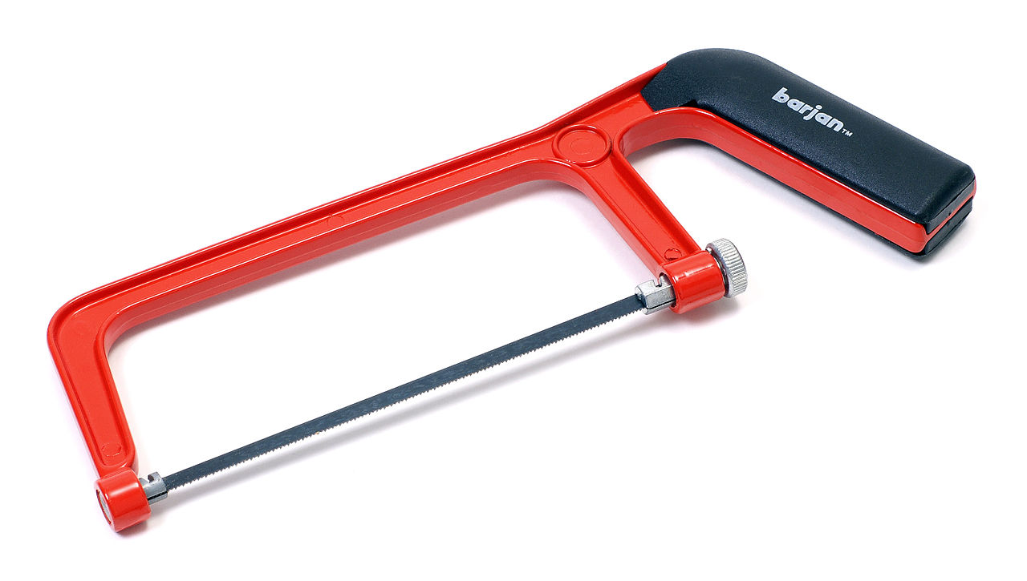
Basic Hand Tools
Hack Saw
Description:
A hacksaw is a fine-toothed saw, originally and mainly made for cutting metal. Most hacksaws are hand saws with a C-shaped frame that holds a blade under tension.
Video demonstration:
Notes:
Image source: Evan Amos / Public Domain (via Wikipedia)
Create video demonstration showing how to use the tool

Slide 23
Basic Hand Tools
Utility Knife (Retractable)
Description:
A utility knife is a knife used for general or utility purposes. The utility knife was originally a fixed blade knife with a cutting edge suitable for general work such as cutting hides and cordage, scraping hides, butchering animals, cleaning fish, and other tasks. Craft knives are tools mostly used for crafts. Today, the term "utility knife" also includes small folding or retractable-blade knives suited for use in the general workplace or in the construction industry. (Wikipedia)
Video demonstration:
https://youtu.be/2m0ZxP62TSc
unknown/ Public Domain (via Wikimedia)

Slide 24
Basic Hand Tools
Wire Strippers
Description:
A wire stripper is a small, hand-held device used to strip the electrical insulation from electric wires. (Wikipedia)
Video demonstration:
Windell Oskay / CC BY (via Flickr)
Notes:
Notes:
1. Create video demonstration showing how to use the tool

Slide 25
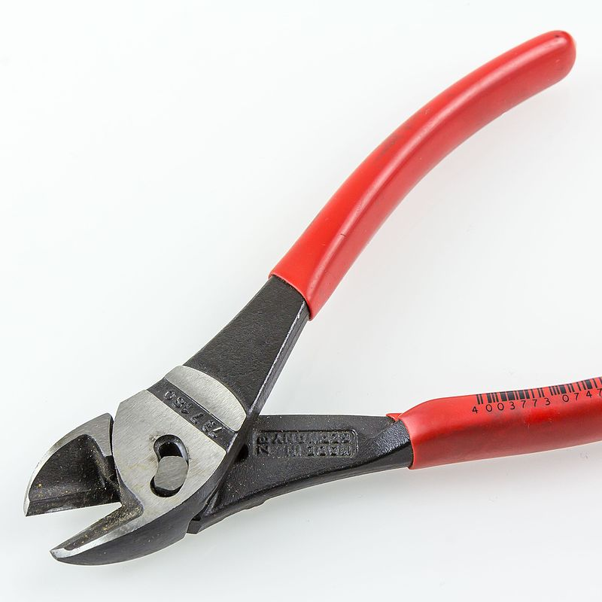
Basic Hand Tools
Side Cutters (Wire Cutting Tool)
Description:
A hand tool resembling pliers, intended for cutting wires using a ‘pinching’ action to cut wires.
Video demonstration:
Raimond Spekking / CC BY-SA 4.0 (via Wikimedia Commons)
Notes:
1. Create video demonstration showing how to use the tool

Slide 26
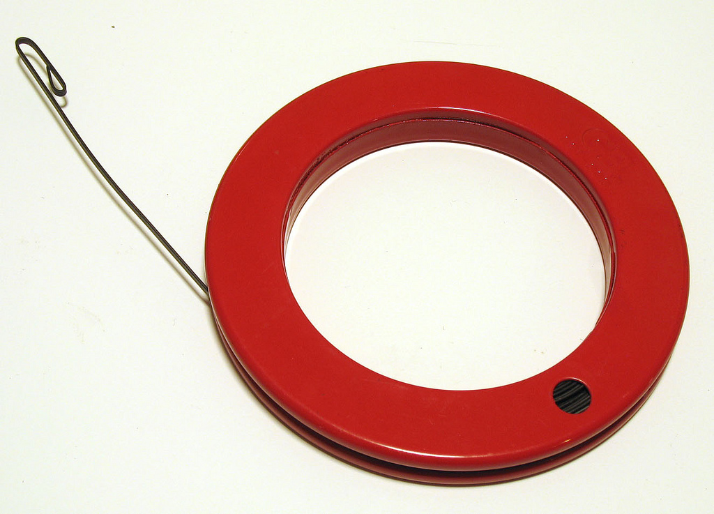
Basic Hand Tools
Fish Tape
Description:
A fish tape (also known as a draw wire or draw tape) is a tool used by electricians to route new wiring through walls and electrical conduit. (Wikipedia)
Video demonstration:
Lucius Kwok / CC BY-SA 2.0 (via Wikimedia Commons)
Notes:
1. Create video demonstration showing how to use the tool

Slide 27
Basic Hand Tools
Screw Driver (Flat Blade)
Description:
A screwdriver is a tool, manual or powered, for screwing and unscrewing (inserting and removing) screws. A typical simple screwdriver has a handle and a shaft, ending in a tip the user puts into the screw head before turning the handle. The shaft is usually made of tough steel to resist bending or twisting. The tip may be hardened to resist wear, treated with a dark tip coating for improved visual contrast between tip and screw—or ridged or treated for additional 'grip'. Handles are typically wood, metal, or plastic and usually hexagonal, square, or oval in cross-section to improve grip and prevent the tool from rolling when set down. (Wikipedia)
Video demonstration:
https://youtu.be/tE-pojHecvE
unknown/ Public Domain (via Wikimedia)
Notes:
1. Create video demonstration showing how to use the tool

Slide 28
Basic Hand Tools
Tin Snips
Tin snips are either straight or curved blades
The straight type being used for cutting a straight lines
The curved type for cutting curved edges
Video demonstration:
NOTE: Always protect the blades from corrosion by applying a thin layer of oil especially to the cutting edge. Do not use tin snips for cutting wires or other material beyond their capacity
Notes:
. Create video demonstration showing how to use the tool

Slide 29
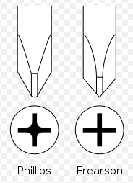
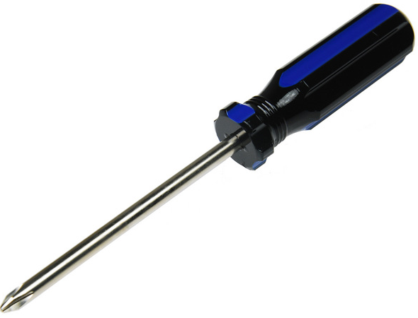
Basic Hand Tools
Screw Driver (Phillips)
Description:
Phillips screwdrivers come in several standard sizes, ranging from tiny ‘jeweler's’ to those used for automobile frame assembly—or #000 to #4 respectively. This size number is usually stamped onto the shank (shaft) or handle for identification. Each bit size fits a range of screw sizes, more or less well. Each Phillips screwdriver size also has a related shank diameter. The driver has a 57° point and tapered, unsharp (rounded) flutes. The #1 and smaller bits come to a blunt point, but the #2 and above have no point, but rather a nearly squared-off tip, making each size incompatible with the other. (Wikipedia)
Video demonstration:
https://youtu.be/PoN_2UVxHkU
unknown/ Public Domain (via Wikimedia)

Slide 30

Basic Hand Tools
Hammer
Description:
A hammer is a tool that delivers a blow to an object. Most hammers are hand tools used to drive nails, fit parts, forge metal, and break apart objects. (Wikipedia)
Video demonstration:
Evan Amos / Public Domain (via Wikipedia)
Notes:
. Create video demonstration showing how to use the tool

Slide 31
Basic Hand Tools
Wrenches
Description:
Video demonstration:
Notes:
Create image showing various types of wrenches
Create video demonstration showing how to use the tool

Slide 32
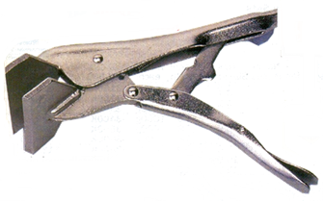
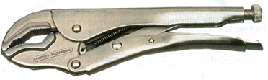
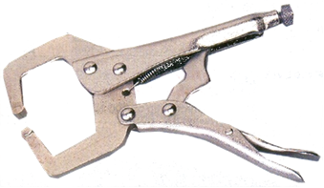
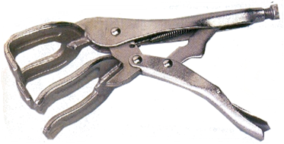
Basic Hand Tools
Vice Grips
Description:
Video demonstration:
Vice Grip
Flat Welding Grip
Welding Grip
C-Clamp Pliers
Notes:
Create video demonstration showing how to use the tool

Slide 33
Basic Hand Tools
Rubber Mallet
Description:
A mallet is a kind of hammer, often made of rubber or sometimes wood, that is smaller than a maul or beetle, and usually has a relatively large head. The term is descriptive of the overall size and proportions of the tool, and not the materials it may be made of, though most mallets have striking faces that are softer than steel. (Wikipedia)
Video demonstration:
https://youtu.be/EobT_J2NB5E
Notes:
Photo full copyright
Video: Standard YouTube License: Start at 2:22

Slide 34
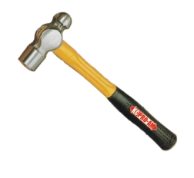
Basic Hand Tools
Ball Peen Hammer
Description:
Though the process of peening (surface hardening by impact) has become rarer in metal fabrication, the ball-peen hammer remains useful for many tasks, such as striking punches and chisels (usually performed with the flat face of the hammer). The peening face is useful for rounding off edges of metal pins and fasteners, such as rivets. The ball face of the hammer can also be used to make gaskets for mating surfaces. A suitable gasket material is held over the surface where a corresponding gasket is desired, and the operator will lightly tap around the edges of the mating surface to perforate the gasket material. (Wikipedia)
Video demonstration:
https://youtu.be/uSf_TKmSyas
Notes:
Photo full copyright
Video: Standard YouTube License: Start at 2:22

Slide 35
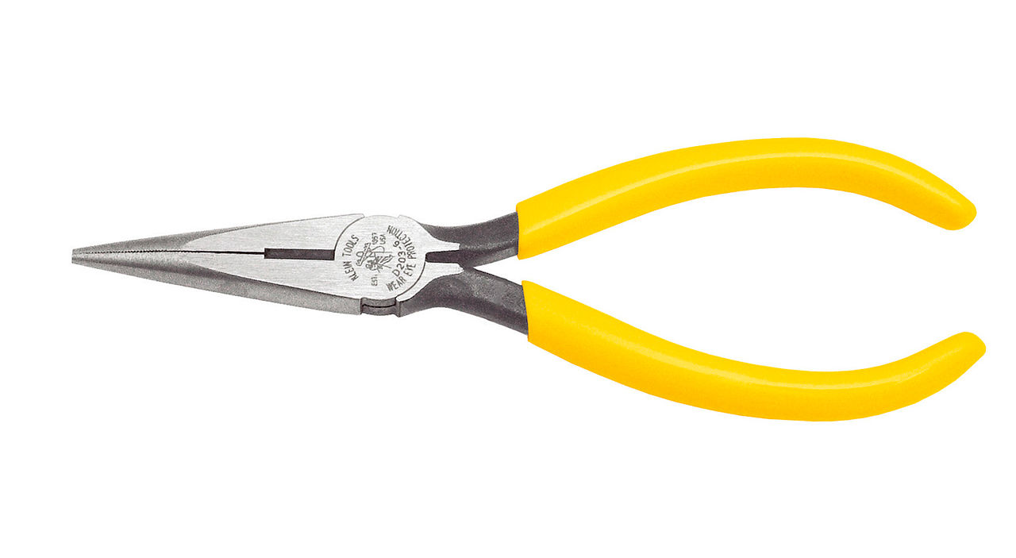
Basic Hand Tools
Needle Nose Pliers
Description:
Needle-nose pliers (also known as pointy-nose pliers, long-nose pliers, pinch-nose pliers or snipe-nose pliers) are both cutting and holding pliers used by artisans, jewellery designers, electricians, network engineers and other tradesmen to bend, re-position and snip wire. (Wikipedia)
Video demonstration:
https://youtu.be/gEu6SDltCqI
User 2000 – CC BY SA on Wikipedia
Notes:
Photo CC BY SA on Wikipedia
Video: Standard YouTube License

Slide 36
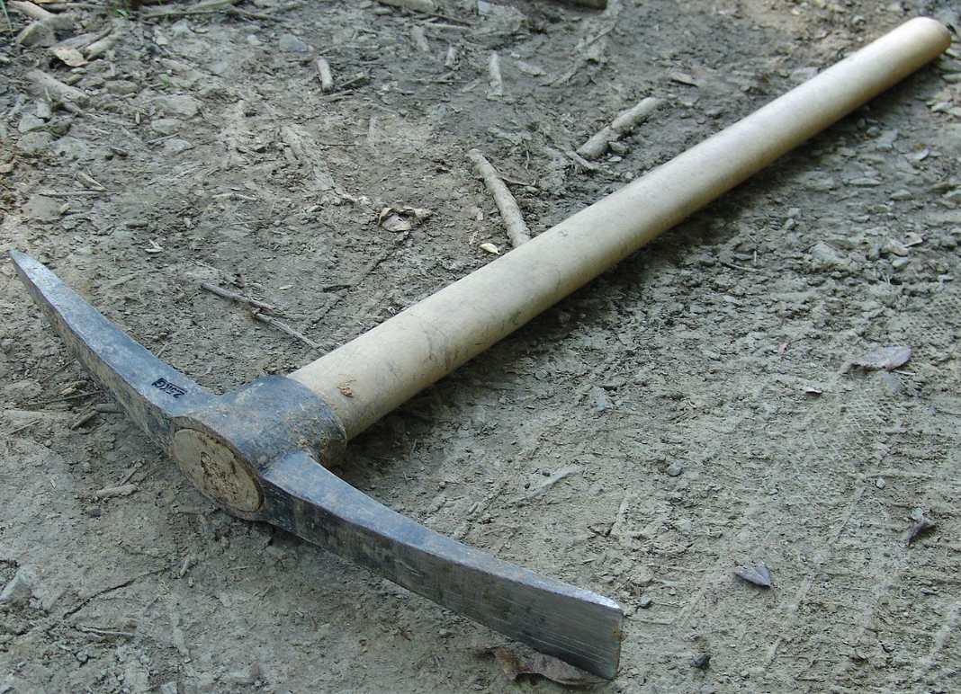
Basic Hand Tools
Pick Axe
Description:
pickaxe, pick-axe, or pick is a hand tool with a hard head attached perpendicular to the handle.
The head is usually made of metal, and the handle is most commonly wood, metal or fiberglass. The head is a spike ending in a sharp point, may curve slightly, and often has a counter-weight to improve ease of use. The stronger the spike, the more effectively the tool can pierce the surface. Rocking the embedded spike about and removing it can then break up the surface.
The counterweight nowadays is nearly always a second spike, often with a flat end for prying. (Wikipedia)
Video demonstration:
https://youtu.be/O3YaitjDrI0
Hyena/ Public Domain (via Wikimedia)

Slide 37
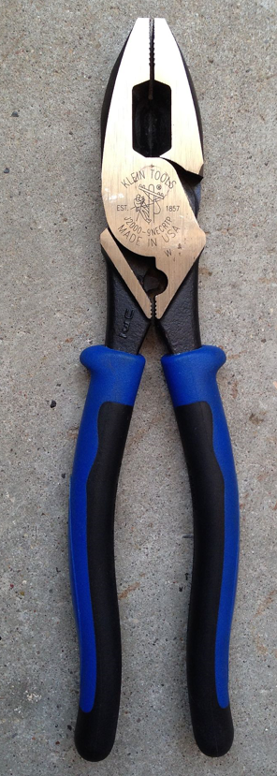
Basic Hand Tools
Pliers
Description:
The basic design of pliers has changed little since their origins, with the pair of handles, the pivot (often formed by a rivet), and the head section with the gripping jaws or cutting edges forming the three elements.
The materials used to make pliers consist mainly of steel alloys with additives such as vanadium or chromium, to improve strength and prevent corrosion. The metal handles of pliers are often fitted with grips of other materials to ensure better handling; grips are usually insulated and additionally protect against electric shock. The jaws vary widely in size, from delicate needle-nose pliers to heavy jaws capable of exerting much pressure, and shape, from basic flat jaws to various specialized and often asymmetrical jaw configurations for specific manipulations. The surfaces are typically textured rather than smooth, to minimize slipping. (Wikipedia)
Video demonstration:
https://youtu.be/MIWvbLjEHMo
Typhoon/ CC BY SA (via Wikimedia)

Slide 38
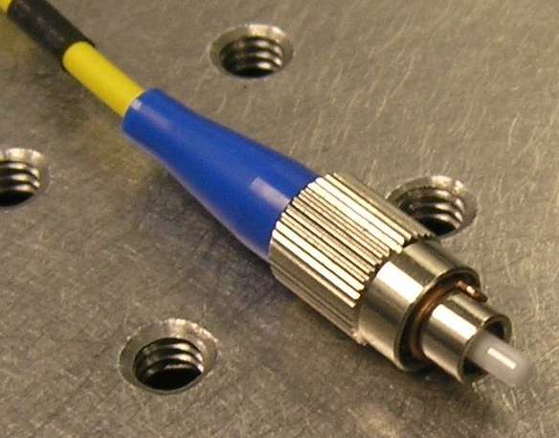
Basic Hand Tools
Ferrules (FC Connectors)
Description:
The FC connector is a fiber-optic connector with a threaded body, which was designed for use in high-vibration environments. It is commonly used with both single-mode optical fiber and polarization-maintaining optical fiber. FC connectors are used in datacom, telecommunications, measurement equipment, and single-mode lasers. They are becoming less common, displaced by SC and LC connectors. The FC connector was originally called a "Field Assembly Connector" by its inventors. The name "FC" is an acronym for "ferrule connector" or "fiber channel". (Wikipedia)
Video demonstration:
https://www.youtube.com/watch?v=os66cID30Ek
Srleffler/ Public Domain (via Wikipedia)

Slide 39
Basic Hand Tools
Screw Driver (Flat Blade)
Description:
A screwdriver is a tool, manual or powered, for screwing and unscrewing (inserting and removing) screws. A typical simple screwdriver has a handle and a shaft, ending in a tip the user puts into the screw head before turning the handle. The shaft is usually made of tough steel to resist bending or twisting. The tip may be hardened to resist wear, treated with a dark tip coating for improved visual contrast between tip and screw—or ridged or treated for additional 'grip'. Handles are typically wood, metal, or plastic and usually hexagonal, square, or oval in cross-section to improve grip and prevent the tool from rolling when set down. (Wikipedia)
Video demonstration:
https://youtu.be/tE-pojHecvE
unknown/ Public Domain (via Wikimedia)

Slide 40
Basic Hand Tools
Screw Driver (Phillips)
Description:
Phillips screwdrivers come in several standard sizes, ranging from tiny ‘jeweler's’ to those used for automobile frame assembly—or #000 to #4 respectively. This size number is usually stamped onto the shank (shaft) or handle for identification. Each bit size fits a range of screw sizes, more or less well. Each Phillips screwdriver size also has a related shank diameter. The driver has a 57° point and tapered, unsharp (rounded) flutes. The #1 and smaller bits come to a blunt point, but the #2 and above have no point, but rather a nearly squared-off tip, making each size incompatible with the other. (Wikipedia)
Video demonstration:
https://youtu.be/PoN_2UVxHkU
unknown/ Public Domain (via Wikimedia)

Slide 41
Basic Hand Tools - Side Cutters (Wire Cutting Tool)
Description:
A hand tool resembling pliers, intended for cutting wires using a ‘pinching’ action to cut wires.
Video demonstration:
Raimond Spekking / CC BY-SA 4.0 (via Wikimedia Commons)

Slide 42
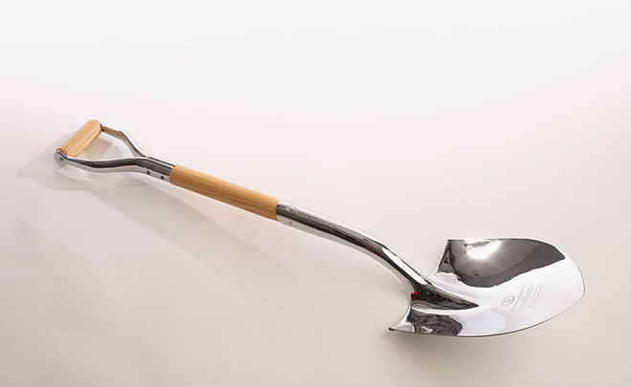
Basic Hand Tools
Spade
Description:
A spade is a tool primarily for digging, comprising a blade – typically narrower and less curved than that of a shovel – and a long handle. Early spades were made of riven wood or of animal bones (often shoulder blades). After the art of metalworking was developed, spades were made with sharper tips of metal. Before the introduction of metal spades manual labour was less efficient at moving earth, with picks being required to break up the soil in addition to a spade for moving the dirt. With a metal tip, a spade can both break and move the earth in most situations, increasing efficiency. (Wikipedia)
Video demonstration:
https://youtu.be/0AiQPWL3epE
CIA/ Public Domain (via Wikimedia)

Slide 43
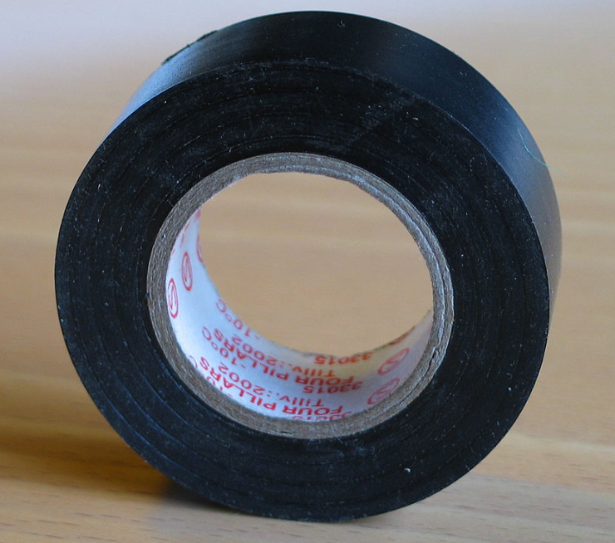
Materials
Insulation Tape
Description:
Electrical tape (or insulating tape) is a type of pressure-sensitive tape used to insulate electrical wires and other materials that conduct electricity. It can be made of many plastics, but vinyl is most popular, as it stretches well and gives an effective and long lasting insulation. (Wikipedia)
Video demonstration:
https://youtu.be/tEs2_SUYQoE
Jonas Bergsten/ Public Domain (via Wikimedia)

Slide 44
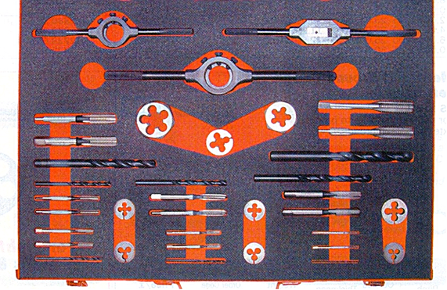
STOCKS AND DIES
Dies are used for external threads
Dies are very slightly adjustable
There is a nut, which is used to clean threads
Or fix damaged threads and must not be used to cut new threads

Slide 45


Appendix
ICONS REQUIRED
ICON REQUIRED | ICON PURPOSE | Example:
Outcomes | Icon to represent Learning Outcomes
Extra Information | Icon to represent Additional Information
Instruction | Icon/ Or actual person to represent an Instruction (something learner needs to do)
Tip | Icon to represent a hint or tip
Glossary | Icon to represent Glossary Page
Reflection | Icon to represent Reflection/ Stop and Think
Notes:
Icons to be re-created and used across all UNITS as required. These are examples only.

