Slide 1
Electrical Principles
Topic 4: Solving AC Electrical Circuits

Slide 2
Assumed prior learning
05_01_00
05_01_02
05_02_01
05_03_01
05_04_01
Notes:
Note for navigation on site:
This information needs to be taken into account and needs to stated on the LMS, perhaps as part of the introduction?

Slide 3
Outcomes
By the end of this unit the learner will be able to:
Explain what the resonant frequency of a series RLC circuit is
Describe the conditions present in a resonant or tuned series RLC circuit
Calculate the resonant frequency for a series RLC circuit
Calculate the capacitance or inductance necessary to achieve resonance in a series RLC circuit.

Slide 4
Unit 4.7: Resonance in Series RLC Circuits

Slide 5
Introduction
We learnt in the previous unit that if X_{L} < X_{C}, the RLC circuit will behave inductively and if X_{C} > X_{L} it will behave capacitively.
But what happens when X_{L} = X_{C}? This is the question we will explore in this unit.
X_{L} = X_{C}

Slide 6
Summary of RL and RC circuits
Before going further, let’s revise some of what we know about series RLC circuits.
X_{L} > X_{C}
X_{C} > X_{L}
$$V_{T}=\sqrt{{V_{R}}^{2}+{{(V_{L}−V}_{C})}^{2}}$$
$$V_{T}=\sqrt{{V_{R}}^{2}+{{(V_{C}−V}_{L})}^{2}}$$
$$Z=\sqrt{R^{2}+{{(X_{L}−X}_{C})}^{2}}$$
$$Z=\sqrt{R^{2}+{{(X_{C}−X}_{L})}^{2}}$$

Slide 7
What is resonance?
Let’s do an investigation to work out what happens in a circuit when X_{L} = X_{C}.
Download and work through the worksheet. Then watch the video to make sure you completed everything correctly.
Vid01
Download the worksheet
Notes:
Download the worksheet = on click, open Doc01. See appendix for brief
Img01 = EveryCircuit logo
Vid01 = on click, play Vid01 full screen. See appendix for brief

Slide 8
The resonant frequency
Every series RLC circuit will have a specific frequency at which X_{L} = X_{C}. This is called the resonant frequency of the circuit and is give the symbol f_{r}.
Vid02
Watch the video to learn more.
Notes:
Vid02 = on click, play Vid02 full screen. See appendix for brief

Slide 9
Resonant frequency summary
The following things happen at the resonant frequency:
Click on each point.
The inductive reactance (X_{L}) and the capacitive reactance (X_{C}) cancel each other out.
1
All the opposition to current flow is resistive i.e. Z = R.
2
Because impedance is a minimum, current is at a maximum.
3
V_{L} = V_{X} are equal but opposite so cancel each other out.
4
The full supply voltage is dropped over the resistor i.e. V_{T} = V_{R}.
5
Notes:
On click of each number, reveal the whole point.

Slide 10
Resonance for series RLC circuits?
We need a formula in order to calculate the resonant frequency in any series RLC circuit.
YT01
Watch the video to find out what this formula is and how we derive it.
Notes:
YT01 = on click, play YT01 full screen. YT01 = https://www.youtube.com/watch?v=jacrT6mISm0

Slide 11
Series RLC resonant circuits – example 1
Let’s put all our new knowledge to work with an example.
The circuit is represented is tuned. Calculate the value of the capacitor.
Note: A tuned circuit is one at resonance.
100V
Redraw the circuit on a blank piece of paper.
Notes:
Img02 = redraw circuit

Slide 12
Series RLC resonant circuits – method 1
The first method uses the fact that in a tuned circuit X_{L} = X_{C}.
Calculate the inductive reactance, X_{L}. Enter your answer to three decimal places.
100V
X_{L}
Ω
Check
Notes:
Img02
Fill in the blank question
Correct answer: 2764.691Ω
Feedback:
Correct – Well done. You got it!
Incorrect – That is not correct. X_{L} = 2πfL = 2π x 2x10⁶ x 220x10⁻⁶ = 2764.601

Slide 13
Series RLC resonant circuits – method 1
But we know that XL = XC. So
$$X_{C}=\frac{1}{2πfC}=X_{L}=2764.601$$
Rearrange the equation and solve for C, the capacitance of the capacitor. Enter your answer to three decimal places
100V
C
pF
Check
Notes:
Img02
Fill in the blank question
Correct answer: 28.784pF
Feedback:
Correct – Well done. You got it!
Incorrect – That is not correct. We know that $X_{C}=\frac{1}{2πfC}=X_{L}∴C=\frac{1}{2πfX_{L}}=\frac{1}{2π×2×{10}^{6}×2764.601}=0.000000000028784=28.784×{10}^{−12}=28.784pF$

Slide 14
Series RLC resonant circuits – method 2
The second method uses the resonant frequency formula.
$$f_{r}=\frac{1}{2π\sqrt{LC}}$$
Rearrange the equation and solve for C, the capacitance of the capacitor. Enter your answer to three decimal places.
100V
C
pF
Check
Notes:
Img02
Fill in the blank question
Correct answer: 28.784pF
Feedback:
Correct – Well done. You got it!
Incorrect – That is not correct. $f_{r}=\frac{1}{2π\sqrt{LC}}∴\frac{1}{\sqrt{LC}}=2πf_{r}∴\frac{1}{LC}={(2πf_{r})}^{2}∴\frac{1}{C}={(2πf_{r})}^{2}$L $∴C=\frac{1}{{(2πf_{r})}^{2}\text{L}}=28.784pF$. If you had problems doing this calculation on your calculator, be sure to watch the full worked solution video.

Slide 15
Solving series RLC circuits - solution
Watch the video to see the full worked solution for this question.
You can also have a look at a simulation of the circuit.
Full worked solution
100V
Notes:
Img02
Full worked solution = on click, open Vid04 full screen. See appendix for brief.

Slide 16
Tuned circuits can store energy
There is one property of tuned circuits we have not yet touched on. That is their ability to store energy.
Img03
Click on the image to open it full screen to learn how this energy is stored.
Notes:
Img03 = on click, open the first frame of the image series full screen. See appendix for brief.

Slide 17
The basic tuning circuit
One of the many practical uses of resonance is in radio tuning circuits. Here an inductor and variable capacitor are connected in series. When we tune a radio, the LC circuit is set at resonance for a particular radio frequency.
Basic tuning circuits use a variable capacitor to tune into different frequencies.
Vid04
Watch the video to see how this works in more detail.
Notes:
Vid04 = on click, play Vid04 full screen. See appendix for brief

Slide 18
Series RLC resonant circuits – example 2
Calculate the:
Inductive reactance;
Capacitive reactance;
Impedance
Supply current
Voltage across the inductor coil.
Here is another resonance circuit example to try.
A 10μF capacitor is connected in series with a 20mH inductor that also has a resistance of 500Ω. The circuit is supplied with 50V at 10kHz.
Start by drawing and labelling the circuit on a piece of paper.
Represent the resistance of the inductor as a resistor.

Slide 19
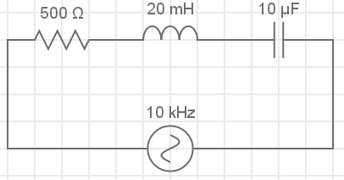
Series RLC resonant circuits – step 1
This is what your circuit diagram should have looked like.
Correct your diagram if you need to.
C =
I_{L}
I_{C}
V_{L}
V_{C}
I_{T}
V_{T} = 50V
Notes:
Img04 – redraw circuit

Slide 20
Series RLC resonant circuits – step 2
Now we can start answering the questions.
C =
I_{L}
I_{C}
Calculate the inductive reactance, X_{L}. Enter your answer to three decimal places.
V_{L}
V_{C}
I_{T}
V_{T} = 50V
X_{L}
Ω
Check
Notes:
Img04
Fill in the blank question
Correct answer: 1256.637Ω
Feedback:
Correct – Well done. You got it!
Incorrect – That is not correct. X_{L} = 2πfL = 2π x 10x10³ x 20x10⁻³ = 1256.637Ω

Slide 21
Series RLC resonant circuits – step 2
Calculate the capacitive reactance, X_{C}. Enter your answer to three decimal places.
C =
I_{L}
I_{C}
V_{L}
V_{C}
I_{T}
V_{T} = 50V
X_{C}
Ω
Check
Notes:
Img04
Fill in the blank question
Correct answer: 1.592Ω
Feedback:
Correct – Well done. You got it!
Incorrect – That is not correct. We know that $X_{C}=\frac{1}{2πfC}=\frac{1}{2π×2×{10}^{3}×{10}^{−6}}=1.592Ω$

Slide 22
Series RLC resonant circuits – step 2
Calculate the impedance, Z. Enter your answer to three decimal places.
C =
I_{L}
I_{C}
V_{L}
V_{C}
I_{T}
V_{T} = 50V
X_{C}
Ω
Check
Notes:
Img04
Fill in the blank question
Correct answer: 1350.977Ω
Feedback:
Correct – Well done. You got it!
Incorrect – That is not correct. $Z=\sqrt{R^{2}+{(X_{L}−X_{C})}^{2}}=\sqrt{{500}^{2}+{(1256.637−1.592)}^{2}}=130.977Ω$

Slide 23
Series RLC resonant circuits – step 2
Calculate the supply current, I_{T}. Enter your answer to three decimal places.
C =
I_{L}
I_{C}
V_{L}
V_{C}
I_{T}
V_{T} = 50V
I_{T}
mA
Check
Notes:
Img04
Fill in the blank question
Correct answer: 37mA
Feedback:
Correct – Well done. You got it!
Incorrect – That is not correct. $I_{T}=\frac{V_{T}}{Z}=\frac{50}{1350.977}=0.037A=37mA$

Slide 24
Series RLC resonant circuits – step 2
Calculate the voltage across the coil, V_{coil}. Enter your answer to three decimal places.
C =
I_{L}
I_{C}
V_{L}
V_{C}
I_{T}
V_{T} = 50V
V_{coil}
V
Check
Notes:
Img04
Fill in the blank question
Correct answer: 37mA
Feedback:
Correct – Well done. You got it!
Incorrect – That is not correct. The voltage across the inductor coil needs to take account of the voltage drop due to its inductance and resistance i.e V_{coil} = V_{R} + V_{L}. Remember that these are vectors separated by 90 therefore $V_{coil}=\sqrt{{V_{R}}^{2}+{V_{L}}^{2}}$. V_{R} = I_{T} x R = 0.037 x 500 = 18.5V. V_{L} = I_{T} x X_{L} = 0.037 x 1256.637 = 46.496V. Therefore, $V_{coil}=\sqrt{{18.5}^{2}+{46.496}^{2}}=50.041V$

Slide 25
Document Briefing – Doc01 (1 of 3)
Create an annotated PDF worksheet with the following steps.
Make sure you have downloaded the EveryCircuit App from your app store.
If you are working on a computer, visit http://everycircuit.com/app/.
Open the EveryCircuit app and signup. After your trial, you will still have access to EveryCircuit and other people’s circuits. You will just not be able to create your own circuits.
Go to the community space and search for the circuit called “NOC_Resonance”
Open the circuit.
This circuit has an AC power supply with a frequency of 650Hz (or 650 cycles per second) and a peak voltage of 9V. It also has a 30Ω resistor and a 20mH inductor and 2μF capacitor.
Start by making a copy of the following table on a piece of paper.

Slide 26
Document Briefing – Doc01 (2 of 3)
f | 650Hz | 700Hz | 750Hz | 800Hz | 850Hz | 900Hz | 950Hz
I
X_{L}
X_{C}
Z

Slide 27
Document Briefing – Doc01 (3 of 3)
With the supply frequency at 650Hz, click on the ammeter and write down the value of the circuit current. Also calculate X_{L}, X_{C} and Z.
Now click on the supply and then on the spanner icon. Select Frequency and change it to 700Hz. Write down the values of the circuit current, X_{L}, X_{C} and Z. Note: you may need to give the simulation time to settle on a current value.
Complete the table.
At what frequency is a maximum current reached? What is the total impedance in the circuit when the current is a maximum? What is the relationship between the total impedance and the value of R when the current is a maximum?
What can you say about the values of X_{L} and X_{C} when the current is a maximum?
What are the values for V_{L} and V_{C} when the current is a maximum? Click on the respective voltmeters to find out.
On the same set of axes, draw graphs of X_{L} vs f and X_{C} vs f.
How does this graph relate to the frequency you found at which the current is a maximum?

Slide 28
Video Briefing – Vid01 (1 of 2)
Create a screencast video presented by an expert presenter. The presenter needs to work through the Doc01 worksheet and cover and explain the following steps.
Opening the app and opening the circuit for mobile and desktop
Complete the table showing how to do at least 1 column’s changes and calculations (see next slide)
Show that max current happens at 800Hz. At this frequency XL = XC but because they are in opposite directions (show a phasor diagram) they cancel each other out.
Explain that the total reactance is thus zero and Z = R. Because impedance is at a minimum, current is at a maximum.
All of this only happens when the frequency is 800Hz.
Show the graphs of X_{L} and X_{C} vs f (see https://www.desmos.com/calculator/cycwnsry8k) and pinpoint where they cross – this frequency is called the resonant frequency (f_{r} )– that frequency where the inductive and capacitive reactances are equal and opposite.

Slide 29
Video Briefing – Vid01 (2 of 2)
f | 650Hz | 700Hz | 750Hz | 800Hz | 850Hz | 900Hz | 950Hz
I | 175mA | 225mA | 276mA | 299mA | 276mA | 234mA | 195mA
X_{L} | 81.681Ω | 87.965Ω | 94.248Ω | 100.531Ω | 106.814Ω | 113.097Ω | 119.381Ω
X_{C} | 124.291Ω | 115.413Ω | 107.719Ω | 100.987Ω | 95.046Ω | 89.766Ω | 85.041Ω
Z | 52.111Ω | 40.662Ω | 32.886Ω | 30.000Ω | 32.226Ω | 38.004Ω | 45.599Ω

Slide 30
Video Briefing – Vid02 (1 of 4)
Create a screencast video presented by an expert presenter explaining resonant frequency with the use of the graphics on the next slides:
We know that inductive reactance is proportional to frequency and so the graph of X_{L} vs f looks like this (Img02).
We can also plot capacitive reactance vs frequency. Because X_{C} is inversely proportional to f, the graph looks like this (Img03).
If we combine these graphs we get one that looks like this – it plots reactance vs frequency for both XL and XC (Img04).
There is a point at which these graphs cross – there is a frequency that makes X_{L} = X_{C}.
This specific frequency is called the resonant frequency f_{r}
At frequencies less than fr, we can see that XC > XL and the circuit will behave capacitively.
At frequencies greater than fr, we can see that XL > XC and the circuit will behave inductively.

Slide 31
Video Briefing – Vid02 (2 of 4)
At fr we know that X_{L} = X_{C}, but because they are equal and opposite they cancel each other out.
Open https://www.desmos.com/calculator/2qtekovc0a
Here is a simple resonant frequency simulation
The purple graph is capacitive reactance
The green graph is inductive reactance
We can change the values of L and C and we can see that this changes the shape of each graph.
But there is always a point where they cross. This is fr.
On the side we have the phasor diagram. As we increase f from zero, we can see that X_{C} is larger than X_{L} and that the circuit is capacitive. The overall voltage lags the current.
But as we get closer and closer to fr so X_{C} and X_{L} approach the same value until at fr they are equal (but opposite) and cancel each other out. The voltage is in phase with the current and the circuit behaves resistively. In other words there is no reactance and all the impedance is due to resistance i.e. Z = R. At this point Z is at a minimum, therefore I is at a maximum.

Slide 32
Video Briefing – Vid02 (3 of 4)
Also at fr, and V_{L} = V_{C}. Remember the voltage drop across these components is in proportion to their reactances so if X_{L} = X_{C} , then V_{L} = V_{C}. But because they are opposite, like reactance, they cancel each other out and all the supply voltage is dropped over the resistor i.e. V_{T} = V_{R}.
Past fr, X_{L} is bigger than X_{C} and the circuit will be inductive. Overall, voltage will lead current.
Notice that we can keep frequency the same and change the values of L or C to find resonance.

Slide 33
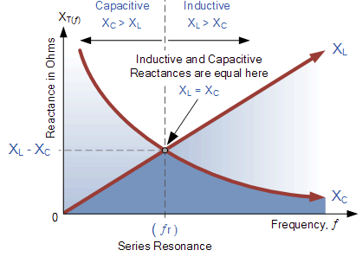
Video Briefing – Vid02 (4 of 4)
Notes:
Img02 (inductive reactance) = img11 from 01_04_03
Img03 (capacitive reactance) = img17 from 01_04_03
Img04 (combined graphs) = https://www.electronics-tutorials.ws/accircuits/acp204.gif – redraw

Slide 34
Video Briefing – Vid03 (1 of 3)
Create a screencast video presented by an expert presenter. The presenter needs to work through the question in example 1.
The circuit is represented is tuned. Calculate the value of the capacitor.
Note: A tuned circuit is one at resonance.
100V

Slide 35
Video Briefing – Vid03 (2 of 3)

Slide 36
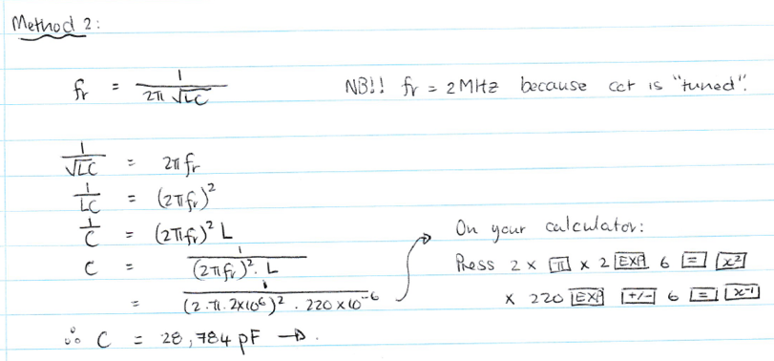
Video Briefing – Vid03 (3 of 3)

Slide 37
Video Briefing – Vid04 (1 of 1)
Create a screencast video presented by an expert presenter explaining the working of a basic tuning circuit using https://www.desmos.com/calculator/y6pljojunw. Set f = 360, L = 200, C = 1 and R = 200.
Explain the working of a basic tuning circuit.
If we want to tune into the frequency of 360, we need to increase the capacitance of the capacitor. As we do so, we change the shape of the capacitive reactance graph.
As we increase C, we eventually tune the circuit by making the X_{C} = X_{L} for the desired frequency. In this simulation, we had to make C = 260.
The same circuit could, in principle, be designed with a variable inductor but in practice simple tuning circuits use variable capacitors.
In these circuits, the inductor provides both the inductance and the resistance. Remember that an inductor is really just a piece of wire. It is this wire that offers resistance to the flow of current.

Slide 38
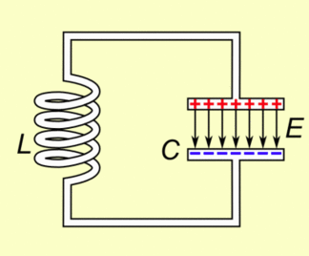
Image Briefing – Img03 (1 of 5)
Create a set of images with descriptive text as described, including the simple back/forward navigation.
Part A:
In a LC circuit, the capacitor stores energy in the electric field between its plates. The amount of energy depends on the voltage across it. The indictor stores energy in its magnetic field, depending on the current through it.
At some point, the capacitor will be full charged.
Next
Notes:
Animation screenshots from https://en.wikipedia.org/wiki/File:Tuned_circuit_animation_3.gif – marked for reuse.

Slide 39
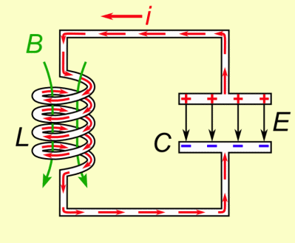
Image Briefing – Img03 (1 of 5)
Part B:
If an indictor is connected to the capacitor, current will start to flow through the inductor, building up a magnetic field.
Back
Next

Slide 40
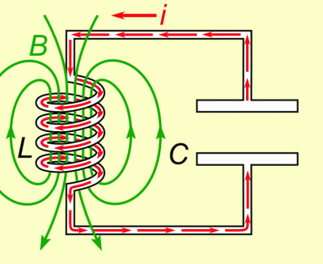
Image Briefing – Img03 (1 of 5)
Part C:
Current will flow until all the charge in the capacitor is gone and its voltage is zero.
Back
Next

Slide 41
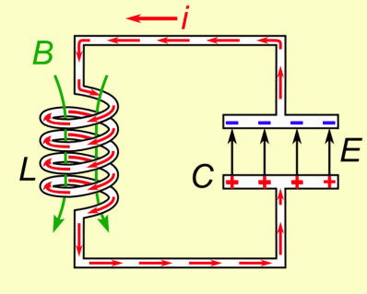
Image Briefing – Img03 (1 of 5)
Part D:
However, the current will continue flowing because an indictor resists changes in current. The current will begin to charge the capacitor with the opposite polarity to before.
Back
Next

Slide 42
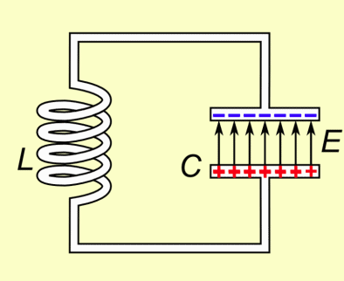
Image Briefing – Img03 (1 of 5)
Part E:
Current will continue to flow until the inductor magnetic field has completely collapsed and all the charge is again stored in the capacitor but with the opposite polarity. The cycle begins again.
Back
Next

Slide 43
Image Briefing – Img03 (1 of 5)
Part F:
Therefore, charge flows back and forth between the plates of the capacitor through the inductor. Energy would oscillate back and forth between the capacitor and the inductor for ever were it not for the internal resistance in the wires of the circuit.
However, if we connect the circuit to an external AC power supply at the same resonant frequency, we keep the oscillations going.
Back
Notes:
This part must have the full repeating animation as found at https://en.wikipedia.org/wiki/File:Tuned_circuit_animation_3.gif

