Slide 1
Electrical Principles
Topic 4: Solving AC Electrical Circuits

Slide 2
Assumed prior learning
05_01_00
05_01_02
05_02_01
05_03_01
05_04_01
Notes:
Note for navigation on site:
This information needs to be taken into account and needs to stated on the LMS, perhaps as part of the introduction?

Slide 3
Outcomes
By the end of this unit the learner will be able to:
Calculate resistance, inductive reactance, impedance, voltage, current, power, power factor and frequency in a series RLC circuit.
Construct a phasor diagram to represent the relationship between the voltage and current in a series RLC circuit.

Slide 4
Unit 4.6: Series RLC Circuits

Slide 5
Introduction
In the previous two units we have looked at RL and RC circuits. But what happens when we have resistors, inductors AND capacitors all together in the same circuit?
Well, in this unit, we will find out.
Notes:
Img01 = redraw circuit

Slide 6
Summary of RL and RC circuits
Let’s revise some of what we know about series RL and RC circuits.
Series RL Circuits
Series RC Circuits
$$I_{T}=I_{R}+I_{L}$$
$$I_{T}=I_{R}+I_{C}$$
$$V_{T}=\sqrt{{V_{R}}^{2}+{V_{L}}^{2}}$$
$$V_{T}=\sqrt{{V_{R}}^{2}+{V_{C}}^{2}}$$
$$Z=\sqrt{R^{2}+{X_{L}}^{2}}$$
$$Z=\sqrt{R^{2}+{X_{C}}^{2}}$$

Slide 7
RL + RC circuits = RLC circuits
But what happens when we put series RL and RC circuits together.
Click on each animation to watch it.
Waveforms
Phasor Diagrams
Vid01
Vid02
Notes:
Vid01 = on click, play Vid01 full screen. See appendix for brief.
Vid02 = on click, play Vid02 full screen. See appendix for brief.

Slide 8
The basics of solving series RLC circuits
We just saw that if V_{L} = V_{C} in a RLC circuit, they will cancel each other out and the circuit behaves as if it only has resistors i.e. where the voltage is in phase with the current.
But usually V_{L} and V_{C} are not the same and the voltage either leads or lags the current.
Vid03
Watch the video to see how to deal with RLC circuits where V_{L} and V_{C} are different.
Notes:
Img03 = Img01 + label
Img04 = redraw graphs

Slide 9
Series RLC circuits where X_{L} > X_{C}
When X_{L} > X_{C}, the circuit behaves inductively and, therefore overall, voltage LEADS current.
V_{L}
(X_{L})
$$V_{T}=\sqrt{{V_{R}}^{2}+{{(V_{L}−V}_{C})}^{2}}$$
V_{T}
(Z)
V_{L} – V_{C}
(X_{L} – X_{C})
θ
$$Z=\sqrt{R^{2}+{{(X_{L}−X}_{C})}^{2}}$$
I_{T}
V_{R}
(R)
V_{C}
(X_{C})
Phasor Diagram
Notes:
Img02 = Redraw the phasor diagram

Slide 10
Series RLC circuits where X_{C} > X_{L}
When X_{C} > X_{L}, the circuit behaves capacitively and, therefore overall, voltage LAGS current.
V_{L}
(X_{L})
$$V_{T}=\sqrt{{V_{R}}^{2}+{{(V_{C}−V}_{L})}^{2}}$$
V_{R}
(R)
θ
I_{T}
V_{C} – V_{L}
(X_{C} – X_{L})
V_{T}
(Z)
$$Z=\sqrt{R^{2}+{{(X_{C}−X}_{L})}^{2}}$$
V_{C}
(X_{C})
Phasor Diagram
Notes:
Img03 = Redraw the phasor diagram

Slide 11
The phase angles in series RLC circuits
There are many ways to calculate the phase angle (θ) in a series RLC circuit.
Click on each image to see a larger version.
Img04
Img05
Notes:
Img04 = on click, open Img04 in a popup. See appendix for brief
Img05 = on click, open Img05 in a popup. See appendix for brief

Slide 12
Which is which?
Here’s a good way to remember in which situation the voltage leads or lags the current.
In an inductive circuit (L)
V LEADS I
CIVIL
In a capacitive circuit (C)
I LEADS V
Notes:
Img06 = CIVIL plus borders, arrows and labels

Slide 13
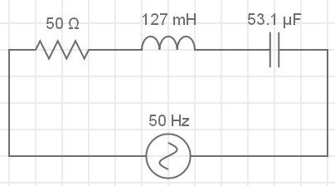
Solving series RLC circuits – example 1
Let’s put all our new knowledge to work with an example.
40Ω
60Ω
Calculate the:
Impedance;
Total current;
Inductance of the inductor;
Capacitance of the capacitor;
Phase angle; and
Draw the phasor diagram.
V_{T} = 230V
Redraw the circuit on a blank piece of paper.
Notes:
Img07 = redraw circuit

Slide 14
Solving series RLC circuits – step 1
Once you have drawn the basic circuit, you need to label it. When dealing with series RLC circuits, it is important that you label it correctly. This will help later on.
X_{L} = 40Ω
X_{C} = 60Ω
R =
I_{L}
I_{C}
I_{R}
V_{R}
V_{L}
V_{C}
I_{T}
V_{T} = 230V
Remember that this is still a series circuit so I_{T} = I_{R} = I_{L}=I_{C}
Notes:
Img08 = redraw circuit diagram

Slide 15
Solving series RLC circuits – step 2
Now we can start answering the questions.
X_{L} = 40Ω
X_{C} = 60Ω
R =
I_{L}
I_{C}
I_{R}
Calculate the total impedance in the circuit. Enter your answer to three decimal places.
V_{R}
V_{L}
V_{C}
I_{T}
V_{T} = 230V
Ω
Check
Notes:
Img08
Fill in the blank question
Correct answer: 53.852Ω
Feedback:
Correct – Well done. You got it!
Incorrect – That is not correct. We do not know the total circuit current yet so we cannot use $Z=\frac{V_{T}}{I_{T}}$ to calculate the total impedance. But we do know the resistance and reactance of the various components. We also know that XC > XL so we can calculate impedance as follows: $Z=\sqrt{R^{2}+{(X_{C}+X_{L})}^{2}}=\sqrt{{50}^{2}+{(60−40)}^{2}}=53.852Ω$

Slide 16
Solving series RLC circuits – step 2
Calculate the total circuit current. Enter your answer to three decimal places.
X_{C} = 60Ω
R =
X_{L} = 40Ω
I_{L}
I_{C}
I_{R}
V_{R}
V_{L}
V_{C}
I_{T}
I_{T}
A
V_{T} = 230V
Check
Notes:
Img08
Fill in the blank question
Correct answer: I_{T} = 4.523A
Feedback:
Correct – Well done. You got it!
Incorrect – That is not correct. We know the total voltage and the total impedance. Therefore we can calculate total current as $I_{T}=\frac{V_{T}}{Z}=\frac{230}{50.852}=4.523A$

Slide 17
Solving series RLC circuits – step 2
Calculate the inductance of the inductor. Enter your answer to 2 decimal place.
X_{L} = 40Ω
X_{C} = 60Ω
R =
I_{L}
I_{C}
I_{R}
V_{R}
V_{L}
V_{C}
I_{T}
V_{T} = 230V
L
mH
Check
Notes:
Img08
Fill in the blank question
Correct answer: L = 127.32mH
Feedback:
Correct – Well done. You got it!
Incorrect – That is not correct. We know that $X_{L}=2πfL∴L=\frac{X_{L}}{2πf}∴L=\frac{40}{2.π.50}=0.12732H=127.32mH$.

Slide 18
Solving series RLC circuits – step 2
Calculate the capacitance of the capacitor. Enter your answer to 1 decimal place
X_{L} = 40Ω
X_{C} = 60Ω
R =
I_{L}
I_{C}
I_{R}
V_{R}
V_{L}
V_{C}
I_{T}
V_{T} = 230V
C
μF
Check
Notes:
Img08
Fill in the blank question
Correct answer: C = 53.051μF
Feedback:
Correct – Well done. You got it!
Incorrect – That is not correct. We know that $X_{C}=\frac{1}{2πfC}∴2πfC=\frac{1}{X_{C}}∴C=\frac{1}{2πfX_{C}}=\frac{1}{2.π.50.60}=0.000053051F=53.051μF$. If you are struggling to do this calculation on your calculator, be sure to watch the full worked solution video at the end of this example.

Slide 19
Solving series RLC circuits – step 2
Calculate the phase angle. Enter your answer to three decimal places.
X_{L} = 40Ω
X_{C} = 60Ω
R =
I_{L}
I_{C}
I_{R}
V_{R}
V_{L}
V_{C}
I_{T}
V_{T} = 230V
θ
°
Check
Notes:
Img08
Fill in the blank question
Correct answer: θ = 21.802°
Feedback:
Correct – Well done. You got it!
Incorrect – That is not correct.$cosθ=\frac{R}{Z}=\frac{50}{53.852}$. Therefore θ = 21.802°

Slide 20
Solving series RLC circuits – step 2
Draw the phasor diagram for this circuit on a piece of paper then take a photo of it and upload it to your online portfolio.
Choose image
Upload
Notes:
Img09 = https://cdn.pixabay.com/photo/2016/01/03/00/43/upload-1118929_960_720.png – marked for reuse
Choose image = Launch file selection window
Upload = Upload file

Slide 21
Solving series RLC circuits - solution
Watch the video to see the full worked solution for this question.
You can also have a look at a simulation of the circuit.
X_{L} = 40Ω
X_{C} = 60Ω
R =
I_{L}
I_{C}
I_{R}
V_{R}
V_{L}
V_{C}
I_{T}
Full worked solution
V_{T} = 230V
Notes:
Img10
Full worked solution = on click, open Vid04 full screen. See appendix for brief.

Slide 22
Solving series RLC circuits – example 2
Calculate the:
Total voltage;
V_{C} if X_{C} = 3.979Ω;
V_{L};
Frequency of the supply;
Total impedance; and
Draw the phasor diagram
A series RLC circuit has a total current of 3.67A. It contains a resistor (75Ω), an inductor (50mH) and a capacitor (125μF). In the circuit X_{L} > X_{C}.
The true power is known to be 1.013kW with a phase angle of 52.161°.
Try the question on your own and then watch the full worked solution.
Full worked solution
Notes:
Img11 – redraw circuit
Full worked solution = on click, play Vid05 full screen. See appendix for brief
Circuit simulation = on click, open http://everycircuit.com/circuit/6134386931269632 in a new window

Slide 23
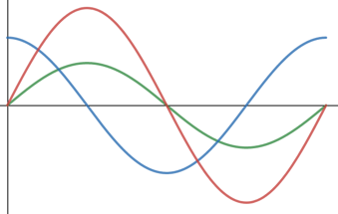
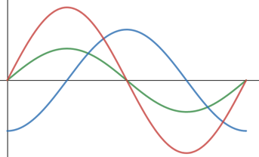
Video Briefing – Vid01 (1 of 2)
Create a 2 step animation showing the combining of the RL and RC waveforms into a single graph. On play, slide the 2 graphs towards each other to form the graph in the next slide.
Series RL Circuit
Series RC Circuit
V_{R}
V_{R}
I_{T}
I_{T}
V_{L}
V_{C}
In a series RL circuit, the voltage leads the current.
In a series RC circuit, the voltage lags the current.
Notes:
These 2 images are the same as Img04 in 01_04_03 and Img04 in 01_04_04
In the right hand RC diagram, make blue V_{C} line and label orange instead

Slide 24
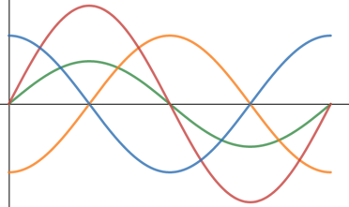
Video Briefing – Vid01 (2 of 2)
This is what the final graph must look like. Transition to the new heading and description. Also transition between the initial and final label positions.
Series RLC Circuit
I_{T}
V_{R}
V_{C}
V_{L}
Here V_{L} and V_{C} are out of phase by 180°. If they are the same magnitude, they will cancel each other out.

Slide 25
Video Briefing – Vid02 (1 of 2)
Create a 2 step animation showing the combining of the RL and RC phasors into a single diagram. On play, slide the 2 graphs towards each other to form the diagram in the next slide.
Series RL Circuit
Series RC Circuit
I_{T}
V_{R} 0°
V_{L} 90°
I_{T}
V_{R} 0°
V_{C} -90°
In a series RL circuit, the voltage leads the current.
In a series RC circuit, the voltage lags the current.
Notes:
These 2 images are based on Img05 in 01_04_03 and Img05 in 01_04_04
Note – use the same colours for each variable as in Vid01
In the right hand RC diagram, make blue V_{C} line and label orange instead

Slide 26
Video Briefing – Vid02 (2 of 2)
Series RLC Circuit
V_{L} 90°
This is what the final graph must look like. Transition to the new heading and description. Also transition between the initial and final label positions.
I_{T}
V_{R} 0°
V_{C} -90°
Here V_{L} and V_{C} are out of phase by 180°. If they are the same magnitude, they will cancel each other out.

Slide 27
Video Briefing – Vid03 (1 of 3)
Create a screencast video presented by an expert presenter explaining the following:
Start with a phasor where X_{L} > X_{C} (X_{L} = 4Ω, X_{C} = 1.5Ω, R = 6Ω). Let’s assume I_{T} = 2A.
Calculate V_{L}, V_{C}, V_{R}. Add the voltages to the phasor diagram.
In order to do the vector sum, we need to find the combination of V_{L} and V_{C}. They are acting in opposite directions so the result is just V_{L} – V_{C} or 8V - 3V. We always subtract the smaller vector from the larger one.
Draw the new phasor with (V_{L} - V_{C}) and do the vector sum graphically (1V = 1cm) and then algebraically.
Because the voltage drops across the inductor and capacitor are directly proportional to their reactances, we know that if X_{L} > X_{C} then V_{L} > V_{C} and the circuit will behave inductively. In this case, we do the normal vector sum but with the new resulting leading voltage of V_{L} - V_{C}

Slide 28
Video Briefing – Vid03 (2 of 3)
Now draw a phasor where X_{C} > X_{L} (X_{L} = 4Ω, X_{C} = 7.5Ω, R = 12Ω). Let’s assume I_{T} = 2A.
Calculate V_{L}, V_{C}, V_{R}. Add the voltages to the phasor diagram.
In order to do the vector sum, we need to find the combination of V_{L} and V_{C}. They are acting in opposite directions but now V_{C} > V_{L} so the result is V_{C} – V_{L} or 15V - 8V. Remember, we always subtract the smaller vector from the larger one.
Draw the new phasor with (V_{C} - V_{L}) and do the vector sum graphically (1V = 1cm) and then algebraically.
Because the voltage drops across the inductor and capacitor are directly proportional to their reactances, we know that if X_{C} > X_{L} then V_{C} > V_{L} and the circuit will behave capacitively. In this case, we do the normal vector sum but with the new resulting leading voltage of V_{C} - V_{L}

Slide 29
Video Briefing – Vid03 (3 of 3)
Now do the case where X_{C} = X_{L} (X_{L} = 5Ω, X_{C} = 5Ω, R = 12Ω). Let’s assume I_{T} = 2A.
Calculate V_{L}, V_{C}, V_{R}. Add the voltages to the phasor diagram.
Because V_{C} = V_{L} they cancel out and the voltage is in phase with the current
Draw the new phasor with (V_{C} = V_{L})
Because the voltage drops across the inductor and capacitor are directly proportional to their reactances, we know that if X_{C} = X_{L} then V_{C} = V_{L} and the circuit will behave resistively. In this case, we can ignore V_{C} / V_{L}.

Slide 30
Image Briefing – Img04
V_{L}
(X_{L})
$$cosθ=\frac{V_{R}}{V_{T}}$$
$$cosθ=\frac{R}{Z}$$
V_{T}
(Z)
V_{L} – V_{C}
(X_{L} – X_{C})
$$sinθ=\frac{V_{L}−V_{C}}{V_{T}}$$
$$sinθ=\frac{X_{L}−X_{C}}{Z}$$
θ
I_{T}
V_{R}
(R)
V_{C}
(X_{C})
$$tanθ=\frac{{V_{L}−V}_{C}}{V_{R}}$$
$$tanθ=\frac{X_{L}−X_{C}}{R}$$

Slide 31
Image Briefing – Img05
V_{L}
(X_{L})
V_{R}
(R)
$$cosθ=\frac{V_{R}}{V_{T}}$$
$$cosθ=\frac{R}{Z}$$
θ
I_{T}
V_{C} – V_{L}
(X_{C} – X_{L})
$$sinθ=\frac{V_{C}−V_{L}}{V_{T}}$$
$$sinθ=\frac{X_{C}−X_{L}}{Z}$$
V_{T}
(Z)
$$tanθ=\frac{{V_{C}−V}_{L}}{V_{R}}$$
$$tanθ=\frac{X_{C}−X_{L}}{R}$$
V_{C}
(X_{C})

Slide 32
Video Briefing – Vid04 (1 of 3)
Create a screencast video presented by an expert presenter. The presenter needs to work through the question in example 1.
Calculate the:
Impedance;
Total current;
Inductance of the inductor;
Capacitance of the capacitor;
Phase angle; and
Draw the phasor diagram.
X_{L} = 40Ω
X_{C} = 60Ω
R =
I_{L}
I_{C}
I_{R}
V_{R}
V_{L}
V_{C}
I_{T}
V_{T} = 230V

Slide 33
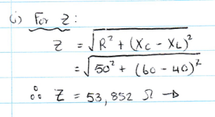
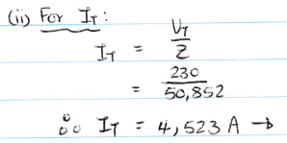
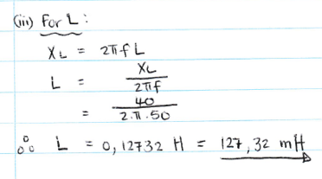
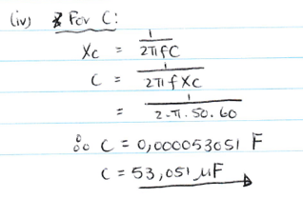
Video Briefing – Vid04 (2 of 3)

Slide 34
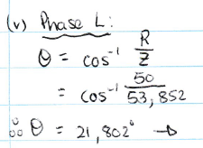
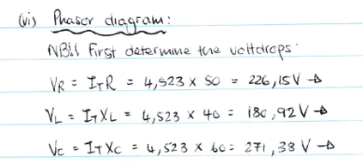
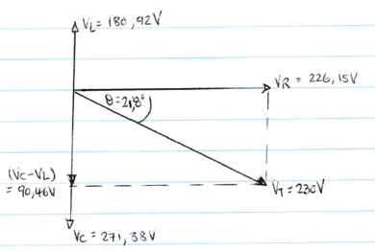
Video Briefing – Vid04 (3 of 3)

Slide 35
Video Briefing – Vid05 (1 of 5)
Create a screencast video presented by an expert presenter. The presenter needs to work through the question in example 2.
A series RLC circuit has a total current of 3.67A. It contains a resistor (75Ω), an inductor (50mH) and a capacitor (125μF). In the circuit X_{L} > X_{C}.
The true power is known to be 1.013kW with a phase angle of 52.161°.
Calculate the:
Total voltage;
V_{C} if X_{C} = 3.979Ω;
V_{L};
Frequency of the supply;
Total impedance; and
Draw the phasor diagram

Slide 36
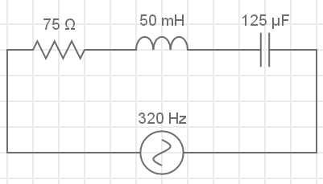
Video Briefing – Vid05 (2 of 5)
Start by drawing and labelling the circuit with what is known and unknown. Note that I_{T} = I_{R} = I_{C} = I_{L}
R =
L =
C =
I_{R}
I_{L}
I_{C}
V_{R}
V_{L}
V_{C}
I_{T} = 3.67A
V_{T}

Slide 37
Video Briefing – Vid05 (3 of 5)
Question 1:
P = VIcosθ; θ = 52.161° and I = 3.67A
V = P / Icosθ = 1013 / 3.67 x cos52.161 = 449.953V ≃ 450V
Question 2:
V_{C} = I_{T} x X_{C} where X_{C} = 3.979Ω
V_{C} = 3.67 x 3.979 = 14.603V
Question 3:
We do not know X_{L} and cannot calculate it without f, so we cannot use V_{L} = I_{T} x X_{L}. We know V_{R} = I_{T} x R = 3.67 x 75 = 275.25V
$V_{T}=\sqrt{{V_{R}}^{2}+{(V_{L}^{}−V_{C}^{})}^{2}}∴{V_{T}}^{2}=$ ${V_{R}}^{2}+{(V_{L}^{}−V_{C}^{})}^{2}$
$∴$ ${V_{T}}^{2}−$ ${V_{R}}^{2}=$ ${(V_{L}^{}−V_{C}^{})}^{2}$ $∴\sqrt{{V_{T}}^{2}− {V_{R}}^{2}}+$ $V_{C}^{}$= $V_{L}^{}∴$ $V_{L}^{}$= $\sqrt{{450}^{2}− {\text{275.25}}^{2}}+$14.603 =341.399V

Slide 38
Video Briefing – Vid05 (4 of 5)
Question 4:
We know that X_{C} = 3.979Ω and that C = 125μF so we can calculate f.
X_{C} = 1 / 2πfC
f = 1 / 2πX_{C}C = 1 / 2π x 3.979 x 125 x 10⁻⁶ = 320Hz
Question 5:
Z = V_{T} / I_{T} = 450 / 3.67 = 122.615Ω
OR
With f, we can calculate X_{L}.
X_{L} = 2πfL = 2π x 320 x 50 x 10⁻³ = 100.531Ω
Now we can calculate Z: $Z=\sqrt{R^{2}+{(X_{L}−X_{C})}^{2}=}\sqrt{{75}^{2}+{(100.531−3.979)}^{2}}=122.259Ω$ NOTE: slight difference in answers due to rounding errors.

Slide 39
Video Briefing – Vid05 (5 of 5)
Question 6:
V_{L} = 341.399Ω
V_{T} = 450V
V_{L} – V_{C} = 326.796V
52.161°
V_{T} = 275.25V
V_{C} = 14.603V

