Slide 1
Electrical Principles
Topic 4: Solving AC Electrical Circuits

Slide 2
Assumed prior learning
05_01_00
05_01_02
05_02_01
05_03_01
05_04_01
Notes:
Note for navigation on site:
This information needs to be taken into account and needs to stated on the LMS, perhaps as part of the introduction?

Slide 3
Outcomes
By the end of this unit the learner will be able to:
Calculate resistance, inductive reactance, impedance, voltage, current, power, power factor and frequency in a series RC circuit.
Construct a phasor diagram to represent the relationship between the voltage and current in a series RC circuit.

Slide 4
Unit 4.5: Series RC Circuits

Slide 5
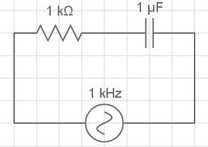
Introduction
In the previous unit we learnt how to work with AC circuits that had resistors and inductors in them.
In this unit, we are going to look at how circuits with resistors and capacitors in them behave.
Notes:
Img01 = redraw circuit

Slide 6
Series RC circuits
We know that series circuits have all the components connected end to end so that there is only one path for the current. Let’s investigate what happens when we have a resistor and a capacitor together in a series circuit.
Vid01
Download and work through the worksheet. Then watch the video to make sure you completed everything correctly.
Download the worksheet
Notes:
Download the worksheet = on click, open Doc01. See appendix for brief
Img02 = EveryCircuit logo
Vid01 = on click, play Vid01 full screen. See appendix for brief

Slide 7
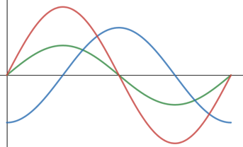
Series RC Circuits
In series AC circuits where there are resistors and capacitors, we need to take account of the fact that the voltage across the capacitor lags the current through the capacitor by 90° when doing calculations.
The voltage across and current through the resistor are in phase.
A series RC circuit
V_{R}
I_{T}
V_{C}
V and I
waveforms
Notes:
Img03 = Img01 + label
Img04 = redraw graphs

Slide 8
Total voltage in a series RC circuit
The total voltage drop in a series RC circuit is the vector sum of the voltage drops across the resistor and the capacitor. Remember that Kirchoff’s Voltage Law does not work.
I_{T}
V_{R} 0°
$$V_{T}=\sqrt{{V_{R}}^{2}+{V_{C}}^{2}}$$
θ
V_{C} -90°
V_{T} θ
Phasor Diagram
Notes:
Img05 = Redraw the phasor diagram

Slide 9
Total impedance in series RC circuits
The combined resistance to the flow of current from resistance and reactance is called impedance (Z). It is measured in Ω. The total impedance in a series RC circuit is the vector sum of the resistance and capacitive reactance.
V_{R}
(R)
$$Z=\sqrt{R^{2}+{X_{C}}^{2}}$$
V_{C}
(X_{C})
θ
V_{C}
(X_{C})
V_{T}
(Z)
Phasor Diagram
Notes:
Img06 = redraw the phasor diagram

Slide 10
The phase angle in series RC circuits
There are many ways to calculate the phase angle (θ) in a series RL circuit.
V_{R} 0°
V_{R}
(R)
θ
V_{C}
(X_{C})
θ
V_{C}
(X_{C})
V_{T}
(Z)
V_{C} -90°
V_{T} θ
$$cosθ=\frac{V_{R}}{V_{T}}$$
$$sinθ=\frac{V_{C}}{V_{T}}$$
$$tanθ=\frac{V_{C}}{V_{R}}$$
$$cosθ=\frac{R}{Z}$$
$$sinθ=\frac{X_{L}}{Z}$$
$$tanθ=\frac{X_{L}}{R}$$
Notes:
Img07 = based on Img05
Img08 = based on Img06

Slide 11
Power in series RC circuits
The current in this circuit leads the voltage by the phase angle, θ, because of the capacitor. Therefore the circuit has a leading power factor.
$pf=cosθ$ (lagging)
P = true power (W)
V_{T} = total voltage (V)
I_{T} = total current (A)
$$P=V_{T}I_{T}cosθ$$
θ = phase angle (°)
Notes:
Img07 = based on Img05
Img08 = based on Img06

Slide 12
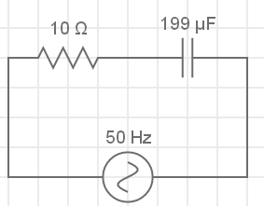
Solving series RL circuits – example 1
Let’s start with this example.
The capacitance of the capacitor is unknown. Calculate the:
Impedance;
The reactance
Value of the capacitor;
Voltage across each component;
Phase angle; and
Draw the phasor diagram.
I_{T} = 10.6A
200V
Redraw the circuit on a blank piece of paper.
Notes:
Img09 = redraw circuit

Slide 13
Solving series RC circuits – step 1
Once you have drawn the basic circuit, you need to label it. When dealing with series RC circuits, it is important that you label it correctly. This will help later on.
R =
C = ?
I_{R}
I_{C}
V_{R}
V_{C}
I_{T} = 10.6A
Remember that this is still a series circuit so I_{T} = I_{R} = I_{C}.
V_{T} = 200V
Notes:
Img10 = redraw circuit diagram

Slide 14
Solving series RC circuits – step 2
Now we can start answering the questions.
R =
C = ?
I_{R}
Calculate the total impedance in the circuit. Enter your answer to three decimal places.
I_{C}
V_{R}
V_{C}
I_{T} = 10.6A
V_{T} = 200V
Ω
Check
Notes:
Img10
Fill in the blank question
Correct answer: 18.868Ω
Feedback:
Correct – Well done. You got it!
Incorrect – That is not correct. $Z=\frac{V_{T}}{I_{T}}=\frac{200V}{10.6A}=18.868Ω$

Slide 15
Solving series RC circuits – step 2
Calculate the reactance in the circuit. Enter your answer to three decimal places.
R =
C = ?
I_{R}
I_{C}
V_{R}
V_{C}
I_{T} = 10.6A
X_{C}
Ω
V_{T} = 200V
Check
Notes:
Img10
Fill in the blank question
Correct answer: X_{C} = 16.000Ω
Feedback:
Correct – Well done. You got it!
Incorrect – That is not correct. We know that $Z=\sqrt{R^{2}+{X_{C}}^{2}}∴Z^{2}=R^{2}+{X_{C}}^{2}∴{X_{C}}^{2}=Z^{2}−R^{2}∴X_{C}=\sqrt{Z^{2}−R^{2}}=\sqrt{{18.868}^{2}−{10}^{2}}=16Ω$

Slide 16
Solving series RC circuits – step 2
Calculate the capacitance of the capacitor. Enter your answer to 1 decimal place
R =
C = ?
I_{R}
I_{C}
V_{R}
V_{C}
I_{T} = 10.6A
V_{T} = 200V
C
μF
Check
Notes:
Img10
Fill in the blank question
Correct answer: C = 198.9μF
Feedback:
Correct – Well done. You got it!
Incorrect – That is not correct. We know that $X_{C}=\frac{1}{2πfC}∴2πfC=\frac{1}{X_{C}}∴C=\frac{1}{2πfX_{C}}=\frac{1}{2.π.50.16}=0.0001989F=198.9μF$. If you are struggling to do this calculation on your calculator, be sure to watch the full worked solution video at the end of this example.

Slide 17
Solving series RC circuits – step 2
Calculate the voltage drop across each component. Enter your answers to one decimal place.
R =
C = ?
I_{R}
I_{C}
V_{R}
V_{C}
I_{T} = 10.6A
V_{R}
V
V_{T} = 200V
V_{C}
V
Check
Notes:
Img10
Fill in the blank question
Correct answer: V_{R} = 106.0V, V_{L} = 169.6V
Feedback:
Correct – Well done. You got it!
Incorrect – That is not correct. We know that I_{T} = I_{R} = I_{L}. So V_{R} = I_{T} x R = 10.6 x 10 = 160V. V_{C} = I_{T} x X_{C} = 10.6 x 16 = 169.6V

Slide 18
Solving series RC circuits – step 2
Calculate the phase angle. Enter your answer to three decimal places.
R =
C = ?
I_{R}
I_{C}
V_{R}
V_{C}
I_{T} = 10.6A
V_{T} = 200V
θ
Check
Notes:
Img10
Fill in the blank question
Correct answer: θ = 57.995°
Feedback:
Correct – Well done. You got it!
Incorrect – That is not correct. Cosθ = R/Z= 10/18.868. Therefore θ = 57.995°

Slide 19
Solving series RC circuits – step 2
Draw the phasor diagram for this circuit on a piece of paper then take a photo of it and upload it to your online portfolio.
Choose image
Upload
Notes:
Img11 = https://cdn.pixabay.com/photo/2016/01/03/00/43/upload-1118929_960_720.png – marked for reuse
Choose image = Launch file selection window
Upload = Upload file

Slide 20
Solving series RC circuits - solution
Watch the video to see the full worked solution for this question.
You can also have a look at a simulation of the circuit.
R =
C = ?
I_{R}
I_{C}
V_{R}
V_{C}
I_{T} = 10.6A
Full worked solution
V_{T} = 200V
See the circuit simulation
Notes:
Img10
Full worked solution = on click, open Vid03 full screen. See appendix for brief.
See the circuit simulation = on click, open http://everycircuit.com/circuit/6566729630351360 in a new window

Slide 21
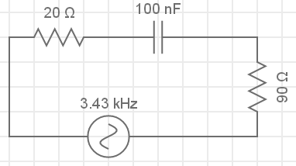
Solving series RC circuits – example 2
In this circuit, calculate the:
Impedance;
Capacitive reactance;
The frequency of the supply;
True power;
Power factor; and
Draw the phasor diagram
90V
I_{T} = 818mA
Circuit simulation
Try the question on your own and then watch the full worked solution.
Full worked solution
Notes:
Img11 – redraw circuit
Full worked solution = on click, play Vid03 full screen. See appendix for brief
Circuit simulation = on click, open http://everycircuit.com/circuit/6134386931269632 in a new window

Slide 22
Document Briefing – Doc01 (1 of 2)
Create an annotated PDF worksheet with the following steps.
Make sure you have downloaded the EveryCircuit App from your app store.
If you are working on a computer, visit http://everycircuit.com/app/.
Open the EveryCircuit app and signup. After your trial, you will still have access to EveryCircuit and other people’s circuits. You will just not be able to create your own circuits.
Go to the community space and search for the circuit called “NOC_Series RC Circuit”
Open the circuit.
This circuit has an AC power supply with a frequency of 1kHz (or 1 000 cycles per second) and a peak voltage of 9V. It also has a 470Ω and a 1μF capacitor.
Click on the ammeter to find out what its reading is. Is this the same current through the resistor and the capacitor? Why or why not?
We know that the capacitance (X_{C}) of a capacitor is given by $\frac{1}{\text{2}\text{π}\text{fC}}$. Calculate X_{C}.
Now calculate the voltage across the capacitor, V_{C}.
Calculate the voltage across the resistor V_{R}.

Slide 23
Document Briefing – Doc01 (2 of 2)
Use the knowledge you gained from RL circuits, to see if we calculate V_{T} in RC circuits the same way i.e. is $V_{T}=\sqrt{{V_{R}}^{2}+{V_{C}}^{2}}$
We know that impedance (Z) is the sum of all the resistance and reactance in a circuit. Use V_{T} and I_{T} to calculate the total impedance in the circuit.
Now calculate the total impedance in the circuit using the resistance R and the capacitive reactance of X_{C} the same way we did for RL circuits i.e. using $Z=\sqrt{R^{2}+{X_{C}}^{2}}$. Do you get the same answer for Z as before?
Try and draw the phasor for this circuit. In this case does voltage LEAD or LAG the current?
Calculate the phase angle in this circuit.

Slide 24
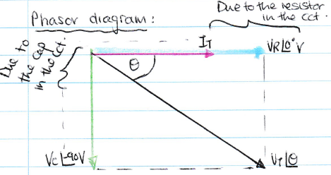
Video Briefing – Vid01 (1 of 2)
Create a screencast video presented by an expert presenter. The presenter needs to work through the Doc01 worksheet and cover and explain the following steps.
Opening the app and opening the circuit for mobile and desktop
Calculate X_{C}, V_{C} and V_{R}.
Check that V_{L} and V_{R} are the same as the voltmeter readings in the simulation.
Show that V_{T} can be calculated using the same method as with RL circuits i.e. using vector addition
Note that this time the voltage across the capacitor LAGS the current by 90° – show this by displaying the voltage across the capacitor on the graph.
Draw the phasor diagram with and
Do the vector addition graphically (1cm = 1V) and then algebraically.
Calculate the total Z using V / I_{T}
Calculate Z using $Z=\sqrt{R^{2}+{X_{C}}^{2}}$.
V_{C} -90°V
V_{R} 0° V

Slide 25
Video Briefing – Vid01 (2 of 2)
Show that the answers are the same.
Explain that we deal with series RC circuits the same way as series RL except that the phasor is different because voltage LAGS current by 90°
Calculate the phase angle
Use $sinθ=\frac{V_{C}}{V_{T}}$ and $cosθ=\frac{R}{Z}$ reminding people (using the phasor) that any of the 6 methods will work.

Slide 26
Video Briefing – Vid02 (1 of 3)
Create a screencast video presented by an expert presenter. The presenter needs to work through the question in example 1.
The capacitance of the capacitor is unknown. Calculate the:
Impedance;
The reactance
Value of the capacitor;
Voltage across each component;
Phase angle; and
Draw the phasor diagram.
I_{T} = 10.6A
200V

Slide 27
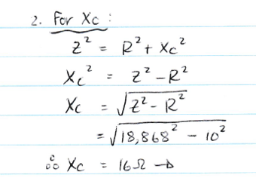
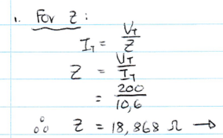
Video Briefing – Vid02 (2 of 3)

Slide 28
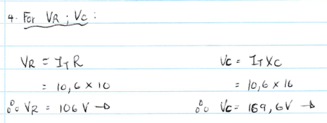
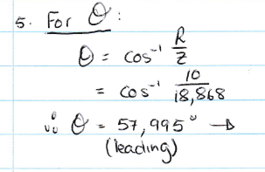
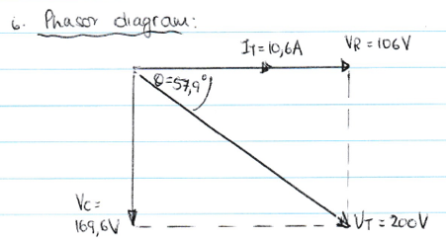
Video Briefing – Vid02 (3 of 3)

Slide 29
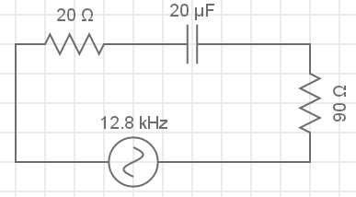
Video Briefing – Vid03 (1 of 5)
Create a screencast video presented by an expert presenter. The presenter needs to work through the question in example 2.
In this circuit, calculate the:
Impedance;
Capacitive reactance;
The frequency of the supply;
True power;
Power factor; and
Draw the phasor diagram
90V
I_{T} = 818mA

Slide 30
Video Briefing – Vid03 (2 of 5)
Redraw and label the circuit as follows. Note that I_{T} = I_{R1} = I_{R2} = I_{C}
R1 =
C =
I_{R1}
I_{C}
I_{R2}
V_{R1}
V_{C}
V_{R2}
R2 =
I_{T} = 818mA
V_{T} = 90V

Slide 31
Video Briefing – Vid03 (3 of 5)
Question 1:
Z = V_{T} / I_{T} = 90V / 0.189A = 476.190Ω
Question 2:
Total series resistance = 20Ω + 90Ω = 110Ω
$$Z=\sqrt{R^{2}+{X_{C}}^{2}}∴Z^{2}=R^{2}+{X_{C}}^{2}∴{X_{C}}^{2}=Z^{2}−R^{2}∴X_{C}=\sqrt{Z^{2}−R^{2}}=\sqrt{{476.190}^{2}−{110}^{2}}=463.311Ω$$
Question 3:
$$X_{C}=\frac{1}{2πfC}∴2πfC=\frac{1}{X_{C}}∴f=\frac{1}{2πCX_{C}}=\frac{1}{2.π.100×{10}^{−9}.463.311}=3435.166Hz=3.43kHz$$

Slide 32
Video Briefing – Vid03 (4 of 5)
Question 4:
True power P = VIcosθ. But cosθ = R / Z = 110 / 476.190. Therefore θ = 76.644°
So P = 90V x 0.189 x cos(76.644) = 3.929W
Question 5:
Power factor = cosθ = cos76.644° = 0.231

Slide 33
Video Briefing – Vid03 (5 of 5)
Question 6:
R_{T} = 110Ω
76.644°
Draw the phasor with impedance as X_{L} and R_{T} were known. Had not worked out voltage drop across both resistors.
X_{C} = 463.311Ω
Z = 476.190Ω

