Slide 1
Electrical Principles
Topic 4: Solving AC Electrical Circuits

Slide 2
Assumed prior learning
05_01_00
05_01_02
05_02_01
05_03_01
05_04_01
Notes:
Note for navigation on site:
This information needs to be taken into account and needs to stated on the LMS, perhaps as part of the introduction?

Slide 3
Outcomes
By the end of this unit the learner will be able to:
Calculate resistance, inductive reactance, impedance, voltage, current, power, power factor and frequency in a series RL circuit.
Construct a phasor diagram to represent the relationship between the voltage and current in a series RL circuit.

Slide 4
Unit 4.4: Series RL Circuits

Slide 5
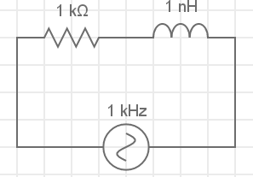
Introduction
In the previous unit we learnt about how inductors and capacitors oppose the flow of current in AC circuits. This opposition is called reactance.
In this unit, we are going to look at how circuits with resistors and inductors in them behave.
Notes:
Img01 = redraw circuit

Slide 6
Series RL circuits
We know that series circuits have all the components connected end to end so that there is only one path for the current. Let’s investigate what happens when we have a resistor and an inductor together in a series circuit.
Vid01
Download and work through the worksheet. Then watch the video to make sure you completed everything correctly.
Download the worksheet
Notes:
Download the worksheet = on click, open Doc01. See appendix for brief
Img02 = EveryCircuit logo
Vid01 = on click, play Vid01 full screen. See appendix for brief

Slide 7
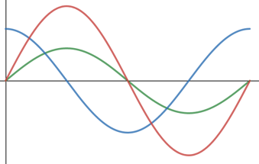
Series RL Circuits
In series AC circuits where there are resistors and inductors, we need to take account of the fact that the voltage across the inductor leads the current through the inductor by 90° when doing calculations.
The voltage across and current through the resistor are in phase.
A series RL circuit
V_{R}
I_{T}
V_{L}
V and I
waveforms
Notes:
Img03 = Img01 + label
Img04 = redraw graphs

Slide 8
Total voltage in a series RL circuit
The total voltage drop in a series RL circuit is the vector sum of the voltage drops across the resistor and the inductor. Remember that Kirchoff’s Voltage Law does not work.
V_{T} θ
$$V_{T}=\sqrt{{V_{R}}^{2}+{V_{L}}^{2}}$$
V_{L} 90°
θ
I_{T}
V_{R} 0°
Phasor Diagram
Notes:
Img05 = Redraw the phasor diagram

Slide 9
Total impedance in series RL circuits
The combined resistance to the flow of current from resistance and reactance is called impedance (Z). It is measured in Ω. The total impedance in a series RL circuit is the vector sum of the resistance and inductive reactance.
$$Z=\sqrt{R^{2}+{X_{L}}^{2}}$$
V_{L}
(X_{L})
V_{T}
(Z)
θ
V_{R}
(R)
Phasor Diagram
Notes:
Img06 = redraw the phasor diagram

Slide 10
The phase angle in series RL circuits
There are many ways to calculate the phase angle (θ) in a series RC circuit.
V_{T} θ
V_{L} 90°
V_{L}
(X_{L})
V_{T}
(Z)
θ
θ
V_{R}
(R)
V_{R} 0°
$$cosθ=\frac{V_{R}}{V_{T}}$$
$$sinθ=\frac{V_{L}}{V_{T}}$$
$$tanθ=\frac{V_{L}}{V_{R}}$$
$$cosθ=\frac{R}{Z}$$
$$sinθ=\frac{X_{C}}{Z}$$
$$tanθ=\frac{X_{C}}{R}$$
Notes:
Img07 = based on Img05
Img08 = based on Img06

Slide 11
Power in series RL circuits
The current in this circuit lags the voltage by the phase angle, θ, because of the inductor. Therefore the circuit has a lagging power factor.
$pf=cosθ$ (lagging)
P = true power (W)
V_{T} = total voltage (V)
I_{T} = total current (A)
$$P=V_{T}I_{T}cosθ$$
θ = phase angle (°)
Notes:
Img07 = based on Img05
Img08 = based on Img06

Slide 12
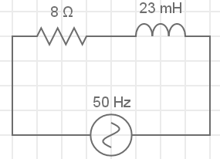
Solving series RL circuits – example 1
Let’s start with this example.
In this circuit, calculate the:
Impedance;
Voltage drop across each component;
Phase angle; and
Draw the phasor diagram.
110V
Redraw the circuit on a blank piece of paper.
Notes:
Img09 = redraw circuit

Slide 13
Solving series RL circuits – step 1
Once you have drawn the basic circuit, you need to label it. When dealing with series RL circuits, it is important that you label it correctly. This will help later on.
R =
L =
I_{R}
I_{L}
I_{T}
V_{R}
V_{L}
Remember that this is still a series circuit so I_{T} = I_{R} = I_{L}.
V_{T} = 110V
Notes:
Img10 = redraw circuit diagram

Slide 14
Solving series RL circuits – step 2
Now we can start answering the questions.
R =
L =
Calculate the total impedance in the circuit. Enter your answer to three decimal places.
I_{R}
I_{L}
I_{T}
V_{R}
V_{L}
V_{T} = 110V
Ω
Check
Notes:
Img10
Fill in the blank question
Correct answer: 10.807Ω
Feedback:
Correct – Well done. You got it!
Incorrect – That is not correct. $Z=\sqrt{R^{2}+{X_{L}}^{2}}$. But $X_{L}=2πfL=2×π×50×23×{10}^{−3}=7.226Ω$. So $Z=\sqrt{8+{7.266}^{2}}=10.807Ω$

Slide 15
Solving series RL circuits – step 2
Calculate the voltage drop across each component. Enter your answers to three decimal places.
L =
R =
I_{R}
I_{L}
I_{T}
V_{R}
V_{L}
V_{R}
V
V_{T} = 110V
V_{L}
V
Check
Notes:
Img10
Fill in the blank question
Correct answer: V_{R} = 81.429V, V_{L} = 73.553V
Feedback:
Correct – Well done. You got it!
Incorrect – That is not correct. First we need to calculate the total current in the circuit. $I_{T}=\frac{V_{T}}{Z}=\frac{110V}{10.807Ω}=10.179A$. We know that I_{T} = I_{R} = I_{L}. So V_{R} = I_{T} x R = 10.179 x 8 = 81.429V. V_{L} = I_{T} x X_{L} = 10.179 x 7.226 = 73.553V

Slide 16
Solving series RL circuits – step 2
Calculate the phase angle. Enter your answer to three decimal places.
R =
L =
I_{R}
I_{L}
I_{T}
V_{R}
V_{L}
V_{T} = 110V
θ
Check
Notes:
Img10
Fill in the blank question
Correct answer: θ = 42.246°
Feedback:
Correct – Well done. You got it!
Incorrect – That is not correct. Cosθ = R/Z= 8/10.807. Therefore θ = 42.246°

Slide 17
Solving series RL circuits – step 2
Draw the phasor diagram for this circuit on a piece of paper then take a photo of it and upload it to your online portfolio.
Choose image
Upload
Notes:
Img11 = https://cdn.pixabay.com/photo/2016/01/03/00/43/upload-1118929_960_720.png – marked for reuse
Choose image = Launch file selection window
Upload = Upload file

Slide 18
Solving series RL circuits - solution
Watch the video to see the full worked solution for this question.
You can also have a look at a simulation of the circuit.
R =
L =
I_{R}
I_{L}
I_{T}
V_{R}
V_{L}
Full worked solution
V_{T} = 110V
See the circuit simulation
Notes:
Img10
Full worked solution = on click, open Vid02 full screen. See appendix for brief.
See the circuit simulation = on click, open http://everycircuit.com/circuit/5239263284428800 in a new window

Slide 19
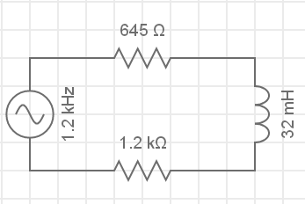
Solving series RL circuits – example 2
In this circuit, calculate the:
Impedance
Total current;
The voltage drop across the inductor;
True power;
Power factor; and
Draw the phasor diagram
9.5V
Circuit simulation
Try the question on your own and then watch the full worked solution.
Full worked solution
Notes:
Img11 – redraw circuit
Full worked solution = on click, play Vid03 full screen. See appendix for brief
Circuit simulation = on click, open http://everycircuit.com/circuit/5232925909188608 in a new window

Slide 20
Document Briefing – Doc01 (1 of 2)
Create an annotated PDF worksheet with the following steps.
Make sure you have downloaded the EveryCircuit App from your app store.
If you are working on a computer, visit http://everycircuit.com/app/.
Open the EveryCircuit app and signup. After your trial, you will still have access to EveryCircuit and other people’s circuits. You will just not be able to create your own circuits.
Go to the community space and search for the circuit called “NOC_Series RL Circuit”
Open the circuit.
This circuit has an AC power supply with a frequency of 1kHz (or 1 000 cycles per second) and a peak voltage of 9V. It also has a 470Ω and a 12mH inductor.
Click on the ammeter to find out what its reading is. Is this the same current through the resistor and the inductor? Why or why not?
We know that the inductance (X_{L}) of an inductor is given by 2πfL. Calculate X_{L}.
Now calculate the voltage across the inductor, V_{L}.
Calculate the voltage across the resistor V_{R}.

Slide 21
Document Briefing – Doc01 (2 of 2)
Click on the voltmeters across the indictor and resistor to check your answers.
What is the total voltage supplied by the power source (V_{T})? Does Kirchoff’s voltage Law hold? In other words, does V_{T} = V_{R} + V_{L}?
We have discovered that Kirchoff’s Voltage Law does not work in this circuit because we cannot just add the voltage drops across the components to find the total voltage drop across the whole circuit.
We know that the total voltage drop across the whole circuit is 9V. Use this and the circuit current to calculate the total resistance in the circuit, R_{T}.
Does R_{T} = R + X_{L}?
We have discovered that we cannot just sum the resistance of the resistor and reactance of the inductor to find the total opposition to current in the circuit.

Slide 22
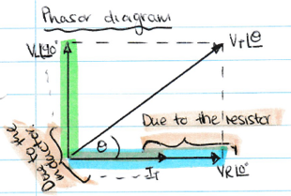
Video Briefing – Vid01 (1 of 2)
Create a screencast video presented by an expert presenter. The presenter needs to work through the Doc01 worksheet and cover and explain the following steps.
Opening the app and opening the circuit for mobile and desktop
Calculate X_{L}, V_{L} and V_{R}.
Check that V_{L} and V_{R} are the same as the voltmeter readings in the simulation.
Show that KVL does not hold.
From I_{T} and V_{T}, calculate R_{T} (for now just a placeholder for Z)
Show that R_{T} does not equal R + X_{L}.
Remind learners that the voltage across the indictor leads the current by 90° but that the voltage across the resistor is in phase with the current (show this in the simulation).
Draw the phasors for V_{R} and V_{L} with respect to the current or V_{T}.
Use (in phase) and (out of phase) nomenclature.

Slide 23
Video Briefing – Vid01 (2 of 2)
Show how to add phasors graphically using a scale of 1cm = 1V
Show how to add the phasors algebraically with Pythagoras
$V_{T}=\sqrt{{V_{R}}^{2}+{V_{L}}^{2}}=\sqrt{{8.88V}^{2}+{1.43V}^{2}}=8.99V$
Note that because, the resistance and inductive reactance of each component is proportional to the voltage drop across each component, we can add R and X_{L} to find the total or combined opposition to current which we call IMPEDENCE (Z).
Calculate Z
$Z=\sqrt{R^{2}+{X_{L}}^{2}}=\sqrt{{470Ω2}^{2}+{75.398Ω}^{2}}=476Ω$
Note that these vectors can also be added graphically and show this calculation.
Lastly, calculate the phase angle (show all workings on the calculator)
$sinθ=\frac{1.43}{8.99}∴θ$=9.14° and using cos$θ=\frac{8.88}{8.99}∴θ=9.14°$

Slide 24
Video Briefing – Vid02 (1 of 3)
Create a screencast video presented by an expert presenter. The presenter needs to work through the question in example 1.
In this circuit, calculate the:
Impedance
Voltage drop across each component
Phase angle
Draw the phasor diagram
110V

Slide 25
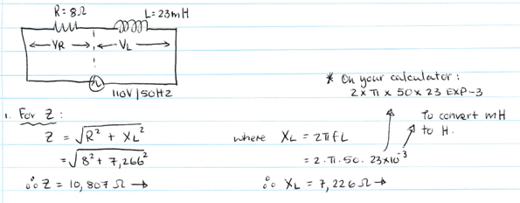
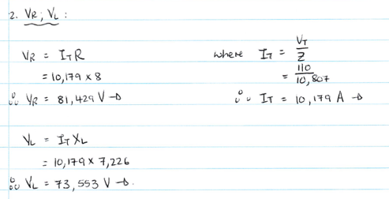
Video Briefing – Vid02 (2 of 3)

Slide 26
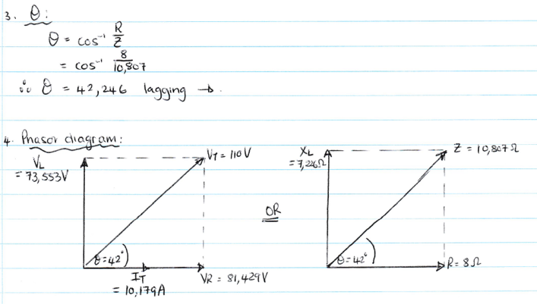
Video Briefing – Vid02 (3 of 3)

Slide 27
Video Briefing – Vid03 (1 of 5)
Create a screencast video presented by an expert presenter. The presenter needs to work through the question in example 2.
In this circuit, calculate the:
Impedance
Total current;
The voltage drop across the inductor; and
True power in the circuit.
9.5V

Slide 28
Video Briefing – Vid03 (2 of 5)
Redraw and label the circuit as follows. Note that I_{T} = I_{R1} = I_{R2} = I_{L}
R1 =
I_{T}
V_{R1}
V_{T} = 9.5V
V_{L}
R2 =
L =
V_{R2}

Slide 29
Video Briefing – Vid03 (3 of 5)
Question 1:
X_{L} = 2πfl = 2π x 1200 x 0.032 = 241.274Ω
There are 2 resistors in series so their combined resistance, R_{T} is R1 + R2 = 1 845Ω
$$Z=\sqrt{R^{2}+{X_{L}}^{2}}=\sqrt{{1845}^{2}+{241.274}^{2}}=1860.710Ω$$
Question 2:
I_{T} = V_{T} / Z = 9.5V / 1860.710Ω = 0.005106A = 5.106mA
Question 3:
V_{L} = I_{T} x X_{L} = 0.005106A = 241.274Ω = 1.232V

Slide 30
Video Briefing – Vid03 (4 of 5)
Question 4:
True power P = VIcosθ. But sinθ = V_{L} / V_{T} = 1.232V / 9.5V. Therefore θ = 7.451°
So P = 9.5V x 0.0051056 x cos(7.451) = 0.04809W = 48.093mW
Question 5:
Power factor = cosθ = cos7.451° = 0.992

Slide 31
Video Briefing – Vid03 (5 of 5)
Question 6:
Z = 1860.710Ω
X_{L} = 241.274Ω
Draw the phasor with impedance as X_{L} and R_{T} were known. Had not worked out voltage drop across both resistors.
7.451°
R_{T} = 1845Ω

