Slide 1
Electrical Principles
Topic 4: Solving AC Electrical Circuits

Slide 2
Assumed prior learning
05_01_00
05_01_02
05_02_01
05_03_01
05_04_01
Notes:
Note for navigation on site:
This information needs to be taken into account and needs to stated on the LMS, perhaps as part of the introduction?

Slide 3
Outcomes
By the end of this unit the learner will be able to:
Describe the relationship between the current and voltage in AC
Use phasor diagrams to describe leading and lagging voltage
Explain true, apparent and reactive power
Calculate true, apparent and reactive for AC systems

Slide 4
Unit 4.2: AC Voltage and Current

Slide 5
In phase = https://www.desmos.com/calculator/ujaoerxgys
V leading = https://www.desmos.com/calculator/yliqb1gyvd
V lagging = https://www.desmos.com/calculator/odbt7mbrvb
Phasors = https://www.desmos.com/calculator/r1xkn8wtyp
In phase phasor = https://www.desmos.com/calculator/vmqq4tjzcj
V leading phasor = https://www.desmos.com/calculator/geaq7hqivl
V lagging phasor = https://www.desmos.com/calculator/pxc1xdyu9p
Phasor shifting simulator = http://www.learnabout-electronics.org/ac_theory/ac_ccts_53.php
Phase shifting with R, C, I = https://www.youtube.com/watch?v=pVS36cyZZI8

Slide 6
Introduction
In the previous unit we were introduced to Alternating Current or AC, how it is generated and why we use it.
In this unit, we will explore AC in more detail and in particular the relationship between AC voltage and current.
Notes:
Img01 = https://cdn.sparkfun.com/assets/b/7/3/d/a/521e6ed1757b7fcc778b456a.png

Slide 7
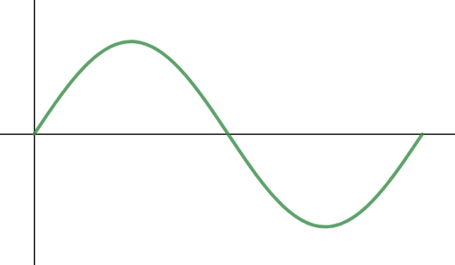
The sine wave
Remember from topic 2 that we often represent AC as a sine wave.
Max value
+
Peak-to-peak
value
Peak value
Click on the parts of the image for a quick refresher of the wave’s key features.
If you need more detail, click the button to go back to the relevant part of topic 2.
0
t (s)
-
1 cycle
Revise the AC sine wave
Notes:
Img02 = based on https://www.desmos.com/calculator/gwbppc4mro
Create the following image hotspots
Max value = on click, present the following in a popup – “This is the greatest or maximum value that the curves reaches. Remember that there are 2 maximum values – a positive max and a negative max.”
Peak value = on click, present the following in a popup – “This is the same thing as the maximum value. We abbreviate peak value with I_{m} for current and V_{m} for voltage”
Peak-to-peak value = on click, present the following in a popup – “This measures the total distance between the 2 peak values. It is therefore, 2 x peak value or 2I_{m} for current and 2V_{m} for voltage.”
1 cycle = on click, present the following in a popup – “After one cycle, the graph repeats itself. This graph only shows 1 cycle.”
t (sec) = on click, present the following in a popup – “When plotting AC, the axis is a measure of time in seconds (s). The y-axis is a measure of voltage (V) or current (I).”
0 = on click, present the following in a popup – “When we plot AC, we measure against time, so the graph starts at 0.”
Revise the AC sine wave = on click open 01_02_xx

Slide 8
Alternating Current
Alternating current alternates. Instead of current always flowing in the same direction, AC changes direction back and forth all the time like the water in the animation.
Click the button to watch a short explanation of the difference between DC and AC.
Difference between DC and AC
Notes:
Img02 = create an animated gif like on https://learn.sparkfun.com/tutorials/alternating-current-ac-vs-direct-current-dc/alternating-current-ac
Difference between DC and AC = on click, play YT01 full screen. YT01 = https://www.youtube.com/watch?v=vN9aR2wKv0U

Slide 9
The AC sine wave
We saw in that last video that we use the shorthand of AC to describe current AND voltage that alternates.
We also saw that we most often show AC as a nice smooth wave – the sine wave.
Click the button to learn more about AC and this sine wave.
Alternating Current
Notes:
Img03 = https://awo.aws.org/wp-content/uploads/2015/08/Alternating-Cureent-Sine-Wave-Electrons-1.png – recreate but make wires shown current direction bigger and clearer.
Alternating Current = on click, play YT02 full screen. YT02 = https://www.youtube.com/watch?v=q-DKc4KHPqU

Slide 10
“Average” AC
Because voltage and current in AC are always changing, we cannot just use the peaks as an indication of power of the supply. We need something else.
Vid01
Watch the video to see how we can calculate a useful “average” voltage or current of an AC supply.
Notes:
Vid01 = on click, play Vid01 full screen. See appendix for brief.

Slide 11
RMS examples
$$RMS=Peak ×0.707$$
A 6V AC supply will have a peak voltage of 6V/0.707 = 8.49V.
A 230V mains supply has a peak voltage of 230V/0.707 = 325V.
AC with a peak current of 12A will have an RMS current of 12A x 0.707 = 8.48A.
$$Peak= \frac{RMS}{0.707}$$
When dealing with AC, Always assume that values given are RMS UNLESS otherwise indicated.

Slide 12
Quick quiz question 1
If an AC peak voltage is 380V, what is the RMS voltage?
269V
537V
380V
266V
Notes:
MCQ:
Correct answer is a)
Feedback:
A – Well done. That is right. RMS = peak x 0.707 = 380V x 0.707 = 269V.
B – That is not right. It looks like you divided rather than multiplied by 0.707. RMS = peak x 0.707 = 380V x 0.707 = 269V.
C – That is not right. Peak voltage in AC is greater than RMS voltage. RMS = peak x 0.707 = 380V x 0.707 = 269V.
D – That is not right. It looks like you multiplied peak by 0.7 instead of by 0.707. RMS = peak x 0.707 = 380V x 0.707 = 269V.

Slide 13
Quick quiz question 2
If an AC RMS current is given as 6.25A, what is the peak current?
3.13A
4.42A
6.25A
8.84A
Notes:
MCQ:
Correct answer is d)
Feedback:
A – That is not right. Remember that RMS = peak x 0.707. Therefore, peak = RMS/0.707 = 6.25A/0.707 = 8.84A.
B – That is not right. Remember that RMS = peak x 0.707. Therefore, peak = RMS/0.707 = 6.25A/0.707 = 8.84A.
C – That is not right. Remember that RMS = peak x 0.707. Therefore, peak = RMS/0.707 = 6.25A/0.707 = 8.84A.
D – Well done. RMS = peak x 0.707. Therefore, peak = RMS/0.707 = 6.25A/0.707 = 8.84A.

Slide 14
Quick quiz question 3
If an AC current is given as 12A, what is the RMS current?
16.97A
8.48A
12A
No way to tell
Notes:
MCQ:
Correct answer is c)
Feedback:
A – That is not right. Remember that when AC current is given, we mean the RMS current. So 12A is the RMS current.
B - That is not right. Remember that when AC current is given, we mean the RMS current. So 12A is the RMS current.
C – Well done. When AC current is given, we mean the RMS current. So 12A is the RMS current.
D - That is not right. Remember that when AC current is given, we mean the RMS current. So 12A is the RMS current.

Slide 15
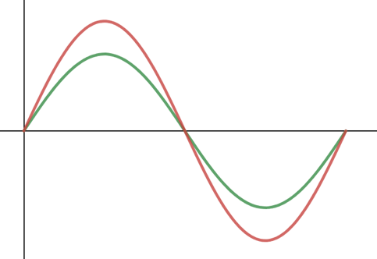
AC voltage and current
Voltage
As we saw in the previous unit, an AC generator creates an alternating voltage (emf) which produces an alternating current. The relationship between the voltage and current can be represented together on the same graph like this.
+
Current
t (sec)
-
Notes:
Img03 = based on https://www.desmos.com/calculator/9drqpsoqq1

Slide 16
In phase
Voltage
In this graph, the increases and decreases in voltage and current happen at exactly the same time and they reach their maximum and zero values at the same time.
We say that the voltage and current are in phase.
+
Current
t (sec)
-
Notes:
Img04 = based on https://www.desmos.com/calculator/9drqpsoqq1

Slide 17
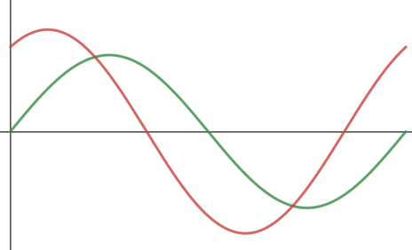
Out of phase
Voltage
As soon as the voltage and current do not line up nicely with their peaks and zero values happening at the same time, we say that they are out of phase.
Current
+
t (sec)
-
Notes:
Img05 = based on https://www.desmos.com/calculator/yliqb1gyvd

Slide 18
Phase angle
If the voltage and current are out of phase, they are out of phase by a certain amount, which we call the phase angle. The bigger the phase angle, the more out of phase the voltage and current are.
Vid01
Watch the video to see a quick demonstration. After the video, click the button to play with the same tool as in the video.
Open the phase shifter tool
Notes:
Vid01 = on click, play Vid01 full screen. See appendix for brief
Open the phase shifter tool = on click, open https://www.desmos.com/calculator/kgyx4bjg8t in a new window. The tool can also be directly embedded in a webpage if this is desirable.

Slide 19
Another way of picturing the sine wave
Sometimes, we can see more clearly what is going on with AC, especially when the voltage and current are out of phase, if we picture the sine wave in a different way.
Vid02
Watch the video to see how the sine wave can be represented using a circle. After the video, click the button to play with the unit circle yourself.
Open the unit circle tool
Notes:
Vid02 = on click, play Vid02 full screen. See appendix for brief
Open the unit circle tool = on click, open https://www.desmos.com/calculator/hxsqqkjeww in a new window. The tool can also be directly embedded in a webpage if this is desirable.

Slide 20
Phasor diagrams
Phasor diagrams are a simple way we have to represent the phase angle between the voltage and current in an AC circuit.
Vid03
Watch the video to learn about phasor diagrams and how they work.
Open the phasor diagram tool
Notes:
Vid03 = on click, play Vid03 full screen. See appendix for brief
Open the phasor tool = on click, open https://www.desmos.com/calculator/9jdbhnteds in a new window. The tool can also be directly embedded in a webpage if this is desirable.

Slide 21
Phasor summary
Click on each button to see an example of a phasor diagram describing each situation.
In phase
1
Voltage leading current
2
Voltage lagging current
3
Notes:
1 = on click, open slide 15 in a popup
2 = on click, open slide 16 in a popup
3 = on click, open slide 17 in a popup

Slide 22
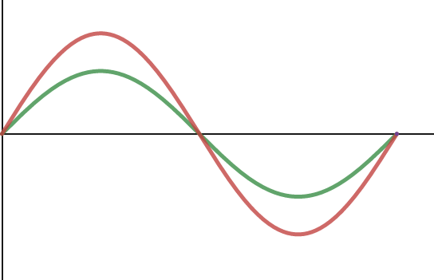
In phase
The phase angle is 0° and the waveforms have the same frequency. The voltage and current are in phase.
Voltage
+
Current
t (sec)
-
Notes:
Img06 = based on https://www.desmos.com/calculator/9jdbhnteds

Slide 23
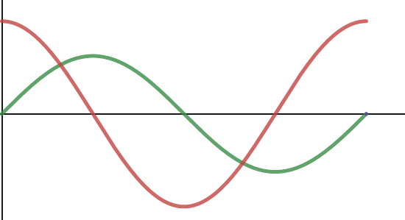
Voltage leading
The phase angle is 90° and the waveforms have the same frequency. The voltage and current are out of phase. The voltage leads the current by 90°.
Voltage
Current
+
90°
90°
t (sec)
-
Notes:
Img07 = based on https://www.desmos.com/calculator/9jdbhnteds

Slide 24
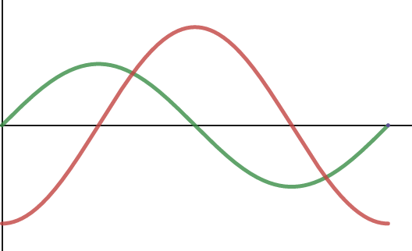
Voltage leading
The phase angle is 90° and the waveforms have the same frequency. The voltage and current are out of phase. The voltage lags the current by 90°.
Current
Voltage
+
90°
90°
t (sec)
-
Notes:
Img07 = based on https://www.desmos.com/calculator/9jdbhnteds

Slide 25
Power in an AC circuit
In DC circuits, we calculate power as voltage x current because the voltage and current are always in phase.
Things get more tricky when voltage and current are out of phase, as often happens in AC circuits.
Vid04
Watch the video to learn how we calculate the power in AC circuits.
Notes:
Vid04 = on click, play Vid04 full screen. See appendix for brief

Slide 26
Power
In AC circuits where the voltage and current are out of phase we can calculate apparent power, true power and reactive power.
Active or True Power: the actual power available to do work in the system
$$P=VIcosθ$$
1
Apparent Power: the total theoretical power
$$S=VI$$
2
Reactive Power: causes energy losses in the system
$$Q=VIsinθ$$
3

Slide 27
Example 1
Example

Slide 28
Power
Example

Slide 29
Power
Example

Slide 30
Angular velocity
One of the benefits of thinking about sine graphs as measuring the height of a rotating radius is that it gives us a way to not just measure how far something has rotated but also how fast.
Vid05
Watch the video to learn about angular velocity. After the video, click on the button to play with the angular velocity tool yourself.
Open the angular velocity tool
Notes:
Vid05 = on click, play Vid05 full screen. See appendix for brief
Open the angular velocity tool = on click, open https://www.desmos.com/calculator/pusgzg59ec in a new window. The tool can also be directly embedded in a webpage if this is desirable.

Slide 31
Frequency
Frequency is a simple concept. It is the number of complete rotations or cycles of the sine graph completed per second. Its symbol is f and it is measured in Hertz (Hz).
Vid06
Watch the video to find out how we can work out what the frequency of a rotating radius is.
Notes:
Vid06 = on click, play Vid05 full screen. See appendix for brief

Slide 32
Examples
An AC generator spins around 20 times every second.
At what frequency is it spinning?
What is its angular velocity?
Notes:
Vid04 = on click, play Vid04 full screen. See appendix for brief

Slide 33
The sine wave
$$I_{m}=Peak current$$
Make sure you are familiar with all these expressions for AC voltage and current, also from topic 2.
$${2I}_{m}=Peak−to−peak current$$
$$i=I_{m}sinθ=I_{m}sinωt=I_{m}sin2πft$$
$$I_{RMS}=0.707I_{m}$$
Click on the parts of the image for a quick refresher of the wave’s key features.
If you need more detail, click the button to go back to the relevant part of topic 2.
$$I_{AVG}=0.637I_{m}$$
Revise the sine wave in topic 2
Notes:
Img02 = based on https://www.desmos.com/calculator/gwbppc4mro
Create the following image hotspots
Max value = on click, present the following in a popup – “This is the greatest or maximum value that the curves reaches. Remember that there are 2 maximum values – a positive max and a negative max.”
Peak value = on click, present the following in a popup – “This is the same thing as the maximum value. We abbreviate peak value with I_{m} for current and V_{m} for voltage”
Peak-to-peak value = on click, present the following in a popup – “This measures the total distance between the 2 peak values. It is therefore, 2 x peak value or 2I_{m} for current and 2V_{m} for voltage.”
1 cycle = on click, present the following in a popup – “After one cycle, the graph repeats itself. This graph only shows 1 cycle.”
t (sec) = on click, present the following in a popup – “When plotting AC, the axis is a measure of time in seconds (s). The y-axis is a measure of voltage (V) or current (I).”
0 = on click, present the following in a popup – “When we plot AC, we measure against time, so the graph starts at 0.”

Slide 34
Test Yourself
We have come to the end of this unit. Answer the following questions to make sure you understand voltage and current in AC circuits.
Notes:
See 01_03_03_Activity for the original questions. Doc01 = This document must also be formatted into a downloadable worksheet. The memo is 01_03_03_Activity Solutions – see appendix for brief

Slide 35
Question 1
An alternating voltage is represented by the equation
$e=500\sin\left(314.2t\right)$ volts.
Note that the angle is in radians. From this equation, answer the questions that follow.

Slide 36
Question 1
1.1:
Calculate the resistance of the parallel combination and enter your answer (correct to 0 decimal places) in the space below. Make sure to include the correct units.
Notes:
Maths cloze question with symbol selector
Correct answer: 500V
Feedback:
Correct: Well done. That is correct.
Incorrect. That is not correct. Have a look at the worked solution to see where you went wrong. See 01_04_02_Activity Solutions for full worked solution.

Slide 37
Question 1
1.2:
Calculate the frequency of the supply and enter your answer (correct to 0 decimal places) in the space below. Make sure to include the correct units.
Notes:
Maths cloze question with symbol selector
Correct Answer: 50Hz
Feedback:
Correct: Well done. That is correct.
Incorrect. That is not correct. Have a look at the worked solution to see where you went wrong. See 01_04_02_Activity Solutions for full worked solution.

Slide 38
Question 1
1.3:
Calculate the effective value of the voltage and enter your answer (correct to 1 decimal place) in the space below. Make sure to include the correct units.
Notes:
Maths cloze question with symbol selector
Correct Answer: 353.5V
Feedback:
Correct: Well done. That is correct.
Incorrect. That is not correct. Have a look at the worked solution to see where you went wrong. See 01_04_02_Activity Solutions for full worked solution.

Slide 39
Question 1
1.4:
Calculate the instantaneous value 0.003 seconds after zero while the wave is going positive and enter your answer (correct to 3 decimal places) in the space below. Make sure to include the correct units.
Notes:
Maths cloze question with symbol selector
Correct Answer: 404.565V
Feedback:
Correct: Well done. That is correct.
Incorrect. That is not correct. Have a look at the worked solution to see where you went wrong. See 01_04_02_Activity Solutions for full worked solution.

Slide 40
Question 2
An electrical technician measures the amperes, voltage and power of an AC circuit. The readings obtained are 10A, 260V and 2 200W. Answer the questions that follow.

Slide 41
Question 2
2.1:
Calculate the circuit power factor and enter your answer (correct to 3 decimal places) in the space below. Make sure to include the correct units.
Notes:
Maths cloze question with symbol selector
Correct answer: 0.846
Feedback:
Correct: Well done. That is correct.
Incorrect. That is not correct. Have a look at the worked solution to see where you went wrong. See 01_04_02_Activity Solutions for full worked solution.

Slide 42
Question 2
2.2:
Calculate the active or true current component and enter your answer (correct to 3 decimal places) in the space below. Make sure to include the correct units.
Notes:
Maths cloze question with symbol selector
Correct Answer: 8.46A
Feedback:
Correct: Well done. That is correct.
Incorrect. That is not correct. Have a look at the worked solution to see where you went wrong. See 01_04_02_Activity Solutions for full worked solution.

Slide 43
Question 2
2.3:
Calculate the reactive current component and enter your answer (correct to 3 decimal place) in the space below. Make sure to include the correct units.
Notes:
Maths cloze question with symbol selector
Correct Answer: 5.332A
Feedback:
Correct: Well done. That is correct.
Incorrect. That is not correct. Have a look at the worked solution to see where you went wrong. See 01_04_02_Activity Solutions for full worked solution.

Slide 44
Question 1
2.4:
Calculate the reactive volt-amps and enter your answer (correct to 3 decimal places) in the space below. Make sure to include the correct units.
Notes:
Maths cloze question with symbol selector
Correct Answer: 1386.32VAr
Feedback:
Correct: Well done. That is correct.
Incorrect. That is not correct. Have a look at the worked solution to see where you went wrong. See 01_04_02_Activity Solutions for full worked solution.

Slide 45
Question 3
The figure shows a sine wave where the angles are measured in degrees.

Slide 46
Question 3
3.1:
Calculate the the waveform’s effective value and enter your answer (correct to 3 decimal places) in the space below. Make sure to include the correct units.
Notes:
Maths cloze question with symbol selector
Correct answer: 219.17V
Feedback:
Correct: Well done. That is correct.
Incorrect. That is not correct. Have a look at the worked solution to see where you went wrong. See 01_04_02_Activity Solutions for full worked solution.

Slide 47
Question 3
3.2:
Draw the waveform circuit on a piece of paper, indicating RMS, peak and average values. Then take a photo of it and upload it.
Notes:
Upload document question
Feedback:
Make sure that your circuit looks similar to this one. See 01_04_02_Activity Solutions for correct circuit diagram.

Slide 48
Question 4
An alternating EMF is represented by the following expression:
$$e=240sin⁡(471.239t)$$
Note: The angle is in radians. Answer the questions that follow.

Slide 49
Question 4
4.1:
Calculate the maximum value of this emf and enter your answer (correct to 0 decimal places) in the space below. Make sure to include the correct units.
Notes:
Maths cloze question with symbol selector
Correct answer: 240V
Feedback:
Correct: Well done. That is correct.
Incorrect. That is not correct. Have a look at the worked solution to see where you went wrong. See 01_04_02_Activity Solutions for full worked solution.

Slide 50
Question 4
4.2:
Calculate the average value of the emf and enter your answer (correct to 2 decimal places) in the space below. Make sure to include the correct units.
Notes:
Maths cloze question with symbol selector
Correct Answer: 152.88V
Feedback:
Correct: Well done. That is correct.
Incorrect. That is not correct. Have a look at the worked solution to see where you went wrong. See 01_04_02_Activity Solutions for full worked solution.

Slide 51
Question 4
4.3:
Calculate the RMS value of the emf and enter your answer (correct to 2 decimal place) in the space below. Make sure to include the correct units.
Notes:
Maths cloze question with symbol selector
Correct Answer: 169.68V
Feedback:
Correct: Well done. That is correct.
Incorrect. That is not correct. Have a look at the worked solution to see where you went wrong. See 01_04_02_Activity Solutions for full worked solution.

Slide 52
Question 4
4.4:
Calculate the form factor and enter your answer (correct to 2 decimal places) in the space below. Make sure to include the correct units.
Notes:
Maths cloze question with symbol selector
Correct Answer: 1.11
Feedback:
Correct: Well done. That is correct.
Incorrect. That is not correct. Have a look at the worked solution to see where you went wrong. See 01_04_02_Activity Solutions for full worked solution.

Slide 53
Question 4
4.5:
Calculate the frequency and enter your answer (correct to 0 decimal places) in the space below. Make sure to include the correct units.
Notes:
Maths cloze question with symbol selector
Correct Answer: 75Hz
Feedback:
Correct: Well done. That is correct.
Incorrect. That is not correct. Have a look at the worked solution to see where you went wrong. See 01_04_02_Activity Solutions for full worked solution.

Slide 54
Video Briefing – Vid01
Create a screencast video presented by an expert presenter. Use the interactive Phase Shifter available at https://www.desmos.com/calculator/cmth9m2oik to explain what is meant by phase angle, leading and lagging.
On opening the interactive, the phase angle (P) is zero and the selected point of comparison (m) is 180°.
Change the phase angle to any positive number and explain the how the voltage now leads the current by the selected angle. This means that the voltage graph gets to this point (in this case zero) first by the the selected angle. This lead is indicated by the dotted line.
Do the same thing but now with a negative phase angle and explain that, in this case, the voltage lags the current as it reaches the point after the current. Again the dotted line shows the extent of the lag in degrees. We can also say that the current leads the voltage by the phase angle.
Now redo a lead and lag example but this time change the point of comparison (m) to show that the phase angle (horizontal distance between the points) is the same no matter which point of comparison we take. First take a peak as a point of comparison and then any other point(s).

Slide 55
Video Briefing – Vid02 (1 of 2)
Create a screencast video presented by an expert presenter. Use the interactive unit circle available at https://www.desmos.com/calculator/3rqulsvfzn to explain how the sine graph represents the height of the phasor in the unit circle.
The circle has a radius of 1 unit. At the moment, the green line is at 0 degrees.
Drag the “a” slider slowly to 90 degrees and explain how the height of the sine graph is actually a measure of the vertical height of the radius, in other words the purple line as the radius is rotated through a number of degree relative to the horizontal line or x-axis. At 90⁰ the height of the sine graph is a maximum just like the height of the radius.
After 90⁰ the height of the purple line (and the sine graph) decrease until, at 180⁰, its height is again zero (and the sine graph is again at zero).
After zero, the height of the purple line increase again, but this time in the opposite direction i.e. negative. The sine graph matches this.
At 270⁰ the height of the purple line is again a maximum and the sine graph is at its negative maximum.
Past 270⁰, the height of the lines starts to decrease back to zero and the cycle then repeats.

Slide 56
Video Briefing – Vid02 (2 of 2)
Now, increase the radius of the circle by dragging the R slider and explain how the radius of the circle is always the same as the height of the sine graph because the length of the purple line at 90⁰ and 270⁰ is always the radius of the circle and is the maximum value for the graph.
Explain how the sine graph therefore is a representation of the circular motion of the radius as it spins around the centre of the circle.
This is why the x-axis of the sine graph is given in degrees – these are the degrees through which the radius has been spun.
Now hide the degrees labels and show the Radians and explain that radians is just another way of measuring angles. 180° is defined as π radians. Therefore 90° is π/2 radians, 270° 1.5 or 3/2π radians and 360° is 2π radians and so on.

Slide 57
Video Briefing – Vid03 (1 of 2)
Create a screencast video presented by an expert presenter. Use the interactive phasor diagram tool available at https://www.desmos.com/calculator/9jdbhnteds to explain phasor diagrams.
Explain that a phasor diagram is a way to visualise the phase angle between current and voltage in an AC circuit.
Explain that there are 2 phasors in the simulation – the dotted green one representing voltage and the orange one representing current. At the moment, the phase angle between them is zero and they both have the same magnitude (size). Show that if we drag the angle (a) slider, the sine graphs will on completely on top of each other (in phase).
Now increase the length (L) of the voltage phasor to 2. The height of the sine graph also changes as we expect BUT the voltage and current are still in phase.
Set a back to zero. Now change the phase angle (P) to 90° and show how the voltage phasor is now 90° to the current phasor and that the voltage phasor is leading. Increase a to show how the phase angle between the phasors stays constant as both phasors rotate around the point and that the voltage curve leads the current curve by 90°.
Now change the phase angle (P) to 120° to show that the angle between the

Slide 58
Video Briefing – Vid03 (2 of 2)
Set a back to zero. Now change the phase angle (P) to 120° to show that the angle between the phase angle between the phasors is now 120°. Increase a to show how the angle between the phasors stays at 120° as they both spin.
Set a back to zero and illustrate the same things with a negative phase angle. This time explain that the voltage (dotted green line) is lagging the current by the defined angle.

Slide 59
Video Briefing – Vid04 (1 of 2)
Icosθ
V
θ
Isinθ
I
Create a screencast video presented by an expert presenter to explain Power, true power, apparent power and reactive power.
Restate that P = V x 1 BUT only if V and I are in phase. In DC this is always the case so in DC P = V x I. If voltage and current are in phase in AC, P = V x I
But in AC V and I are often out of phase. Draw the diagram above where voltage leads current by θ.
Add in the vertical and horizontal components of I. Explain that we already know that the vertical height of the phasor is represented by sine. The horizontal length of the phasor is represented by cosine.
Explain that true power = the voltage x that part of the current that is in phase with the voltage i.e. Icosθ. Therefore true power, P = V x Icosθ. P is in W, voltage is in V, current is in A and θ is the phase angle in degrees.
Show at the this point that if V and I are in phase, the formula still works but as cos0 = 1, we get back to P = V x I

Slide 60
Video Briefing – Vid04 (2 of 2)
Icosθ
V
θ
Isinθ
I
Explain that apparent power ignores any phase angle. It is given the symbol S and is measured as Volt-Amps (VA).
Show that S = V x I and therefore when the phase angle is zero true power = apparent power.
The ratio of true power to apparent power given by P/S = V x Icosθ/V x I = cosθ is called the power factor and indicates what proportion of the potential (or apparent power) is actually usable (true power).
Explain that when there is a phase angle the difference between apparent power and true power is called Reactive power which is give the symbol Q and measured in VAR (Volt-Amps-Reactive). Therefore S = P + Q.
Explain that Reactive power is given by voltage x the vertical component of the out of phase current i.e. Q = V x Isinθ.
When voltage and current are in phase sin0 = 0 so there is no reactive power. Reactive power generally causes energy loss through heat in a system and is generally considered a loss.

Slide 61
Video Briefing – Vid05
Create a screencast video presented by an expert presenter. Use the interactive angular velocity tool available at https://www.desmos.com/calculator/pusgzg59ec to explain angular velocity.
This is a standard unit circle. Click on the play button next to the ”a” slider. At the moment the speed is set to x1 which means a revolution will be completed in 4 seconds or, in other words π/2 revolutions (a quarter turn) each second.
Explain that the angular velocity, given by the Greek letter omega (lowercase) ω is a measure of the number of radians rotated through per second or rad/sec. Therefore the angular velocity is currently 1/2π radians/sec because it rotates through π/2 radians every second.
Increase the speed of the animation to 1.5x. Now one revolution or 2π radians is completed every three seconds. So the angular velocity is 2π/3 or 2/3π rad/sec.
Decrease the speed of the animation to 0.5x. Now it will take 8 seconds for 1 revolution – an angular velocity of 2π/8 = 1/4π rad/sec.

Slide 62
Video Briefing – Vid06
Create a screencast video presented by an expert presenter explaining frequency.
Explain that frequency (f) is the number of revolutions or cycles completed per second and that this can either be the number of times a radius completes a full revolution in 1 second or the number of times a sine wave repeats itself per second.
Open the unit circle tool (https://www.desmos.com/calculator/gs0rkhhcht) and make sure that the animation speed for “a” is set to x1 and that it is set to only run forward (click the double arrow icon until both arrows point right). Remind learners that x1 means that the animation will complete once in 4 seconds. But the animation has to go through 720° or 2 revolutions in 4 seconds. Therefore it will go through 1 revolution in 2 seconds. This means that every second only ½ a revolution or cycle is completed. Therefore frequency is simply give as $f=\frac{1}{t}=\frac{1}{2}Hz$ where t is the time taken to complete a full revolution. Emphasise the fact that frequency measures revolutions completed per second or cycles of the sine graph completed per second.
Calculate the angular velocity of the current animation: ω = 2π/2 = π/second.
Show that we can also calculate f from angular velocity as $f=\frac{ω}{2π}=\frac{π}{2π}=\frac{1}{2}Hz$
Change the animation speed to 5x and calculate the frequency using t and angular velocity.

Slide 63
Video Briefing – Vid01 (1 of 3)
Create a screencast vide presented by an expert electrician explaining RMS voltage/current in AC systems. Base explanation on https://www.allaboutcircuits.com/textbook/alternating-current/chpt-1/measurements-ac-magnitude/. Use similar images to those on page 3.
AC is always changing value. What value do we give it? Can we use peak values even though, most of the time the AC is less than the peak value? DC is easy because voltage and current are always the same.
We could try the average but, for any sine wave this is zero (A).
We could make all the negative values positive(B) first and get an average this way.
But this average is not the same as the supply’s ability to do work or its power. It is slightly less. Remember that P = V²/R or I²R. There are squares involved.
Having a measure that allows us to compare the power delivered by different AC supplies and between AC and DC supplies would be useful (C).
If 50W were dissipated in a DC circuit with 10V, 5A and 2Ω, then it would be useful to be able to say that an AC circuit with 5A and 2Ω and also dissipating 50W was also 10V.

Slide 64
Video Briefing – Vid01 (2 of 3)
This 10V AC is called the Root Mean Square or RMS value. You don’t need to know the maths behind this. You just need to know that RMS = Peak of the AC x 0.707.
RMS of an AC voltage or current is the equivalent DC voltage or current that would deliver the same amount of power. RMS is sometimes called DC equivalent.
The conversion factor of 0.707 ONLY applies to AC sources that are sinusoidal. Other waves forms have different conversion factors.
For sine waves the average voltage or current = Peak of the AC x 0.637.
Because RMS allows us to make better comparisons it is almost always used instead of Average.
When dealing with AC always assume that the values given are RMS values UNLESS you are told otherwise.

Slide 65
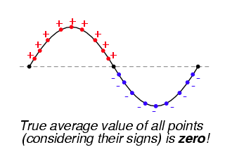
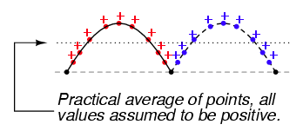
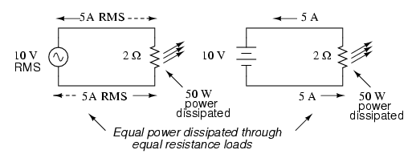
Video Briefing – Vid01 (3 of 3)

