Slide 1
Electrical Principles
Topic 4: Solving AC Electrical Circuits

Slide 2
Assumed prior learning
05_01_00
05_01_02
05_02_01
05_03_01
05_04_01
Notes:
Note for navigation on site:
This information needs to be taken into account and needs to stated on the LMS, perhaps as part of the introduction?

Slide 3
Outcomes
By the end of this unit the learner will be able to:
Define what alternating current (AC) is
Identify the waveform of AC
Explain why AC is used for electrical distribution systems
Explain how a simple AC generator works
Explain what the peak value, RMS and average value for AC voltage and current are and how they are calculated.

Slide 4
Unit 4.1: Alternating Current

Slide 5
Introduction
This topic is all about AC (Alternating Current) and how it is different to DC (Direct Current).
The differences between AC and DC are expressed very nicely in their symbols, as we shall see.
Click on each symbol to see a simple definition of each type of electricity.
Notes:
Img01 = DC and AC symbols
DC = on click, open slide 7 in a popup
AC = on click, open slide 8 in a popup

Slide 6
Direct Current
Direct current or DC is the kind of electricity you get out of batteries. It is at a fixed voltage and the electrons always flow in the same direction.
Vid01
Notes:
Vid01 = DC animation similar to that found at https://www.youtube.com/watch?v=JZjMuIHoBeg

Slide 7
Alternating Current
Alternating current or AC is the kind of electricity that comes out of your plug. The electrons do not always flow in the same direction. They keep changing or alternating direction.
Vid02
Notes:
Vid02 = AC animation similar to that found at https://www.youtube.com/watch?v=JZjMuIHoBeg

Slide 8
What is alternating current
So we have seen that AC stands for alternating current – current where the direction of the electrons keeps changing. In other words, they move back and forth.
Vid03
Watch this video to find out more.
Notes:
Vid03 = on click, play Vid03 full screen. See appendix for brief.

Slide 9
Representing DC
We can represent the voltage and current of a circuit against time with a graph.
Here is a typical DC graph. The voltage and current are constant. Because the voltage is always positive, current always flows in the same direction.
Img02
Click on the image to see a larger version.
Notes:
Img02 = on click, display Img02 full screen. Img02 based on https://www.desmos.com/calculator/pbgqwemstz – redraw and label orange line current and purple line voltage. Also add in + and – labels for the y-axis.

Slide 10
Representing AC
Here is a typical AC graph. The voltage and current are not constant. Because the voltage changes polarity (goes from positive to negative), the current flows in one direction (indicated as positive) and then the other direction (indicated as negative). It alternates.
Img03
Click on the image to see a larger version.
Notes:
Img03 = on click, display Img03 full screen. Img03 based on https://www.desmos.com/calculator/l6xrii16lm – redraw and label orange line current and purple line voltage. Also add in + and – labels for the y-axis.

Slide 11
Pulsating DC
Sometimes the voltage of DC is not constant. However, even in this case, the voltage does not change polarity (change from positive to negative) so, even though the amount of current changes, it NEVER flows in the opposite direction. It always still flows in ONE direction. This is called pulsating DC.
Img04
Click on the image to see a larger version.
Notes:
Img04 = on click, display Img04 full screen. Img04 based on https://www.desmos.com/calculator/5nn2hx3tlj – redraw and label orange line current and purple line voltage. Also add in + and – labels for the y-axis.

Slide 12
Question 1
Which of the following graphs represent AC?
a)
Img05
b)
Img06
c)
Img07
d)
Img08
Notes:
Img05 = https://www.desmos.com/calculator/g8shvgobii – red line
Img06 = https://www.desmos.com/calculator/g8shvgobii – purple line
Img07 = https://www.desmos.com/calculator/g8shvgobii – blue line
Img08 = https://www.desmos.com/calculator/g8shvgobii – orange line
Multiple choice question
Correct answer: d
Feedback:
A – That is not correct. This graph represents typical constant voltage DC.
B - That is not correct. This graph represents pulsating DC. The voltage is always positive so current will always flow in the same direction.
C – That is not correct. This graph represents pulsating DC. The voltage is never negative. Times when the voltage is zero, represent when no current will flow, but the polarity is never reversed so current will never flow in the other direction.
D – Well done! This graph represents typical AC.

Slide 13
Question 2
Which graphs represents AC?
1 only
2 only
1 and 2
Neither
1)
Img09
2)
Img10
Notes:
Img09 = https://www.desmos.com/calculator/v0q9fnx2qj – orange line
Img10 = https://www.desmos.com/calculator/v0q9fnx2qj – purple line
Multiple choice question
Correct answer: a
Feedback:
A – Well done. Graph 1 represents AC because, for some of the time, the voltage is positive and it then becomes negative. This means the polarity switches so current will flow in the other direction.
B – That is not correct. Graph 2 is DC. Even though the voltage is shown as negative, it never changes to become positive so the polarity does not change. Therefore, current does not flow in the other direction ever.
C – That is not correct. Graph 1 does represents AC because, for some of the time, the voltage is positive and it then becomes negative. This means the polarity switches so current will flow in the other direction. But graph 2 does not represent AC. Even though the voltage is shown as negative, it never changes to become positive so the polarity does not change. Therefore, current does not flow in the other direction ever.
D – That is not correct. Graph 1 does represents AC because, for some of the time, the voltage is positive and it then becomes negative. This means the polarity switches so current will flow in the other direction.

Slide 14
Question 3
Which of the following graphs represent DC?
1 only
1 and 3
1 and 2
None
1)
Img11
2)
Img12
3)
Img13
4)
Img14
Notes:
Img11 = https://www.desmos.com/calculator/4oowoiewmw – red line
Img12 = https://www.desmos.com/calculator/4oowoiewmw – green line
Img13 = https://www.desmos.com/calculator/4oowoiewmw – blue line
Img14 = https://www.desmos.com/calculator/4oowoiewmw – orange line
Multiple choice question
Correct answer: b
Feedback:
A – That is not correct. While graph 1 does represent DC (the voltage is never negative so current always flows in the same direction), graph 3 also represents DC.
B – Well done. Both graphs 1 and 3 always have positive voltage so the current always flows in the same direction.
C – That is not correct. While graph 1 does represent DC (the voltage is never negative so current always flows in the same direction), graph 2 has negative voltage. This means that the polarity is reversed and current will flow in the opposite direction i.e. AC.
D – That is not correct. Graphs 2 and 4 have periods where the voltage is negative. During these times, the polarity will be reversed and current will flow in the opposite direction. Graphs 1 and 3 never have negative voltage so the polarity is never reversed. Therefore, these represent DC as direct only ever flows in one direction.

Slide 15
Why bother with AC?
So many of our household appliances need DC, not AC to run. So why do we bother with AC at all?
The answer has to do with how electricity gets to our homes in the first place.
YT01
Watch this video to learn the story behind why we use AC today.
Notes:
YT01 = on click, play YT01 full screen. YT01 = https://www.youtube.com/watch?v=xyQfrzBfnDU

Slide 16
Why AC
There are two parts to the argument for distributing electricity as AC.
Efficiency
The need to get energy from the power station to your home.
Safety
The need to make the delivery of electricity safe.
1
2
Click on each box to unpack each part of the argument.
Notes:
Power = on click, present slide 18 as a popup
Transformers = on click, present slide 19 as a popup

Slide 17
Efficiency
We have to get electrical energy or power from the power station to your home. Power = voltage x current.
Higher voltages mean less current for the same power.
1
Less current means smaller energy losses.
Less current means thinner/cheaper cables.
Less current means thinner/cheaper cables.
2
3
We distribute power at high voltages.
4

Slide 18
Safety
We have to get electrical energy to your home safely and in a safe to use format.
We distribute power at high voltages.
1
High voltage in homes is dangerous
2
We use transformers to change the voltage.
3
Transformers only work with AC.
4

Slide 19
Write your own explanation
In the space provided, write your own explanation for why we distribute electrical energy (or power) as AC. This will become part of your online portfolio.
Submit
Notes:
Paragraph question. On submission, present the following response and model answer. “You said [response text]. The equation P = I x V tells us that, if we distribute power at higher voltages, we reduce the current in the wires for the same power. Reducing the current, means that we can use thinner and less expensive wires. Reducing the current also means that we reduce the losses because of resistance. The equation P = I² x R tells us that the relationship between power and current is exponential, meaning that reducing the current a bit, reduces the losses a lot.
But delivering high voltage to people’s homes is dangerous so we need a way to reduce the voltage. Transformers are machines that do this well but they only work with AC. For this reason, we distribute electrical energy or power as AC.
Submit = submit text.

Slide 20
Generating AC
Most power stations around the world generate AC power using AC generators (also called alternators). Generators convert kinetic energy into electrical.
To understand how they work, you need to understand the basics of electromagnetism.
Click the button if you need to revise electromagnetism form topic 2.
Revise electromagnetism
Notes:
Img15 = https://upload.wikimedia.org/wikipedia/commons/a/a6/93-01-xx%2C_Zimmer_Power_Plant%2C_Generator_and_Turbine.jpg – marked for reuse
Revise electromagnetism = on click, open 01_02_01

Slide 21
Electromagnetic induction
The two basic principles of electromagnetic induction explain how an AC generator works.
When a conductor is placed inside a changing magnetic field, an emf is induced in the conductor.
The size of the induced emf is proportion to the rate of change of the magnetic field.
1
2
Click the button to watch a great video of how AC generators work.
Electromagnetic induction
Notes:
Electromagnetic induction = on click, play YT02 full screen. YT02 = https://www.youtube.com/watch?v=jeTmIa00_rc

Slide 22
Basic principles
From the previous video, we learnt some very important things.
Electromagnetic induction is produced in a conductor by a change in magnetic flux.
1
Magnetic flux = the strength of the magnetic field x surface area of the conductor perpendicular to the magnetic field.
2
If we spin a magnet near a wire, the wire will experience a constantly changing magnetic flux and an AC current will be induced.
3

Slide 23
Real AC generators
Most of the time, it is not the magnet that spins near a coil of wire. Rather, a coil of wire is turned inside a magnetic field.
YT03
Watch the video for a detailed look at how real AC generators work.
Notes:
YT03 = on click, play YT03 full screen. YT03 = https://www.youtube.com/watch?v=gQyamjPrw-U

Slide 24
How much emf is induced?
The amount of of emf induced (or current produced) by a generator is given by the following equation.
Click on each symbol to learn what it means.
$$E=βlv$$
Notes:
E = on click, present the following in a popup – “This is the induced emf or voltage (measured in V).”
Beta = on click, present the following in a popup = “This is the Greek letter beta and is the strength or density of the magnetic flux (measured in Teslas). We can increase the emf by using stronger magnets.”
L = on click, present the following in a popup = “This is the length of the conductor or wire inside the generator (measured in metres). We can increase the emf by using more wire.”
v = on click, present the following in a popup = “This is the velocity with which the conductor is moving (measured in metres/second). We can increase the emf by spinning the conductor faster.”

Slide 25
Ste by step
Img16
Click on the button to rotate the conductor step-by-step through the magnetic field to see the result.
Notes:
Img16 = See appendix for brief

Slide 26
How much emf is induced?
Drag the following descriptions of what is happening in an AC generator to the correct picture.
N
S
Maximum emf is induced.
No emf is induced
N
S
Some emf is induced
Some emf is induced but in the opposite direction
Notes:
Drag and drop question:
Top picture = part 8 of Img16 – Maximum emf is induced
Bottom picture = part 5 of Img16 – Some emf induced but in the opposite direction

Slide 27
Test Yourself
We have come to the end of this unit. Answer the following questions to make sure you understand resistors in series.
Notes:
Tanya to provide

Slide 28
Video Briefing – Vid03 (1 of 3)
Create a screencast video presented by an expert presenter. Use the Phet Circuit Construction Kit (AC+DC), available at https://phet.colorado.edu/en/simulation/circuit-construction-kit-ac, to explain the difference between AC and DC.
Create a simple DC circuit with a battery and light bulb
Show how the electrons always flow in one direction from negative to positive
Explain that conventional current therefore also always flows in one direction, from positive to negative
Create a simple AC circuit with a AC source and light bulb next to the DC circuit
Emphasise how the electrons keep switching direction
Explain how this change in direction makes the bulb go on and off (you can lower the frequency to make this clearer)
Current starts to flow in one direction and the bulb lights up
Current then starts to slow down in this direction and the bulb starts to dim
At some point, the electrons stop (no current flowing) and the bulb is off
Then electrons start flowing in the opposite direction and the bulb gets brighter again
Current then starts to slow down in this direction and the bulb starts to dim

Slide 29
Video Briefing – Vid03 (2 of 3)
Add voltage and current meters to both circuits to show
How the current in DC is constant
How the voltage in DC is constant
How the current in AC is always changing
How the voltage in AC is always changing
Draw the link between how (you can pause the animation to make the following points)
When the voltage is increasing to a positive maximum, the current increases to a positive maximum (we know that with constant R, when voltage increases, current increases)
When the voltage decreases to zero, the current decreases to zero
When the voltage is zero, the current is zero
When the voltage goes below zero or becomes negative, this means the polarity of the supply has changed – the positive and negative terminals are switched around.
As voltage becomes negative and the polarity is switched, current starts to flow in the opposite direction. If the negative terminal is on the other side of the supply, then this side of the supply will start to push the electrons

Slide 30
Video Briefing – Vid03 (3 of 3)
As voltage increases to a negative maximum, the current increases but is shown as negative because it is in the other direction.
When voltage gets to its negative maximum, current is at its maximum
As voltage starts to decrease back to zero, current starts to decrease back to zero.
See https://www.dropbox.com/s/avcunvjy7cwe9lk/AC%20vs%20DC?dl=0 for an example of the Phet animation setup

Slide 31
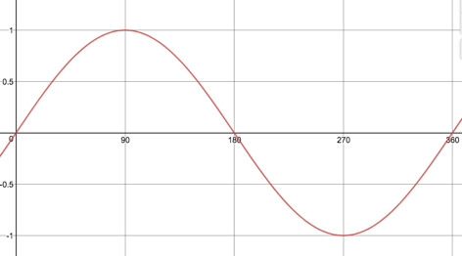
Image Briefing – Img16 (1 of 10)
Create a set of images that are displayed one by one as the learner clicks on the button. This is the basic design of the images.
N
S
Next

Slide 32
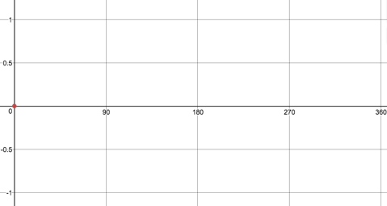
Image Briefing – Img16 (2 of 10)
Position 1
N
S
Conductor at 0°
The conductor lies parallel to the magnetic field lines and is no cutting any of the field lines. Therefore, no emf is induced in the conductor.
Next

Slide 33
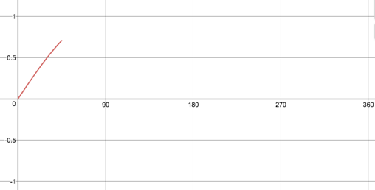
Image Briefing – Img16 (3 of 10)
Position 2
N
S
Conductor at 45°
The conductor cuts the field lines and its magnetic flux is increasing. Therefore, an emf is induced and current flows in the positive direction.
Next

Slide 34
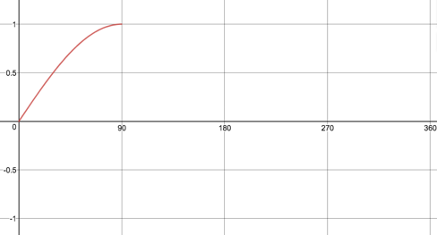
Image Briefing – Img16 (4 of 10)
Position 3
N
S
Conductor at 90°
The conductor is perpendicular to the field lines. Its magnetic flux is at a maximum. Therefore a maximum emf is induced.
Next

Slide 35
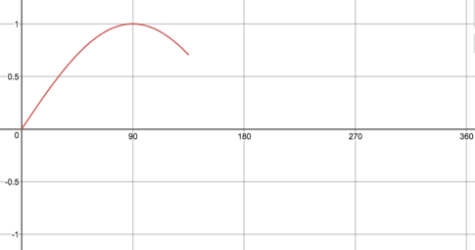
Image Briefing – Img16 (5 of 10)
Position 4
N
S
Conductor at 135°
The conductor is now cutting fewer field lines. Its magnetic flux is decreasing and a smaller emf then before is being produced.
Next

Slide 36
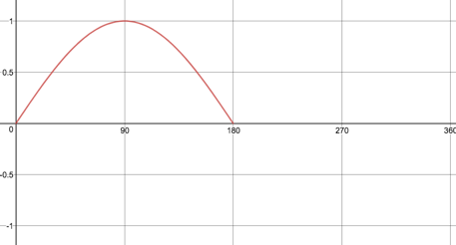
Image Briefing – Img16 (6 of 10)
Position 5
N
S
Conductor at 180°
The conductor is once again parallel to the field lines. Therefore there is no magnetic flux and no emf is induced.
Next

Slide 37
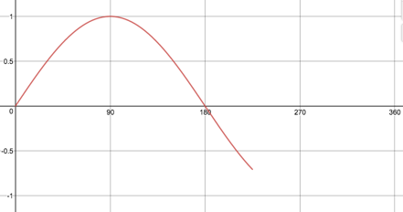
Image Briefing – Img16 (7 of 10)
Position 6
N
S
Conductor at 225°
The conductor cuts the field lines and an emf is produced. This time, however, the other side of the conductor is facing the North pole. Therefore the induced emf is reversed and current will flow in the opposite direction to before.
Next

Slide 38
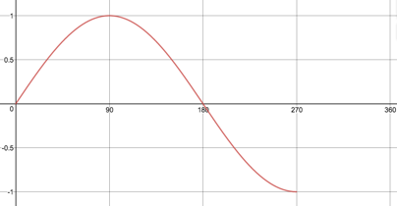
Image Briefing – Img16 (8 of 10)
Position 7
N
S
Conductor at 270°
The conductor is again perpendicular to the field lines so magnetic flux is a maximum. Therefore a maximum emf is induced, but this time in the opposite direction to before.
Next

Slide 39
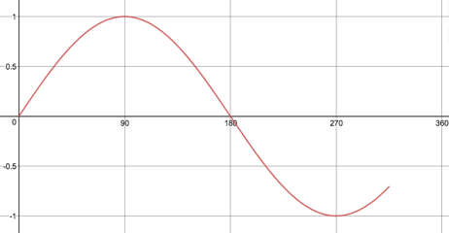
Image Briefing – Img16 (9 of 10)
Position 8
N
S
Conductor at 315°
The conductor is cutting fewer field lines then before so the magnetic flux has reduced. Therefore the induced emf has also reduced.
Next

Slide 40
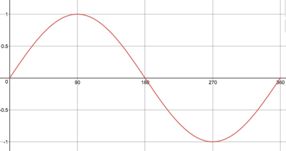
Image Briefing – Img16 (10 of 10)
Position 9
N
S
Conductor at 360°
The conductor has rotated through a full cycle and again lies parallel to the field lines. Therefore, no emf is induced.
Next

