Slide 1
Electrical Principles
Topic 3: Solving DC Electrical Circuits

Slide 2
Assumed prior learning
05_01_00
05_01_02
05_02_01
05_03_01
05_04_01
Notes:
Note for navigation on site:
This information needs to be taken into account and needs to stated on the LMS, perhaps as part of the introduction?

Slide 3
Outcomes
By the end of this unit the learner will be able to:
Explain and apply Kirchoff’s current law and Kirchoff’s voltage law in combination circuits.

Slide 4
Unit 3.4: Kirchoff’s Laws in ombination Circuits

Slide 5
Introduction
In the last unit, we got some practice solving simple combination circuits.
In this unit, we are going to learn how to apply Kirchoff’s Voltage and Current Laws to solve more complicated combination circuits.
Kirchoff’s Current Law
Kirchoff’s Voltage Law
Click on each button to see a reminder of each of these laws.
Notes:
Kirchoff’s Current Law = on click, present slide 6 as a popup
Kirchoff’s Voltage Law = on click, present slide 7 as a popup

Slide 6
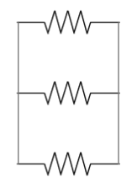
Kirchoff’s current law
R₁
The sum of the currents entering a node or junction is equal to the sum of the currents leaving the node or junction.
This is also called the First Law and applies to parallel circuits.
I₁
R₂
I_{T}
I₂
I_{T}
R₃
I₃
I_{T} = I₁ + I₂ + I₃
Notes:
Img01 - redraw

Slide 7
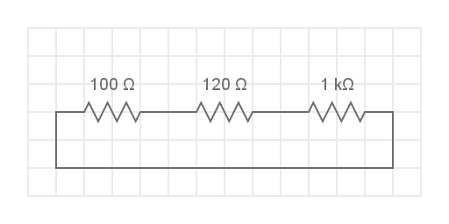
Kirchoff’s voltage law
The sum of the voltage drops in a closed circuit is equal to the applied circuit voltage.
This is also called the Second Law and applies to series circuits.
V₁
V₂
V₃
R₁
R₂
R₃
V_{T}
V_{T} = V₁ + V₂ + V₃
Notes:
Img02 = based on Img12 from 01_03

Slide 8
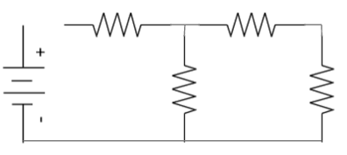
Solving circuits using Kirchoff – example 1
R₁=6Ω
R₃=12Ω
In this circuit, calculate the current through R₁ and R₂.
V_{T}=24V
R₂=8Ω
R₄=4Ω
Try this question on your own. Start by redrawing the circuit on a blank piece of paper. When you are done, watch the full worked solution.
See the full worked solution
Notes:
Img03 – redraw
See the full worked solution = on click, play Vid01 full screen. See appendix for brief

Slide 9
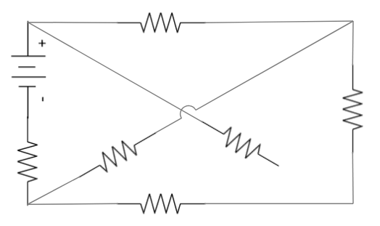
Solving circuits using Kirchoff – example 2
D
I₂
8Ω
A
I₁
Use Kirchoff’s laws to determine the values of I₁ and I₂. Only use loops DABCD and DACD.
I₁ – I₂
0.9A
V_{T}=12V
6Ω
2Ω
4Ω
4Ω
C
I₁ - 0.9A
B
8Ω
Try this example on your own first and then watch the full worked solution.
See the full worked solution
Notes:
Img04 = Redraw
See the full worked solution = on click, play Vid02 full screen. See appendix for brief

Slide 10
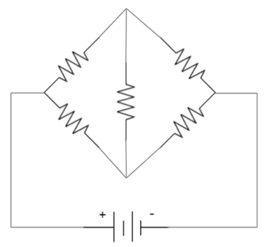
Solving circuits using Kirchoff – example 3
B
Determine, with the aid of Kirchoff’s laws:
The equation for loop ABDA;
The equation for loop BCDB; and
I₁ and I₂
I₁-0.012A
R₁=10Ω
R₂=15Ω
I₁
0.012A
A
C
I₂
R₅=5Ω
R₄=25Ω
R₃=20Ω
I₂+0.012A
D
I_{T}
V_{T}=12V
Try this example on your own first and then watch the full worked solution.
See the full worked solution
Notes:
Img05 = Redraw
See the full worked solution = on click, play Vid03 full screen. See appendix for brief

Slide 11
Test Yourself
We have come to the end of this unit. Answer the following questions to make sure you understand Kirchoff’s Laws in combination circuits.
Notes:
See 01_03_04_Activity for the original questions. Doc01 = This document must also be formatted into a downloadable worksheet. The memo is 01_03_04_Activity Solutions – see appendix for brief

Slide 12
Question 1
Kirchoff’s first law is applicable to
Series circuits
Parallel circuits
Series-parallel circuits
Notes:
MCQ
Correct answer: b
Feedback:
Correct – Well done. That is correct.
Incorrect – That is not correct. Kirchoff’s first law is the current law. The voltage law is called Kirchoff’s second law.

Slide 13
Question 2
Which definition of Kirchoff’s voltage law is the most accurate?
The sum of the voltage drops in a closed circuit is equal to the applied voltage.
The algebraic sum of the voltage drops in a closed circuit is equal to the applied voltage.
The algebraic sum of the voltage drops in a parallel circuit is equal to the applied voltage.
Notes:
MCQ
Correct answer: b
Feedback:
Correct – Well done. That is correct
Incorrect – That is not correct. Kirchoff’s voltage law does not only apply to parallel circuits and it is the not just the sum but the algebraic sum of voltage drops that equals the applied voltage. In other words, if there are 2 voltage drops in a circuit of 2V and -0.5V, this would equate to an applied voltage of 1.5V and not 2.5V.

Slide 14
Question 3
Indicate whether the following statement is TRUE or FALSE:
Kirchoff’s current law states that the algebraic sum of the currents entering a point is equal to the algebraic sum of the current leaving a point.
True
False
Notes:
T/F question
Correct answer: True
Feedback:
Correct – Well done. This is correct.
Incorrect – That is not correct. This statememt is a statement of Kichoff’s first or current law.

Slide 15
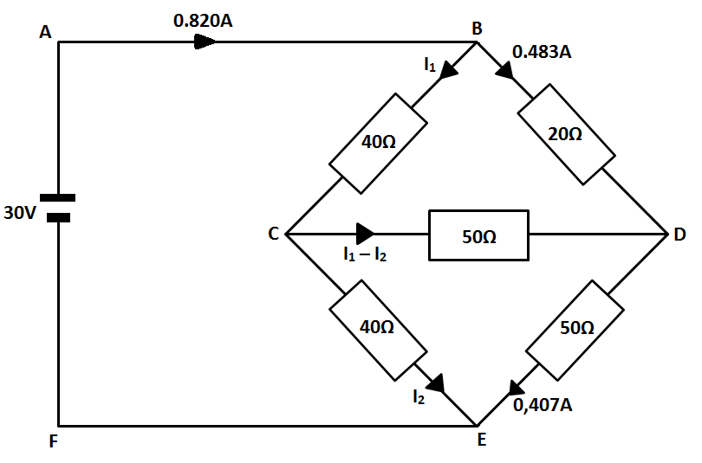
Question 4
Use Kirchoff’s method to calculate the current flow I₁ – I₂ in this circuit. Enter your answer (correct to 3 decimal places) in the space below. Make sure to include the correct units.
Notes:
Maths cloze question with symbol selector
Correct answer: -0.076A or -76mA
See 01_03_04_Activity Solutions for full worked solution.

Slide 16
Question 5
Study the circuit and then use Kirchoff’s laws to answer the questions that follow:

Slide 17
Question 5
5.1:
What is the equation of loop ABCEFA?
$5=5I_{1}−40I_{2}$
$4=5I_{1}+40I_{2}$
$5=5I_{1}+40I_{2}$
$4=5I_{1}−40I_{2}$
Notes:
MCQ:
Correct answer: c
Feedback:
Correct: Well done. That is correct.
Incorrect. That is not correct. Have a look at the worked solution to see where you went wrong. See 01_03_04_Activity Solutions for full worked solution.

Slide 18
Question 5
5.2:
What is the equation of loop CDEC?
$3=5I_{1}−45I_{2}$
$4=5I_{1}+45I_{2}$
$1=5I_{1}+45I_{2}$
$1=5I_{1}−45I_{2}$
Notes:
MCQ:
Correct answer: d
Feedback:
Correct: Well done. That is correct.
Incorrect. That is not correct. Have a look at the worked solution to see where you went wrong. See 01_03_04_Activity Solutions for full worked solution.

Slide 19
Question 5
5.3:
Calculate the value of I₁ and I₂ and enter your answers (correct to 3 decimal places) in the spaces below. Make sure to include the correct units.
I₁
I₂
Notes:
Maths cloze question with symbol selector
Correct Answer: I1 = 0.624A or 624mA; I2 = 0.047A or 47mA
Feedback:
Correct: Well done. That is correct.
Incorrect. That is not correct. Have a look at the worked solution to see where you went wrong. See 01_03_04_Activity Solutions for full worked solution.

Slide 20
Question 6
Determine the currents I₁, I₂, I₃ and I₄ in this circuit making use of Kirchoff’s laws. enter your answers (correct to 3 decimal places) in the spaces below. Make sure to include the correct units.
0,6 A
0,9 A
0,3 A
I₁
I₂
I₁
I₄
2,5 A
2,5 A
I₂
I₃
I₃
0,6 A
0,3 A
I₄
Notes:
Maths cloze question with symbol selector
Correct Answer: I1 = 1.5A; I2 = 1A; I3 = 1.9A; I4 = 0.6A
Feedback:
Correct: Well done. That is correct.
Incorrect. That is not correct. Have a look at the worked solution to see where you went wrong. See 01_03_04_Activity Solutions for full worked solution.

Slide 21
Video Briefing – Vid01 (1 of 6)
Create a screencast video presented by an expert presenter. The presenter needs to work through the example using Img03 and the following steps. At each step, learners should be encouraged to pause the video and add to their diagram or try the calculations themselves.
Step 1: Label each corner and intersection
R₁=6Ω
R₃=12Ω
A
B
C
V_{T}=24V
R₂=8Ω
R₄=4Ω
F
E
D

Slide 22
Video Briefing – Vid01 (2 of 6)
Step 2: Use KCL to label current in each branch limiting the number of variables to 2. Explain that we could either use I2 = IT – I3 or I3 = IT – I2.
R₁=6Ω
R₃=12Ω
A
B
C
I_{T}
I₃
I₂=I₁-I₃
V_{T}=24V
R₂=8Ω
R₄=4Ω
F
E
D

Slide 23
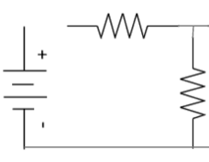
Video Briefing – Vid01 (3 of 6)
Step 3: Choose a CLOSED loop in direction of conventional current. Explain that we could also use loop BCDEB.
R₁=6Ω
A
B
I_{T}
I₂=I₁-I₃
V_{T}=24V
R₂=8Ω
F
E

Slide 24
Video Briefing – Vid01 (4 of 6)
Step 4: Use KVL to generate an equation of the voltage drops in the loop.
R₁=6Ω
$$V_{T}=V_{1}+V_{2}$$
$$∴24V=I_{T}R_{1}+(I_{T}−I_{3})R_{2}$$
$$∴24=6I_{T}+8I_{T}−8I_{3}$$
$$∴24=14I_{T}−8I_{3}$$
A
B
I_{T}
V₁
I₂=I₁-I₃
V_{T}=24V
V₂
R₂=8Ω
F
E

Slide 25
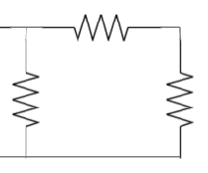
Video Briefing – Vid01 (5 of 6)
Step 5: Now set up a similar voltage equation using KVL in the other loop BCDEB.
V_{T} = V₃ + V₄ – V₂
V_{T} = 0 since there is no voltage source in the loop.
V₂ is negative because the direction of the loop is against the flow of conventional current.
0 = I₃R₃ + I₃R₄ – (I_{T} – I₃)R₂
0 = 12I₃ + 4I₃ – 8I_{T} + 8I₃
0 = 24I₃ – 8I_{T}
R₃=12Ω
B
C
I₃
I₂=I₁-I₃
V₂
V₂
R₂=8Ω
V₄
R₄=4Ω
E
D

Slide 26
Video Briefing – Vid01 (6 of 6)
Step 6: Solve the 2 equations simultaneously
24 = 14I_{T} – 8I₃ …. (1)
0 = 24I₃ – 8I_{T} …. (2)
Multiply (1) by 3: 72 = 42I_{T} – 24I₃
∴ 24I₃ = 42I_{T} – 72 … (3)
Substitute (3) into (2): 0 = (42I_{T} – 72) – 8I_{T}
∴ 0 = 42I_{T} – 72 – 8I_{T} = 34I_{T} – 72
∴ 72 = 34I_{T}
∴ I_{T} = 72/34 = 2.118A
Substitute into (3): 24I₃ = 42(2.118A) – 72
∴ 24I₃ = 16.956A
∴ I₃ = 16.956/24 = 0.7065A
∴ I₂ = 2.118A – 0.7065A = 1.412A
Check solution with http://everycircuit.com/circuit/5278768561389568

Slide 27
Video Briefing – Vid02 (1 of 4)
Create a screencast video presented by an expert presenter. The presenter needs to work through the example using Img04 and the following steps. At each step, learners should be encouraged to pause the video and add to their diagram or try the calculations themselves.
Step 1: Redraw the circuit diagram including all the given information. Highlight the 2 loops.
D
I₂
8Ω
A
I₁
I₂ - 0.9A
I₁ – I₂
0.9A
V_{T}=12V
6Ω
2Ω
4Ω
4Ω
C
I₁ - 0.9A
B
8Ω

Slide 28
Video Briefing – Vid02 (2 of 4)
Work in loop DACD to set up an equation using KVL

Slide 29
Video Briefing – Vid02 (2 of 4)
Work in loop DABCD to set up an equation using KVL

Slide 30
Video Briefing – Vid02 (2 of 4)
Solve the equations simultaneously

Slide 31
Video Briefing – Vid03 (1 of 4)
Create a screencast video presented by an expert presenter. The presenter needs to work through the example using Img05 and the following steps. At each step, learners should be encouraged to pause the video and add to their diagram or try the calculations themselves.
Step 1: Redraw the circuit diagram including all the given information. Highlight the 2 loops.
B
I₁-0.012A
R₁=10Ω
R₂=15Ω
I₁
0.012A
A
C
I₂
R₅=5Ω
R₄=25Ω
R₃=20Ω
I₂+0.012A
D
I_{T}
V_{T}=12V

Slide 32
Video Briefing – Vid03 (2 of 4)
Work in loop ABDA
V_{T} = V₁ + V₅ – V₄
Remind learners:
V_{T} = 0 because there is no voltage source in the loop
V₄ is negative because direction of the loop is opposite to conventional current

Slide 33
Video Briefing – Vid03 (3 of 4)
Work in loop BCDB
V_{T} = V₂ - V₃ – V₅
Remind learners:
V_{T} = 0 because there is no voltage source in the loop
V₃ and V₅ are negative because direction of the loop is opposite to conventional current

Slide 34
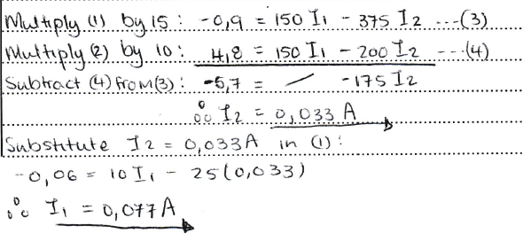
Video Briefing – Vid03 (4 of 4)
Solve the equations simultaneously

Slide 35
Document Briefing – Doc01
Create a worksheet based on 01_03_04_Activity and a worked solutions memo based on 01_03_04_Activity Solutions

Slide 36
Determine, with the aid of Kirchoff’s laws:
The equation for loop ABDA;
The equation for loop BCDB; and
I₁ and I₂

