Slide 1
Electrical Principles
Topic 3: Solving DC Electrical Circuits

Slide 2
Assumed prior learning
05_01_00
05_01_02
05_02_01
05_03_01
05_04_01
Notes:
Note for navigation on site:
This information needs to be taken into account and needs to stated on the LMS, perhaps as part of the introduction?

Slide 3
Outcomes
By the end of this unit the learner will be able to:
Calculate current, voltage, resistance and power in circuit in combination circuits.

Slide 4
Unit 3.3: Combination Circuits

Slide 5
Introduction
So far in this topic, we have looked at series circuits and parallel circuits.
In this unit, we are going to solve combination circuits – circuits that have series and parallel elements.
Click on different parts of the image to learn more.
Notes:
Img01 = https://www.electronicshub.org/wp-content/uploads/2014/12/5.-Resistors-in-Combination-Circuit.png

Slide 6
Series and parallel circuits
Before we begin, let’s quickly revise what we know about series and parallel circuits.
Click on each circuit for a summary of what we know.
Parallel Circuit
Series Circuit
Notes:
Img02 = Img02 from 01_03_02 without the arrows, nodes and labels
Img03 = Img03 from 01_03_02 without arrows

Slide 7
Series circuit summary
In a series circuit the following are true.
Img04
Img06 from 01_03_01
R_{T} = R₁ + R₂ + R₃
I_{T} = I₁ = I₂ = I₃
V_{T} = V₁ + V₂ + V₃
Notes:
Img04 = Img06 from 01_03_01
Duplicate slide 17 from 01_03_01

Slide 8
Parallel circuit summary
In a parallel circuit the following are true.
Img05
Img05 from 01_03_02
V_{T} = V₁ = V₂ = V₃
I_{T} = I₁ + I₂ + I₃
$$\frac{1}{R_{T}}=\frac{1}{R_{1}}+\frac{1}{R_{2}}+\frac{1}{R_{3}}$$
Notes:
Img05 = Img05 form 01_03_02
Duplicate slide 12 from 01_03_02

Slide 9
Remember power
Also, remember that we can calculate the power dissipated in a circuit using any of the following three expressions
P = V x I
But V = I x R
∴ P = (I x R) x R
∴ P = I² x R
But I = V/R
∴ P = V x (V/R)
∴ P = V²/R

Slide 10
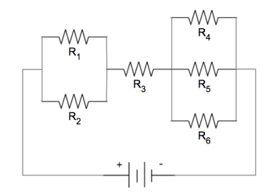
Solving combination circuits – example 1
Let’s start with this example.
6Ω
In this circuit, calculate the:
Total resistance
Voltage drop across R1, R3 and R4
Current through R2, R3 and R5
10Ω
18Ω
12Ω
15Ω
22Ω
V_{T} = 12V
Redraw the circuit on a blank piece of paper.
Notes:
Img06 = redraw circuit

Slide 11
Solving series circuits – step 1
Once you have drawn the basic circuit, you need to label it. When dealing with combination circuits, it is important that you label it correctly. This will help later on.
Img07
Click on the image to see a full screen version of how you should label your circuit.
Notes:
Img07 = on click, display Img07 full screen. See appendix for brief

Slide 12
Did you notice?
Img07
Just by looking at your labeled image, what can you say about
I₃
V₁ and V₂
V₄, V₅ and V₆?
Click on the button to see the answers.
Answers
Notes:
Img07
Answers = on click, present the following in a popup.
I₃ = I_{T} (Kirchoff’s current law
V₁ = V2 = V1 (voltage is the same over resistors in parallel)
V4 = V5 = V6 = V2 (voltage is the same over resistors in parallel)

Slide 13
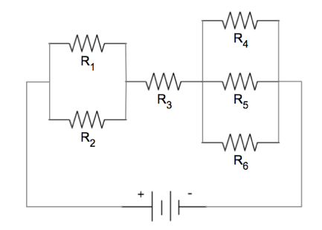
Solving combination circuits – step 2
When dealing with combination circuits, the basic strategy is to make them into series circuits by finding the equivalent series resistances of all the parallel parts.
R∥₁
I₄
R∥₂
=6Ω
I₁
V₄
=10Ω
I_{T}
V₁
I₃
I₅
=18Ω
=12Ω
I₂
V₅
=15Ω
I₆
V₂
=22Ω
Calculate the resistances of R∥₁
and R∥₂.
V∥₁
V₁
V∥₂
V_{T} = 12V
R∥₁
Ω
R∥₂
Ω
Check
Notes:
Img07
Fill in the blank question
Correct answers: R∥₁=6Ω | R∥₂=3.385Ω
Feedback:
Correct – Well done. You got those calculations right.
Incorrect – That is not correct. Here are the correct calculations. R∥₁=$\frac{1}{R_{1}}+\frac{1}{R_{2}}=\frac{1}{10}+\frac{1}{15}∴{R∥}_{1}=6Ω$. R∥₂=$\frac{1}{R_{1}}+\frac{1}{R_{2}}+\frac{1}{R_{3}}=\frac{1}{6}+\frac{1}{12}+\frac{1}{22}∴{R∥}_{2}=3.385Ω$

Slide 14
Solving combination circuits – step 3
Now that we have calculated the equivalent resistances of the parallel parts, we can redraw the circuit as a series circuit.
Img08
Redraw your circuit as a series circuit and then click on the image to see a full screen version of what your circuit should look like.
Notes:
Img08 = on click, display Img08 full screen. See appendix for brief

Slide 15
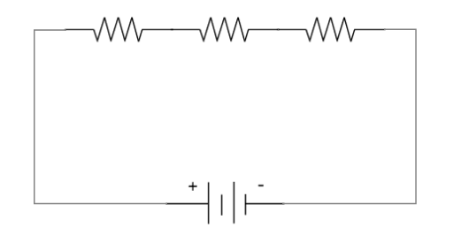
Solving combination circuits – step 4
Finally, we can answer the questions. The first question asked you to calculate the total resistance.
R∥₁=6Ω
R₃=18Ω
R∥₂=3.385Ω
I_{T}
I₃
V∥₁
V₃
V∥₂
Calculate the total resistance in the circuit.
V_{T} = 12V
Ω
Check
Notes:
Img08
Fill in the blank question
Correct answer: 27.385Ω
Feedback:
Correct – Well done. You got it!
Incorrect – That is not correct. $R_{T}={R∥}_{1}+{R∥}_{2}+R_{3}=6Ω+3.385Ω+18Ω=27.385Ω$

Slide 16
Solving combination circuits – step 4
Calculate the voltage drop across R₁, R₃ and R₄.
R∥₁=6Ω
R₃=18Ω
R∥₂=3.385Ω
I_{T}
I₃
V∥₁
V₃
V∥₂
V₁
V
Check
V₃
V
Check
V₄
V
Check
V_{T} = 12V
See the full worked solution
Notes:
Img08
Fill in the blank question
Correct answers: V₁ = 2.628V | V₃ = 7.884V | V₄ = 1.483V
Feedback:
V₁
Correct – Well done. You got it!
Incorrect – That is not correct. Watch the video to see the full worked solution.
V₃
Correct – Well done. You got it!
Incorrect – That is not correct. Watch the video to see the full worked solution.
V₄
Correct – Well done. You got it!
Incorrect – That is not correct. Watch the video to see the full worked solution.
See the full worked solution = only display ater all answers have been submitted. On click, play Vid01 full screen. See appendix for Vid01.

Slide 17
Solving combination circuits – step 4
Calculate the current through drop across R₂, R₃ and R₅.
R∥₁=6Ω
R₃=18Ω
R∥₂=3.385Ω
I_{T}
I₃
V∥₁
V₃
V∥₂
I₂
A
Check
I₃
A
Check
I₅
A
Check
V_{T} = 12V
See the full worked solution
Notes:
Img08
Fill in the blank question
Correct answers: I₂ = 0.175A | I₃ = 0.438A | I₅ = 0.124A
Feedback:
V₁
Correct – Well done. You got it!
Incorrect – That is not correct. Watch the video to see the full worked solution.
V₃
Correct – Well done. You got it!
Incorrect – That is not correct. Watch the video to see the full worked solution.
V₄
Correct – Well done. You got it!
Incorrect – That is not correct. Watch the video to see the full worked solution.
See the full worked solution = only display ater all answers have been submitted. On click, play Vid02 full screen. See appendix for Vid02.

Slide 18
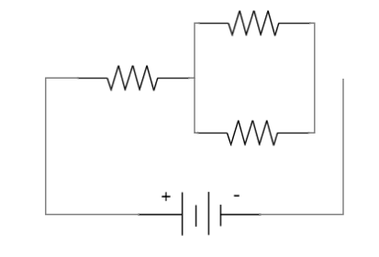
Solving combination circuits – example 2
R₃=34Ω
In this circuit, calculate the:
Resistance of the parallel section
Total resistance;
Power consumed by R₁;
Total voltage; and
Voltage across the parallel section.
R₁=18Ω
R₂=42Ω
I_{T}=9A
V_{T}
Try the question on your own and then watch the full worked solution.
Full worked solution
Notes:
Img09 – redraw
Full worked solution = on click, play Vid03 full screen. See appendix for brief

Slide 19
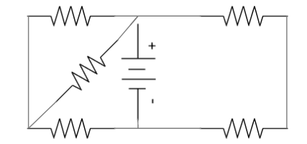
Solving combination circuits – example 3
In this circuit, calculate the:
Total resistance in the circuit;
Total current flowing in the circuit; and
The voltage drop across the 950Ω resistor.
790Ω
800Ω
950Ω
200V
900Ω
630Ω
Hint
Try the question on your own and then watch the full worked solution.
Full worked solution
Notes:
Img10 – redraw
Full worked solution = on click, play Vid04 full screen. See appendix for brief
Hint = on click, display slide 20 in a popup

Slide 20
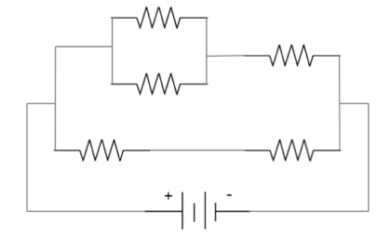
This circuit may seem very unusual but it is just an ordinary combination circuit. The first thing you should do is redraw it in the more recognizable combination circuit form.
790Ω
800Ω
790Ω
900Ω
950Ω
950Ω
200V
800Ω
630Ω
900Ω
630Ω
200V
Notes:
Img11 = redraw

Slide 21
Test Yourself
We have come to the end of this unit. Answer the following questions to make sure you understand resistors in combination circuits.
Notes:
See 01_03_03_Activity for the original questions. Doc01 = This document must also be formatted into a downloadable worksheet. The memo is 01_03_03_Activity Solutions – see appendix for brief

Slide 22
Question 1
Two resistors R₁ and R₂ with values of 15Ω and 10Ω respectively are connected in parallel. This combination is then connected in series to a third resistor, R₃, which has a value of 5Ω. The complete circuit is supplied by a 100V DC power source.

Slide 23
Question 1
1.1:
Calculate the resistance of the parallel combination and enter your answer (correct to 3 decimal places) in the space below. Make sure to include the correct units.
Notes:
Maths cloze question with symbol selector
Correct answer: 6Ω
Feedback:
Correct: Well done. That is correct.
Incorrect. That is not correct. Have a look at the worked solution to see where you went wrong. See 01_03_03_Activity Solutions for full worked solution.

Slide 24
Question 1
1.2:
Calculate the total resistance of the circuit and enter your answer (correct to 3 decimal places) in the space below. Make sure to include the correct units.
Notes:
Maths cloze question with symbol selector
Correct Answer: 11Ω
Feedback:
Correct: Well done. That is correct.
Incorrect. That is not correct. Have a look at the worked solution to see where you went wrong. See 01_03_03_Activity Solutions for full worked solution.

Slide 25
Question 1
1.3:
Calculate the total current in the circuit and enter your answer (correct to 3 decimal places) in the space below. Make sure to include the correct units.
Notes:
Maths cloze question with symbol selector
Correct Answer: 9.091A
Feedback:
Correct: Well done. That is correct.
Incorrect. That is not correct. Have a look at the worked solution to see where you went wrong. See 01_03_03_Activity Solutions for full worked solution.

Slide 26
Question 1
1.4:
Calculate the power dissipated by the parallel combination and enter your answer (correct to 3 decimal places) in the space below. Make sure to include the correct units.
Notes:
Maths cloze question with symbol selector
Correct Answer: 495.878W
Feedback:
Correct: Well done. That is correct.
Incorrect. That is not correct. Have a look at the worked solution to see where you went wrong. See 01_03_03_Activity Solutions for full worked solution.

Slide 27
Question 1
1.5:
Calculate voltage drop across R₃ and enter your answer (correct to 3 decimal places) in the space below. Make sure to include the correct units.
Notes:
Maths cloze question with symbol selector
Correct Answer: 45.455V
Feedback:
Correct: Well done. That is correct.
Incorrect. That is not correct. Have a look at the worked solution to see where you went wrong. See 01_03_03_Activity Solutions for full worked solution.

Slide 28
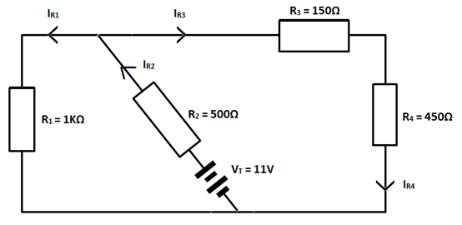
Question 2
Study the circuit and then answer the questions that follow.

Slide 29
Question 2
2.1:
Calculate the total resistance (R_{T}) of the circuit and enter your answer (correct to 3 decimal places) in the space below. Make sure to include the correct units.
Notes:
Maths cloze question with symbol selector
Correct Answer: 875Ω
Feedback:
Correct: Well done. That is correct.
Incorrect. That is not correct. Have a look at the worked solution to see where you went wrong. See 01_03_03_Activity Solutions for full worked solution.

Slide 30
Question 2
2.2:
Calculate the current I_{R2} and enter your answer (correct to 3 decimal places) in the space below. Make sure to include the correct units.
Notes:
Maths cloze question with symbol selector
Correct Answer: 0.013A or 13mA
Feedback:
Correct: Well done. That is correct.
Incorrect. That is not correct. Have a look at the worked solution to see where you went wrong. See 01_03_03_Activity Solutions for full worked solution.

Slide 31
Question 2
2.3:
Calculate the voltage drop V_{R2} and enter your answer (correct to 3 decimal places) in the space below. Make sure to include the correct units.
Notes:
Maths cloze question with symbol selector
Correct Answer: 6.5V
Feedback:
Correct: Well done. That is correct.
Incorrect. That is not correct. Have a look at the worked solution to see where you went wrong. See 01_03_03_Activity Solutions for full worked solution.

Slide 32
Question 2
2.4:
Calculate the voltage drop V_{R1} and enter your answer (correct to 3 decimal places) in the space below. Make sure to include the correct units.
Notes:
Maths cloze question with symbol selector
Correct Answer: 4.5V
Feedback:
Correct: Well done. That is correct.
Incorrect. That is not correct. Have a look at the worked solution to see where you went wrong. See 01_03_03_Activity Solutions for full worked solution.

Slide 33
Question 2
2.5:
Calculate the value of the current I_{R1} and enter your answer (correct to 3 decimal places) in the space below. Make sure to include the correct units.
Notes:
Maths cloze question with symbol selector
Correct Answer: 0.005A or 4.5mA
Feedback:
Correct: Well done. That is correct.
Incorrect. That is not correct. Have a look at the worked solution to see where you went wrong. See 01_03_03_Activity Solutions for full worked solution.

Slide 34
Question 2
2.6:
Calculate the power consumed by the resistor R₄ and enter your answer (correct to 3 decimal places) in the space below. Make sure to include the correct units.
Notes:
Maths cloze question with symbol selector
Correct Answer: 32.5mW or 0.033W
Feedback:
Correct: Well done. That is correct.
Incorrect. That is not correct. Have a look at the worked solution to see where you went wrong. See 01_03_03_Activity Solutions for full worked solution.

Slide 35
Question 3
The DC circuit has a supply voltage of 60V. A voltmeter is connected across the 2K2Ω resistor. Analyse the circuit and then answer the following questions.

Slide 36
Question 3
3.1:
Calculate the total resistance of the circuit and enter your answer (correct to 3 decimal places) in the space below. Make sure to include the correct units.
Notes:
Maths cloze question with symbol selector
Correct Answer: 468.613Ω
Feedback:
Correct: Well done. That is correct.
Incorrect. That is not correct. Have a look at the worked solution to see where you went wrong. See 01_03_03_Activity Solutions for full worked solution.

Slide 37
Question 3
3.2:
Calculate the total current in the circuit and enter your answer (correct to 3 decimal places) in the space below. Make sure to include the correct units.
Notes:
Maths cloze question with symbol selector
Correct Answer: 0.128A or 128mA
Feedback:
Correct: Well done. That is correct.
Incorrect. That is not correct. Have a look at the worked solution to see where you went wrong. See 01_03_03_Activity Solutions for full worked solution.

Slide 38
Question 3
3.3:
Calculate the voltage across the 2K2Ω resistor and enter your answer (correct to 3 decimal places) in the space below. Make sure to include the correct units.
Notes:
Maths cloze question with symbol selector
Correct Answer: 36.96V
Feedback:
Correct: Well done. That is correct.
Incorrect. That is not correct. Have a look at the worked solution to see where you went wrong. See 01_03_03_Activity Solutions for full worked solution.

Slide 39
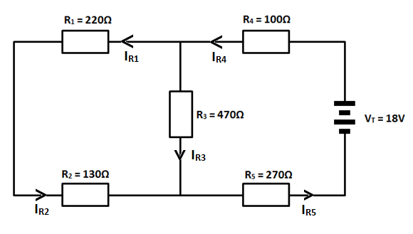
Question 4
Study the circuit and then answer the question that follow.

Slide 40
Question 4
4.1:
Calculate the total resistance (R_{T}) of the circuit and enter your answer (correct to 3 decimal places) in the space below. Make sure to include the correct units.
Notes:
Maths cloze question with symbol selector
Correct Answer: 570.61Ω
Feedback:
Correct: Well done. That is correct.
Incorrect. That is not correct. Have a look at the worked solution to see where you went wrong. See 01_03_03_Activity Solutions for full worked solution.

Slide 41
Question 4
4.2:
Calculate the value of the current I_{R4} and enter your answer (correct to 3 decimal places) in the space below. Make sure to include the correct units.
Notes:
Maths cloze question with symbol selector
Correct Answer: 0.032A or 32mA
Feedback:
Correct: Well done. That is correct.
Incorrect. That is not correct. Have a look at the worked solution to see where you went wrong. See 01_03_03_Activity Solutions for full worked solution.

Slide 42
Question 4
4.3:
Calculate the value of the voltage drop V_{R4} and enter your answer (correct to 3 decimal places) in the space below. Make sure to include the correct units.
Notes:
Maths cloze question with symbol selector
Correct Answer: 3.2V
Feedback:
Correct: Well done. That is correct.
Incorrect. That is not correct. Have a look at the worked solution to see where you went wrong. See 01_03_03_Activity Solutions for full worked solution.

Slide 43
Question 4
4.4:
Calculate the value of the voltage drop V_{R5} and enter your answer (correct to 3 decimal places) in the space below. Make sure to include the correct units.
Notes:
Maths cloze question with symbol selector
Correct Answer: 8.64V
Feedback:
Correct: Well done. That is correct.
Incorrect. That is not correct. Have a look at the worked solution to see where you went wrong. See 01_03_03_Activity Solutions for full worked solution.

Slide 44
Question 4
4.5:
Calculate the value of the voltage drop V_{R3} and enter your answer (correct to 3 decimal places) in the space below. Make sure to include the correct units.
Notes:
Maths cloze question with symbol selector
Correct Answer: 6.42V
Feedback:
Correct: Well done. That is correct.
Incorrect. That is not correct. Have a look at the worked solution to see where you went wrong. See 01_03_03_Activity Solutions for full worked solution.

Slide 45
Question 4
4.6:
Calculate the value of the current I_{R1} and enter your answer (correct to 3 decimal places) in the space below. Make sure to include the correct units.
Notes:
Maths cloze question with symbol selector
Correct Answer: 0.018A or 18mA
Feedback:
Correct: Well done. That is correct.
Incorrect. That is not correct. Have a look at the worked solution to see where you went wrong. See 01_03_03_Activity Solutions for full worked solution.

Slide 46
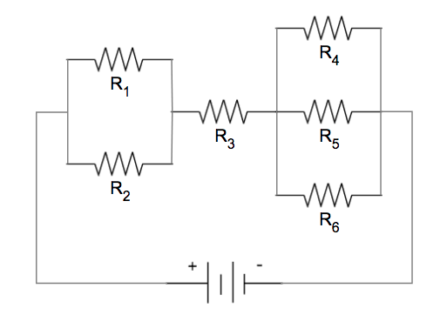
Image Briefing – Img07
When working with combination circuits, you must also label the portions of the circuit that are in parallel. In this case, we have labeled them R∥₁ and R∥₂.
R∥₁
R∥₂
I₄
=6Ω
I₁
=10Ω
V₄
I_{T}
V₁
I₃
I₅
=18Ω
=12Ω
V₅
I₂
=15Ω
I₆
V₂
=22Ω
V₁
V∥₁
V∥₂
V_{T} = 12V

Slide 47
Image Briefing – Img08
R∥₁=6Ω
R₃=18Ω
R∥₂=3.385Ω
I_{T}
I₃
V∥₁
V₃
V∥₂
V_{T} = 12V

Slide 48
Video Briefing – Vid01
Create a screencast video presented by an expert presenter. The presenter needs to work through the calculations for calculating the voltage drop across R1, R3 and R4.

Slide 49
Video Briefing – Vid02
Create a screencast video presented by an expert presenter. The presenter needs to work through the calculations for calculating the voltage drop across I1, I3 and I5.

Slide 50
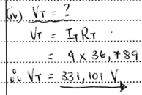
Video Briefing – Vid03
Create a screencast video presented by an expert presenter. The presenter needs to work through example 2 as follows, using the Img08 as a basis. Check the answers with http://http://everycircuit.com/circuit/5047957555773440.
V₁

Slide 51
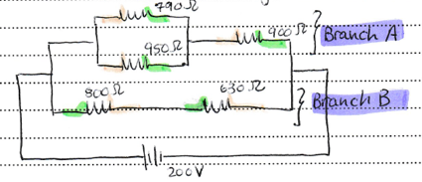
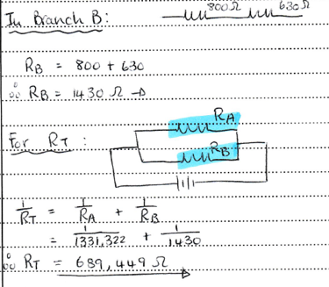
Video Briefing – Vid04 (1 of 2)
Create a screencast video presented by an expert presenter. The presenter needs to work through example 2 as follows, using the Img08 as a basis. Check the answers with http://everycircuit.com/circuit/4915314839257088.
First redraw the circuit…

Slide 52
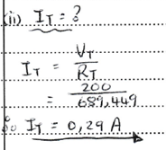
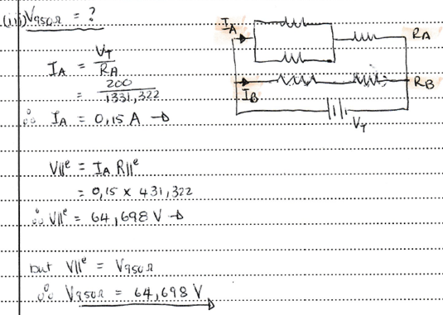
Video Briefing – Vid04 (2 of 2)

Slide 53
Document Briefing – Doc01
Create a worksheet based on 01_03_03_Activity and a worked solutions memo based on 01_03_03_Activity Solutions

