Slide 1
Electrical Principles
Topic 2: Electromagnetism

Slide 2
Assumed prior learning
05_01_00
05_01_02
05_02_01
05_03_01
05_04_01
Notes:
Note for navigation on site:
This information needs to be taken into account and needs to stated on the LMS, perhaps as part of the introduction?

Slide 3
Outcomes
By the end of this unit the learner will be able to:
Describe what self-induction is and explain how and why it occurs
Describe Lenz’s Law and use it to predict the direction of the induced back emf.
Calculate the magnitude of back emf induced when given the number of coil turns, magnetic flux and time taken for the field to reverse direction
State one application of self-induction

Slide 4
Unit 2.4: Self Induction

Slide 5
Introduction
We know from unit 2 that a current through a conductor produces a magnetic field around the conductor (the electromagnetic effect).
We know from unit 3 that a changing magnetic field induces an emf in a conductor (electromagnetic induction).
Therefore, if the magnetic field produced around the conductor by the electromagnetic effect is changing because the current is changing, will this induce an emf in the conductor itself?
Notes:
Img01 = https://upload.wikimedia.org/wikipedia/commons/thumb/3/35/Orange_question_mark.svg/2000px-Orange_question_mark.svg.png – marked for reuse

Slide 6
Self induction
The answer to the previous question is YES and is a process called self induction.
Self induction is when an emf is induced in a current carrying conductor because the current through the conductor is changing.
YT01
Watch the video to see a demonstration of self induction.
Notes:
YT01 = on click, play YT01 full screen. YT01 = https://www.youtube.com/watch?v=HxTYsO_4NBk

Slide 7
Self induction
The process by which self induction happens can be tricky to understand. Let’s take another look at how it works
Vid01
Watch the video for another demonstration and explanation of self-induction.
Notes:
Vid01 = on click, play Vid01 full screen. See appendix for brief

Slide 8
Solenoids and self induction
Because self induction relies on there being a changing magnetic field, we almost always use solenoids (coils) to demonstrate and apply self-induction. Remember, solenoids produce stronger magnetic fields than straight pieces of conductor so the self induction effects are greater in solenoids.
Notes:
Img02 = https://upload.wikimedia.org/wikipedia/commons/4/45/Solenoid-1.png – marked for reuse

Slide 9
How self induction works
Let’s review how self induction happens, step by step.
Click each button to step through the process again.
Changing Current
1
Changing Magnetic Field
2
Induced emf
3
Notes:
Display the following text in the box on click of each button.
1 – Changing current: For there to be self induction, the current through the conductor needs to be changing in some way – either increasing or decreasing. This rate of change can be constant or itself changing.
2 – Changing Magnetic Field: If the current through the conductor is changing, the magnetic field around the conductor will also be changing. As the current increases, the magnetic field builds up. As current decreases, the field collapses.
3 – Induced emf: When a conductor is in a changing magnetic field (either because the field is moving, or the conductor is moving, or the field is changing strength), then an emf will be induced in the conductor.

Slide 10
Important point
Remember that self induction will only happen if
The conductor experiences a changing magnetic field. This changing magnetic field is usually the result of a changing current like AC.
Notes:
Box 1 = on click, open slide 11 in a pop-up
Box 2 = on click, open slide 12 in a pop-up

Slide 11
Lenz’s Law and the direction of the induced emf
The direction of the self-induced emf is always such that it opposes the change in the magnetic flux that induced it in the first place.
This is called Lenz’s Law.
YT02
Watch the video to learn about Lenz’s Law.
Notes:
YT02 = on click, play YT02 full screen. YT02 = https://www.youtube.com/watch?v=xxZenoBs2Pg

Slide 12
Lenz’s Law
Here are 2 more excellent videos that explain Lenz’s Law and how we can apply it to work out the direction of the emf produced as a result of self induction.
Watch the video on the left first.
YT03
YT04
Notes:
YT03 = on click, play YT03 full screen. YT03 = htthttps://www.youtube.com/watch?v=wXcg7GnwssU
YT04 = on click, play YT04 full screen. YT04 = https://v637g.app.goo.gl/ssEfbybthRCccqLP9

Slide 13
Back emf
Img03
Because the induced emf is always in opposition to the change in magnetic flux that produced it, we call it back emf.
Click on the image to step through the process of self-induction to see how Lenz’s Law helps determine the direction of the back emf.
Notes:
Img05 = on click, display Img05 fullscreen. See appendix for brief

Slide 14
Back emf
Img04
Here is another step-by-step example of how Lenz’s Law determines the direction of the back emf.
Click on the image to step through this process.
Notes:
Img04 = on click, display Img06 fullscreen. See appendix for brief

Slide 15
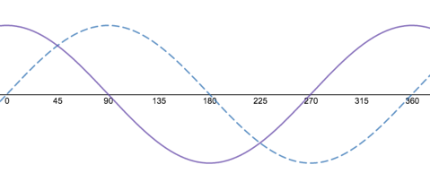
Important note
It is important to note that the back emf is not always in the opposite direction to the original emf (and current). Instead it always opposes the change in the magnetic flux that induced it.
Click on the image to open it full screen and then click on each part of the graph for an explanation of what is happening.
Notes:
Img05 = on click, display Img05 full screen. See appendix for brief.

Slide 16
Important note on back emf and current
AC
DC
In an AC circuit where there is always a changing supply voltage, the back emf does not actually produce a back current. The back emf simply opposes changes in the flow of the supply current.
In the case of a DC circuit when current first starts to flow, the back emf does not produce a back current. It opposes the increase in the supply current.
When the battery is disconnected, the back emf is the only source of voltage and so in this case results in a “back” current flowing as there is no supply voltage and current to resist. This is why the bulb only flashes when the battery is disconnected.
Notes:
Create a tab system

Slide 17
What’s it good for?
Self induction is a key feature of how inductors work in circuits, especially AC circuits. We will explore these properties in more detail in topic 4 of this course.
When combined with capacitors and resistors in AC circuits, inductors are used to create circuits like those in your radio for tuning to different frequencies.
Notes:
Img06 = https://c1.staticflickr.com/7/6207/6138240034_a4ea109e99_b.jpg – marked for reuse

Slide 18
How much back emf is induced
The magnitude of the back emf induced in a coil is dependent on
The number of turns in the coil (N)
1
The magnetic flux (Φ)
2
The time is takes for the magnetic field to reverse direction (t)
3
Notes:
On click of each symbol in the equation, display the text below in a popup:
E = induced emf, measured in V (volts)
B = strength of the magnetic field (or magntic flux density) measured in T (teslas)
l = the length of the conductor, measured in m (meters)
v = the velocity of the conductor (or the field), measured in ms⁻¹ (metres per second)

Slide 19
The back emf equation
We can use the following equation to calculate the amount of back emf induced in a coil.
Click on each symbol in the equation to find out more.
$$E=N\frac{Φ}{t}$$
Notes:
On click of each symbol in the equation, display the text below in a popup:
E = induced emf, measured in V (volts)
N = the number of turns in the coil
Φ = the magnetic flux in Wb (Webers)
t = the time it takes for the magnetic field to reverse direction in s (seconds)

Slide 20
Example
A magnetic flux of 600μWb passing through a coil of 1 000 turns is reversed in 0.1 seconds. Calculate the average value of the back emf induced in the coil?
Vid02
Try answering this question on your own and then watch the video for the full worked solution.
Notes:
Vid02 = on click, play Vid02 full screen. See appendix for brief

Slide 21
Activity
Tanya to provide

Slide 22
Test Yourself
We have come to the end of this unit. Answer the following questions to make sure you self induction.

Slide 23
Question 1
Tanya to provide
Notes:
MCQ:
Correct answer: c and d
Feedback:
= This is not correct. This statement is TRUE. For there to be electromagnetic induction, the conductor must cut through magnetic field lines. There is no electromagnetic induction if the conductor is parallel to the magnetic field lines.
= This is not correct. This statement is TRUE. For there to be electromagnetic induction, there must be a changing magnetic field so that the conductor cuts magnetic field lines. This change can be achieved by either moving the conductor or magnetic field or by directly changing the strength of the magnetic field.
= Well done. This statement is FALSE. It is not enough for a conductor to experience a magnetic field. It must experience a changing magnetic field.
= Well done. This statements is FALSE. The induced emf is proportional to the rate at which the conductor cuts the field lines. The faster the conductor cuts the field lines, the greater the emf.

Slide 24
Video Briefing – Vid01 (1 of 2)
Create a video of an expert electrician explaining and demonstrating the principles and process of self-induction in both a simple DC and AC circuit.
Start off with a simple DC circuit including a battery, solenoid and light bulb.
Connect battery. Disconnect battery and notice bulb flash.
Explain that as battery is connected, current starts to flow in the circuit. At this moment, current is increasing so there is a growing (changing) magnetic field produced around the solenoid.
Because this magnetic field is changing, an emf is induced in the coil itself.
After this time, the current through the solenoid is not changing – so there is no changing magnetic field – so there is no induced emf in the solenoid.
Explain that as the battery is disconnected, current stops flowing in the circuit. At this moment, current is decreasing so the magnetic field is collapsing (changing). Because the magnetic field is again changing, an emf will be induced in the solenoid. It is this emf that causes a current to flow in the circuit just after the battery is disconnected and it is this current that makes the bulb flash.
Notes:
Create an image like this one – voltage source, switch and solenoid but no magnetic field.

Slide 25
Video Briefing – Vid01 (2 of 2)
Now look at what happens in a AC circuit with a supply, resistor and solenoid. Do this part on paper using a similar diagram.
Here the current is always changing so the magnetic field around the solenoid is always changing. This means that there is an emf induced in the solenoid.

Slide 26
Image Briefing – Img03 (1 of 4)
Imagine an increasing current flowing around the loop in a clockwise direction as shown. This will generate a changing (growing) field into the page. Use the right hand rule. Curve your fingers in the direction of the current and your thumb will point in the direction of the field inside the loop.
Next >>
Notes:
Animate arrows to be growing from small to large
Right hand rule hand image – show hand as indicated but orientate fingers in direction of the current (clockwise) so that the thumb points into the page.

Slide 27
Image Briefing – Img05 (2 of 4)
Lenz’s Law tells us that a back emf will be induced to oppose this growing field into the page. In other words a growing field out of the page will be created.
<< Back
Next >>
Notes:
Keep animating arrows to grow form small to large. In sync, animate field markers (x’s) to also grow from small to large.

Slide 28
Image Briefing – Img05 (3 of 4)
In order for such an opposing field to be created, the back emf induced must be such that it would generate a current in the coil to produce this opposing field. Using the right hand rule again, we can see that this current must flow in a counter-clockwise direction.
<< Back
Next >>
Notes:
Animate opposing field markers (dots) to grow from small to large in sync with other field markers (x’s)
Right hand rule hand image – show hand as indicated but orientate fingers in direction of the current (counter-clockwise) so that the thumb points out of the page.

Slide 29
Image Briefing – Img05 (4 of 4)
In this way, a back emf is induced in a direction that sets up a current that opposes the change of magnetic flux responsible for inducing the back emf. In this case, the back emf is in the opposite direction to the original emf.
<< Back
Notes:
Animate back current arrows (orange) to grow from small to large in sync with green current arrows but keep them slightly smaller.

Slide 30
Image Briefing – Img04 (1 of 4)
Imagine a decreasing current flowing around the loop in a clockwise direction as shown. This will generate a changing (collapsing) field into to the page. Use the right hand rule. Curve your fingers in the direction of the current and your thumb will point in the direction of the field inside the loop.
Next >>
Notes:
Animate current arrows to shrink form big to small
Right hand rule hand image – show hand as indicated but orientate fingers in direction of the current (clockwise) so that the thumb points into the page.

Slide 31
Image Briefing – Img05 (2 of 4)
Lenz’s Law tells us that a back emf will be induced to oppose this changing (collapsing) field into the page. In other words a growing field into the page will be created.
<< Back
Next >>
Notes:
Animate filed markers (x’s) to shrink from big to small in sync with current arrows

Slide 32
Image Briefing – Img05 (3 of 4)
In order for such an opposing field to be created, the back emf induced must be such that it generates a current in the coil to generate this opposing field. Using the right hand rule again, we can see that this current must flow in a clockwise direction.
<< Back
Next >>
Notes:
Animate orange field markers to grow from small to large in sync with shrinking green markers – as green shrink, orange grow
Right hand rule hand image – show hand as indicated but orientate fingers in direction of the current (counter-clockwise) so that the thumb points out of the page.

Slide 33
Image Briefing – Img05 (4 of 4)
In this way, a back emf is induced in a direction that sets up a current that opposes the change of magnetic flux responsible for inducing the back emf.
<< Back
Notes:
Animate orange current arrows to grow from small to large in sync with green arrows – as green shrink, orange grow

Slide 34
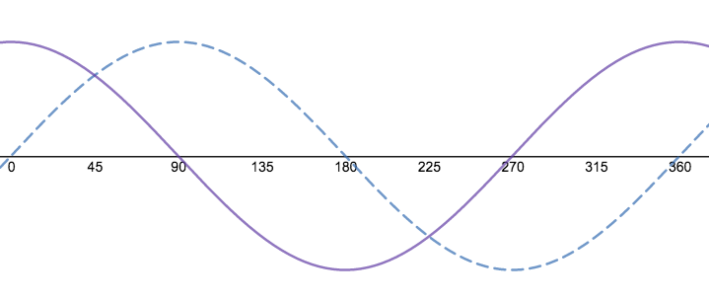
Image Briefing – Img05
Back EMF
Current
Notes:
0 – 90: Here the current is positive but decreasing so the magnetic flux is collapsing. But the rate of decrease and collapse is getting higher and higher and so the back emf is getting larger and larger to oppose this change. The rate of current change is at its maximum at 90 so this is where the back emf is greatest. Because the current is positive decreasing, the back emf is positive and increasing.
90- 180: Here the current is negative and increasing (getting more negative) so the magnetic flux is now in the opposite direction and getting stronger. Also, the rate of change is getting less and less until, at 180, there is no change in current. Therefore, the back emf is decreasing until, at 180, it is zero.
180 – 270: ??
270 – 360: ??

Slide 35
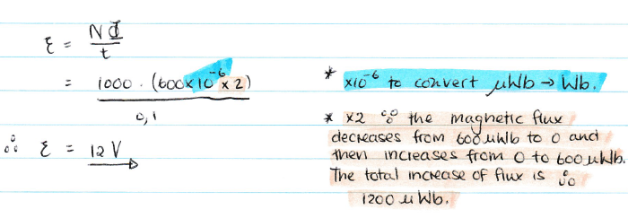
Video Briefing – Vid02 (1 of 2)
Create a screencast video answering the question.

