Slide 1
Electrical Principles
Topic 1: Basic Atomic Theory
Unit 4: Bonding forces within the atomic structure of solids

Slide 2
Outcomes
By the of this unit, you will be able to:
1. Describe the forces acting on an orbiting electron.
2. Describe the forces in a covalent bond.
3. Describe the forces in an ionic bond.
4. Describe the forces acting in a metallic bond.
Notes:
Present boxes with just the number. On click/touch, reveal the full statement as a slide right animation
Display small animations to indicate that boxes can be clicked/touched

Slide 3
Introduction
So far, in this unit on Atomic Theory, we have looked at:
In this topic, we investigate the bonding forces within the atomic structure of solids – to get an understanding of how to improve the electrical conductivity of substances or materials.
Composition of matter
1
Conductors, insulators and semi-conductors
2
Ions and Ionisation
3
Notes:
When learner clicks on button text, it expands to reveal FULL description. When learner clicks on second text button, the first will collapse to reveal second description.
Text as follows:
The composition of matter – to get an understanding nature of substances and materials;
Conductors, insulators and semi-conductors – to understand why certain materials will allow electric current to flow and why certain materials will prevent the flow of electric current; and
Ions and Ionisation – to understand the process by which electrically neutral atoms or molecules are converted to electrically charged atoms or molecules (ions).

Slide 4
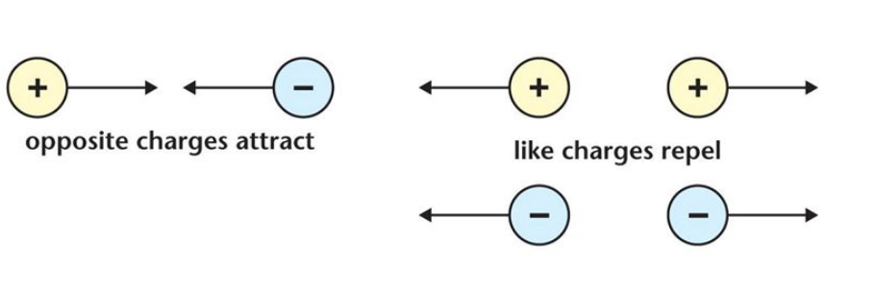
Forces acting on electrons
The most important forces acting on electrons inside an atom or molecule are electrostatic forces. Remember these can be forces of attraction or repulsion
Repulsion Attraction
Like Charges Repel each other
Unlike charges Attract each other

Slide 5
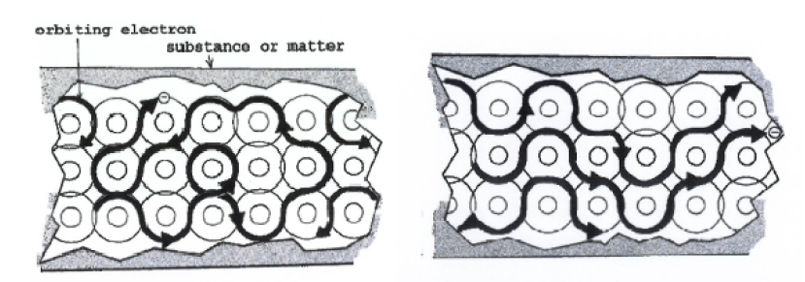
The flow of electrons
Video demo showing flow of electrons
When a free electron is lost from a metal atom, an unbalanced state develops.
The atom becomes positively charged and attracts electrons from other atoms in order to regain its balance. This causes electrons to move from atom to atom in a random direction. When a battery or source of electrical energy is connected to the ends of the metal, the free electrons flow in the same direction. This is called an electric current.

Slide 6
Changing state of matter
When a substance goes from one state of matter — solid, liquid, or gas — to another state of matter, the process is a change of state. Some rather interesting things occur during this process.
More about Melting point
More about Boiling point
Notes:
Links to additional info slides

Slide 7
Melting point
Placeholder Video – Expert demonstrating this process
Notes:
Expert Demonstration; expert being filmed doing process. Script as a guide:
If you measure the temperature of a chunk of ice, you may find it to be –5° Celsius or so. If you take temperature readings while heating the ice in a pot on your stove, you find that the temperature of the ice begins to rise as the heat from the stove causes the ice particles to begin vibrating faster and faster. After a while, some of the particles move so fast that they break free of the crystal lattice (which keeps a solid solid), and the lattice eventually breaks apart. The solid begins to go from a solid state to a liquid state — a process called melting. The temperature at which melting occurs is the melting point (mp) of the substance. The melting point for ice 0° Celsius. If you watch the temperature of ice as it melts, you see that the temperature remains steady at 0°C until all the ice has melted. During changes of state (phase changes), the temperature remains constant even though the liquid contains more energy than the ice (because the particles in liquids move faster than the particles in solids).

Slide 8
Boiling point of water
Placeholder Video – Expert demonstrating this process
Notes:
Expert Demonstration; expert being filmed doing process. Script below as a guide:
If you heat a pot of cool water, the temperature of the water rises and the particles move faster and faster as they absorb the heat. The temperature rises until the water reaches the next change of state — boiling. As the particles move faster and faster, they begin to break the attractive forces between each other and move freely as steam — a gas. The process by which a substance moves from the liquid state to the gaseous state is called boiling. The temperature at which a liquid begins to boil is called the boiling point (bp). The bp is dependent on atmospheric pressure, but for water at sea level, it’s 100°C. The temperature of the boiling water will remain constant until all the water has been converted to steam.

Slide 9
Chemical bonds
Chemical Bonds
Ionic bonds
Covalent bonds
Metallic bonds
A chemical bond is a lasting attraction between atoms, ions or molecules that enables the formation of chemical compounds.
The strength of chemical bonds varies greatly. The three primary bonds are ionic, covalent and metallic bonds.
Click each bond to find out more.
NEXT
Notes:
Note for interactivity :
Only when all three bonds have been reviewed, does Next appear

Slide 10
Ionic bonds
Ionic bonds:
When a metal and non-metal element combine to form a compound, a different type of bonding takes place. Atoms of the metal lose electrons and atoms of the non-metal gain electrons, forming charged particles called ions. The metals form positive ions and the non-metals form negative ions. The oppositely charged ions in the compound attract each other. This is called ionic bonding.
When the bond results from the electrostatic force of attraction between oppositely charged ions, we call it an ionic bond.
Watch the video to find out more.
Notes:
Embedded youtube video: https://www.youtube.com/watch?v=Qf07-8Jhhpc

Slide 11
Covalent bonds
Covalent bonds:
Elements classified as non-metals and compounds composed of non-metallic elements are held together by covalent bonds. Atoms in these substances share one or more specific pairs of electrons. Their electrons are localised (they cannot move freely throughout the substance), and these materials do not therefore conduct electricity.
When the bond results from the sharing of electrons, it is a covalent bond.
Watch the video to find out more about covalent bonds.
Notes:
Embedded youtube video: https://www.youtube.com/watch?v=VSc491HLzDo

Slide 12
Metallic bonds
Metallic bonds:
Elements classified as metals lose electrons easily. The electrons in a metallic element are free to move along all the atoms in the metal, and these materials are good electrical conductors. The atoms are held together by attractive forces between the nuclei and these freely moving electrons. These substances are said to have metallic bonds.
When the type of chemical bond between atoms in a metallic element, is formed by the valence electrons moving freely through the metal lattice, it is known as a metallic bond.
Watch the video to find out more about metallic bonds.
Notes:
Embed you tube video: https://www.youtube.com/watch?v=Bjf9gMDP47s

Slide 13
Stop and Reflect
Add supporting images for each bond type
Let’s recap what we know about the three primary bonds.
Ionic bonds
1
Covalent bonds
2
Metallic bonds
3
Notes:
When learner clicks on button text, it expands to reveal description. When learner clicks on second text button, the first will collapse to reveal second description. Supporting image to be shown with text
Text as follows:
1. Ionic Bond – When the bond results from the electrostatic force of attraction between oppositely charged ions, it is an ionic bond.
2. Covalent bond - When the bond results from the sharing of electrons, it is an covalent bond.
3. Metallic bond - When the bond occurs between atoms in a metallic element, and is formed by the valence electrons moving freely through the metal lattice, it is a metallic bond.

Slide 14
A quick quiz
Before we end off, take some time to check your understanding of what we have covered in this topic by answering the following questions.
Notes:
Correct answers:
1.

Slide 15
Question 1
Atoms in a molecule are held together by:
the strong nuclear force
covalent bonds
Gravity
Ionic bonds
Notes:
Multiple choice. Option B is correct

Slide 16
Question 2
When atoms share valence electrons, what type of bond is formed?
a) covalent bond
b) ionic bond
c) metallic bond
Notes:
Multiple choice. Option A is correct

Slide 17
Question 3
What is a valence electron?
a) an electron that is found in the outermost shell of an atom.
b) an electron found in the innermost shell of an atom.
c) an electron found in the middle shell.
Notes:
Multiple choice. Option A is correct

Slide 18
Question 4
Generally speaking, when two non-metals form a chemical bond, the bond is a __________ bond.
a) covalent
b) ionic
c) metallic
Notes:
Multiple choice. Option A is correct

Slide 19
Question 5
In metallic bonding...
Bonding takes place between positively charged areas of one atom with a negatively charged area of another atom.
A couple of atoms share their electrons with each other.
Some electrons are redistributed so they are shared by all the atoms as a whole.
One atom takes the outer shell electrons from another atom.
Notes:
Multiple choice. C is correct

Slide 20
Question 6
Which of the following is NOT a characteristic of metals?
Brittle/Shatters easily
Malleable
Shiny lustre
conducts electricity
Notes:
Multiple choice. A is correct

Slide 21
Question 7
In ionic bonding electrical forces between same charged ions holds the atoms together.
A) False B) True
Notes:
Multiple choice. A is correct

Slide 22
Question 8
In ionic bonding…
Electrons are given away
Electrons are accepted
Electrons are shared
Two answers are correct
Notes:
Multiple choice. D is correct

