Slide 1
Electrical Principles
Topic 1: Basic Atomic Theory
Unit 3: Ionisation

Slide 2
Outcomes
By the of this unit, you will be able to:
1. Explain the transfer of electrons and the formation of negative and positive ions
2. Explain why a solution containing ions conducts electricity
3. Explain why distilled water cannot conduct electricity
4. Explain what is meant by electrolyte
Notes:
Present boxes with just the number. On click/touch, reveal the full statement as a slide right animation
Display small animations to indicate that boxes can be clicked/touched

Slide 3
Introduction
In the previous units, we looked at the composition of matter and classified materials as conductors, insulators or semi-conductors.
In this unit we will be discussing ions and the process of ionisation.
What is an Ion?
1
What is Ionisation?
2
Placeholder – Embedded Video
Watch this video for a great introduction to Ions.
Notes:
Notes for interactivity:
When learner clicks on button text, it expands to reveal description. When learner clicks on second text button, the first will collapse to reveal second description.
Text as follows: (text to be accompanied with supporting image – see right)
Ion- An ion is simply a charged atom or group of atoms.
Ionisation - Ionisation is the process by which an atom acquires a negative or positive charge by gaining or losing electrons to form ions. This often happens at the same time as other chemical changes.
Link for embedded Youtube video: https://www.youtube.com/watch?v=WWc3k2723IM

Slide 4
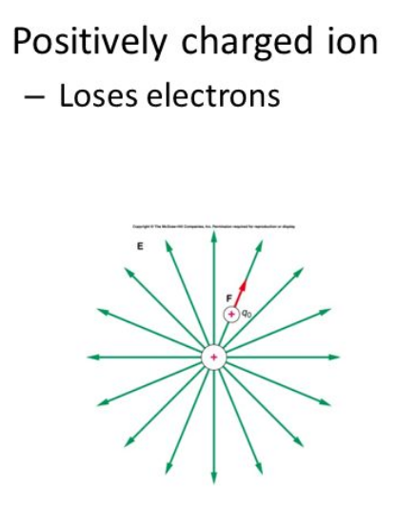
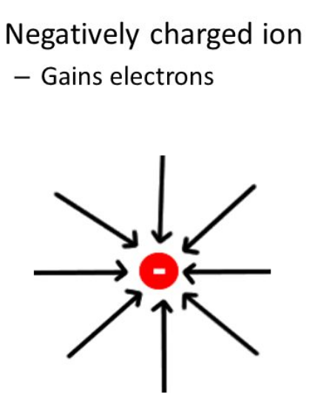
Ions
We know that an ion is a charged atom or group of atoms. If the number of electrons is equal to the number of protons, then the atom is uncharged and is electrically neutral.
When atoms gain or lose electrons, this increases or decreases the negative charge.
Positive Charge (Cation)
Negative Charge (Anion)
Notes:
Notes for design:
Please recreate images in appealing layout

Slide 5
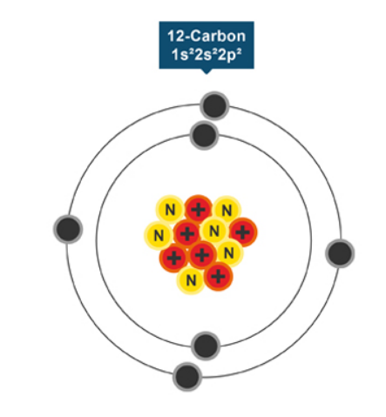
How are electrons lost?
Electrons are lost due to collisions or from ionising radiation which forces the electron away from the atom.
Let’s take a look at this Carbon atom, as an example.
The Carbon atom has 6 Neutrons, 6 Protons and 6 Electrons. When an atom is hit by ionising radiation, it loses an electron.
This turns the atom into a POSITIVELY CHARGED ION as it has more protons than electrons.
https://www.youtube.com/watch?v=TxoY6rQ9Dsk
Notes:
Notes to design: Recreate image

Slide 6
Electrolytes
Electrolytes are chemicals that break into ions (ionise) when they are dissolved in water. Remember, the positively-charged ions are called cations, while the negatively charged ions are called anions.
Substances can be categorized as strong, weak or non electrolytes.
Click on the types of electrolytes to find out more.
Strong Electrolytes
Weak Electrolytes
Non Electrolytes
Examples
Salts: Sodium chloride
Acids: Hydrochloric acid
Bases: Sodium hydroxide
Examples
Salts: calcium carbonate
Acids: acetic acid
Bases: ammonium hydroxide
Examples
Salts: lead carbonate
Elements: sulfur
Compounds: silicon oxide
Notes:
Each block to link to additional info slide

Slide 7
Strong electrolytes
Strong electrolytes completely ionise in water. This means 100% of the dissolved chemical breaks into cations (positively-charged ions) and anions (negatively-charged ions). These solutions are able to conduct electricity because the ions are free to move and not held in fixed positions.
The reason this happens is because water is a molecule which has a positive charged end and negatively charged end. It is called a dipole.
There are two types of substances that form free moving ions in solution:
Salts that dissolve in water Molecules contain hydrogen
Place holder graphic showing an ionic lattice found in salt. Some ions must surrounded by water molecules.
Place holder graphic showing a HCl molecule surrounded by water molecules
Click on each of the images to see how ions form to make electrolytes .
Notes:
Link to the slides that follow

Slide 8
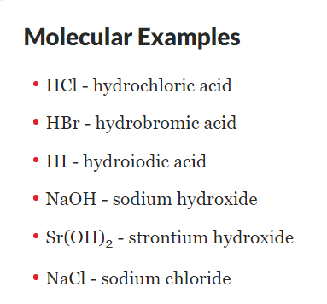
How salts form electrolytes
Ions are held together in a lattice by electrostatic forces. These are strong forces between the anions (negatively charge ions) and cations ( positively charged ions).
There are also forces of attraction between the water molecules (dipoles) and the ions.
In a solution there are more water molecules than anions or cations. So the forces between the water molecules and the ions can overcome the forces holding the ions in the ionic lattice.
So when the salt dissolves to form an electrolyte the cations and anions are separated from each other are free to move surrounded by water molecules.

Slide 9
How molecules form electrolytes
The covalent bond between hydrogen and a non-metal is called a polar covalent bond. For example the electrons are not shared equally between hydrogen and chlorine in the hydrogen chloride molecule. The hydrogen end of the molecule becomes slightly positive and the chloride end is slightly negative. This is a dipole.
The water molecule is also a dipole and it has space to hold on to a hydrogen ion.
When a hydrogen chloride molecule is surround by water molecules, the slightly positive hydrogen end of the molecule is attracted to the negative end of the water molecule.
The shared pair of electrons that form the hydrogen –chlorine covalent bond, remain on the chlorine atom and forms a negatively charged chloride ion and at the same time the hydrogen ion joins the water molecule to form a positively charge ion, called a hydronium ion. These ions are free to move so the solution can conduct electricity.

Slide 10
Weak electrolytes
Needs more here
Weak electrolytes only partially dissociate in solution therefore produce relatively few ions in the solution. That is the reason weak electrolytes are poor conductors of electricity.
Examples of weak electrolytes
Vinegar (Acetic acid)
Ammonia
Water
Limewater (calcium hydroxide)

Slide 11
Non electrolytes
Non-electrolytes do not separate into ions in their solution.
The atoms of these substance are generally held together by strong covalent bonds. The molecules formed have an equal distribution of electrons around the whole molecule. These are not dipole molecules but are non-polar molecules.
Common examples include most organic compounds (compounds containing carbon) such as sugars, fats, and alcohols.
Some non-metals form large covalent molecules that will not dissolve in water. These include elements like diamond (carbon), sulphur and phosphorus. Compounds of non-metals, like silicon oxide (sand) also do not dissolve.
There are also some salts that are insoluble. The forces between the cations and ions are very strong and the attraction of the water molecules on the ions is too weak to separate the ions from the lattice. These salts are non-electrolytes.

Slide 12
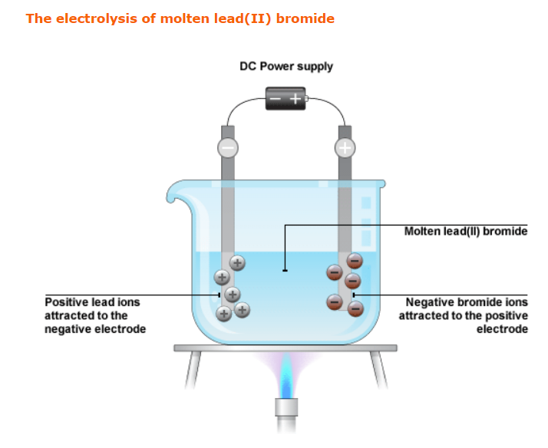
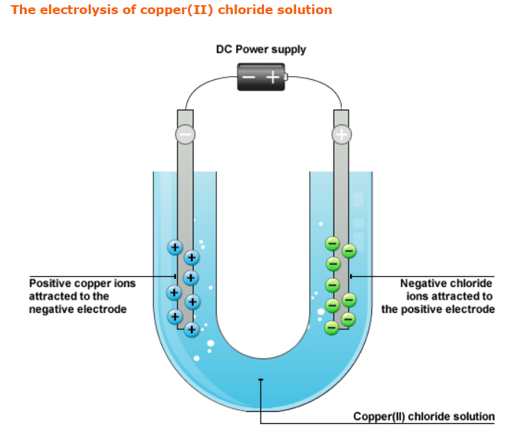
Electrolysis
Not sure this is needed.
Electrolysis is the process which takes place when an ionic solution or melt has electricity passed through it.
Let’s take a look at how electrolysis works using two examples. Click on each to view.
Electrolysis of molten lead (II) bromide
Electrolysis of copper (II) chloride solution

Slide 13
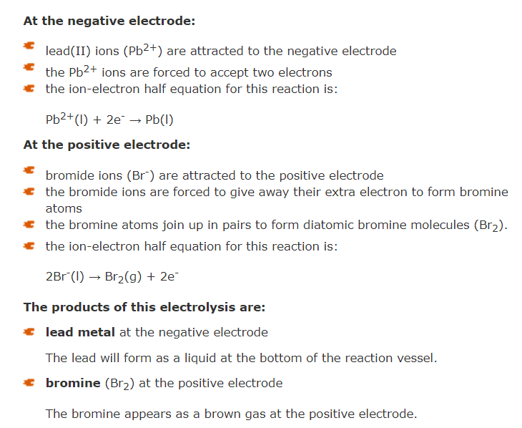
The electrolysis of molten lead(II) bromide
Notes:
Note for interactivity –
Convert to animation in which each step described is animated on the image

Slide 14
The electrolysis of copper(II) chloride solution
Notes:
Note for interactivity –
Convert to animation in which each step described is animated on the image

Slide 15
What do we know about electrolysis?
There are certain processes which take place during electrolysis. Here’s what we know:
1
2
3
4
5
Notes:
Notes for interactivity:
Numbers display only, when clicked, full statement is revealed.
Ions are attracted to the electrodes
Negative non-metal ions are attracted to the positive electrode
Positive metal ions are attracted to the negative electrode
At the electrodes, electrons are gained or lost by the ions involved
Products are formed at each electrode

Slide 16
How do solutions containing ions conduct electricity?
Ionic substances are made of charged particles called ions.
When the ionic solid is dissolved in water, the ionic lattice breaks up and the ions become free to move around in the water.
When you pass electricity through the ionic solution, the ions are able to carry the electric current because of their ability to move freely.
Placeholder – Need image or animation explaining process

Slide 17
Why can’t pure water conduct electricity?
Pure water contains very few ions, so it does not conduct electricity very well. When table salt is dissolved in the water, the solution conducts very well, because the solution contains ions.

Slide 18
A quick quiz
Before we end off, take some time to check your understanding of what we have covered in this unit by answering the following questions.
Q1: Identify the cation present in a sodium chloride crystal
Q2: An atom has 16 protons and gains 2 electrons.
What type of ion is formed? What is the charge on the ion?
Q3: Which of the following is a strong electrolyte: sodium nitrate (salt), diamond, limewater, ammonia
Q4: In the electrolysis of copper chloride on which electrode will copper form and where will bubbles of chlorine form?
Notes:
Correct answers:
Q1: Sodium ion (Na⁺)
Q2: Anion Charge = -2
Q3: sodium nitrate
Q4: copper forms on the negative electrode
chlorine bubbles appear on the positive electrode

Slide 19
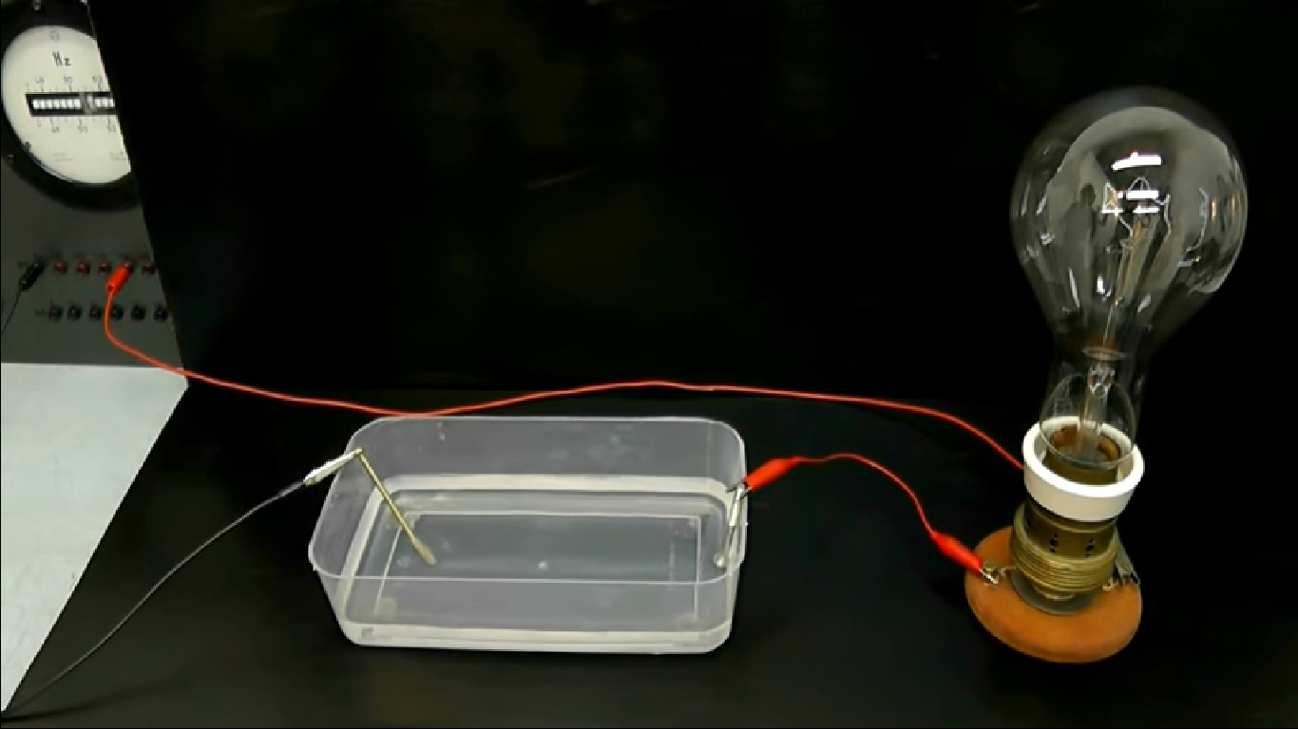
Experiment: Conductivity of Ions in a Solution
Let’s have some fun experimenting with the conductivity of Ions in a solution.
Instructions:
Click here to download the Experiment instructions and question sheet. Remember to save to your computer.
Conduct the experiment and then answer the questions.
Once complete, upload your saved document to your e-Portfolio.
Upload to e-Portfolio
Notes:
Image source: https://www.youtube.com/watch?v=ODbgKXFED5o
Click here to activity- Link to Word doc- Activity: Conductivity of Ions in a solution- can be found in resources section

Slide 20
Activity: Conductivity of Ions in a Solution
How did you find the experiment? In case you were unsure, here is a summary of the results Click here to download.
Notes:
Link to Answer Sheet in Resource folder – Activity – Conductivity of Ions in a Solution – Answer sheet
Note to design: Please recreate/format sheet

Slide 21
Activity: Covalent and Ionic Substances
Create downloadable worksheet which can be uploaded to portfolio
Instructions:
Click here to open the simulation.
On the top select the ‘micro’ tab. Shake some sodium chloride into the solution. What do you observe?
Remove the solute, select the sucrose and shake some sugar into the water. What do you observe.
On the top select the ‘water’ tab. By looking at the water, what kind of intramolecular bonds exist between water? Give a reason for your answer.
Now, add the salt crystal lattice to the water. What happens?
What type of intramolecular force exists in salt lattices?
What is the smallest particle of a salt lattice?
Now add the sugar crystal to the water. What do you observe?
What kind of intramolecular forces exist between sugar particles?
What is the smallest particle of sugar?
Will the salt water or sugar water or both conduct electricity? Explain your answer.
Will the plain water conduct electricity? Explain your answer.
Notes:
Link to simulation: https://phet.colorado.edu/en/simulation/legacy/sugar-and-salt-solutions
Answers:
The lattice breaks up in water.
The sugar also breaks up but not into individual ions like the salt.
Covalent. The smallest particle of water is a molecule.
The lattice breaks up into ions.
Ionic
Ions
The sugar molecules separate but the individual molecules stay intact.
Covalent.
Molecule
Salt. It forms free ions in solution.
No, It doesn’t have ions in solution.

