Slide 1
Electrical Principles
Topic 1: Basic Atomic Theory
Unit 2: Conductors, Semi-conductors and Insulators

Slide 2
Outcomes
By the of this unit, you will be able to:
1. Explain the atomic structural differences between conductors, semi-conductors and insulators
2. Describe the electrical and mechanical properties of conductors, semi conductors and insulators.
Notes:
Present boxes with just the number. On click/touch, reveal the full statement as a slide right animation
Display small animations to indicate that boxes can be clicked/touched

Slide 3
Introduction
Have you ever received an electric shock when touching a live wire? Why did you think that happened? Why don’t you get the same shock when you are holding a plastic stick to touch the wire? In order to understand the flow of electricity through materials, we first need to understand the categories in which materials can be placed:
Conductors
1
Insulators
2
Semi-conductors
3
Click here if you want to refer to the Periodic table to see which elements are conductors (metals), semi-conductors (metalloids) and insulators (non-metals).
Notes:
Note for interactivity:
When learner clicks on button text, it expands to reveal description. When learner clicks on second text button, the first will collapse to reveal second description.
Text as follows:
Conductors:
Conductors are mainly made from elements that are metals. These materials conduct electricity easily. Very little electric force is required to cause electrons to flow in conductors. This is due to "free electrons“ , which exist in the atoms of conductors. Remember, “free electrons" are electrons that are valence electrons that are very weakly attract to the positive nucleus of an atom. With very little external electrical force,(for example supplied from a battery), they drift or flow in the same direction to create an electric current. Metals such as copper, silver, and gold are very good conductors. Graphite (a form of carbon) is also an example of a good conductor, even though it is a non-metal element.
Insulators:
Insulators are mostly materials made up of molecules and atoms that hold onto all their electrons very tightly. They have no free electrons, and it takes a great deal of electric force to get the electrons of an insulator to move through them in the same direction. The flow of electrons in an insulator is tends to be accompanied by intense heat, loud noise, melting or explosions, smoke and/or flame. You will have seen this when air, which is an insulator, is forced to carry charges during a thunderstorm – the flashes of light you see in lightning is evidence that the air is carrying a flow of electrons. Materials such as rubber, glass, paper and ceramics are good insulators.
Semi-conductors:
Semi-conductors lie somewhere between conductors and insulators. Elements on the Periodic Table that are between the metals and non-metals, the metalloids, are semi-conductors. These materials have the properties of both conductors and insulators, depending on the conditions. The atoms of a semi-conductor have no free electrons, so at low temperatures are insulators. However, they do have valence electrons that are loosely held and can be move when the temperature is increased and a small electric force is applied across it’s ends. Under these conditions, semi-conductors can conduct electricity without being damaged. But, semi-conductors can be damaged with too much electric force is applied. Silicon is the most common semi-conductor.

Slide 4
Conductors, insulators and semi-conductors
Watch the video for an introduction to conductors and insulators.
Embedded Youtube video
Notes:
Embedded video: https://www.youtube.com/watch?v=U8IFo7ykHuU

Slide 5
Types of bonds
The way in which the atoms are combined within the material (its bond type) will determine whether or not the material will allow the flow of electrons. There are three types of bonds:
Metallic bonds
1
Covalent bonds
2
Ionic bonds
3
Did you know?
Metals are not only good electrical conductors, they also conduct heat. Metals can be made into strands of wire (ductile) or rolled into flat sheets (malleable).
Notes:
Note for interactivity:
When learner clicks on button text, it expands to reveal description. When learner clicks on second text button, the first will collapse to reveal second description.
Text as follows:
Metallic bonds:
Elements classified as metals lose their valence electrons easily. The valence electrons in a metallic element are free to move between all the atoms in the metal – they are delocalised or free electrons. The atoms of a metal are held together by the electrostatic attraction between the positively charged nuclei and core electrons (together they form a positive ion) and the free electrons. This arrangement of positively charged metal ions in a fixed lattice covered by free electrons moving in a random pattern is called a metallic bond. These elements are good conductors of electricity.
Covalent bonds:
Elements classified as non-metals and compounds composed of non-metallic elements are held together in molecules by covalent bonds. Atoms in these substances share one or more specific pairs of valence electrons. The electrons in the molecules formed are localised (they cannot move freely throughout the substance), and these materials do not therefore conduct electricity.
Ionic bonds:
When a metal and non-metal element combine to form a compound, a different type of bonding takes place. Atoms of the metal lose valence electrons to form a positive ion and atoms of the non-metal gain electrons, to form a negative ion. There is a very strong electrostatic force of attraction between these oppositely charged ions. This is called ionic bonding. The ions are arranged in a regular 3D arrangement known as an ionic lattice. We find this in compounds that form crystals when solid. As a solid, the ions cannot move and so do not conduct electricity. But if the crystalline solid melts or dissolve in water, the ions are free to move and will conduct electricity.

Slide 6
Conductors
An electrical current is the free movement of charged particles. So if a material allows the flow of electrons through it, it is a conductor.
Hint
All these conductors contain one electron in their outer shell. These are called valence electrons. Valence electrons are easily freed from the atom of conductors, producing current flow.
Take a look at the atomic structure of three metal elements below. Do you notice anything that these atoms have in common?
Copper
Silver
Gold
Need a hint…? Click here.
Notes:
Notes for design: Please recreate atomic structure diagrams
Note for interactivity:
When learner, clicks on hint box, hint appears
Also, when hint appears, animate the valence electrons (outer electron) on each of the elements do that it glows/stands out.

Slide 7
Atomic structure of a conductor
Let’s take a look at the atomic structure of two conductors, silver and copper.
Notes:
Notes to design team: Recreate image

Slide 8
What makes a good conductor?
Metals are good conductors of electricity. Metals have valence electrons which are loosely bound. In an electric circuit, these electrons can freely move around the circuit with a domino-like effect. (*We cover electrical circuits in more detail in the next unit).
Metals (Conductors)
Ceramics (Insulators)
Electricity blocked
Free-flowing electrons
Can you name a metal which you are familiar with which is used in electrical wiring?

Slide 9
Characteristics and uses of conductors
Note to design: Need to source images of each as used for electrical purposes
What are the characteristics and uses of some popular conductors? Let’s explore, click on each to find out more.
Aluminium
Carbon
Brass
Bronze
Copper
Gold
Iron and steel
Lead
Magnesium
Mercury
Silver
Tin
Impure water
Zinc and alloys
Too much information. Not sure all of these are necessary.
Next
Notes:
Notes for design:
Source remaining images for each element, make sure all same style. I.e remove backgrounds, so all on transparent bg. These are from Wikipedia
Note for interactivity:
Redo layout to suit the technology chosen.
Student clicks on each card to link to additional content. Once all content has been viewed, NEXT button is displayed.
Additional content slides follow.

Slide 10
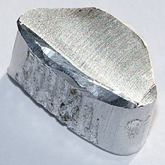
Aluminium
13
Uses
Al
Aluminium is used for electric wires, cable conductors and cable sheaths and overhead
lines. It is used for panels where mass must be limited. It is also used as a heat-sink in
electronic apparatus.
Aluminium
26.982
Aluminium is a white coloured metal. It is a soft metal. All sample of Aluminium have a low mass for its size (low density). It is ductile and malleable, corrosion resistant, and a good electrical conductor. Aluminium melts at 660°C.
Forms of Supply
Rolled sheet, draw bar and drawn
sections.
Click here to find out even more about Aluminium on the Periodic Table of Elements.
Notes:
Notes to design team:
Please recreate layout to visually appealing format
Link to periodic table: https://ptable.com/

Slide 11
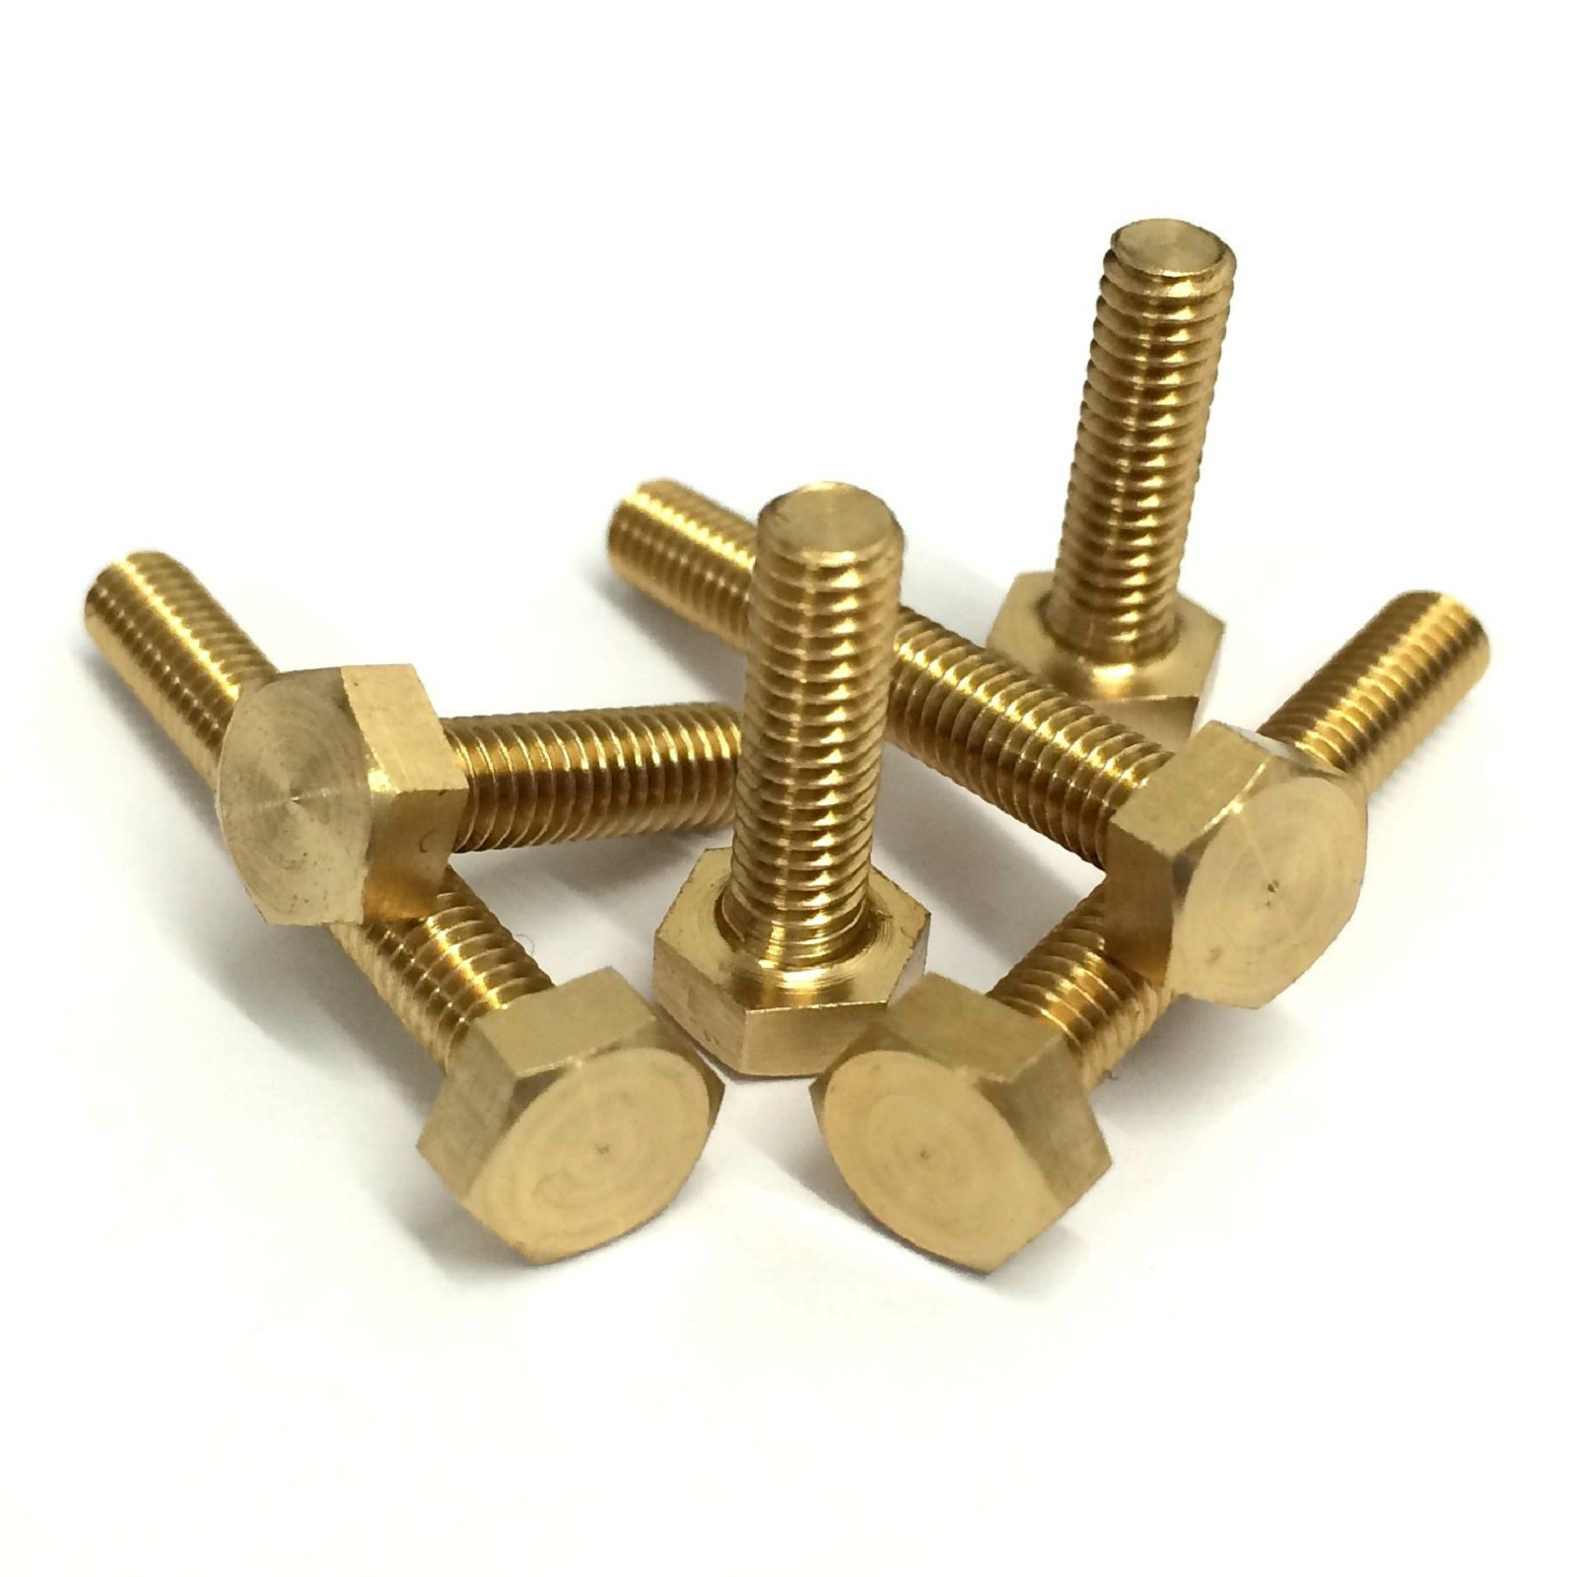
Brass
Uses
Soft brass is used for wire, shimstock and mixed with carbon for brushes for electric motors and generators. Hard brass is used for bearings, casting and forging and electrical terminals.
Brass is gold coloured alloy. It is a mixture of copper and zinc. (About 60% copper to 40 % zinc). Brass melts at between 800°C and 1000°C. It is corrosion resistant and a good electrical conductor.
Forms of Supply
Ingots for casting, rolled sheet, drawn bar and tube.
There is no element symbol for brass because it consists of a mixture of metals.
Notes:
Notes to design team:
Please recreate layout to visually appealing format

Slide 12
Bronze
Uses
Bronze is used for bearings, cast water taps and valves.
Bronze is a red-gold colour alloy of. It is an alloy of copper and tin (About 90% copper to about 10% tin). Often other metals are added; for example, phosphor-bronze with a phosphorus content of about 12 % is as hard as many steels. Melting point is between 800°C to 1000°C. It is corrosion resistant and a good electrical conductor.
Forms of Supply
Ingots for casting and cast bar.
There is no element symbol for bronze because it consists of a mixture of metals.
Notes:
Notes to design team:
Please recreate layout to visually appealing format

Slide 13
Copper
29
Uses
Cu
Copper is used for electric wires and bus-bars, water pipes, hot water tanks, soldering and iron bits.
Copper
63.656
Copper is red coloured metal. It is very ductile, malleable and corrosion resistant. Melting Point is 1083°C. Copper is a very good electrical conductor. It is still the most common electrical conductor, but aluminium is taking its place because aluminium is cheaper than copper. The conductance of copper is about 40% better than aluminium.
Forms of Supply
Ingots, pipe, rolled sheet, drawn wire and bar.
Click here to find out even more about Copper on the Periodic Table of Elements.
Notes:
Notes to design team:
Please recreate layout to visually appealing format
Link to periodic table: https://ptable.com/

Slide 14
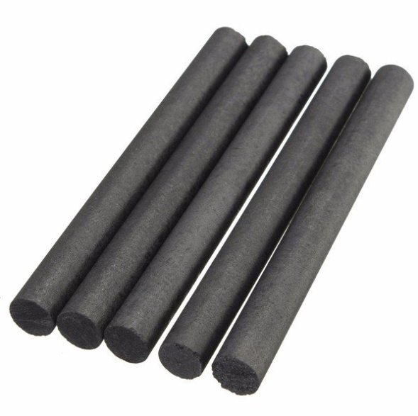
Carbon
6
Uses
C
Carbon is used for brushes for motors and generators; and for resistors.
Carbon
12.011
Carbon is an element that exists as a black or dark grey coloured solid called graphite. Graphite is a non-metallic conductor of electricity. It has a low mechanical strength (breaks easily).
Forms of Supply
Blocks, rods and powder.
Click here to find out even more about Carbon on the Periodic Table of Elements.
Notes:
Notes to design team:
Please recreate layout to visually appealing format
Link to periodic table: https://ptable.com/

Slide 15
Gold
Need image of gold for electrical purposes
79
Uses
Au
Gold is used for very fine wires and connections in
electronic circuits, jewellery and money.
Gold
196.97
Gold is a yellow lustrous metal. It is very ductile, malleable and corrosion resistant. It resists chemical attack. Gold is an excellent electrical conductor but is very expensive.
Forms of Supply
Ingots, fine wire and very thin sheets.
Click here to find out even more about Gold on the Periodic Table of Elements.
Notes:
Notes to design team:
Please recreate layout to visually appealing format
Link to periodic table: https://ptable.com/

Slide 16
Iron and Steel
Need image of iron and steel for electrical purposes
Uses
Iron and steel are used for frames of motors, generators, transformers, switchgear, cable ducts and many other machines.
Iron is an element that rusts easily. It is commonly mixed with carbon and other metals to make alloys, called steel. Steel alloys are strong and durable. Both iron and steel conduct electricity and are can be magnetised.
Forms of Supply
Rolled sheet; drawn bar; wire and tube; ingots for casting; drawn section, I, U, T and L.
Click here to find out even more about Iron on the Periodic Table of Elements.
Notes:
Notes to design team:
Please recreate layout to visually appealing format
Link to periodic table: https://ptable.com/

Slide 17
Lead
Need image of lead for electrical purposes
82
Uses
Pb
Lead is used for the plates in lead acid battery cells, and cable sheathing. It is also used for
chemical containers.
Lead
207.2
Lead is dull grey coloured metal. It is very dense and soft. It is corrosion resistant. Lead melts at 327°C.
Forms of Supply
Ingot, rolled sheet and extruded pipe.
Click here to find out even more about Lead on the Periodic Table of Elements.
Notes:
Notes to design team:
Please recreate layout to visually appealing format
Link to periodic table: https://ptable.com/

Slide 18
Magnesium
Need image of magnesium for electrical purposes
12
Uses
Mg
Magnesium is used for light die-castings, flash bulb ribbon, and aircraft parts.
Magnesium
24.305
Magnesium is a shiny grey coloured metal.
It has a low density (Very light for its size). Magnesium melts at 650°C.
Forms of Supply
Ingots and ribbon.
Click here to find out even more about Magnesium on the Periodic Table of Elements.
Notes:
Notes to design team:
Please recreate layout to visually appealing format
Link to periodic table: https://ptable.com/

Slide 19
Mercury
Need image of mercury for electrical purposes
Uses
Mercury is used in float switches, and rectifiers.
Mercury is a white/grey liquid metal. It has a high density of 13.5 g/cm³. (Heavy for it’s size)
It is a good electrical conductor. Mercury melts at - 39°C. Mercury is poisonous.
Forms of Supply
As a liquid.
Notes:
Notes to design team:
Please recreate layout to visually appealing format
Link to periodic table: https://ptable.com/

Slide 20
Silver
Need image of silver for electrical purposes
47
Uses
Ag
Silver is used for the contacts and points in contactors.
Silver
107.87
Silver is a white shiny metal. It is very ductile, malleable and corrosion resistant. Silver is a very good conductor of electricity but it is very expensive. Silver melts at 960°C.
Forms of Supply
Ingots and fine wire.
Click here to find out even more about Silver on the Periodic Table of Elements.
Notes:
Notes to design team:
Please recreate layout to visually appealing format
Link to periodic table: https://ptable.com/

Slide 21
Tin
Need image of tin used for electrical purposes
50
Uses
Sn
Tin is alloyed with copper to produce solder. Solder used to contain lead but this has been stopped for health reasons (lead is poisonous). Tin is alloyed with copper to produce bronze.
Tin
118.71
Tin is a silver/grey coloured metal. It is soft and weak. Tin melts at 232°C.
Forms of Supply
Ingots.
Click here to find out even more about Tin on the Periodic Table of Elements.
Notes:
Notes to design team:
Please recreate layout to visually appealing format
Link to periodic table: https://ptable.com/

Slide 22
Impure water
Need image of water used for electrical purposes
Uses
Water is mixed with salts and
acids to form an electrolyte.
Pure water is a colourless, tasteless, odourless liquid. Pure water is NOT an electrical conductor but with even the smallest quantities of impurity, it becomes a good electrical conductor of electricity.
Impurities are substances that form free moving ions when dissolved such as salts, and acids. We call the solution of dissolved ions an electrolyte.
Forms of Supply
As a liquid and as ice.
Notes:
Notes to design team:
Please recreate layout to visually appealing format
Link to periodic table: https://ptable.com/

Slide 23
Zinc and alloys
Need image of zinc for electrical purposes
30
Uses
Zn
Zinc is alloyed with copper to make brass. A coating of zinc is applied to steel parts ‘galvanize’ them, which prevents corrosion. Zinc is
also used in die casting.
Zinc
65.38
Zinc is a dull grey metal. It is soft and weak. The melting temperature 419°.
Forms of Supply
Ingots.
Click here to find out even more about Zinc on the Periodic Table of Elements.
Notes:
Notes to design team:
Please recreate layout to visually appealing format
Link to periodic table: https://ptable.com/

Slide 24
Experiment: What makes a good conductor?
In this experiment you will test the conductivity of several solids.
Time required: 45 minutes
Instructions:
Click here to download the Experiment worksheet.
Conduct the experiment as instructed and complete the table provided. (Don’t forget to save the document to your computer)
When complete, upload to your e-portfolio.
Upload to e-Portfolio
Notes:
Click here to download Experiment– to open in popup (see Word doc in Dropbox folder)
Experiment taken from: http://www.fofweb.com/onfiles/seof/chemistry_experiments/4-08.pdf

Slide 25
Experiment: What makes a good conductor?
How did you find the experiment? In case you were unsure, here is a summary of the findings from the experiment. Click here to download.
Notes:
Click here – to link to Experiment findings in Dropbox folder

Slide 26
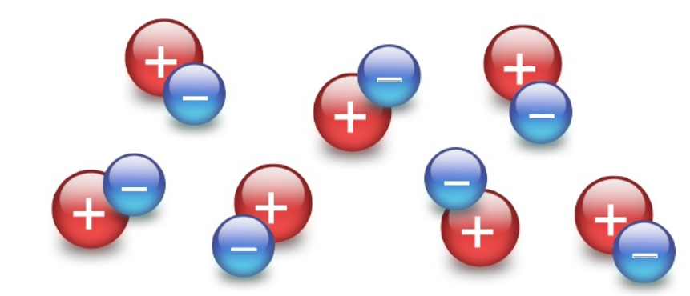
Insulators
Insulators are the opposite of conductors. They are substances or materials that do not conduct electricity. In an insulator, the electrons (-) are tightly bound to the nuclei (+), and so they prevent movement AND therefore do not allow electric current to pass through them.
Neon
Notes:
Notes for design: Please recreate atomic structure diagrams

Slide 27
Atomic structure of an insulator
Let’s take a look at the atomic structure of two insulators, neon and argon.
Notes:
Notes to design team: Recreate image

Slide 28
Properties of Insulators
So, how do we know if a material is useful for the purpose of insulation? The following factors should be considered:
Electrical
Mechanical
Physical
Chemical
Notes:
Notes for interactivity:
Student clicks on each card to flip over/reveal content. Relevant graphics/icon to be created to represent each item which displays before card is flipped. Example provided only- they must be recreated.
Flipcard text:
1. Electrical
The higher the voltage at which a piece of equipment works, the more complex the problem of insulation becomes. We evaluating if a material is a good insulator we look at the resistivity, electric strength, flash-over value, permittivity and dielectric loss.
2. Mechanical
The properties we look at here relate to the strength of the material. We ask how the material responses to forces of tension ( Stretching or tensile strength), compression (squashing), twisting and bending. We also need to consider if the material can be changed by turning it on a lathe or cutting it into particular shapes (machining ability).
3. Physical
An insulating material must be able to with stand high temperatures (high melting point) and must not absorb moisture easily.
4. Chemical
Insulators should not be substances that are chemically reactive. It is possible that chemicals such as oils, oxygen and acids could come into contact with an insulating material in a machine. You need to make sure that the insulator will not be affected by these chemicals, even at high temperatures.

Slide 29
Note to SME:
Seems a lot. Do we need to cover all these?
Characteristics and uses of insulators
Note to design: Need to source images of each as used for electrical purposes
Let’s take a look at the characteristics and uses of some popular insulating materials.
Click on each to find out more.
Air
Asbestos
Bitumen
Cotton and Silk
Empire cloth and tape
Glass
Mica
Paper
Porcelain
Oil
Liquid Silicon
Rubber
Plastic
Next
Notes:
Notes for design:
Source remaining images for each element, make sure all same style. I.e remove backgrounds, so all on transparent bg. These are from Wikipedia
Note for interactivity:
Redo layout so it is formatted nicely.
Student clicks on each card to link to additional content. Once all content has been viewed, next button is displayed. Additional content slides follow.

Slide 30
Air
Placeholder image
Uses
Air is used as an insulator for overhead lines, open air switchgear, and bus-bar chambers.
Air is a good insulator, particularly when clean and dry.
Lightning and sparks are examples of where air is no longer an insulator but is conducting charge.
Notes:
Notes to design team:
Please recreate layout to visually appealing format

Slide 31
Asbestos
Placeholder image
Uses
Asbestos is used to insulate conductors where temperatures are high, for example, stoves.
Asbestos is mined in fibre form. It can be pressed into rigid sheets or woven into matting or tubes. It is flexible in woven form but is weak in tension. Rigid sheets of asbestos are brittle. Asbestos is a good insulator and can withstand high ttemperatures.
Notes:
Notes to design team:
Please recreate layout to visually appealing format

Slide 32
Bitumen
Placeholder image
Uses
Bitumen is used for sealing cable boxes to keep moisture out.
Bitumen is a product of oil refining. It has a melting temperature of 135°C. It is a hard solid at low temperatures and gets soft and plastic as temperature increases. Bitumen is a low grade insulator. It does not absorb water.
Notes:
Notes to design team:
Please recreate layout to visually appealing format

Slide 33
Cotton and Silk
Placeholder image
Uses
Cotton and silk tapes are used in insulating the windings in generators and motors. They are also used in insulating bell and telephone wire.
Cotton and silk are natural fibres. They are good insulators when dry.
They are flexible and durable and can absorb water. They are not used where temperatures are above 65°C.
Notes:
Notes to design team:
Please recreate layout to visually appealing format

Slide 34
Empire cloth and tape
Placeholder image
Uses
Empire tape is used to insulate motor and generator windings, cables and bus bars.
Empire cloth and tape are non-adhesive insulating material of cotton fabric soaked with a flexible insulating varnish. As an additional protection against moisture, it is usually supplied with an outside coating of wax. It is a good insulator, flexible, durable and does not absorb water when waxed. It is not used when temperatures are above 65°C.
Notes:
Notes to design team:
Please recreate layout to visually appealing format

Slide 35
Glass
Placeholder image
Uses
Glass is used for lamps, neon signs, and insulators for overhead lines, television screens and many other aapplications. Fibre glass is a type of glass
used to insulate motor and generator windings where temperatures are above 65°C.
Glass is a very good insulator when dry. It is easily moulded to any shape.
In its standard form, glass is very brittle. When used as a woven fibre glass it is flexible and strong.
Notes:
Notes to design team:
Please recreate layout to visually appealing format

Slide 36
Mica
Placeholder image
Uses
Mica is used as an insulation for iron elements, insulation between commentator segments.
Mica is mined. It is a form of rock, which is layered.
Mica is a very good insulator if pure. It will withstand high temperature and pressure. It does not absorb water but cracks easily if bent.
Notes:
Notes to design team:
Please recreate layout to visually appealing format

Slide 37
Paper
Placeholder image
Uses
Paper is used as insulation on power cables and transformer windings. It is usually covered in oil to keep moisture out.
Paper is a very good insulator when dry.
It can absorb water and is not used where the temperature will exceed 65°C.
Notes:
Notes to design team:
Please recreate layout to visually appealing format

Slide 38
Plastics
Placeholder images
Placeholder for infographic on Plastic. Thumbnail to display on screen but opens to large, downloadable version when clicked.
The development and application of plastics has been very rapid; new plastics are continually been developed and existing ones improved.
Click on the image to find out more about the advantages and disadvantages of plastics over other materials.
Notes:
Notes to design team:
Please recreate layout to visually appealing format for Infographic. Document to be converted into infographic can be found in resources in dropbox.

Slide 39
Porcelain
Placeholder image
Uses
Porcelain is used for overhead line insulators, high voltage transformer bushings, Bus-bar insulators,
bobbins and cleats.
Porcelain is a very good insulator when dry. It is easily moulded to any shape before it is dried and baked.
Once it is glazed, it does not absorb water. It is very brittle and will not withstand mechanical shock.
Notes:
Notes to design team:
Please recreate layout to visually appealing format

Slide 40
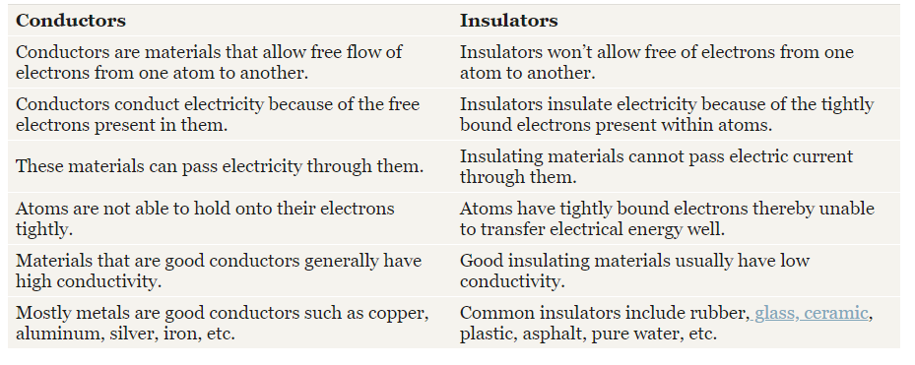
Pause and reflect
Take a moment to pause and reflect on the main differences between conductors and insulators.
Notes:
Recreate table

Slide 41
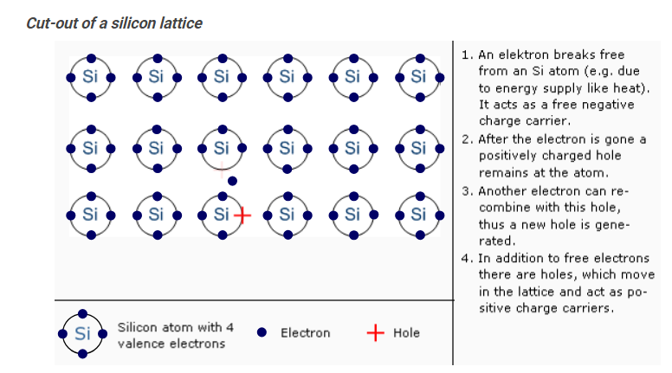
Semi-conductors
Not sure if this detail is necessary?
Semi-conductors are materials which have a conductivity between conductors (generally metals) and insulators (such as most ceramics). Some of these are metalloids on the Periodic Table.
Particles of semiconductors are arranged in a lattice structure. At low temperatures the electrons are not free to move but as the temperature increases conductivity increases.
This happens because increasing the temperature weakens the forces on valence electrons and free electrons are generated. At the point where a free electron was released, a small positive region called defect hole") forms. The presence of “holes” allows electrons to move through the material.
Notes:
Recreate this animation found on: https://www.halbleiter.org/en/fundamentals/conductors-insulators-semiconductors/
OR EMBED??

Slide 42
Atomic structure of a semi-conductor
Let’s take a look at the atomic structure of two semi-conductors; carbon and silicon.
Notes:
Notes to design team: Recreate image

Slide 43
Why are semi-conductors so important?
Due to their role in the manufacture of electronic devices, semi-conductors are an important part of our lives. Imagine life without electronic devices? There would be no radios, no TV's, no computers, no video games, and poor medical diagnostic equipment. Although many electronic devices could be made using vacuum tube technology, the developments in semiconductor technology during the past 50 years have made electronic devices smaller, faster, and more reliable.
Take a moment to think about all the encounters you have had with electronic devices. How many of the following have you seen or used in the last twenty-four hours? Each has important components that have been manufactured with electronic materials.
Placeholders
Notes:
Notes to design team:
Create icons/images to represent the following electronic devices:
Microwave
Computer
Watch
TV
Air conditioner
Stove

Slide 44
A quick quiz
Before we end off, take some time to check your understanding of what we have covered in this unit by answering the following questions.
Q1: What type of elements are good conductors?
Q2: Name a non-metal conductor
Q3: What type of bonding do you find between the atoms of insulators?
Q4: What word do we use to describe a material that is a mixture of metals?
Q5: What metals are present in bronze?
Add feedback and multiple choice options
Notes:
Correct answers:
Q1: Metals
Q2: Graphite (carbon)
Q3: Covalent bonding
Q4: Alloy
Q5: Copper and tin

Slide 45
Activity: Conductors and insulators
You are going to have fun experimenting with conductors and insulators.
Instructions:
Click here to open the simulation tool.
Next, click here to download the question sheet. Remember to save to your computer.
Once complete, upload to your e-Portfolio
Upload to e-Portfolio
Notes:
CLICK HERE Link to simulation: https://phet.colorado.edu/en/simulation/legacy/conductivity
Click here to activity- Link to Word doc- Activity: Conductors and Insulators - can be found in resources section

Slide 46
Activity: Conductors and Insulators
How did you find the activity? In case you were unsure, here is a summary of the results from the activity. Click here to download.
Notes:
Link to Answer Sheet in Resource folder – Activity – Conductors and Insulators – Answers
Note to design: Please recreate/format sheet

Slide 47
APPENDIX

