Slide 1
Electrical Principles
Topic 1: Basic Atomic Theory
Unit 1: Composition of matter

Slide 2
Assumed Prior Learning
For this Unit there no assumptions about prior learning
Notes:
Note for navigation on site:
This information needs to be taken into account and needs to stated on the LMS, perhaps as part of the introduction?

Slide 3
Outcomes
By the of this topic, you will be able to:
1. Describe matter, elements, compounds and molecules
2. Describe the construction of an atom in respect of orbits, nucleus, electrons, valence electrons and free electrons
3. Explain the forces in an atom
Notes:
Present boxes with just the number. On click/touch, reveal the full statement as a slide right animation
Display small animations to indicate that boxes can be clicked/touched

Slide 4
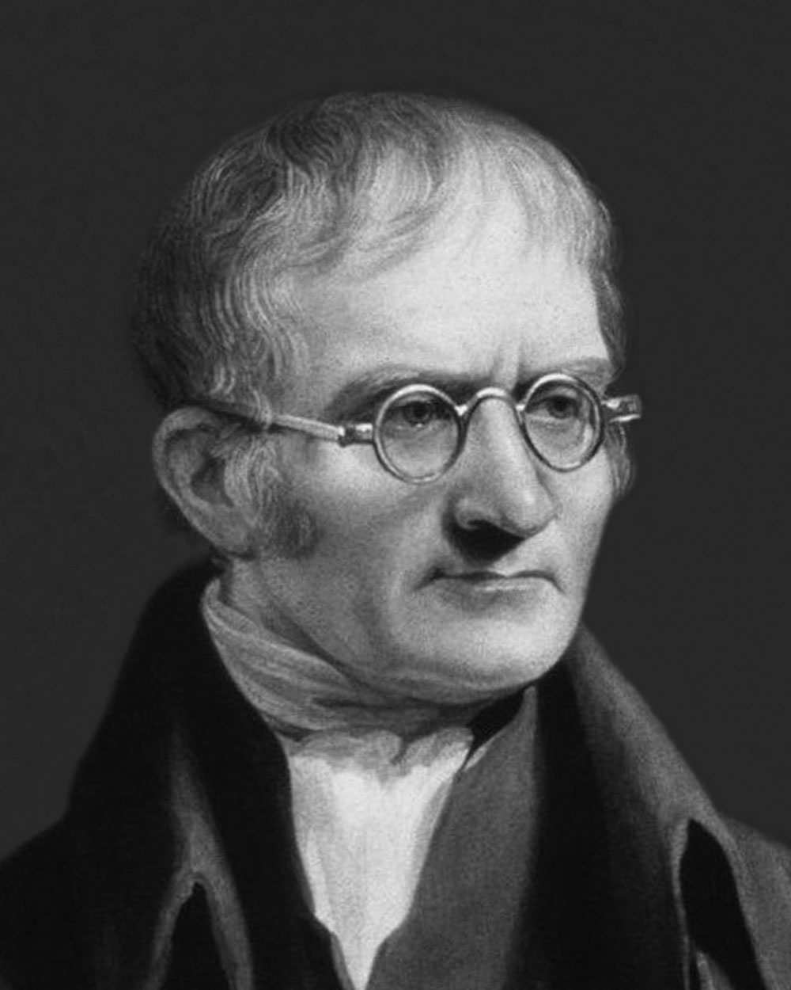
Introduction
To help us understand electricity, we must first understand some facts about matter and the building blocks of matter. In this topic we will explore the composition of matter atomic theory.
In 1803, John Dalton, a British scientist, introduced the Atomic Theory which states that all matter is made up of tiny indivisible particles, called atoms.
John Dalton
Notes:
John Dalton- image source: http://www.technologycorp.com.au/resource/john_dalton/

Slide 5
What is matter?
Matter is another word for the things that ‘stuff’ is made of. Matter is anything that has weight (mass) and takes up space (has volume).
Think about it. Matter is all around you. The chair you sit in… the food you eat…anything you can see and touch. And even some things you cannot see or touch are also forms of matter.
Watch the video to find out more about matter.
Placeholder for Video- see notes
Notes:
Video- embed Youtube video: https://youtu.be/wyRy8kowyM8

Slide 6
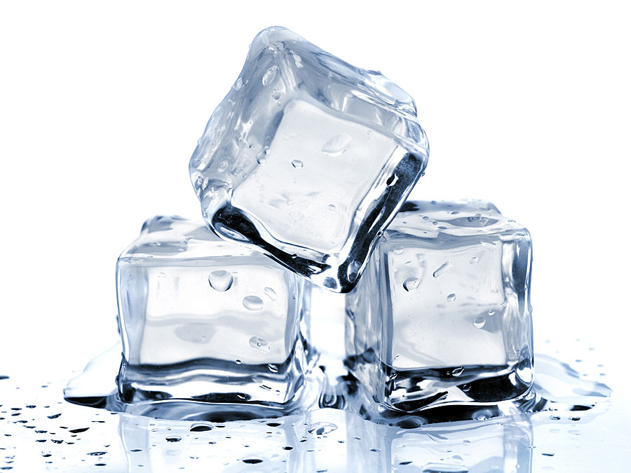
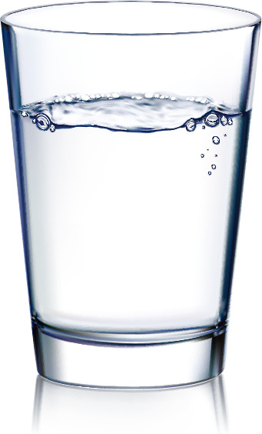
What is matter?
How can something be matter if I can’t see it or touch it? Matter can take on different forms, depending on how the particles inside it are arranged. The forms (or states) of matter include solids, liquids and gases.
Click on each of the states of matter to find out more about them.
Solids
Liquids
Gases
Notes:
Notes for Design and Interactivity:
Recreate or find suitable image replacements
When learner clicks on each item, additional info pops up and image for each changes – see next 3 slides

Slide 7
What are solids?
Examples of Solids at room temperature
Solids are substances that have a their own shape and volume. This is because the particles are packed together in a regular 3-dimensional pattern. All substances can be solid if we decrease the temperature.
Placeholder: Create Images to represent the following examples:
rock, chalk, sugar, a piece of wood, plastic, steel, nail
Characteristic of particles in a solid
There are strong forces of attraction between particles of a solid.
The particles of solids are packed close together – there are very small spaces between the particles. (that’s why they cannot be squashed or compressed)
Particles cannot move freely from place to place (this is why they have a fixed shape and volume)
The particles of each solid are arranged in a regular, distinct pattern
The particles have enough energy to vibrate in a fixed position.
Notes:
Note to media/design team: Recreate content here to visually appealing format

Slide 8
What are liquids?
Examples of Liquids at room temperature
Liquids have their own volume but they do not have their own shape. Liquids take the shape of the container they are placed in. The particles in liquids are arranged in a random pattern and can move over short distances.
Placeholder: Create Images to represent the following examples:
River, coffee, juice, milk
Characteristic of particles in a liquid
The forces of attraction between particles of a liquid are weaker than in a solid. (That’s why liquids don’t have their own shape).
The particles are close together, but not as tightly packed as in solids. (Liquids cannot be compressed or squashed).
Particles are arranged in a random way.
Particles have enough energy to move around each other. (This explains why liquids can mix together and be poured from one container into another.)
Notes:
Note to media/design team: Recreate content here to visually appealing format

Slide 9
What are gases?
Examples of gases at room temperature
Gases are substances that do not have their own shape or volume. Gases take the shape and volume of the contained they are placed in.
Placeholder: Create Images to represent the following examples:
Helium, Carbon dioxide, nitrogen dioxide
.
Characteristic of particles in a gas
The forces of attraction between particles of a gas are very weak. (That’s why gases don’t have their own shape or volume).
Particles are far apart from each other and arranged in a random way. (That’s why most gases are colourless!)
There are large spaces between gas particles. (That’s why gases can be compressed or squashed.)
The particles have enough energy to move quickly in all directions, over large distances.
Notes:
Note to media/design team: Recreate content here to visually appealing format

Slide 10
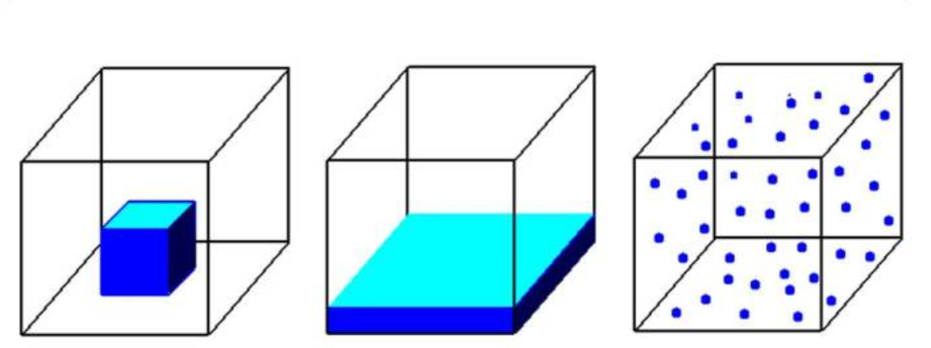
Summary of matter
Let’s summarise what you know about matter
Fill in the missing words in the table below the diagram
State | Solid | Liquid | Gas
Shape | Fixed shape | Shape of container | Shape of container
Volume | Own volume | Own volume | Volume of container
Forces between particles | Strong forces | Medium forces | Weak forces
Notes:
Graphic: https://www.tes.com/lessons/K_sJGJe1TnCcKA/solid-liquid-and-gas (Original from NASA)
Feedback
If correct: Well done! You know the differences between states of matter!
If incorrect: Sorry, you got a few wrong. Don’t worry, you can revise them. Click here (Link back to the 1st slide on- What is matter (slide 4))

Slide 11
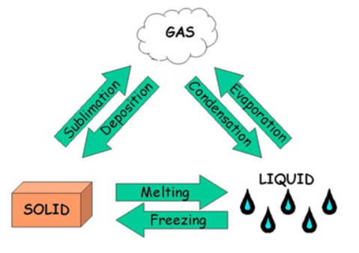
Changing states of matter
So Matter is anything that has weight (mass) and takes up space (has volume). And can exist either as a solid, liquid or gas. The state of matter depends on the way the particles are arranged at a particular temperature.
By changing the temperature (amount of energy particles have) we can change the state of matter.
Click on the arrow in the diagram below to see what we call each of the changes in state.
Placeholder:
Notes:
Interactive graphic: Click on arrow to reveal name
http://teachersinstitute.yale.edu/curriculum/units/2016/4/16.04.06.x.html

Slide 12
Activity: Changing states
You are going to use a simulation to see what happens to the particles of a substance when the temperature changes.
Instructions:
Click here to open the simulation tool and select “States”.
The starting item on “Atoms & Molecules” menu is Neon. Above the thermometer the temperature is given as 13K (13 Kelvin) Click to change the temperature reading to degrees Celsius.
Now, click on:
Solid: Look at how the particles are arranged
Liquid: What do you notice about how the particles are arranged? What has happened to the temperature?
Gas: What do you notice about how the particles are arranged? What has happened to the temperature?
4. Select a different substance from the “Atoms & Molecules” menu and repeat step 3. You can change the temperature by using the heat or cool switch too.
Notes:
CLICK HERE Link to simulation: https://phet.colorado.edu/sims/html/states-of-matter-basics/latest/states-of-matter-basics_en.html

Slide 13
Sort the matter
Help sort the matter! Drag and drop the items into the correct containers.
Solids
Liquids
Gases
Placeholder: Create images to represent the following items:
pencil
water
nitrogen
ice cream
copper wire
juice
Notes:
Notes for interactivity:
Drag and drop activity.
Correct Answers:
Solids
pencil
ice cream
Copper wire
Liquids
water
juice
Gases
Nitrogen
Feedback
If correct: Great, well done! You know your matter!
If incorrect: Sorry, you got a few wrong. Don’t worry, you can revise them. Click here (Link back to slide- What is matter)

Slide 14
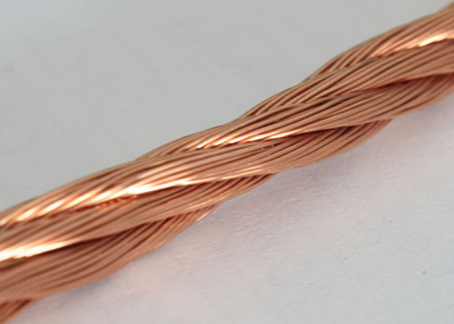
Different types of matter
You already know quite a lot about matter! But there is much more to learn about matter too. You will notice that different solids look different and have different properties. This is because they are made up of different particles. Scientists classify or group substances into three main categories, namely, elements, compounds and mixtures
Element Compound Mixture
Click on each of the types of matter to find out more about them.
Copper Water Brass
Notes:
Notes for Design and Interactivity:
Recreate or find suitable image replacements
When learner clicks on each item, additional info pops up and image for each changes – see next 3 slides
Element: Copper https://upload.wikimedia.org/wikipedia/commons/7/76/Enamelled_litz_copper_wire.JPG (By Alisdojo [CC0], from Wikimedia Commons)
Compound: Re-Use image created for liquid water (Slide 6)
Mixtures: Brass https://commons.wikimedia.org/wiki/File:Brass_instruments,_Tuba,_part_of.jpg

Slide 15
What are elements?
Examples of elements
Elements are pure substances that cannot be broken down into simpler substances. Each element has a unique symbol so that you can identify it.
There are three types of elements - metals, metalloids and non-metals. The main difference in these types of elements is related to how they conduct or do not conduct electricity.
Placeholder: Create Images to represent the following examples:
Copper Cu
Iron Fe,
Silicon Si
Oxygen O₂,
Mercury Hg
Particles in an element
The smallest particles in all elements are atoms. Some non-metals atoms, like oxygen, hydrogen and nitrogen, join together to form simple units called molecules of two atoms each.
Different elements are made from atoms of different size and mass.
The atoms of a specific element have the same size and are similar in mass.
Elements are arranged in the Periodic Table. Click here to see an interactive Periodic Table. Click on a symbol of element to find out more about it’s properties.
Notes:
Note to media/design team: Insert gfx of a sample of each element showing were you will find it. (Copper wire, Iron – nail, silicon – computer chip, Oxygen – gas bottle connected to life support / breathing apparatus, Mercury – thermometer. Label each image with name and symbol. Include an arrow so users can click on the image and move on to the next example
Information block: Link Click here to https://ptable.com/

Slide 16
What are compounds?
Examples of compounds
Compounds are pure substances that are formed when elements combine with each other during a chemical reaction.
The chemical formula of a compound shows the ratio of how the elements combine e.g. H₂O is the chemical formula of water. The ratio between the amount of hydrogen to oxygen is 2:1
Placeholder: Create Images to represent the following examples:
Water (H₂O),
Carbon dioxide (Dry ice) (CO₂)
Polyethene (Plastic)
([-(CH₂)-]_{n}
Sodium chloride
(salt)(NaCl)
Particles in a compound
The particles in all compounds are a collection of atoms joined together.
In many compounds the atoms join together in the simple ratio as given in the chemical. The particles are called molecules.
Molecules can vary in size from small (a few atoms per molecule) to giant sized molecules (thousands of atoms per molecule).
When a metal atom joins to a non-metal atom an ordered arrangement of positively charged and negatively charge particles (ions) is formed. This structure is called an ionic lattice.
Notes:
Note to media/design team:
Insert gfx of a sample of each compound showing were you will find it. (Water – glass with ice cubes in the water, Carbon dioxide –dry ice, Clear plastic – like for a shopping bag, sodium chloride – salt crysals. Label each image with name and formula. Include a tab on the graphic labelled Particles – show gfx of molecules (water, dry ice, plastic) or ionic lattice (salt) Include an arrow so users can click on the image and move on to the next example

Slide 17
What are mixtures?
Examples of mixtures
Mixtures are impure substances that are random combinations of elements or / and compounds. There is no fixed ratio of the components of a mixture. Each part of the mixture retains its own properties
Placeholder: Create Images to represent the following examples:
Tea, concrete,
Brass, Bronze, Steel,
Particles in a mixture
The particles of a mixture can be any combination of atoms, molecules or ionic lattices.
The particles of the different components can be separate from each other by mechanical method. For example, hand sorting or filtering or by using a magnet.
Mixtures of metals are called alloys. These are formed when hot molten metals (liquid) are mixed together. Common alloys include:
Brass - Copper & Zinc Bronze – Copper & tin
Steel – Iron, carbon & chromium Solder (modern) – tin and copper
Notes:
Note to media/design team:
Insert gfx of a sample of each mixture showing were you likely to find it. Add in label and the components that make up the mixture below
Tea: Water, sugar, milk, chemicals extracted from tea leaves
Concrete: stones, sand, cement
Brass: Copper & Zinc
Bronze Copper & tin
Steel: Iron, carbon, chromium or magnesium or vanadium
Solder: tin and copper ( Used to include lead too but removed due to health risks)

Slide 18
What are atoms made of?
As you have seen the basic building block of all matter is the atom. You cannot see an atom but by doing experiments scientists have developed different models of what an atom is.
Do you know or remember the parts of an atom? Make a drawing and write down a few notes to see what you know.
Check your ideas by watching the video below:
Placeholder for Video- See appendix
Notes:
Embed the video – See appendix- Video script- What is an atom?

Slide 19
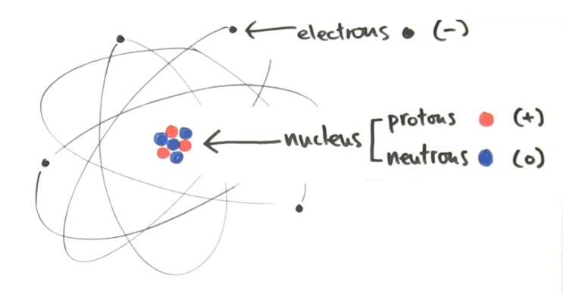
Structure of the atom
Completed Diagram
We know that there are three basic parts of an atom. Can you drag and drop the labels to their correct position?
Protons
Electrons
Neutrons
Basic Structure of an Atom
Notes:
Interactivity;
Recreate image
Learner must drag and drop labels to correct positions on atom structure. If label is placed on incorrect place, it wont stick and will bounce back to original position. Learner must try again until they get it right. Please recreate atom image.
When learner places them on corresponding spot, following text appears:
Protons -positive electrical charge, found in the nucleus of an atom
Neutrons - neutral or no electrical charge, found in the nucleus of an atom
Electrons - negative electrical charge. Electrons are the smallest of the three particles that make up atoms and are found in shells or orbitals that surround the nucleus of an atom.

Slide 20
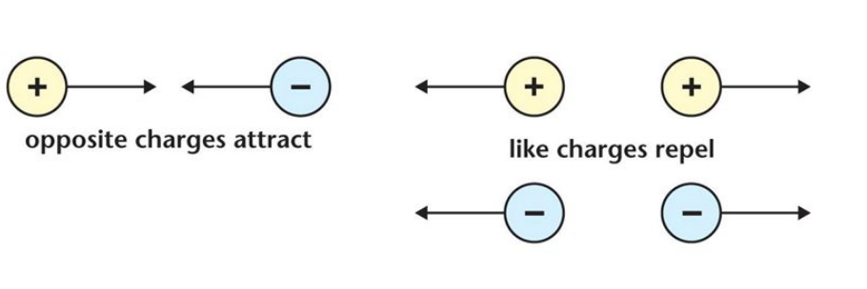
Electrostatic forces
The most important forces that you will need to know about in this course are electrostatic forces. These forces are non-contact forces that are found between charged objects. They can act over a large distance.
There are two types of electrostatic forces. The force of attraction and the force of repulsion
Like Charges Repel each other
Unlike charges Attract each other
Electrostatic forces are found inside atoms and also between atoms of elements and compounds.

Slide 21
Forces inside an atom
There are different forces inside an atom.
Forces between the nucleus and the electrons:
The force between the positively charged protons and negatively charged nucleus is called an electrostatic force. This is a force of attraction.
The force between the electrons moving in a circular motion around the nucleus. This force is called the centrifugal force and pushes the electrons away from the nucleus.
Forces inside the nucleus:
Positively charged protons and neutral neutrons are held together in the nucleus by very strong nuclear forces. These forces are not the same as electrostatic forces.

Slide 22
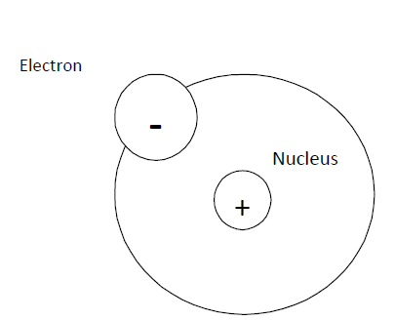
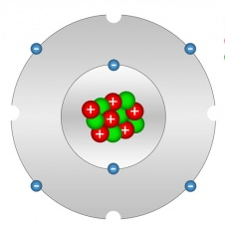
Are all atoms the same?
It is true that all things are made of atoms, and all atoms are made of the same three basic particles - protons, neutrons, and electrons.
But, all atoms are NOT the same.
The number of protons in the nucleus of an atom will determine the element it represents. This is called the atomic number (Z) of an element.
The mass number (A) of an atom is the number of protons and neutrons in the nucleus.
Let’s take a closer look at some examples of atoms. Click on each below.
Hydrogen Atom
Carbon Atom
Notes:
Notes to design:
Please recreate atom images to all be same style
Images link to additional info slides.. Once both are viewed, can proceed to next slide in sequence.

Slide 23
Hydrogen atom
Hydrogen Atom
The nucleus of every atom contains one proton.
In most hydrogen atoms there are no neutrons.
Complete the table below for a common hydrogen atom:
Number of protons | 1
Number of electrons | 1
Number of neutrons | 0
Atomic Number (Z) | 1
Mass Number (A) | 1
A small % of hydrogen atoms have one neutron. It has a mass number of 2. We say this is an isotopes of Hydrogen and write it’s name as hydrogen - 2.
Notes:
Note for interactivity:
Create image as animated gif which shows one electron moving in a circle around one proton.
Correct values are filled in on table in blue
Feedback from table: If values are all correct – Well done! Now look at the carbon atom
If values are not correct – Not all your answers are correct. Look at the image of the hydrogen atom and try again. Remember, in any neutral atom the number of protons is equal to the number of electrons, the Atomic Number is equal to the number of protons and the Mass number is equal to the number of protons plus the number of neutrons.
Return to slide 21 after positive feedback

Slide 24
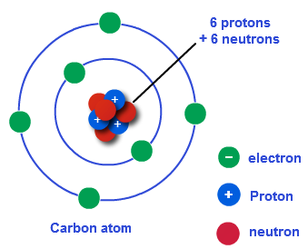
Carbon atom
Carbon Atom
The most common carbon atom can be represented by the following symbol:
12
C
6
Use the information from the table symbol and the diagram a common carbon atom to complete the table:
Number of protons | 6
Number of electrons | 6
Number of neutrons | 6
Atomic Number (Z) | 6
Mass Number (A) | 12
Notes:
Note for interactivity:
Create image as animated gif which shows 6 electrons moving around a nucleus with 6 neutrons and 6 protons
Correct values are filled in on table in blue
Feedback from table: If values are all correct – Well done! You are ready to move on
If values are not correct – Not all your answers are correct. Look at the image of the carbon atom and try again. Remember, in any neutral atom the number of protons is equal to the number of electrons, the Atomic Number (shown below the symbol C) is equal to the number of protons and the Mass number (shown above the symbol C) is equal to the number of protons plus the number of neutrons.
Return to slide 24 after positive feedback

Slide 25
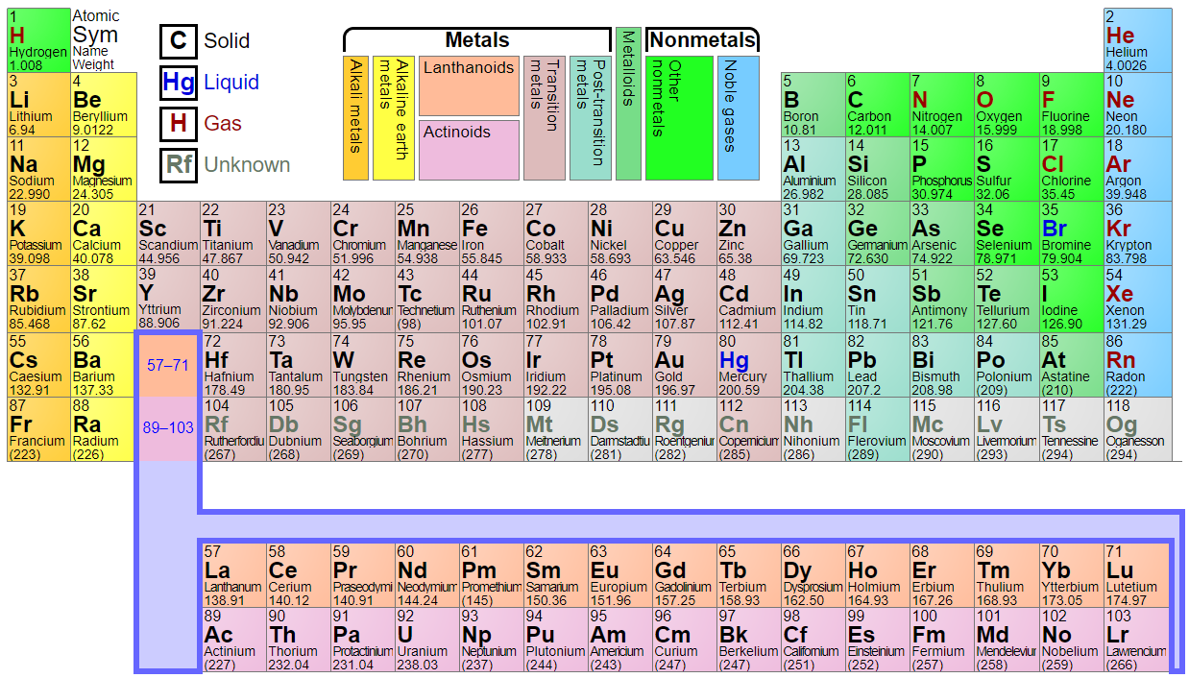
Organising the elements
All together there are 118 elements, 94 of which occur naturally on earth. Each element has unique characteristics.
The Periodic Table of the Elements provides a great a way to organise the elements. The elements are arranged in order of atomic number written above each symbol on this table.
The number below the symbol is the atomic weight and is the average weight of an atom including all isotopes of the elements. The atomic weight is usual written a decimal number.
Periodic table of elements
Click on the image of periodic table and find out the properties of different elements.
Notes:
Image of periodic table taken from https://ptable.com/
2. When user clicks on image direct user to https://ptable.com/

Slide 26
Can you use the Periodic Table of the elements?
Some of the information about these elements is missing. Refer back to the Table of Elements and then complete the missing information.
29
27
8
1
Cu
Zn
O
Ag
58.933
65.38
15.999
107.87
Submit
Notes:
Note for interactivity:
Link to Interactive table of elements: https://ptable.com/
Learner to type in missing details into the blocks
Activity:
Correct answers for missing detail:
Element 1: Copper; 63.546
Element 2: C; Cobalt
Element 3: 30; Zinc
Element 4: Oxygen
Element 5: H, Hydrogen, 1.008
Element 6: 47, Silver
When learner clicks on ‘submit’ button they should be taken to feedback page.
Feedback if all correct: Well done! You have completed all the elements correctly.
Feedback if some incorrect: Oops not quite, you seem to have got a few wrong. Here’s the correct answers (indicated on hidden slide that follows)

Slide 27
Check you complete the elements?
Some of the information about these elements is missing. Refer back to the Table of Elements and then complete the missing information.
29
27
30
8
1
47
Cu
Zn
O
Ag
Co
H
Copper
Cobalt
Zinc
Oxygen
Hydrogen
Silver
63.656
58.933
65.38
15.999
1.008
107.87
Submit
Notes:
Activity:
Correct answers for missing detail:
Element 1: Copper; 63.546
Element 2: Co; Cobalt
Element 3: 30; Zinc
Element 4: Oxygen
Element 5: H, Hydrogen, 1.008
Element 6: 47, Silver

Slide 28
Activity: Building Atoms
You are going to have some fun building several different types of atoms.
Instructions:
Click here to open the simulation tool.
Choose the ‘Symbol’ option. You will work the Atomic Number and Mass Number of different isotopes of the elements.
Now, try to build the following:
Hydrogen atom: Place one proton and one neutron in the nucleus. Place one electron in the first orbit (energy level).
Carbon atom: Place six protons and six neutrons in the nucleus. Place six electrons on the atom. Start by filling the orbit (energy level) closest to the nucleus.
Neon atom: Place ten protons and ten neutrons in the nucleus. Place ten electrons on the atom.
4. When you feel ready select the ‘Game’ option and complete all four games.
Notes:
CLICK HERE Link to simulation: https://phet.colorado.edu/sims/html/build-an-atom/latest/build-an-atom_en.html
Click here link to Games:

Slide 29
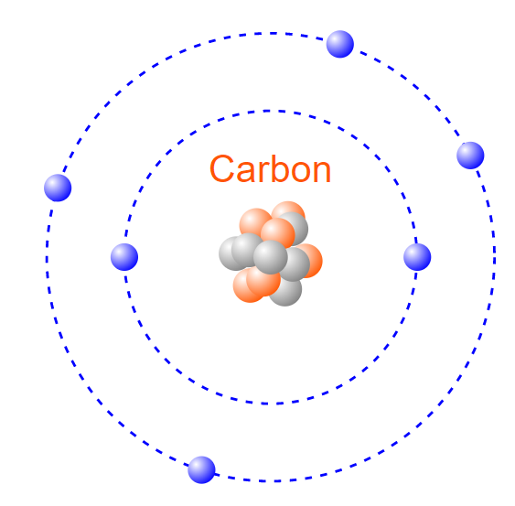
How the electrons are arranged around the nucleus of an atom
When you were building atoms did you notice how that the electrons are not all the same distance away from the nucleus?
The negative electrons in the orbits (energy levels) closest to the nucleus experience a strong force of attraction to the positively charged nucleus. These electrons are called core electrons
The electrons in the orbit (energy level) furthest from the nucleus are not as tightly held. These electrons are called the valence electrons of an atom
How many valence electrons are there in a carbon atom?
Enter answer: 4
Notes:
Note for interactivity:
Recreate image (Image taken from https://phet.colorado.edu/sims/html/build-an-atom/latest/build-an-atom_en.html)
Answer Box: Answer in blue is correct
Feedback
Correct answer
Well done! A neutral carbon atom has 6 electrons. Two electrons are in the 1st energy level (core electrons) and 4 electrons are in the 2nd energy level furthest from the nucleus.
Incorrect answer
Try again! Count the number of electrons in the carbon atom. How many are in the 1st energy level. These are the core electrons. How many electrons are in the 2nd energy level? These are the valence electrons of the carbon atom.

Slide 30
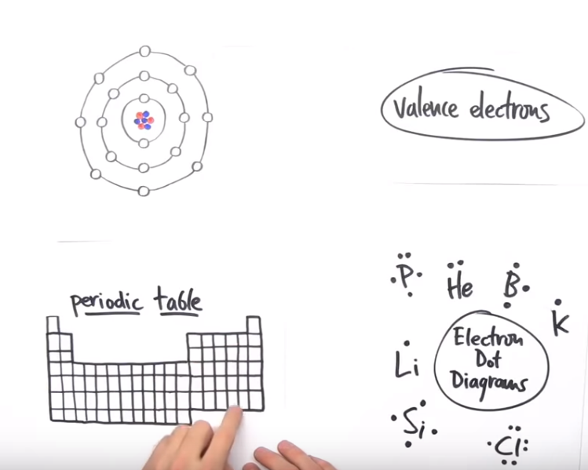
Valence electrons
Click on the image below to watch a video that shows you how to draw a diagram showing the valence electrons of an atom.
The valence electrons of an atom are very important. They are involved in chemical bonding when atoms of different element join together to form molecules or an ionic lattice.
When valence electrons are not tightly held, they are called free or delocalise electrons. Atoms that have free electrons are found in elements that are good conductors of heat and electricity.
Notes:
Video link on image taken from video: https://www.youtube.com/watch?v=yADrWdNTWEc

Slide 31
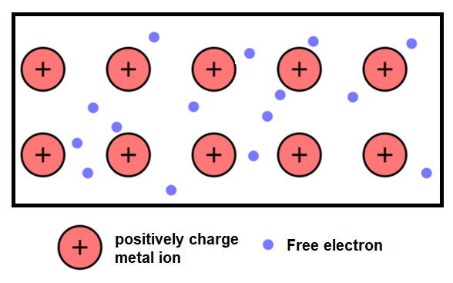
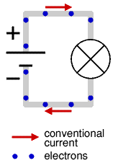
A closer look at atoms in metals
Video demo showing flow of electrons
All metal atoms have only a few valence electrons. These valence electrons are not tightly held by the positively charged nucleus and can drift away from one atom to a neighbouring atom. We call these electrons delocalised or free electrons.
When a free electron moves away from an atom, the atom becomes a positively charged ion and attracts electrons from other atoms in order to become neutral. This causes electrons to move from atom to atom in a random way and also holds all the metal atoms together.
We call this a metallic bond.
Watch the video demonstrating the metallic bond.
Notes:
Video link: Fuse School (OER): https://www.youtube.com/watch?v=S08qdOTd0w0

Slide 32
The movement of free electrons
Video demo showing flow of electrons
Free electrons from the outer orbit move in a random way through the arrangement of positively charge metal ions.
If we attach the positive terminal of a battery to one end of the metal wire and the negative end to the other end of the wire, the free electrons all move in the same direction. We call this flow of electrons an electric current.
Watch the short video showing the movement of electrons in a metal.
Notes:
Video link: https://www.youtube.com/watch?v=mCKM7QqypjI

Slide 33
A quick quiz
Before we end off, take some time to check your understanding of what we have covered in this unit by answering the following questions.
Q1: What is the simplest unit of an element called?
Q2: What is the mass number for an atom?
Q3: Provide one word for a substance containing atoms of more than one element.
Q4: Provide the atomic number for: Hydrogen, Neon, Carbon, Oxygen, Silver, Aluminium
Q5: Name three sub-atomic particles that make up an atom.
Add feedback and multiple choice options
Notes:
Correct answers:
Atom
The sum of the protons and neutrons is the mass number of an atom.
Compound
ADD ATOMIC NUMBERS HERE
Protons, neutrons, and electrons

Slide 34
Stop and Reflect
Atoms
1
Elements
2
Molecules
3
Compounds
4
Notes:
When learner clicks on button text, it expands to reveal description. When learner clicks on second text button, the first will collapse to reveal second description. Supporting image to be shown with text
Text as follows:
Atoms
An atom is the smallest particle of matter that makes up an element. An atom consists of protons, neutrons and electrons.
Elements
An element is a pure substance that cannot be broken down into a simpler substance An element is made up of atoms that all have the same number of protons.. For example, the element sodium is made up of only sodium atoms. They all have 11 protons. The atomic number of sodium is 11.
Molecules
A molecule is a substance that contains two or more atoms joined together. We find molecules in compounds, such as water,H₂O. This molecule has two hydrogen atoms joined to one oxygen atom.
Compounds
A compound is a pure substance that is made up of two or more different elements that are joined together. The particles in compounds are either molecules e.g Water H₂O or an ionic lattice e.g salt NaCl.

Slide 35
APPENDIX

Slide 36
Appendix
ICONS REQUIRED
ICON REQUIRED | ICON PURPOSE | Example:
Outcomes | Icon to represent Learning Outcomes
Extra Information | Icon to represent Additional Information
Instruction | Icon/ Or actual person to represent an Instruction (something learner needs to do)
Tip | Icon to represent a hint or tip
Glossary | Icon to represent Glossary Page
Reflection | Icon to represent Reflection/ Stop and Think
Notes:
Icons to be re-created and used across all UNITS as required. These are examples only.

Slide 37
Video Script- What is an atom?
Video of a topic expert speaking through main characteristics/features of atoms, interspersed with hand-drawn images/sketches to illustrate points. Talking Points to be covered include:
Structure of atom
Inner core:
Most of the mass of the atom is found in the inner core
Contains nucleus consisting of protons and neutrons.
Held together by very strong nuclear forces.
Protons (p⁺)
These are positively charged particles found in the nucleus.
The number of protons is called the atomic number of an element. Every element has a unique atomic number.
Neutrons (nº)
These are neutral particles found in the nucleus of the atom.
Atoms of an element can have different numbers of neutrons
Outer region:
Cloud of electrons orbiting the nucleus – a long way from the nucleus.
The electrons are held in their orbits by the electrostatic force between them and the positively charged nucleus.
Electrons are stopped from moving closer to the nucleus because of forces involved in circular motion
Electrons (e⁻)
These are small (almost no mass) negatively charged particles that orbit the nucleus.
Electrons are involved when atoms combine to form molecules and ionic lattices
The ability of electrons to move between atoms close to each other determines how well an element will conduct heat and electricity.
Charge of atom – atoms are neutral because the number of protons is equal to the number of electrons
when an atom loses an electron it becomes a positively charged ion and when an atom gains an electron it becomes a negatively charged ion.
Notes:
Can use this video as a guide for video style and content: https://www.youtube.com/watch?v=h6LPAwAmnCQ

