Slide 1
World of Electrician
Topic 4- Introduction to drawings and schematics

Slide 2
Introduction to schematic drawings
Unit 1 of 1

Slide 3
Outcomes
By the end of this unit you will be able to:
Identify common symbols found on a schematic diagram
Read and interpret a schematic drawing/diagram
Draw your own schematic diagram

Slide 4
Introduction
In this unit you will learn how to read a schematic diagram. Schematic diagrams are meant to show how all the pieces of an installation fit together. They are easier to read and draw than real diagrams which is why Electricians use them when they are planning how to do a job.
Watch this video for a good explanation of schematic diagrams.
Vid 01
Creative commons video
(reuse allowed) Video should be cut at 1.46 sec
https://www.youtube.com/watch?v=3dm_94CcIr8
Notes:
Note for interactivity:
When learner clicks on video is should play fullscreen.

Slide 5
Detailed diagram vs schematic diagram
As you saw in the video, a schematic diagram is much simpler than a detailed diagram of an object. This makes it much quicker to draw and understand.
Take a look at the three images below to see the different between an actual installation, a detailed diagram and a schematic diagram.
Image 01
Downlight installation in a bedroom
Image 02
Detailed drawing of a downlight installation in a bedroom
Image 03
Schematic drawing of downlight installation in a bedroom
Actual installation
Detailed drawing
Schematic drawing

Slide 6
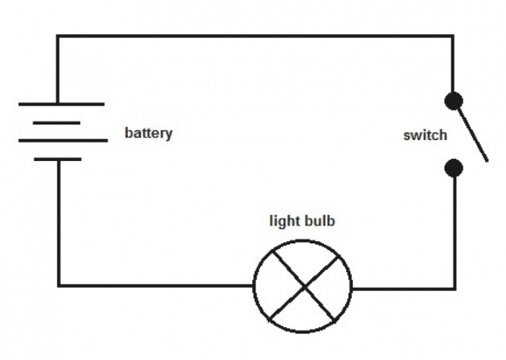
IEC standards
To make sure that everyone is using the same symbols for their schematic diagrams, Electricians in South Africa use symbols outlined by International Electro-technical Commission (IEC). Here is an example of a schematic diagram that uses some of these symbols.
Move over each area of the diagram to see what it means.
Image 04
Simple circuit schematic drawing
Notes:
Note for interactivity:
When learner moves their mouse over each hotspot the following labels should appear:
Diagram 1 (left hand side of diagram) - Battery
Diagram 2 (bottom middle)- Light Bulb
Diagram 3 (right side of diagram) switch

Slide 7
Reading diagrams
To be able to understand what the diagram says you must be able to identify electrical equipment and components from the symbols that are used. Let’s get you started with reading some simple diagrams.

Slide 8
Practice reading diagrams
See if you can identify the symbols in this schematic diagram.
Click on the block that says “IEC symbols” to help you find the correct meaning of the symbol, type it into the boxes and click submit.
Doc 01
List of IEC Symbols
See Slide 11 for brief
What does this symbol stand for?
What does this symbol stand for?
Image 05
Simple resistance schematic drawing
Submit
Notes:
Note for interactivity:
The block “List of IEC symbol” should be linked to a master list of symbols. Learner should be able to download this list and keep it with them.
Two text boxes for typing.

Slide 9
Feedback
Where you able to correctly identify the symbols in this diagram?
What does this symbol stand for?
What does this symbol stand for?
Earth
Resistor
Notes:
Note for interactivity:
The block “List of IEC symbol” should be linked to a master list of symbols. Learner should be able to download this list and keep it with them.
Two text boxes for typing.

Slide 10
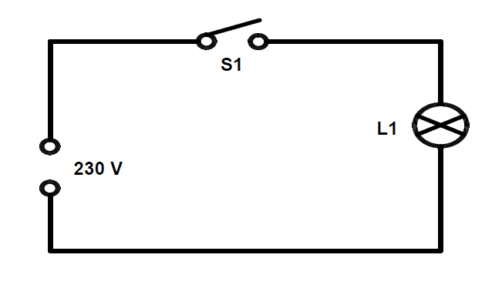
Practice reading diagrams
Here is another diagram for you to try.
Type in what each symbol stands for in the boxes and click submit.
Reuse
Doc 01
IEC Symbols
Image 06
Light connection schematic drawing
Submit
Notes:
Note for interactivity:
The block “List of IEC symbol” should be linked to a master list of symbols. Learner should be able to download this list and keep it with them.
Two text boxes for typing.

Slide 11
Feedback
Where you able to correctly identify the symbols in this diagram?
Make contact (normally open)
Lamp
Notes:
Note for interactivity:
The block “List of IEC symbol” should be linked to a master list of symbols. Learner should be able to download this list and keep it with them.
Two text boxes for typing.

Slide 12
ePortfolio Create your own schematic drawing
Now that you know a bit more about what schematic drawings are and how to understand what the symbols mean, it’s time to try and draw your own simple schematic drawing.
On a piece of paper draw a schematic diagram of the following:
a light controlled by an on/off switch.
Take a photo of your drawing and upload it using the button below. Don’t forget to use your List of IEC symbols to help you.
IEC Symbols
Upload my diagram
What is an on/off switch.
Notes:
Note for interactivity:
IEC Symbols box should be linked to Doc01
Document upload function needed for “Upload my diagram”
What is an on/off switch box should be linked to the following website: https://en.wikipedia.org/wiki/Switch

Slide 13
Doc 01- List of symbols
Document to be created showing table list of most commonly used IEC symbols used by Electricians. In the first column there should be the name of the symbol, in the next column should be image of the symbol and then if there is one the alternative to that symbol.
Re-create document using images on Slide 14.
Notes:
If additional symbols required you can visit the following link: https://www.slideshare.net/vamsinimmakayala/iec-symbol-reference

Slide 14
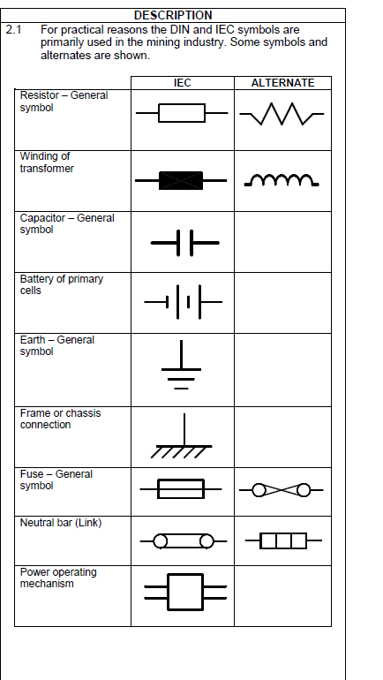
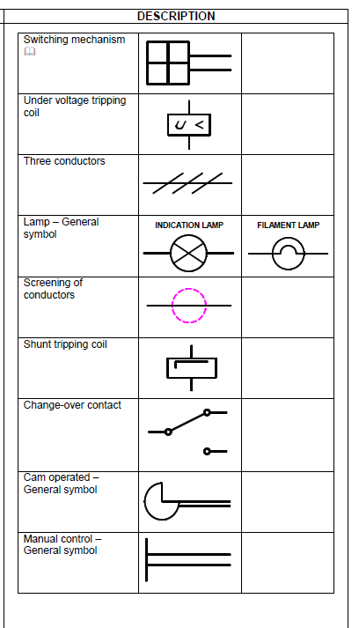
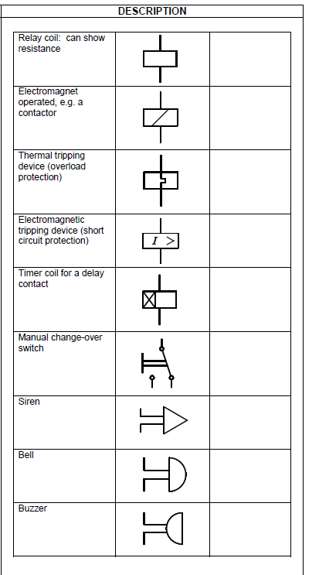
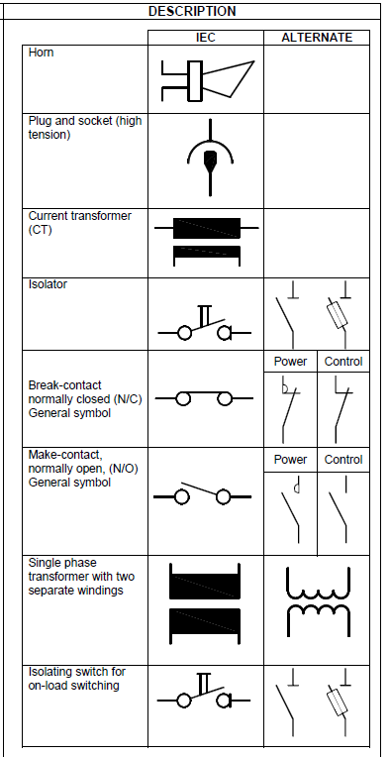
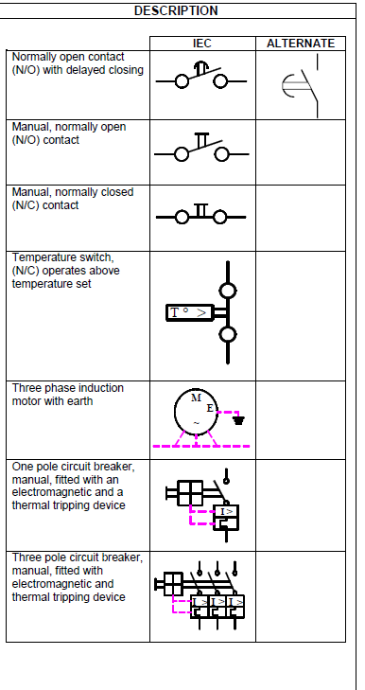
Doc 01- List of symbols

