Slide 1
World of Electrician
Topic 3- General Basic Safety

Slide 2
How to do a risk assessment
Unit 5

Slide 3
Outcomes
By the end of this unit you should be able to:
Identify a hazard
Give a definition for the work ‘risk’.
Identify where various scenarios fall on a scale from low to high risk
Conduct a risk assessment

Slide 4
Introduction
In this unit you will learn what a hazard is and how to decide if there is a good chance that it will hurt someone. You will also learn how to do a risk assessment in order to make the workplace as safe as possible.

Slide 5
What is a hazard?
In the workplace you will often hear people talking about ‘hazards’. A hazard is something that can cause harm.
Take a look at the images below. Which ones are hazards? Drag and drop the hazards into the empty box and click submit.
Image 01
Someone standing on the top step of the ladder
Image 02
Someone making a cup of coffee
Image 03
Someone changing a lightbulb
Hazards
Image 04
Someone talking to a friend
Image 05
Someone using a knife to cut a sandwich
Image 06
Someone playing with a gun
Submit
Notes:
Notes for interactivity:
Drag and drop activity. The blocks that should be dragged into the hazard’s hotspot are as follows:
Someone working on ladder
Someone making a cup of coffee
Someone changing a light bulb
Someone using a knife to cut a sandwich.
Someone playing with a gun.
Feedback if correct: Well done! You identified the correct hazards.
Feedback if incorrect. Oops not quite, on the next page you will see the correct hazards

Slide 6
What is a hazard?
Here are some common hazards.
Click on each image to see an explanation for why each one is a hazard.
Image 01
Someone working on the top step of a ladder.
Image 02
Someone making a cup of coffee
Image 06
Playing with a gun
Image 03
Someone changing a lightbulb
Image 05
Someone using a knife to cut a sandwich
Notes:
Notes for interactivity:
When learner clicks on each of the blocks, they should see the following text:
Image 01- You can fall off the ladder and hurt yourself
Image 02- You can spill boiling water on your hands and hurt yourself
Image 03- You could shock yourself or the lightbulb could shatter, and you could cut yourself
Image 05- The knife could slip, and you could cut your hand.
Image 06- You could accidentally shoot yourself or someone near you with the gun which could lead to injury or death.

Slide 7
What is a risk?
So, now you know that a hazard is something that can cause harm. Building on this, a risk is a chance (high or low) that the hazard will cause someone harm. Let’s use some of the examples of hazards you have identified to work out the level of risk for each one.
Move the arrow on the scale to rate the risks of each of the following hazards and click submit.
Image 01
Someone working on the top step of a ladder
Low risk
High risk
Submit
Notes:
Note for interactivity:
Arrow needs to be movable.
When learner clicks on Submit button they should be taken to the feedback on the next slide.

Slide 8
Feedback- working on a ladder
Here is the risk level for someone working on a ladder.
Standing on the top step of a ladder is dangerous and is not recommended by the manufacturers. A person could easily lose their balance and fall which is why the arrow is closer to the high-risk side.
Image 01
Someone standing on top step of the ladder
Low risk
High risk

Slide 9
Rate the risk- making coffee
What is the risk level for making a cup of coffee?
Move the arrow on the scale to rate the risks of this hazard and click submit.
Image 02
Someone making a cup of coffee
Low risk
High risk
Submit
Notes:
Note for interactivity:
Arrow needs to be movable.
When learner clicks on Submit button they should be taken to feedback on the following slide

Slide 10
Feedback- making coffee
Here is the risk level for someone making a cup of coffee.
While working with boiling water is dangerous, as long as the person has a steady hand, the risk of getting burned is quite low.
Image 02
Someone making a cup of coffee
Low risk
High risk
Submit

Slide 11
Rate the risk- changing a lightbulb
What is the risk level for changing a lightbulb?
Move the arrow on the scale to rate the risks of this hazard and click submit.
Image 03
Someone changing a lightbulb
Low risk
High risk
Submit
Notes:
Note for interactivity:
Arrow needs to be movable.
When learner clicks on Submit button, they should be taken to feedback on the following slide

Slide 12
Feedback- changing a lightbulb
Here is the risk level for someone changing a lightbulb.
Working with electricity can be dangerous especially if there is a high voltage. Since this a socket in a house is only 220V, even if a person gets electrocuted they will only experience a mild shock. That is why this is a medium risk.
Image 03
Someone changing a lightbulb
Low risk
High risk
Submit

Slide 13
Rate the risk-playing with a gun
What is the risk level for playing around with a loaded gun?
Move the arrow on the scale to rate the risks of this hazard and click submit.
Image 06
Playing with a gun
Low risk
High risk
Submit
Notes:
Note for design:
Image of scale needs to be redrawn
Note for interactivity:
Arrow needs to be movable.
When learner clicks on Submit button, they should be taken to feedback on the following slide

Slide 14
Feedback- playing with a gun
Here is the risk level for someone playing with a gun.
A gun is a dangerous weapon that can cause serious injury or death. For that reason, playing with a gun is a very high risk activity.
Image 06
Someone playing with a gun
Low risk
High risk
Submit
Notes:
Note for design:
Image of scale needs to be redrawn

Slide 15
Remove the hazard or lower the risk
To keep people as safe as possible we should remove the hazard completely or we should lower the risk as much as possible. Can you think of some ways in which we could do this for the hazards below?
On the next page you will have a chance to decide if the hazard can be removed or the risk can be lowered.
Image 01
Someone working on the top step of a ladder.
Image 06
Playing with a gun
Notes:
Note for design:
Image of scale needs to be redrawn
Note for interactivity:
Arrow needs to be movable.
When learner clicks on Submit button

Slide 16
Remove the hazard
Is it possible to remove this hazard?
Yes
No
Image 06
Playing with a gun
Choose your answer from the options below and click submit.
Submit
Notes:
Note for interactivity:
Multiple choice activity
Correct answer is in italics
When learner clicks on Submit button they should be taken to the correct feedback.
Feedback if correct: Well done. You are correct. If we take away the gun we have completely removed the hazard.
Feedback if incorrect: Incorrect. In this case we can remove the hazard completely. If we take away the gun and store it somewhere safe, the hazard has been removed.

Slide 17
Remove the hazard
Is it possible to remove this hazard?
Yes
No
Image 01
Someone working on the top step of a ladder.
Choose your answer from the options below and click submit.
Submit
Notes:
Note for interactivity:
Multiple choice activity
Correct answer is in italics
When learner clicks on Submit button they should be taken to the correct feedback.
Feedback if correct: You are correct. The person still needs to work on the ladder, so we can’t remove the hazard completely. Let’s see if we can lower the risk. (Take learner to slide 18)
Feedback if incorrect: Oops not quite. Since the person still needs to work on the ladder so we can’t remove the hazard completely. Let’s see if we can lower the risk. (Take learner to slide 18)

Slide 18
Lower the risk
Since it’s not possible to remove the hazard, how can we lower the risk?
The person working on the ladder can stand on a lower step.
It’s not possible to lower the risk.
Someone can hold the ladder steady while the person stands on the top step.
Choose your answer from the options below and click submit.
Image 01
Someone working on the top step of a ladder.
Submit
Notes:
Note for design:
Image of scale needs to be redrawn
Lower the risk by wearning safety harness
Note for interactivity:
Multiple choice activity
Correct answer is in italics
When learner clicks on Submit button they should be taken to the correct feedback.
Feedback if correct answer 1: You are correct. By simply moving one step down, the person will have a lot more support and balance and the chances of them falling will be reduced.
Feedback if incorrect: answer 2: Incorrect. It is possible to lower this risk. By simply moving on step down, the person will have a lot more support and balance and the chances of them falling will be reduced.
Feedback if incorrect answer 3: While it is a good idea to have a person at the bottom holding the ladder steady, the fact that the person is still standing on the top step means that the risk would not be lowered as they could still lose their balance and fall.

Slide 19
Do a risk assessment
You’ve now had some practice with identifying hazards and deciding what level of risk (high or low) each hazard has. In the workplace this activity would be called doing a risk assessment. A risk assessment is a process where you:
1. Identify hazards and risk factors that have the potential to cause harm.
2. Analyze and evaluate the risk associated with that hazard.
3. Think of ways to remove the hazard, or control the risk when the hazard can’t be removed.
Notes:
Note for design:
Image of scale needs to be redrawn
Note for interactivity:
Arrow needs to be movable.
When learner clicks on Submit button

Slide 20
Do a risk assessment
See if you can do a risk assessment for the following workplace. Can you identify the hazards? What is the level of risk of these hazards? Is it possible to remove the hazard or lower the risk?
Image 07
Workshop/workplace with cables lying on the ground.
Notes:
Note for design:
Image of scale needs to be redrawn
Note for interactivity:
Arrow needs to be movable.
When learner clicks on Submit button

Slide 21
Complete a risk assessment form
Well done on starting to think about risk assessments. When doing your practicals at a training centre you will be expected to complete a risk assessment form before you do a practical task. This is to prepare you to do the same thing once you are working as an electrician.
Click on the image to see an example of a Risk Assessment Form.
Doc 01- Screenshot of Risk Assessment Form
See brief on Slide 34
Notes:
Notes for interactivity:
When learner clicks on image it should enlarge to become fullscreen.

Slide 22
Complete a risk assessment form
On the next couple of pages you will see how trainee Nothemba completes each part of the Risk Assessment Form before she begins the task of installing a geyser.
Click on the video below to watch.
Video 01- The 6 common hazard controls
See Slide 35 for details
Notes:
Notes for interactivity:
When clicked, video should play fullscreen.

Slide 23
Test yourself
Which of the 6 common hazard controls does Nothemba have to worry about when she is connecting a geyser?
Control 1- Vehicles, Traffic or Mobile Equipment
Control 2- Hazardous material or waste
Control 3- Electricity, Machinery, Stored Energy or Machine Isolation
Control 4- Working at Heights above 2 metres
Control 5- Lifting and Material Handling
Control 6- Work with Oxy-fuel gas mixtures
Choose the correct answer(s) from the options below and click submit.
Submit
Notes:
Notes for interactivity:
When learner clicks on submit button they should see following feedback.
Feedback if correct (add depending on scenario)
Feedback if incorrect (add depending on scenario)

Slide 24
Complete a risk assessment form
Click on the video below to watch as Nothemba works through the 6 safety questions.
Video 02- The 6 safety questions
See Slide 36 for details
Notes:
Notes for interactivity:
When clicked, video should play fullscreen.

Slide 25
Test yourself
What are the six safety questions Nothemba needs to think about?
Do I have the correct tools and equipment to do this safely?
Do I feel like doing this job today?
Is everything the same as the last time I did this task?
Do I have all the correct PPE to preform the task safely?
Do I know the plan or procedure to do this task safely?
Is the work area comfortable enough to preform the task?
Am I authorised to do this task?
Is the work area safe to preform the task?
Do I have a colleague to help me do this task?
Choose the correct answers from the options below and click submit.
Submit
Notes:
Notes for interactivity:
When learner clicks on submit button they should see following feedback.
Feedback if correct Yes, you chose the 6 correct safety fundamentals
Feedback if incorrect Oops. Not quite. Here are the correct safety fundamentals:
Do I have the correct tools and equipment to do this safely?
Is everything the same as the last time I did this task?
Do I have all the correct PPE to preform the task safely?
Do I know the plan or procedure to do this task safely?
Am I authorised to do this task?
Is the work area safe to preform the task?

Slide 26
Test yourself
If Nothemba answers “No” or “Not sure” to any of the 6 Safety questions what should she do?
She doesn’t have to do anything, it’s just good to know the information.
She should call her supervisor who will help her correct the situation before she carries on.
She should make a copy of the form and give it to her supervisor.
Choose the correct answer from the options below and click submit.
Submit
Notes:
Notes for interactivity:
Multiple Choice- One answer to be selected
Correct answer is in italics
When learner clicks on submit button they should see following feedback.
Feedback if correct (add depending on scenario). Well done you are correct.
Feedback if incorrect (add depending on scenario) Oops. Not quite. Nothemba should call her supervisor who will help her correct the situation before she carries on.

Slide 27
Complete a risk assessment form
In this final video you will see how Nothemba identifies the hazards in her workplace and completes the risk rating table to determine the level of risk of each hazard.
Click on the video for more information.
Video 03- Identify the hazards and complete risk rating table
See Slide 37 for details
Notes:
Notes for interactivity:
When clicked, video should play fullscreen.

Slide 28
Test yourself
What are some of the hazards that Nothemba identified?
Climbing a ladder to get to geyser
Working with electricity
Working with tools
Oil spillage
Noise pollution
Choose the correct answer from the options below and click submit.
Submit
Notes:
Notes for interactivity:
Multiple Choice- 3 correct answers
Correct answer is in italics
When learner clicks on submit button they should see following feedback.
Feedback if correct (add depending on scenario). Well done you are correct.
Feedback if incorrect (add depending on scenario) Oops. Not quite.

Slide 29
Test yourself
At what level did Nothemba rate: Climbing a ladder to get to the geyser?
3 on the bottom scale and 4 on the consequence scale
2 on the bottom scale and 3 on the consequence scale
5 on the bottom scale and 4 on the consequence scale
Choose the correct answer from the options below and click submit.
Submit
Notes:
Notes for interactivity:
Multiple Choice- One answer to be selected
Correct answer is in italics
When learner clicks on submit button they should see following feedback.
Feedback if correct. Well done you are correct. If a person would falls off a ladder it is highly possible to break a bone, especially when climbing onto or in to a roof.
Feedback if incorrect (add depending on scenario) Oops. Not quite. Climbing a ladder would be rated 3 on the bottom scale and 4 on the consequence scale because If a person would falls off a ladder it is highly possible to break a bone, especially when climbing onto or in to a roof.

Slide 30
Test yourself
Using the rating table how would you rate: Working with electricity?
3 on the bottom scale and 5 on the consequence scale
2 on the bottom scale and 1 on the consequence scale
5 on the bottom scale and 4 on the consequence scale
Choose the correct answer from the options below and click submit.
Submit
Notes:
Notes for interactivity:
Multiple Choice- One answer to be selected
Correct answer is in italics
When learner clicks on submit button they should see following feedback.
Feedback if correct (add depending on scenario). Well done you are correct. If isolations are not done properly a person could shock. This could cause serious injury if the heart stops or causes the person to fall off the roof. It might in some cases even be a 5 on the consequences scale
Feedback if incorrect (add depending on scenario) Oops. Not quite. The rating would be 3 on the bottom scale and 5 on the consequence scale. If isolations are not done properly a person could shock. This could cause serious injury if the heart stops or causes the person to fall off the roof. It might in some cases even be a 5 on the consequences scale

Slide 31
Test yourself
If Nothemba rates something in the highlighted area, what should she do?
She should not attempt the task, she should call her supervisor because a special permit would be needed to do this work.
She can go ahead with task but she needs to be very careful
She can ask someone to help her do the task
She can carry on with the task but she must let her supervisor know about it afterwards.
Choose the correct answer from the options below and click submit.
Submit
Notes:
Notes for interactivity:
Multiple Choice- One answer to be selected
Correct answer is in italics
When learner clicks on submit button they should see following feedback.
Feedback if correct (add depending on scenario). Well done you are correct.
Feedback if incorrect (add depending on scenario) Oops. Not quite.

Slide 32
ePortfolio item- Do a risk assessment
Your final activity for this unit is to complete your own risk assessment form. You can either use your own workplace or you can use the photo provided to complete your form.
Download the Risk Assessment Worksheet, complete the sections on the worksheet. Take a photo of your worksheet and upload it to your ePortfolio.
Image 08
workplace with suitable hazards
Download Risk Assessment Worksheet (Doc 01)
Upload photo of worksheet to my ePortfolio
Watch risk assessment videos again.
Notes:
Note for design:
Image of scale needs to be redrawn
Note for interactivity:
“See photo” should enlarge when clicked and should also be downloadable
“Download” button should be linked to Worksheet 01.
“Upload” button should be linked to an upload box for learner to be able to upload a photo to their ePortfolio.
“Watch risk assessment videos “ learner should be taken to slide 32.

Slide 33
Watch Risk Assessment videos again
Here are the three videos showing how Nothemba completed the risk assessment form. Use these videos to help you complete your own risk assessment form.
Click on the video icons on the left. The video you have selected will appear on the right.
Video 01
Common hazard controls
Video 03
Identifying hazards
Video 02
6 safety questions
Back to instructions
Notes:
Notes for interactivity:
When learner clicks on videos they should play full screen
When learner clicks on ‘Back to instructions” they should be taken back to Slide 32 (ePortfolio item- Do Risk Assessment)

Slide 34
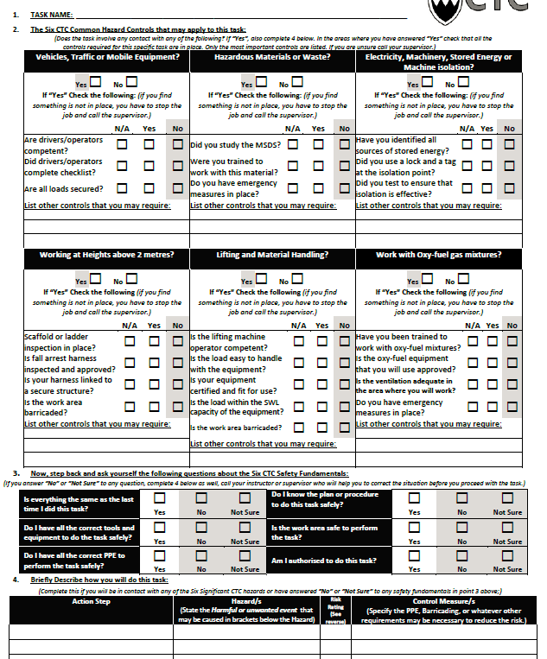
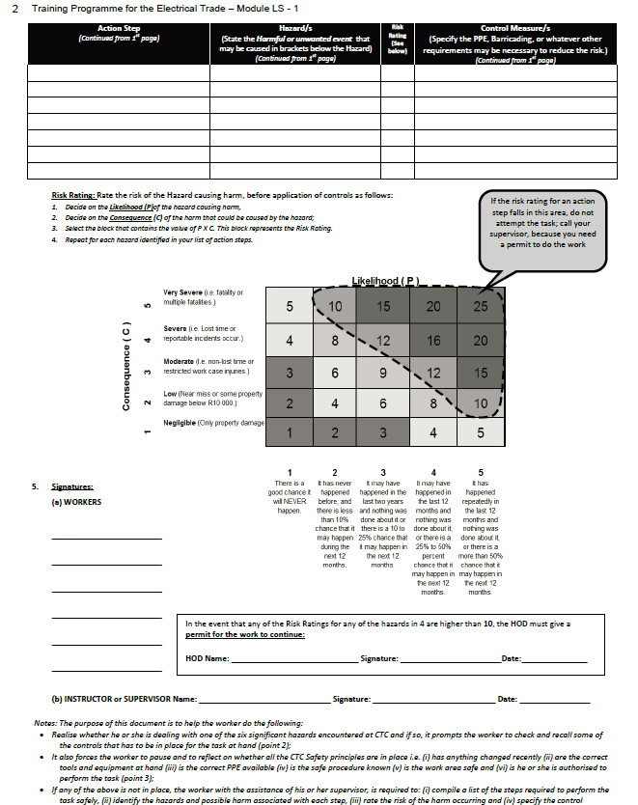
Risk Assessment Worksheet
A PDF worksheet needs to be created with the following information. CTC branding and reference to CTC must be removed.

Slide 35
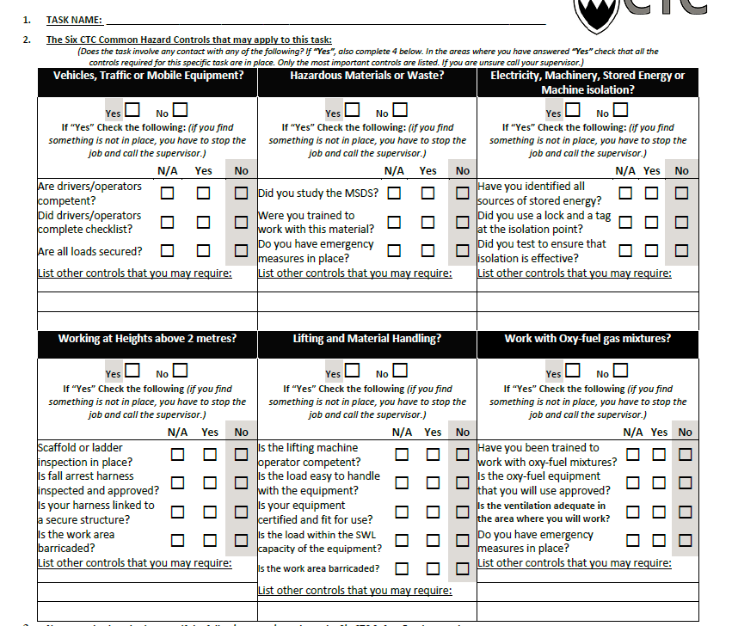
Video 01-6 hazard controls
Demonstration video with voice over by facilitator. Video should show a learner (black female) practising connecting a geyser. Before she begins she must complete the Risk Assessment Form (See Slide 34). A facilitator must talk the learner through how to complete the form correctly using the factors of connecting a geyser. Video should show closeups of the form being completed.
This video must focus only on the first section:
Common Hazards

Slide 36
Video 02- 6 safety questions
Demonstration video with voice over by facilitator. Video should show a learner (black female) practising installing a geyser. Before she begins she must complete the next part of the Risk Assessment Form. A facilitator must talk the learner through how to complete the form correctly using the factors of installing a geyser. Video should show closeups of the form being completed.
This video must focus only on the second section: The 6 safety questions.

Slide 37
Video 03-Identify hazards and risk rating
Demonstration video with voice over by facilitator. Video should show a learner (black female) practising installing a geyser. Before she begins she must complete the final part of the Risk Assessment Form. A facilitator must talk the learner through how to do a risk assessment rating (Rate on the left scale and the bottom scale and add two numbers together) make decision based on that rating. Use the following example: Climbing a ladder to get to geyser. It would be rated 3 on the bottom scale and 4 on the consequence scale. If a person would falls off a ladder it is highly possible to break a bone, especially when climbing onto or in to a roof.
Video should show closeups of the form being completed.
This video must focus only on the third section: Identify hazards and do risk rating.

