Slide 1
World of Electrician
Topic 3- General Basic Safety

Slide 2
Personal protective equipment
Unit 3

Slide 3
Introduction
In this unit you will learn about the clothing and other items you will need to do your job safely. These items are called Personal Protective Equipment (PPE).
Notes:
Note for interactivity:
When learner clicks on the block the following text should appear:
To be safe means of being protected from or unlikely to cause danger, risk, or injury.

Slide 4
Firefighter example
Let’s take a moment to think about a firefighter running into a house to fight a fire. (add in electrician bit) What would he be wearing?
Use the box below to type in what you think a firefighter would wear to fight a very hot fire and click submit once you are done.
Submit
Notes:
Turn into MC instead
Note for interactivity:
Text box for learner

Slide 5
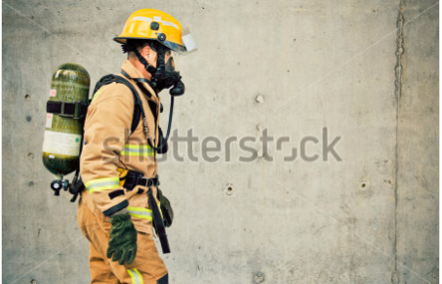
What firefighters wear
Hopefully, you didn’t say that the firefighter is only wearing jeans and a T-shirt…He would get badly burned if that was the case. Firefighters wear specific Personal Protective Equipment (PPE) to protect themselves from fire, heat and smoke.
1
Click on each area on the image to see what each item is and what it is used for.
2
3
Image 01
4
Notes:
Note for design:
Need an image of a firefighter in full uniform. See example on slide.
Note for interactivity:
On the image you will see various hotspots. When learner clicks on them or moves their mouse over them the following labels should appear:
Hotspot 1- Helmet- to protect head against objects falling on the firefighter’s head
Hotspot 2- Oxygen mask, to protect firefighter from inhaling poisonous smoke.
Hotspot 3- Flame and heat resistant overalls to protect the firefighter from getting burned
Hotspot 4- Protective gloves, prevent firefighter from getting burned and allows him to handle very hot items.

Slide 6
Share your thoughts
Do you think electricians need Personal Protective Equipment? Say yes or no and give a reason for your answer.
Use the box below to type in your answer click submit once you are done.
Submit
Notes:
Note for interactivity:
Text box for learner to type into, when the click “Submit” they should be taken to the next slide.

Slide 7
PPE for electricians
Just like a firefighter needs to use PPE while they work, as an electrician you will definitely need to wear PPE!
Click on each of the boxes to see the reasons why electricians need to wear PPE.
Reason 1
Reason 2
Reason 3
Notes:
Notes for interactivity
Reason 1- Working in potentially dangerous environments such as factories and mines
Reason 2- Working with live electricity, which means a possibility of being electrocuted
Reason 3- Working with potentially dangerous power tools like drills and saws.
For safety purposes and for preventation purposes.

Slide 8
Remember:
PPE is not always the best protection against certain hazards. It is always better, where possible, to try and remove or minimise the danger. If this is not possible, PPE is your last line of defence.
Notes:
Notes for interactivity.
Words can fade in for extra emphasis.

Slide 9
Correct PPE for hazard
Before we take a look at the types of PPE that electricians wear, keep in mind that the correct PPE should be chosen for the correct hazard. For example: leather gloves are not suitable when you are working with live electricity, you would need insulated gloves.
Image 02 leather gloves
Image 03 insulated gloves
Image 04 person working with live conductors
Notes:
Notes for interactivity

Slide 10
PPE for Electricians
In the next section we will cover the PPE for Electricians, followed by a quiz. You have a choice, you can either look review the PPE and then do the quiz or if you think you know the PPE you can go straight to the quiz.
Click on the boxes below to select your choice.
I want to review the different types of PPE
I want to go straight to the quiz.
Notes:
Notes for interactivity.
If learner clicks on “I want to review” they should be taken to Slide 11.
If learner clicks on “I want to go straight to the quiz” they should be taken to Slide

Slide 11
PPE overview
This is Thabelo. He is a new apprentice electrician. What types of PPE will he need to do his job safely?
Image 05
Drag and drop the types of PPE you think Thabelo will need onto the image of Thabelo and click submit.
Nail protection
Mouth guard
Protective vest
Hearing protection
Hand protection
Safety harness
Knee guards
Foot protection
Protection against inhalation of hazardous substances
Head protection
Protective clothing
Eye and face protection
Submit
Notes:
Notes for interactivity
Drag and drop activity. Learner can drag and drop the labels onto the image. Correct labels are indicated in green.
Feedback if answer is correct: Well done you are correct. On the next slide you will see more details about each type of PPE.
Feedback if answer is incorrect. Oops not quite, on the next slide you will see the types of PPE for Electricians. (Take learner to slide 12)

Slide 12
PPE overview
Head protection
Eye and face protection
Hearing protection
Here are the types of PPE Thabelo will need to do his job properly.
Protection against inhalation of hazardous substances
Click on each area to learn more about each type of PPE. Once you are finished click on the button below to take the quiz.
Protective clothing
safety harnesss
Hand protection
I’m ready to take the quiz.
Foot protection
Notes:
Notes for design:
Image and labels should be redone to be more stylised. Use an image of an black male or female. The same person should be shown in the close ups wearing different items of Personal Protective Equipment. See slides 13- 27
Notes for interactivity
When learner clicks on “Head Protection” they should be taken to Slide 11
When learner clicks on “Head Protection” they should be taken to Slide 12
When learner clicks on “Head Protection” they should be taken to Slide 13
When learner clicks on “Head Protection” they should be taken to Slide 14
When learner clicks on “Head Protection” they should be taken to Slide 15
When learner clicks on “Head Protection” they should be taken to Slide 16
When learner clicks on “Head Protection” they should be taken to Slide 17
When learner clicks on “Head Protection” they should be taken to Slide 18

Slide 13
Head protection
Image 06
Someone wearing a hard hat in a mining environment
If you are working in a mine, factory, plant, building site or any other area where there is a danger of objects falling on your head you must wear a hardhat.
Image 07
Man wearing safety hardhat
Notes:
Notes for design:
This slide should show a close up on the area being discussed (Head Protection). It should be the same person as shown on Slide 12 but this time the person should be wearing the correct PPE:

Slide 14
Head protection
If you are working with moving machines such as grinders, pedestal drills etc. and you have long hair you need to wear a cap or hairnet so that your hair doesn’t get caught in the machine.
Image 08
Someone with long hair wearing a hairnet/cap and working with a grinder or pedestal drill.
Image 09:
Black lady with braids wearing a hairnet.
Back to PPE Overview
Notes:
Notes for design:
This slide should show a close up on the area being discussed (Head Protection). It should be the same person as shown on Slide 11 but this time the person should be wearing the correct PPE:
Notes for interactivity:
When learner clicks on “Back to PPE Overview” they should be taken to Slide 12.
Suppress back and next buttons

Slide 15
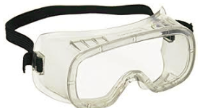
Eye and face protection- safety goggles
Image 10
Someone grinding/chiselling/chasing and wearing safety goggles.
When you are grinding, chiselling, chasing or using any machinery that may cause particles to fly into your eyes you must wear safety goggles.
Image 11
Man wearing safety goggles
Notes:
Notes for design:
This slide should show a close up on the area being discussed (Eye and Face Protection). It should be the same person as shown on Slide 12 but this time the person should be wearing the correct PPE.

Slide 16
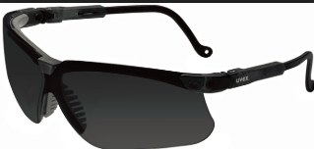
Eye and face protection- darkened safety goggles
When you are working with machines that use fuel gases and oxygen to weld and cut metals you must wear darkened safety goggles to protect your eyes from the bright light from the flame.
Image 12
Someone using oxy acetylene equipment to weld something, wearing darkened safety glasses
Image 13
Man wearing darkened safety goggles
Notes:
Notes for design:
This slide should show a close up on the area being discussed (Eye and Face Protection). It should be the same person as shown on Slide 12 but this time the person should be wearing the correct PPE.

Slide 17
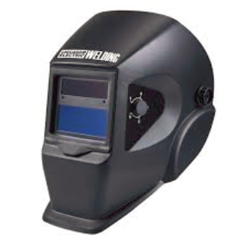
Eye and face protection
Image 14
Someone using an arc welder while wearing a welding helmet ( must show sparks flying)
When you using an arc welder you must wear a welding helmet or shield to protect yourself from sparks.
Image 15
Man wearing welding helmet
Back to PPE Overview
Notes:
Notes for design:
This slide should show a close up on the area being discussed (Eye and Face Protection). It should be the same person as shown on Slide 12 but this time the person should be wearing the correct PPE.
When learner clicks on “Back to PPE Overview” they should be taken to Slide 12.

Slide 18
Hearing protection
Deafness caused by exposure to noise is a serious problem that is usually only picked up later in life. There are two types of noise you need to protect yourself from:
(Placeholder MP3-01)
Click here to an example of this kind of noise
(
1.Continuous noise in plants and factories.
(Placeholder MP3-02)
Click here to an example of this kind of noise
2. Bursts of loud noise, like explosions.
Notes:
Notes for design:
This slide should show a close up on the area being discussed (Head Protection). It should be the same person as shown on Slide 11 but this time the person should be wearing the correct PPE.
Notes for interactivity:
When learner clicks on “Back to main menu” they should be taken to Slide 11.

Slide 19
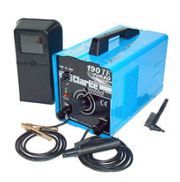
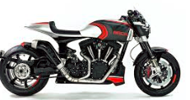
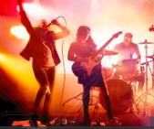
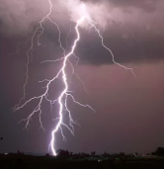
Hearing protection
Earplugs or earmuffs should be worn when there is noise of 85 decibels (Db) or more. So, how loud is that? To give you an idea, here are some items that make different levels of noise.
Image 16
Image 17
Drag and drop the items onto the scale according to how much noise you think they make and click submit.
Image 18
Image 19
Image 20
Image 21
70 Db
80 Db
90 Db
100 Db
110 Db
120 Db
Submit
85 Db
Notes:
Notes for design:
Scale needs to be redrawn.
Images need to be replaced (shower, alarm clock, arc welder,
Notes for interactivity:
Drag and drop activity. Correct answers as follows:
70 Db- Shower
80 Db- Alarm Clock
90 Db- Arc Welder
100Db- Motor cycle
110 Db- Rock Band
120Db- Thunder
Feedback if correct: Well done! You are correct. (Take learner to next slide)
Feedback if incorrect: Oops, not quite. Here are the correct levels of noise for each item. (Show image of scale with pics on the spaces). (Take learner to next slide)

Slide 20
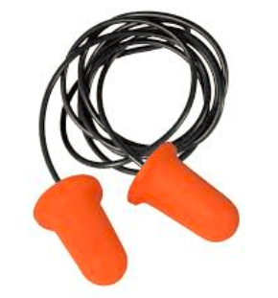
Hearing protection
Image 22
Someone using an arc welder and wearing ear protection.
By wearing ear plugs or ear muffs you can reduce noise by 25-40Db! Make sure you are wearing them when you are working with machinery or when you are in a noisy environment
Image 23
Man wearing ear protection (ear plugs or ear muffs)
Back to PPE Overview
Notes:
Notes for design:
This slide should show a close up on the area being discussed (Hearing Protection). It should be the same person as shown on Slide 12 but this time the person should be wearing the correct PPE.
When learner clicks on “Back to PPE Overview” they should be taken to Slide 12.

Slide 21
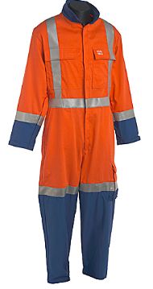
Protective clothing- Overalls
Suitable overalls should be worn in the workplace. These overalls should be fire retardant (this means that they have been treated with a substance that is used to slow or stop the spread of fire or reduce its intensity).
Your overall should also have reflective strips to help make you visible in dark environments.
Image 24
Man wearing overalls with reflective strips
Back to PPE Overview
Notes:
Notes for design:
This slide should show a close up on the area being discussed (Head Protection). It should be the same person as shown on Slide 11 but this time the person should be wearing the correct PPE.
Notes for interactivity:
When learner clicks on “Back to PPE overview” they should be taken to Slide 12.

Slide 22
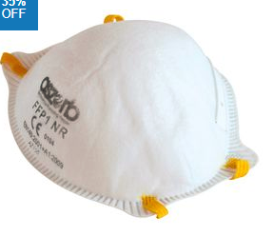
Protection against inhalation of hazardous substances- Dust mask
Image 25
Someone using an a grinder while wearing a dust mask.
When you working in environments where there is a lot of dust or you are using equipment that creates dust you must wear a dust mask.
Image 26
Man wearing a dust mask
Back to PPE Overview
Notes:
Notes for design:
This slide should show a close up on the area being discussed (Protection against inhalation). It should be the same person as shown on Slide 12 but this time the person should be wearing the correct PPE.
Notes for interactivity:
When learner clicks on “Back to PPE overview” they should be taken to Slide 12.

Slide 23
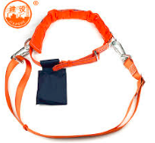
safety harnesss
Image 28
Man wearing a safety harness
When you working in high places such as on roofs, on poles or on overhead lines you must wear a safety harness.
Image 27
Someone working in high places such as on roofs, on poles or on overhead lines wearing a safety harness.
Back to PPE Overview
Notes:
Notes for design:
This slide should show a close up on the area being discussed (Protection against inhalation). It should be the same person as shown on Slide 12 but this time the person should be wearing the correct PPE.
Notes for interactivity:
When learner clicks on “Back to PPE overview” they should be taken to Slide 12.

Slide 24
Note on how to use safety harnesss
When you are working on overhead lines the safety harness should be fastened to the pole and not over the cross arm. This is so that if a person is shocked or electrocuted they can easily be removed.
Image 29
Someone working on overhead lines, showing the safety harness fastened to the pole and not over the cross arm.
Back to PPE Overview
Notes:
Notes for design:
This slide should show a close up on the area being discussed (Protection against inhalation). It should be the same person as shown on Slide 12 but this time the person should be wearing the correct PPE.
Notes for interactivity:
When learner clicks on “Back to PPE overview” they should be taken to Slide 12.

Slide 25
Hand protection- leather gloves
Image 31
Man wearing leather gloves
When you are working with hot or sharp objects or handing heavy material you must wear leather gloves.
Image 30
Someone working with hot/sharp objects wearing leather gloves.
Notes:
Notes for design:
This slide should show a close up on the area being discussed (Hand protection ). It should be the same person as shown on Slide 12 but this time the person should be wearing the correct PPE.

Slide 26
Hand protection- insulated gloves
When you are working on live conductors, for example when it is not possible to switch the power off or when working on live overhead lines you must wear insulated gloves that are made of a special type of rubber.
Image 32
Someone working on live conductors wearing rubber gloves.
Image 33
Man wearing insulated rubber gloves
Back to PPE Overview
Notes:
Notes for design:
This slide should show a close up on the area being discussed (Protection against inhalation). It should be the same person as shown on Slide 12 but this time the person should be wearing the correct PPE.
Notes for interactivity:
When learner clicks on “Back to PPE overview” they should be taken to Slide 12.

Slide 27
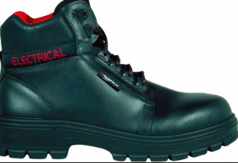
Foot protection-safety shoes
Safety shoes and boots should be worn at all times. The soles are made of a special type of rubber, these shoes will keep you from slipping and also help to protect against electrical shocks. Shoes have steel toe caps to protect feet from falling objects.
Image 34
Someone working on something electrical, wearing rubber safety shoes.
Image 35
Man wearing safety shoes.
Back to PPE Overview
Notes:
Notes for design:
This slide should show a close up on the area being discussed (Protection against inhalation). It should be the same person as shown on Slide 12 but this time the person should be wearing the correct PPE.
Notes for interactivity:
When learner clicks on “Back to PPE overview” they should be taken to Slide 12.

Slide 28
Quiz
Take this quiz to see how well you know the types of PPE required for Electricians. This quiz is out of 20 marks. You must get at least 15 marks to pass.

Slide 29
Question 1
Say whether the following statement is true or false:
PPE is not always the best protection against certain hazards. It is better to try and remove or address the hazard if possible.
True
False
Choose the correct answer from the options below.
Notes:
Notes for interactivity:
Multiple choice, one correct answer.
Mark allocation: 1
Correct answer is in italics.
Feedback if correct: Well done! You are correct. (Take learner to following slide)
Feedback if incorrect: Oops, not quite. The correct answer is True: PPE is not always the best protection against hazards. It is better to try and remove or address the hazard if possible. (Take learner to following slide)

Slide 30
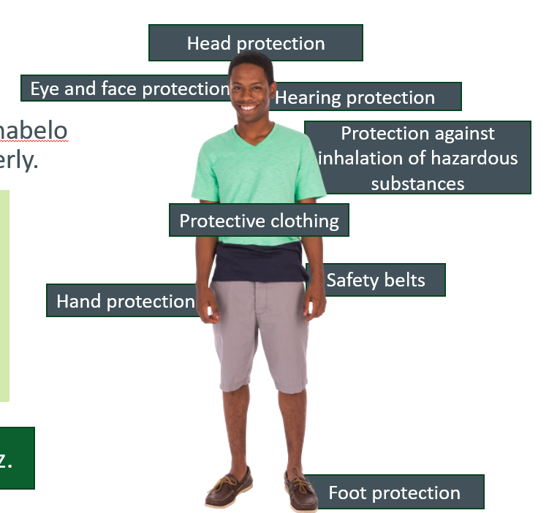
Question 2
Choose the types of PPE required for electricians from the list below:
Image for feedback if incorrect
Select all the correct answers from the options below.
Hand protection
Nail protection
Mouth guard
Foot protection
Protective clothing
safety harnesss
Hearing protection
Protective vests
Knee guards
Protection against inhalation of hazardous substances
Head protection
Eye and face protection
Notes:
Notes for interactivity:
Multiple choice, one correct answer.
Mark allocation: 6
Correct answer is in italics.
Feedback if correct: Well done! You are correct. (Take learner to following slide)
Feedback if incorrect: Oops, not quite. Electricians need the following types of PPE to protect themselves (insert image). (Take learner to following slide)

Slide 31
Question 3
What foot protection should an electrician wear?
None, electricians can wear normal shoes
Safety boots with special rubber
Leather boots
Non-slip steel boots
Choose the correct answer from the options below.
Notes:
Notes for interactivity:
Multiple choice, one correct answer.
Mark allocation: 1
Correct answer is in italics.
Feedback if correct: Well done! You are correct. (Take learner to following slide)
Feedback if incorrect: Oops, not quite. Electricians should wear Safety boots with special rubber.

Slide 32
Question 4
How would safety boots help to keep an electrician safe?
They will keep the electrician from slipping and falling
They will keep his feet warm and protected
They will protect his ankles if he steps of a ladder in the wrong way
The special rubber will help to protect the electrician if there is an accidental shock
Choose the correct answers from the options below.
Notes:
Notes for interactivity:
Multiple choice, one correct answer.
Mark allocation: 2
Correct answer is in italics.
Feedback if correct: Well done! You are correct. (Take learner to following slide)
Feedback if incorrect: Oops, not quite. Electricians should wear Safety boots with special rubber.

Slide 33
Question 5
There are two types of gloves that an electrician would typically use. Choose the reason why they may use each type of glove.
Leather gloves
Insulated gloves
Choose the correct answer from the options below.
Working with hot or sharp objects
Keep hands warm
Protect fingers from bending too much
Working on live conductors
Working with hot or sharp objects
Keep hands warm
Working on live conductors
Carrying heavy metal objects
Notes:
Notes for interactivity:
Select answer from dropdown menu
Mark allocation: 2
Correct answer is in italics.
Feedback if correct: Well done! You are correct. (Take learner to following slide)
Feedback if incorrect: Oops, not quite. Leather gloves are worn when working with hot or sharp objects and Insulated gloves are worn when working on live conductors.

Slide 34
Question 6
If a noise is above ___________ decibels (Db), ear plugs or ear muffs should be worn.
80 Db
85 Db
90 Db
92 Db
120 Db
Choose the correct answer from the options below.
Notes:
Notes for interactivity:
Multiple choice, one correct answer.
Mark allocation: 1
Correct answer is in italics.
Feedback if correct: Well done! You are correct. If you are exposed to noise that is louder than 85D B you should be wearing ear plugs or ear muffs. (Take learner to following slide)
Feedback if incorrect: Oops, not quite. If you are exposed to noise that is louder than 85D B you should be wearing ear plugs or ear muffs. (Take learner to following slide)

Slide 35
Question 7
Why do electricians need to wear protective overalls?
Overalls help everyone to look professional
Overalls prevent people from messing up their clothes
Overalls are made with fire resistant materials which protects an electrician in case of fire
Overalls have reflective bands which means that the electrician wearing them is visible even in a dark environment like a mine
Electricians don’t need to wear overalls, they can wear normal work clothes.
Choose the correct answers from the options below.
Notes:
Notes for interactivity:
Multiple choice, one correct answer.
Mark allocation: 2
Correct answer is in italics.
Feedback if correct: Well done! You are correct. (Take learner to following slide)
Feedback if incorrect: Oops, not quite.
Overalls are made with fire resistant materials which protects an electrician in case of fire
Overalls have reflective bands which means that the electrician wearing them is visible even in a dark environment like a mine
(Take learner to following slide)

Slide 36
Question 8
Why do electricians need to use a safety harness?
The safety harness is made of special rubber and helps to prevent electrocution
Electricians don’t need to wear safety harnesss at all, they are only worn by construction workers.
Electricians wear safety harnesss so that they can hook their tools onto them
When an electrician is working in high places like a roof the safety harness can be attached to a safety line.
Choose the correct answers from the options below.
Notes:
Notes for interactivity:
Multiple choice, one correct answer.
Mark allocation: 1
Correct answer is in italics.
Feedback if correct: Well done! You are correct (Take learner to following slide)
Feedback if incorrect: Oops, not quite. When an electrician is working in high places like a roof the safety harness can be attached to a safety line.
(Take learner to following slide)

Slide 37
Question 9
Say whether the following statement is true or false:
When you are grinding, chiselling, chasing or using any machinery that may cause particles to fly into your eyes you must wear safety goggles.
True
False
Choose the correct answer from the options below.
Notes:
Notes for interactivity:
Multiple choice, one correct answer.
Mark allocation: 1
Correct answer is in italics.
Feedback if correct: Well done! You are correct. (Take learner to following slide)
Feedback if incorrect: Oops, not quite. The correct answer is True: PPE is not always the best protection against hazards. It is better to try and remove or address the hazard if possible. (Take learner to following slide)

Slide 38
Question 10
Say whether the following statement is true or false:
When you using an arc welder you must darkened safety goggles.
True
False
Choose the correct answer from the options below.
Notes:
Notes for interactivity:
Multiple choice, one correct answer.
Mark allocation: 1
Correct answer is in italics.
Feedback if correct: Well done! You are correct. When you are working with an arc welder you would wear a welding mask. (Take learner to following slide)
Feedback if incorrect: Oops, not quite. When you are working with an arc welder you would wear a welding mask. (Take learner to following slide)

Slide 39
Question 11
Why do you need to wear a hairnet or cap if you have long hair and you are working with moving machinery?
Long hair looks untidy and can fall in your face while you are working
Long hair can get caught in moving machinery, causing injury to the person
Long hair can get caught in moving machinery which will cause the machine to stop.
Choose the correct answer from the options below.
Notes:
Notes for interactivity:
Multiple choice, one correct answer.
Mark allocation: 1
Correct answer is in italics.
Feedback if correct: Well done! You are correct. (Take learner to following slide)
Feedback if incorrect: Oops, not quite. If you have long hair you are encourage to wear a cap or hairnet because long hair can get caught in moving machinery, causing injury to the person (Take learner to following slide)

Slide 40
Question 12
Thabelo is drilling a hole in the wall at a house. He is using a drill that makes 70 Db of noise. What items of PPE would you recommend that he wear to protect himself?
Image 37
Image 38
Image 39
Image 40
Image 36
Image 41
Image 43
Image 45
Drag and drop correct items on the image of Thabelo and click submit.
Image 42
Image 44
Image 46
Notes:
Notes for interactivity:
Multiple choice, one correct answer.
Mark allocation: 2
Correct answer is in italics.
Feedback if correct: Well done! You are correct. Thabelo would need the following items:
Protective overall
Safety boots
Safety goggles
Leather gloves
Dust mask
Feedback if incorrect: Oops, not quite. If you are exposed to noise that is louder than 85D B you should be wearing ear plugs or ear muffs. (Take learner to following slide)

Slide 41
Question 12 –Feedback
To prevent dust particles getting in his eyes
To prevent him from inhaling dust
Here are the items Thabelo should be using to drill a hole in a wall at a house.
Most companies insist that their workers wear overalls
Image 46
To prevent him from slipping and protects against possibility of getting shocked
Notes:
Notes for interactivity:
Multiple choice, one correct answer.
Mark allocation: 4
Correct answer is in italics.
Feedback if correct: Well done! You are correct. Thabelo would need the following items:
Protective overall
Safety boots
Safety goggles
Dust mask
Feedback if incorrect: Oops, not quite. On the next slide you will see the recommended PPE for this task.

Slide 42
Question 13
Scenario needs to be refined
Thabelo is installing a 3 phase socket outlet at a hospital. He is not able switch off the power completely.
Drag and drop correct items on the image of Thabelo and click submit.
Notes:
Notes for interactivity:
Multiple choice, one correct answer.
Mark allocation: 2
Correct answer is in italics.
Feedback if correct: Well done! You are correct. Thabelo would need the following items:
Protective overall
Safety boots
Safety goggles
Leather gloves
Dust mask
Feedback if incorrect: Oops, not quite. If you are exposed to noise that is louder than 85D B you should be wearing ear plugs or ear muffs. (Take learner to following slide)

Slide 43
Question 13 –Feedback
Image 45
Here are the items Thabelo should be using to install a 3 phase socket outlet at a hospital where he is not able to switch off the power.
Most companies insist that their workers wear overalls
Since he is working with live power he need to wear special rubber gloves
To prevent him from slipping and protects against possibility of getting shocked
Image 47
Notes:
Notes for interactivity:
Multiple choice, one correct answer.
Mark allocation: 4
Correct answer is in italics.
Feedback if correct: Well done! You are correct. Thabelo would need the following items:
Protective overall
Safety boots
Safety goggles
Dust mask
Feedback if incorrect: Oops, not quite. On the next slide you will see the recommended PPE for this task.

Slide 44
Question 14
Thabelo is working on a roof that is 3 meter high t o install a floodlight. He must install supporting bracket which will require him to drill holes on the wall near the roof.
Drag and drop correct items on the image of Thabelo and click submit.
Notes:
Notes for interactivity:
Multiple choice, one correct answer.
Mark allocation: 2
Correct answer is in italics.
Feedback if correct: Well done! You are correct. Thabelo would need the following items:
Protective overall
Safety boots
Safety goggles
Leather gloves
Dust mask
Safety harness
Feedback if incorrect: Oops, not quite. If you are exposed to noise that is louder than 85D B you should be wearing ear plugs or ear muffs. (Take learner to following slide)

Slide 45
Question 14 –Feedback
Here are the items Thabelo should be using to work on a roof
Most companies insist that their workers wear overalls
Since he is working with live power he need to wear special rubber gloves
Since he is working at a high height he needs a safety harness.
To prevent him from slipping and protects against possibility of getting shocked
Image 48
Notes:
Notes for interactivity:

Slide 46
Quiz Feedback
Well done you have now completed this quiz on PPE.
Your score is [ ]
This means that you passed and you are ready to move onto the next unit
Or
We suggest that you brush up on your PPE knowledge by reviewing the PPE information in this unit and then trying the quiz again.
Exit unit
Work through PPE information
Notes:
Notes for interactivity:
This page should give learner their total score for the quiz and indicate whether they passed or not.
If they click on “Work through PPE” they should be taken to slide Slide 12
If they click on “Exit unit” they should be taken back to course menu.

Slide 47
MP3- 1
Example of continuous noise in a factory.

Slide 48
MP3-2
Example of the noise made by an explosion.

